Slide 1

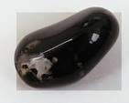


Welcome to Year 2
Diamond and Onyx Class

Slide 2
Aims
To give details of the Year 2 curriculum.
To give details of exciting Year 2 events, such as: Visit to the Church, Drusillas and TTRS day.

Slide 3
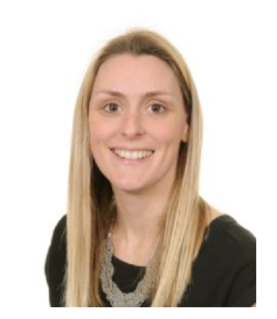
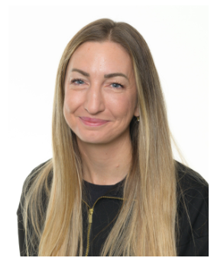
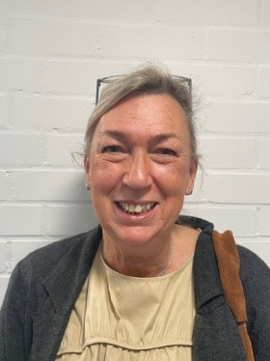
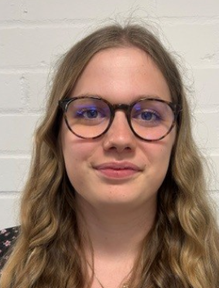
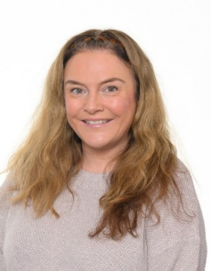
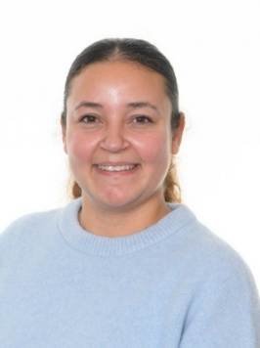
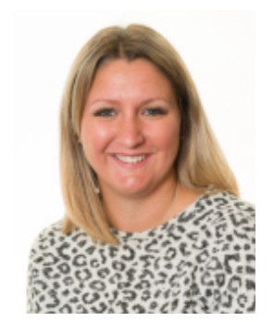

Year 2 staff
Miss Pull Mrs Shallcrass Mrs Couch Miss Cline
Onyx Class Teacher Diamond Class Teacher Diamond Class Teacher Student Teacher
Mrs Smith Mrs Donnelly Miss Penfold
Learning Mentor Learning Mentor Learning Mentor

Slide 4
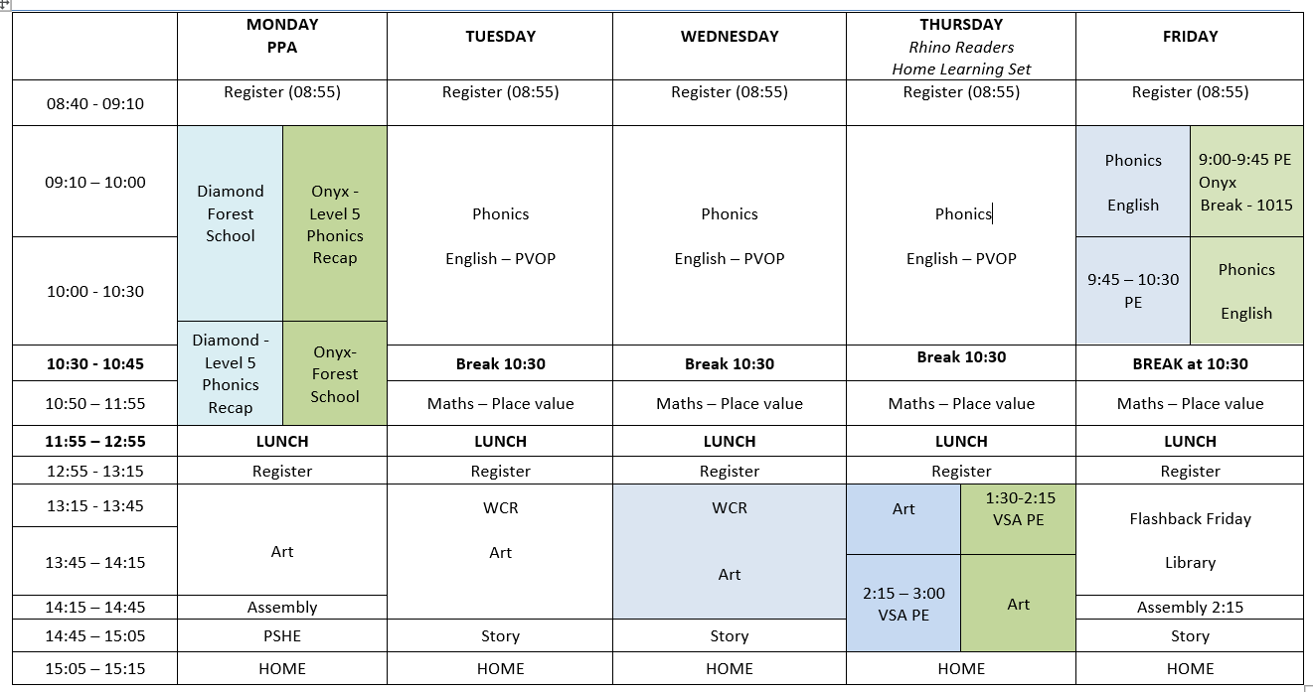
Link to Year 2 page of the website where you can find the weekly timetables and other useful information.
https://www.langshott-surrey.co.uk/page/?title=Year+2&pid=61

Slide 5
Home learning
Reading | Daily and recorded in reading diary
Spelling | Spelling sheet set and checked on a Thursday
Numbots /TTRS | Numbots (Autumn ) and TTRS (From Spring 1) 20 minutes per week
Creative topic | Half-termly tasks
For families who wish to ‘go the extra mile’ and support their child with extra home learning in core areas, CGP workbooks (Question Book bundles & 10 Minutes Book bundles) are available to purchase via Scopay.

Slide 6
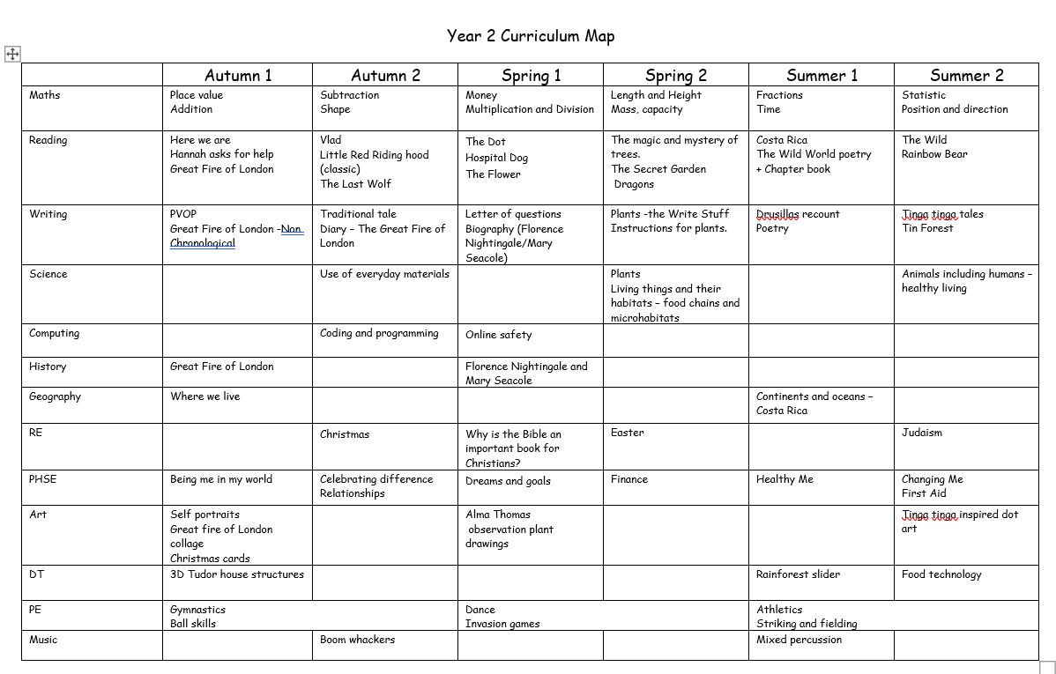

Slide 7
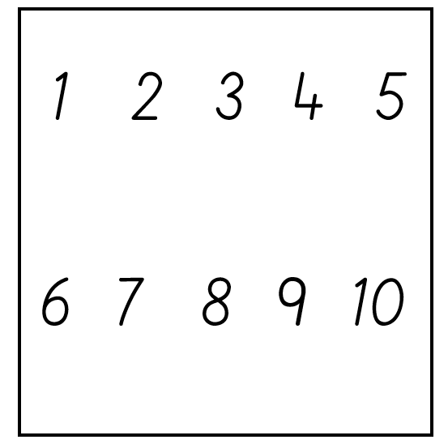
Maths
How to support at home:
To learn 2’s, 3’s, 5’s and 10’s times tables
To be secure in place value in tens and ones.
To form all numbers correctly.

Slide 8

Reading
We expect children to read at home daily and for this to be recorded in their reading diary .
Rhino Readers books are changed on a Thursday.

Slide 9

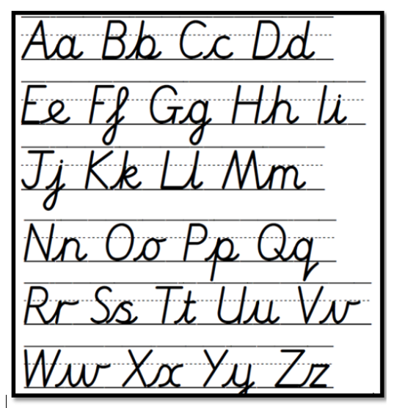
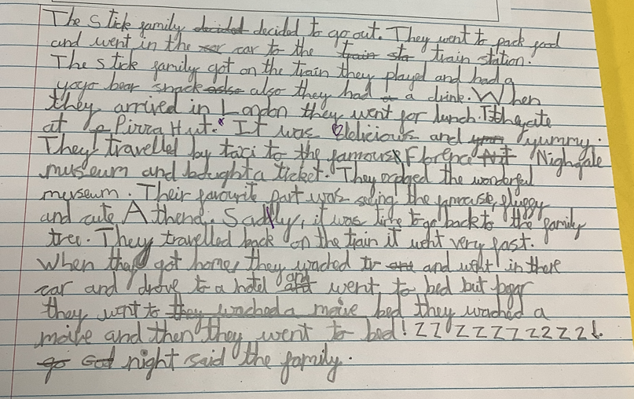
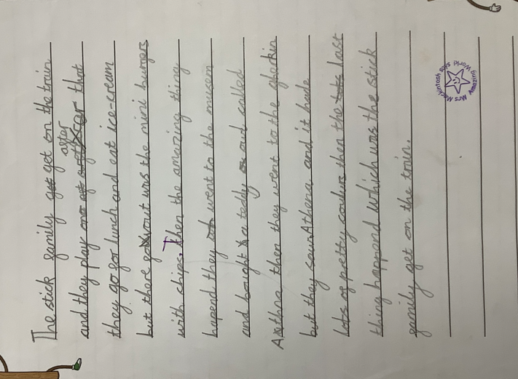
Writing
Examples of the standard of writing in Year 2

Slide 10
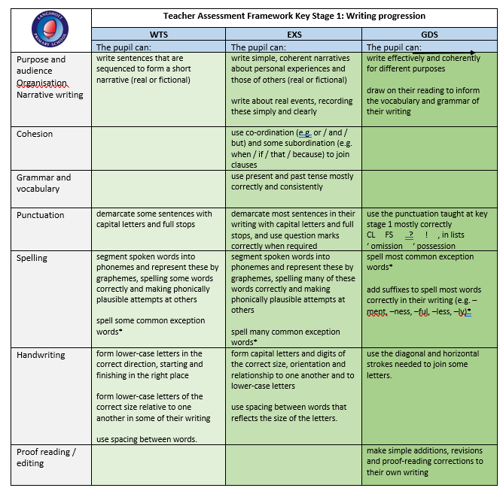

Slide 11
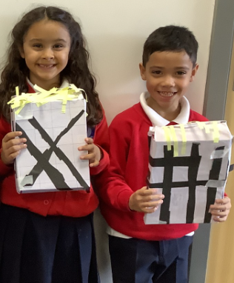
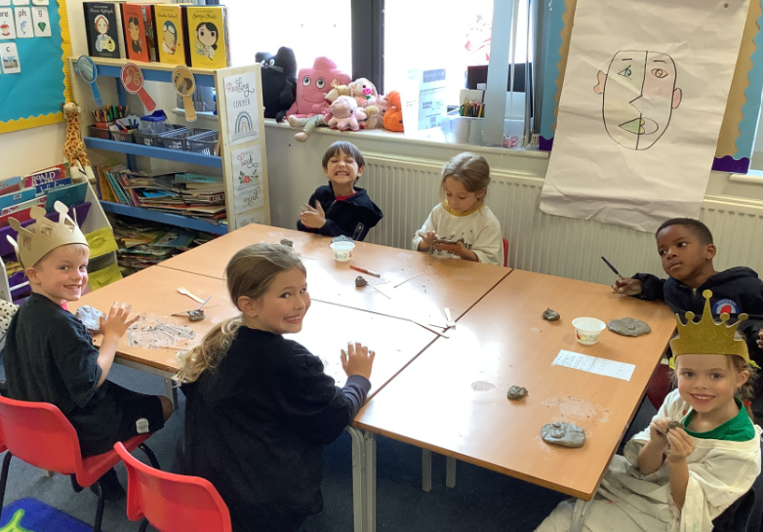
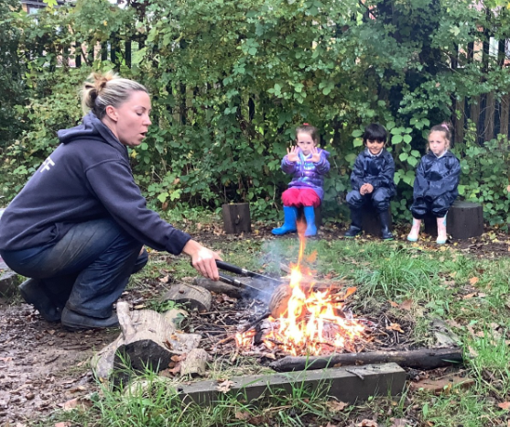
Curriculum highlights
Exploring the Great Fire of London and creating our own Great Fire of Langshott during Forest School.
Creating clay Pablo Picasso sculptures
Researching the life of Florence Nightingale

Slide 12
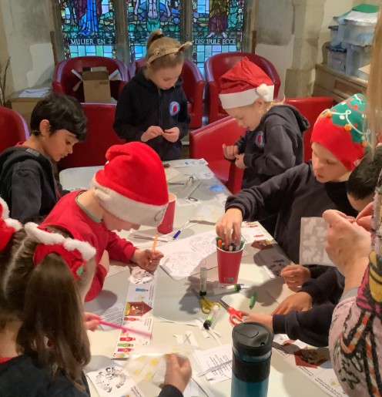
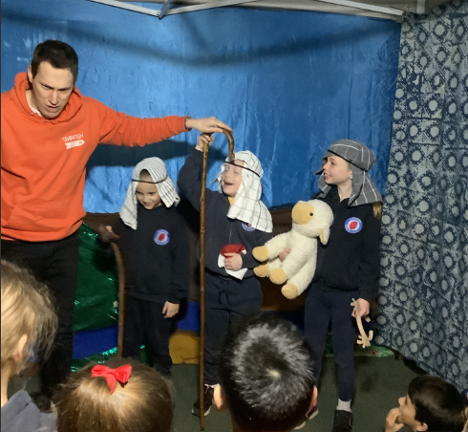
Christmas Journey at St Bartholomew's
On December 9th, we visit the church to experience the Christmas journey and take part in some Christmas craft. A letter will be sent out with more details.

Slide 13

Pantomime
Thursday 17th December

Slide 14

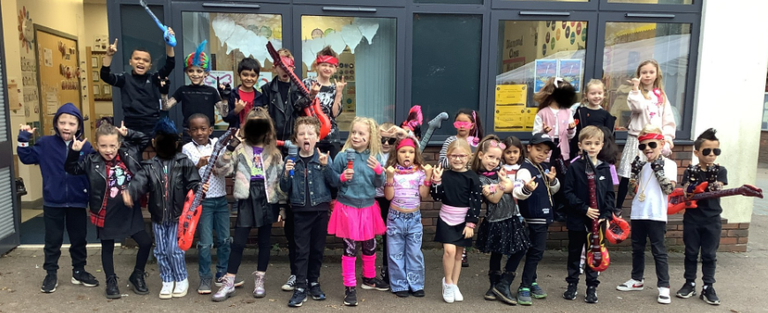
TTRS day
In the Spring term, we will be launching TTRS.
The children will be invited to dress up as a Rock Star and take part in fun maths activities through the day.

Slide 15
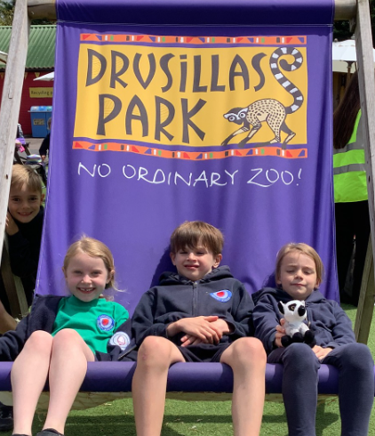
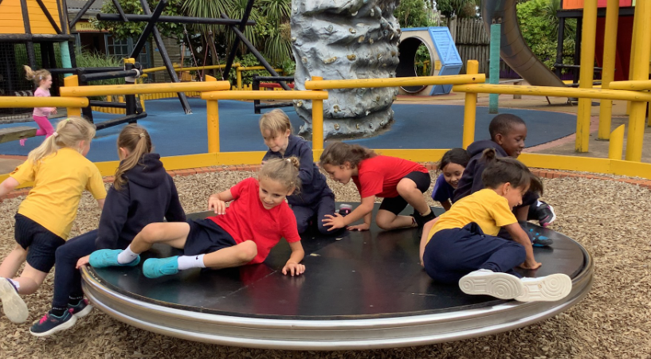
Visiting Drusillas Park
In the Summer Term, we visit Drusillas Park as part of our Costa Rica topic. We have educational talks, where the children can handle live animals and learn about the rainforest habitat.

Slide 16

Sports Day
TBC

Slide 17
Transition
We will be working closely Year 3 teachers.
PSHE lessons will focus on transition during the Summer term.
Transition day – TBC

Slide 18
Inset days
Monday 5th January

Slide 19

Thank you for your support.
Well done to your wonderful children.
There is a lot to look forward to!

