Slide 1

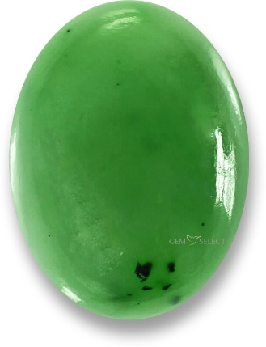
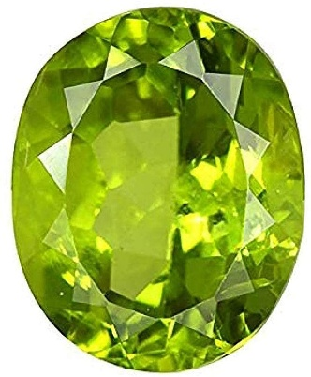

Jade
Welcome
Peridot

Slide 2
Aims
To give details of the Year 5 curriculum.
To give details of exciting Year 5 events, such as:
VR Space experience
Pantomime
Viking and Anglo Saxon day
Easter experience
Maya day
Mercers Lake
Sports Day

Slide 3
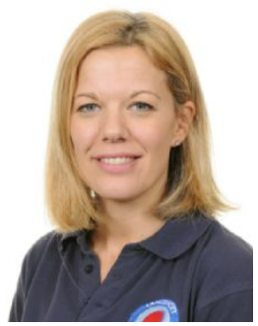
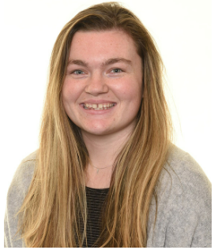
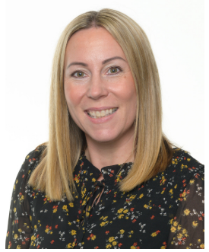
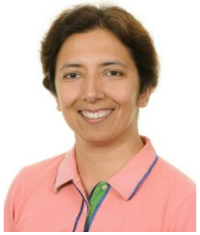
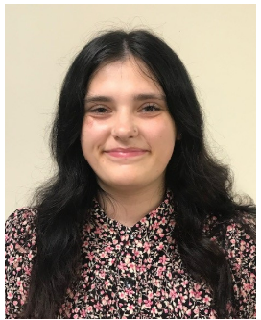
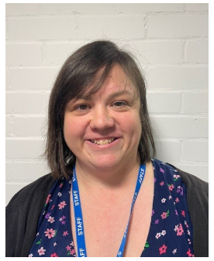
Year 5 staff
Mrs Felstead Miss Buchan Mrs Shevel
Mrs Nagpal Miss Coles-Chalmers Mrs Ellis

Slide 4
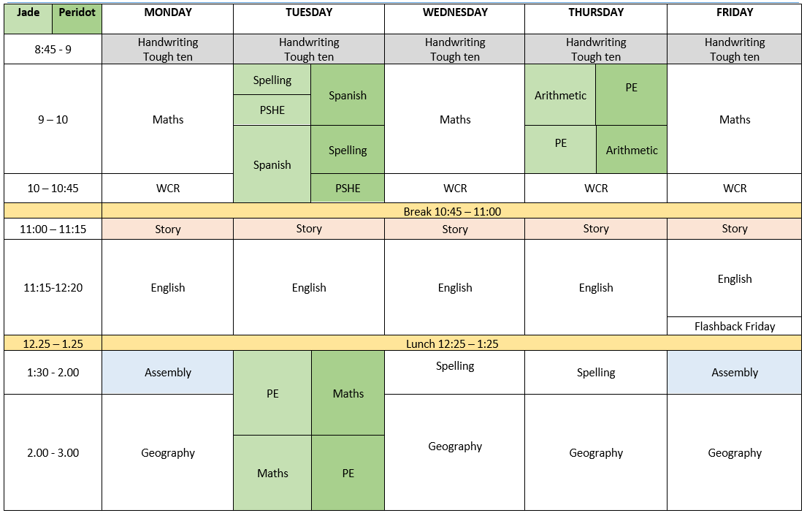
Link to Year 5 page of the website where you can find the weekly timetables and other useful information.
https://www.langshott-surrey.co.uk/page/?title=Timetables&pid=317

Slide 5
Home learning
Reading | Daily and recorded in planners
Spelling | Home learning sheets set and checked on Thursdays. No formal test.
My Maths | 2 activities every 2 weeks set on a Thursday.
TTRS | Optional
Creative topic | Half-termly tasks
For families who wish to ‘go the extra mile’ and support their child with extra home learning in core areas, CGP workbooks (Question Book bundles & 10 Minutes Book bundles) are available to purchase via Scopay.

Slide 6
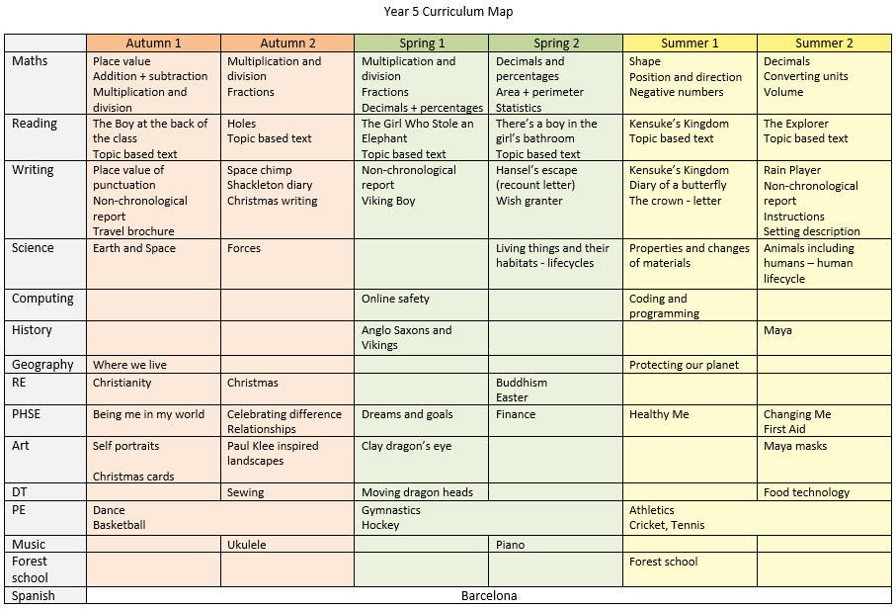

Slide 7
Maths
How to support at home:
Children should be fluent with all of their times tables facts.
The children will either complete an Arithmetic or Reasoning test every week. They will do their corrections with an adult at school and these will be sent home.
The MyMaths tasks are set based on our current topic in order to consolidate their learning.

Slide 8
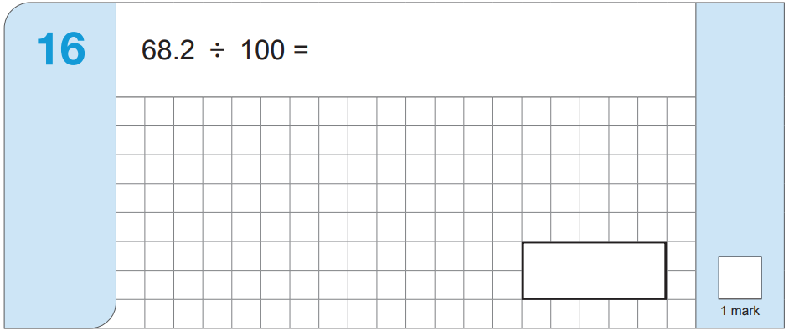
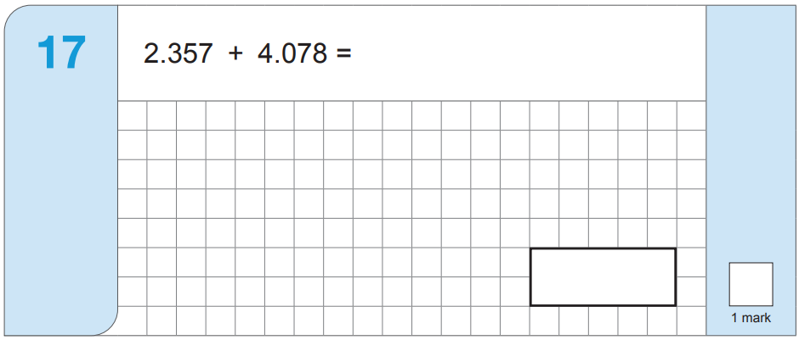
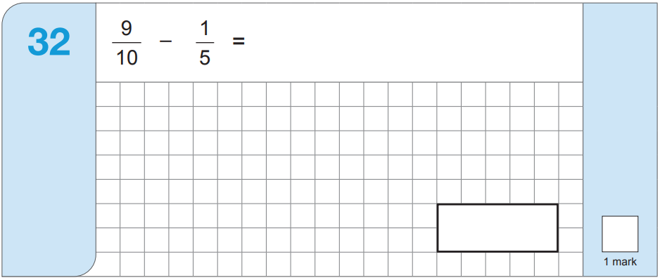
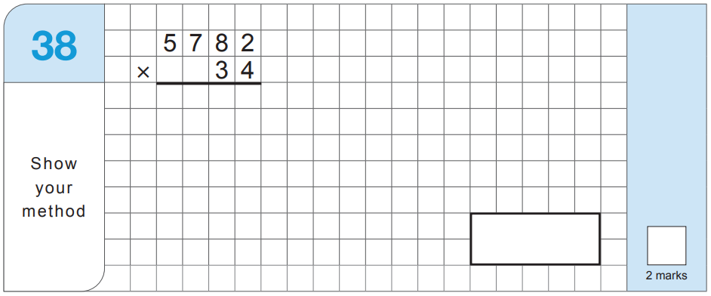
Arithmetic
New learning in Year 5!

Slide 9
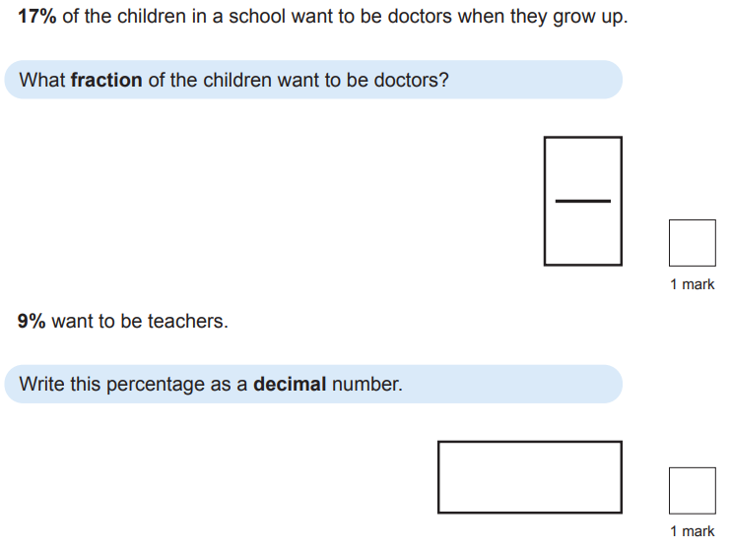
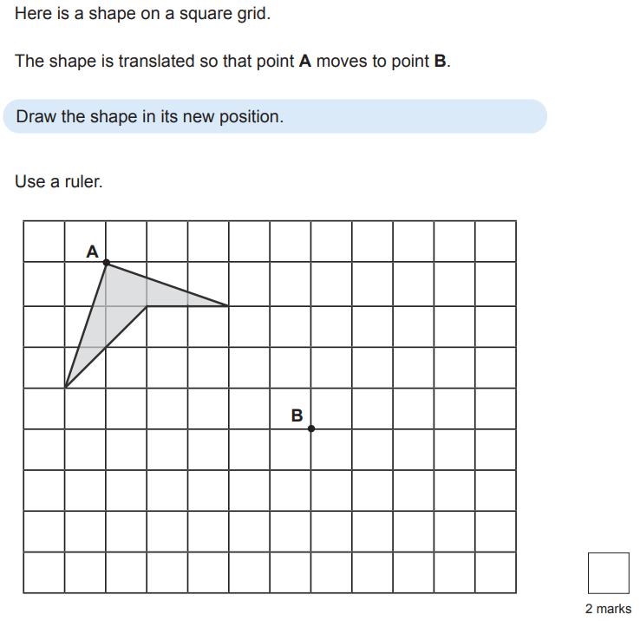
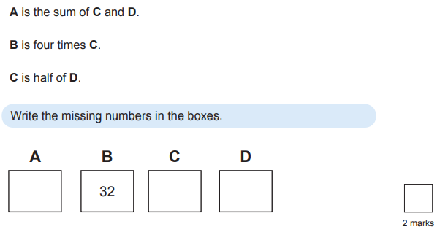
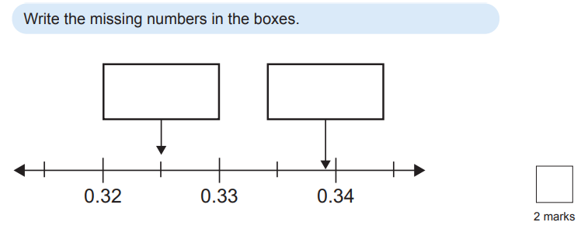
Reasoning
New learning in Year 5!

Slide 10






Reading
The most important thing you can do and home is read!
They will receive a STARS point for every read recorded in their planner.
Here are our class books for throughout the year:
Autumn 1 Autumn 2 Spring 1 Spring 2 Summer 1 Summer 2

Slide 11




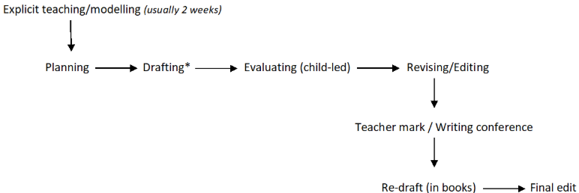
Writing
Writing is taught through a range of stimuli across 4 purposes of writing.
Writing can be broken down into transcription and composition.
Transcription – handwriting and spelling
Composition – sentence construction, vocabulary, punctuation and cohesion
Handwriting
Children are expected to write in legible cursive script. All children in KS2 have choice to write in pen or pencil whilst still maintaining high expectations for presentation.
Writing process

Slide 12
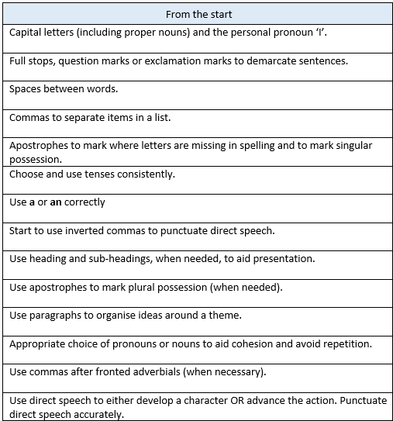
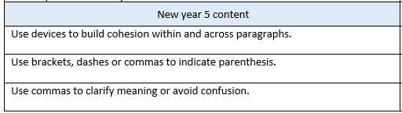
Writing
Children are expected to consistently apply previous learning in their independent writing. In addition, by the end of the year all children are expected to be able to demonstrate the new year 5 content.

Slide 13
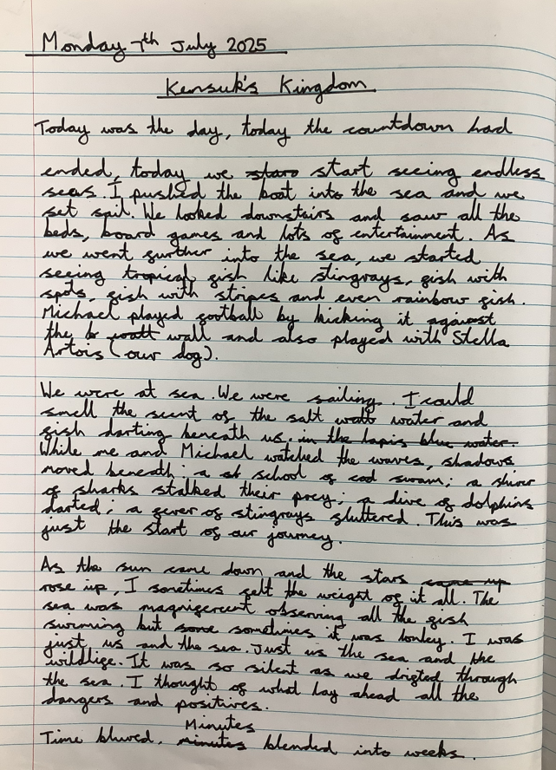
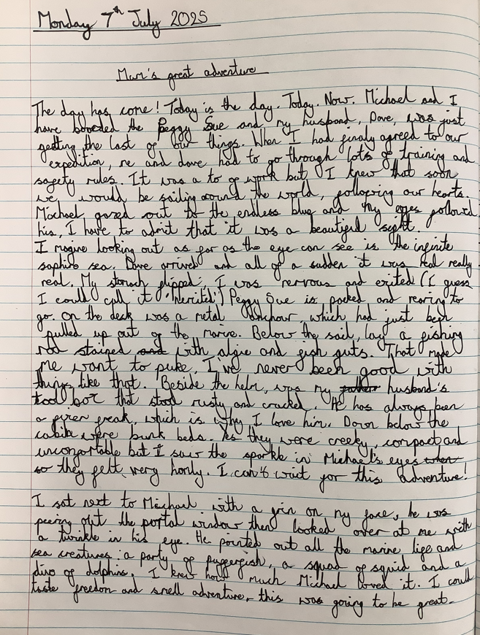
Writing
End of Year 5 writing expectations.
Expected standard
Greater depth

Slide 14





Spelling
In Year 5, we follow the Grammarsaurus spelling scheme which is designed to advance children’s spelling skills beyond phonics by focussing on morphology (the study of word structure). Children will learn important spelling rules and how to build morphemes (a word or part of a word of which has a meaning).

Slide 15
Curriculum
Autumn term – ‘Into the Unknown’ (learning about Space and explorers such as Ernest Shackleton )
Spring term – ‘Intrepid Invaders, Courageous Conquerors and Mythical Monsters’ (learning about the Vikings, Anglo Saxons and mythical creatures)
Summer term 1 – ‘Earth Matters’ (learning about sustainability)
Summer term 2 – ‘Lost cities, Hidden secrets’ (learning about the Mayas)

Slide 16
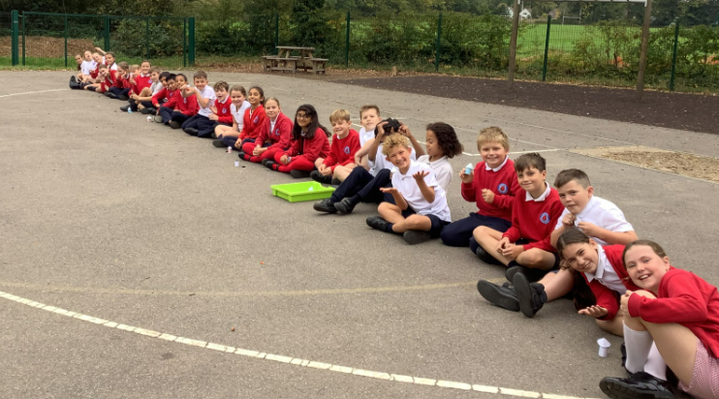
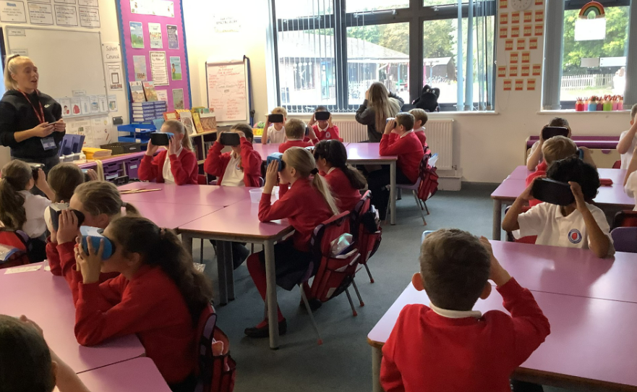
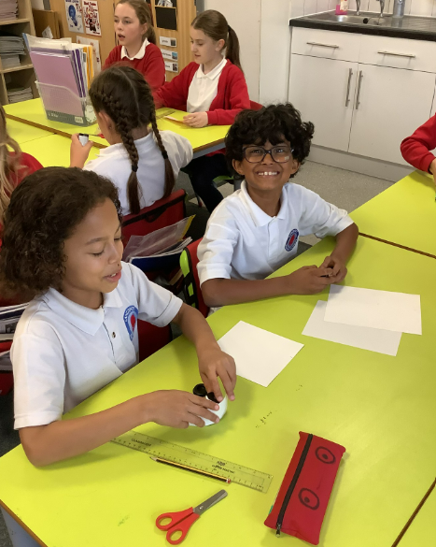
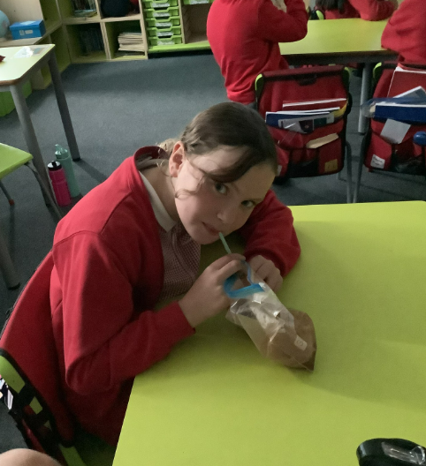
VR Space experience
Space Day is a way of celebrating all of Year 5’s learning about Space and the Solar System. During the day, they take part in a range of different activities: VR experience, launching rockets as well as making astronaut food!

Slide 17

Pantomime
Tuesday 16th December

Slide 18
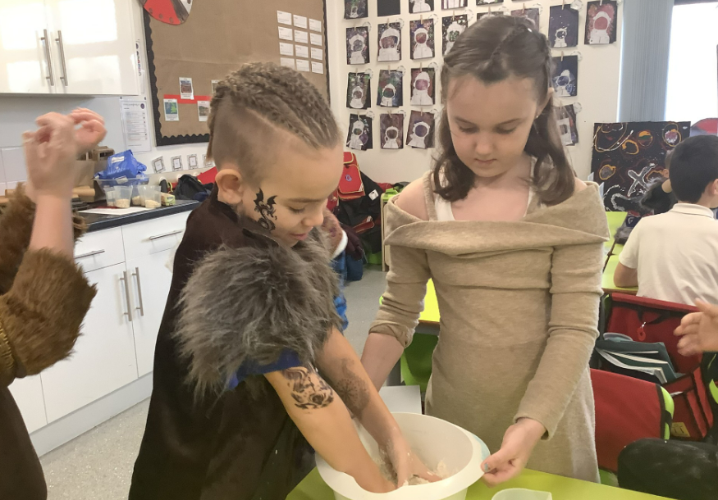
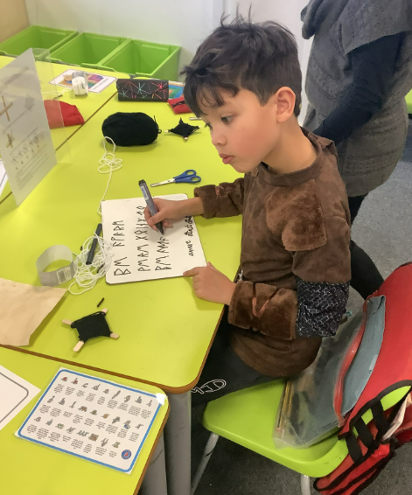
Viking and Anglo Saxon day
During Anglo Saxon and Viking day, the children take part in a range of activities to immerse themselves in the topic. They start the day exploring what daily life was like by making bread and trying their hand at weaving. They also had the opportunity to write secret messages in runes.

Slide 19
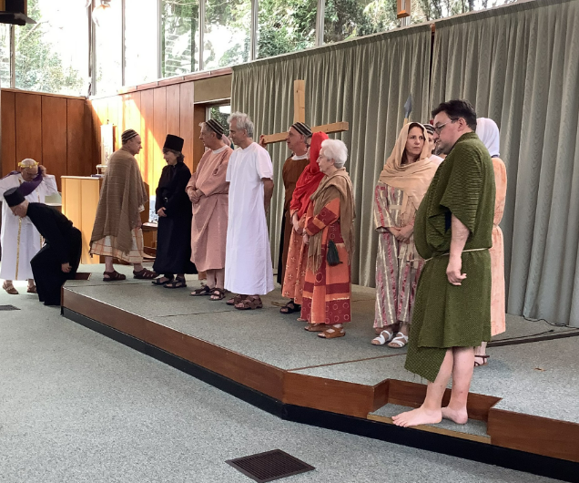
Easter experience
As part of our learning about the Easter story, we have luckily been invited to attend the Easter experience led by SparkFish. During the afternoon, they get to watch the story be acted out. At the end, there is always opportunities for the children to ask questions to the actors (while they are still in role).

Slide 20
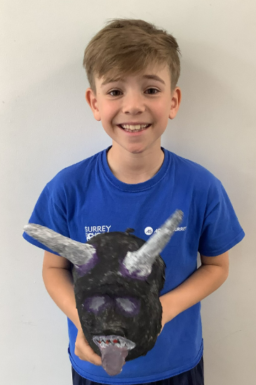
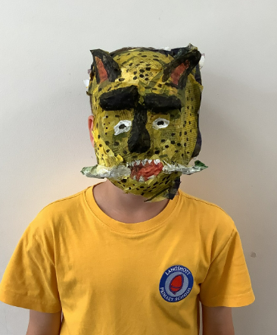
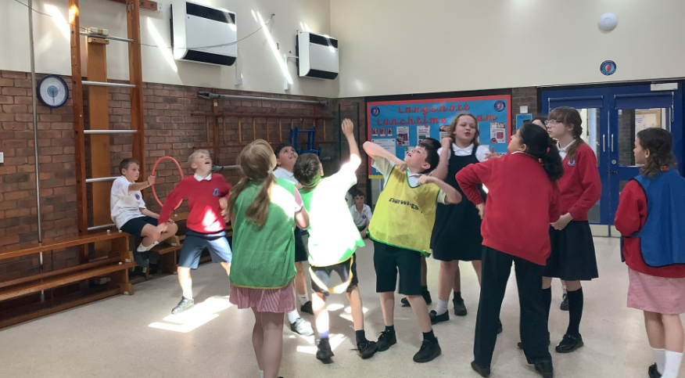
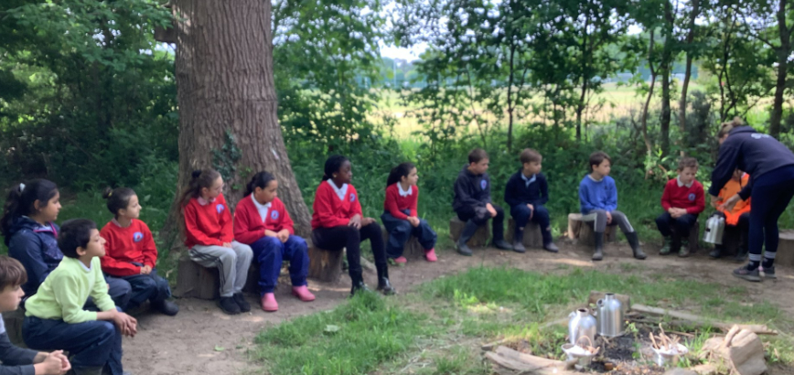
Maya Day
Last year, Year 5 learnt about the Maya civilisation for the first time. Here is a selection of their learning. More details about Maya Day TBC.

Slide 21
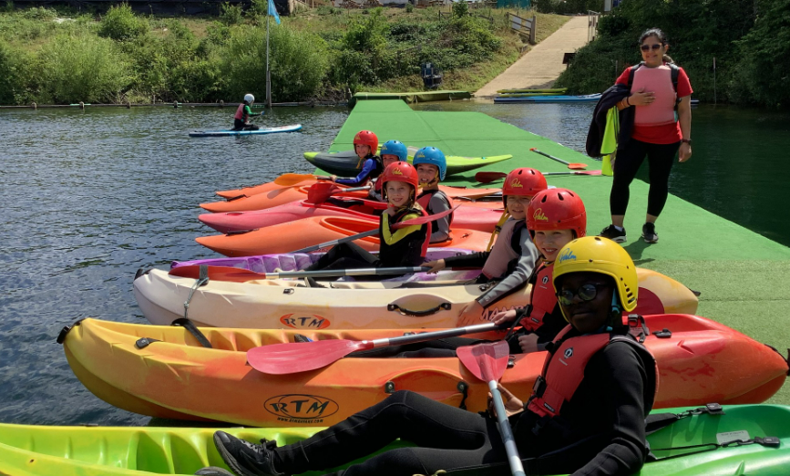
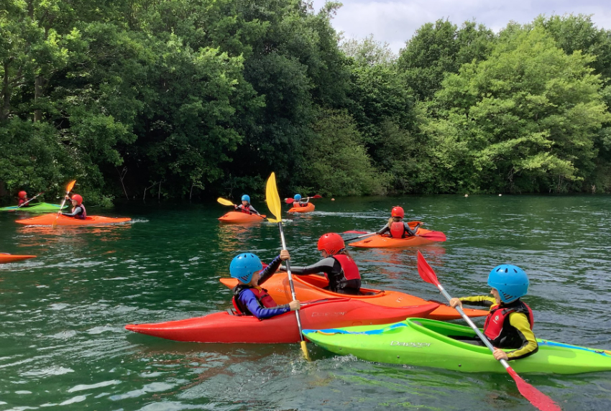
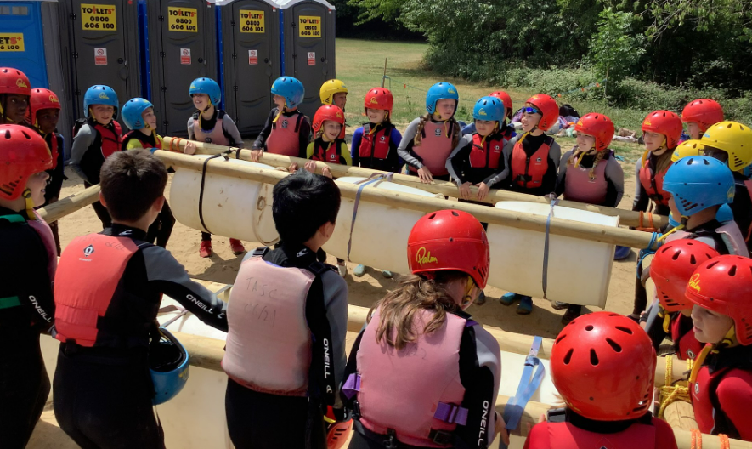
Mercer’s Lake
Friday 26th June
This is many children’s highlight of the year! The whole day children are kept busy with a wide variety of water sports.

Slide 22

Sports Day

Slide 23

Thank you for your support.
Well done to your wonderful children.
There is a lot to look forward to!

