Slide 1

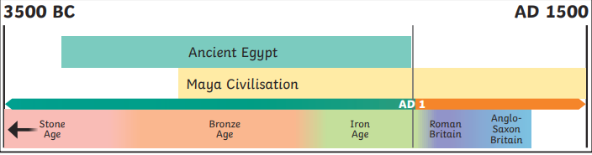
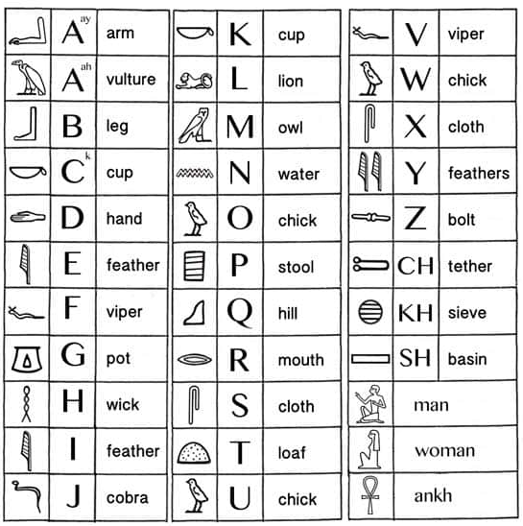
History – Year 3 – Ancient Egyptians
BC | AD
Used to show that a date is before the year AD 1. This is counted backwards so 200 BC is before 100 BC. | Used to show that a date is after the year AD 1. This is counted forwards so AD 100 is before AD 200.
Key Vocabulary
excavate | verb. To make (a hole or channel) by digging.
hieroglyphics | noun. A system of writing that consists of pictures and symbols (hieroglyphs) instead of letters.
merchant | noun. A person involved in trade or business.
mummy | noun. A body of a human being or animal that has been ceremonially preserved by removal of the internal organs, treatment with natron and resin, and wrapping in bandages.
The Nile | noun. A river that runs through Egypt. It was essential to life in ancient Egypt.
scarab | noun. Any scarabaeid beetle, such as a Scarabaeus sacer, regarded as sacred by the ancient Egyptians.
shrine | noun. a place regarded as holy because of its associations with a divinity or a sacred person or relic, marked by a building or other construction.
pharaoh | noun. A ruler of ancient Egypt.
pyramid | noun. a monumental structure with a square or triangular base and sloping sides that meet in a point at the top, especially one built of stone as a royal tomb in ancient Egypt.
tomb | noun. A sealed room where a person was placed after death.
Where is Ancient Egypt on the timeline?
In c. 3000 BC, King Menes united two Egyptian kingdoms to build the empire of ancient Egypt. It lasted until 30 BC when the Romans took over.
The Nile
Life revolved around the Nile. Every year, it flooded and left behind a black silt that enriched the soil for growing crops. The river was also used to irrigate fields in other areas. The Nile was used for water, fishing and trade. Mud from the river banks was used to make bricks and papyrus plants were used to make paper. Most people lived along and around the Nile. This is still true in Egypt today.
Hieroglyphics
Egyptabout.com | In ancient Egypt, scribes wrote on papyrus. Papyrus was a thick type of paper made from reeds that grew along the Nile. Scribes were mostly men who went to a special school to learn to write. Scribes wrote using hieroglyphs. Hieroglyphs were used for religious texts and inscriptions on statues and tombs. They were also used for counting crops and animals so that the right taxes could be taken. Did You Know…? The Rosetta Stone was discovered in 1799. It was written in hieroglyphs and two other languages, including ancient Greek, which language experts could still read. They translated the hieroglyphs by comparing the languages. It took 20 years to translate all the text into modern language.

Slide 2
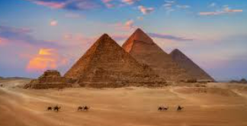
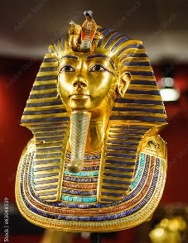
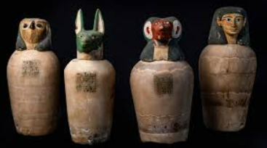
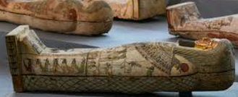
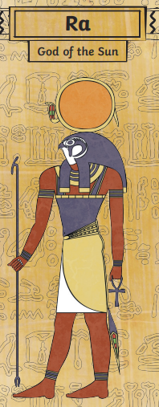
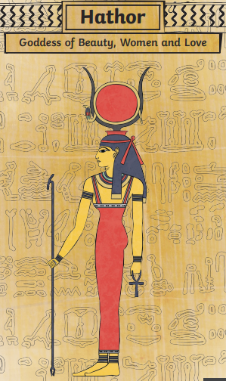
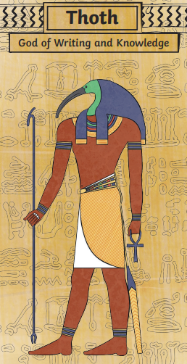
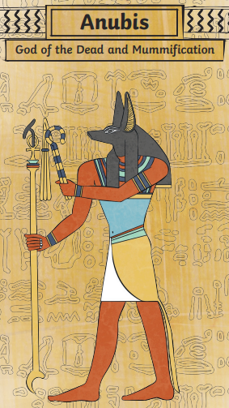
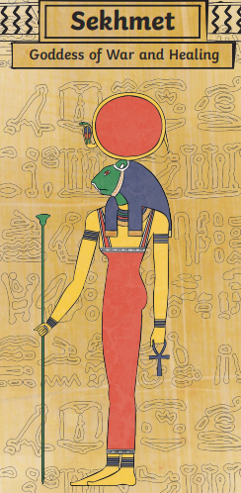
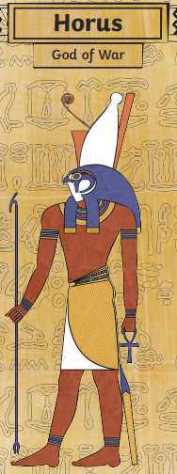
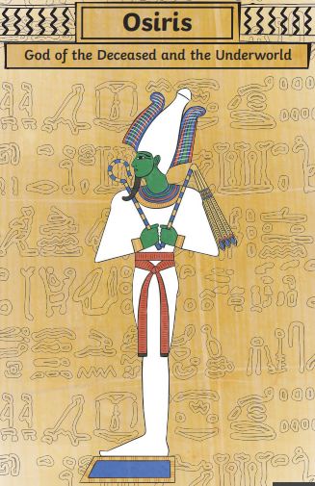
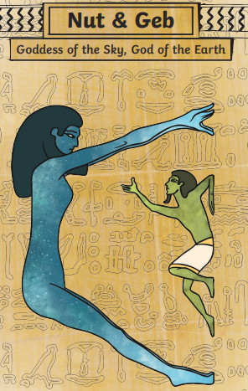
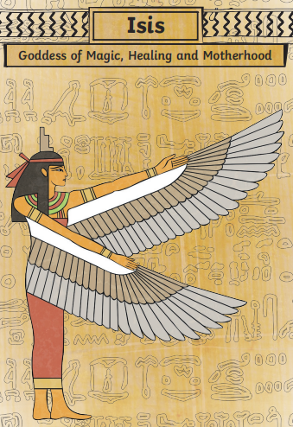
History – Year 3 – Ancient Egyptians
A Pharaoh's death
The ancient Egyptians built the pyramids as resting places for the pharaohs. When a pharaoh died, priests would prepare their bodies with a process called mummification. The pharaoh was then placed in a tomb, often under a pyramid, with their most treasured possessions. The ancient Egyptians believed that these treasures would help them in the afterlife.
Tutankhamun
Tutankhamun was a pharaoh known more recently as the ‘boy king’ because he became pharaoh when he was 9 years old. His tomb was discovered by Howard Carter and his team in the Valley of the Kings in 1922. The discovery helped people to understand more about the Egyptians pharaohs
Mummification
The ancient Egyptians believed in preserving the body ready for the afterlife. The mummification process was a complicated one and took over 70 years.
The body was put on a table and it would be washed and purified. | They would then take out the organs, leaving only the heart. The brain would be taken out through the nose using a hook. Using obsidian, a cut would be made in lower body and organs removed by hand. | The body was filled with stuffing, such as sawdust before being paced in a bath of natron (a type of salt) to dry out. | Up to 200 metres of linen would be used to wrap the body. The body was then covered in a sheet called a shroud. | The body was placed in a large coffin called sarcophagus which was inside the tomb. | The organs which were moved where placed in jars called Canopic jars. The heads were carved in the shape of the four sons of Horus (an ancient Egyptian god). Each protected a different organ: Duamate, with a jackal’s head protected the stomach. Imsety, with a human head, guarded the liver. Qebehsenuf, with a falcon’s head, protected the intestines. Hapi, with a baboon head, protected the lungs.
The Egyptian Gods
The ancient Egyptians worshipped many gods and goddesses who were responsible for different aspects of life and death.

