Slide 1

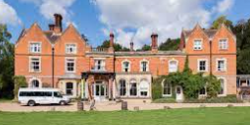
FSC (Field Studies Council) Juniper Hall 2026
Year 4 Residential
Notes:
Hello and Welcome
Tonight’s meeting aims to give you an overview of the trip and give you the opportunities to answer any questions you may have.

Slide 2
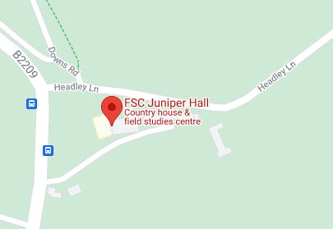
FSC Juniper Hall
Old London Rd,
Dorking,
RH5 6DA
Wednesday 25th – Friday 27th February 2026
Notes:
Juniper Hall is not that far away. It is in Mickleham and just at the bottom of Box Hill. It is beautiful.

Slide 3
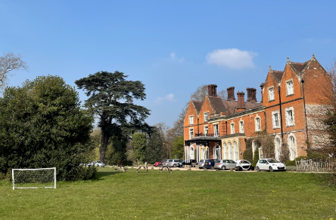

Aims of the Meeting
To share our excitement about the trip
To give you key information about the trip

Slide 4
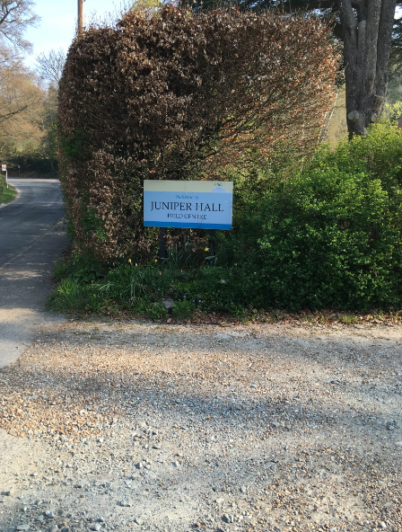
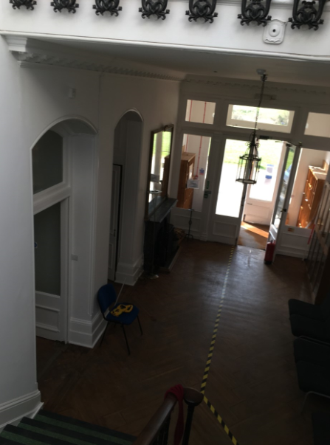

Slide 5
Timings
Drop off in the hall between 9:45-10:10
We will return home in time for you to pick them up from the hall at 2:00pm

Slide 6
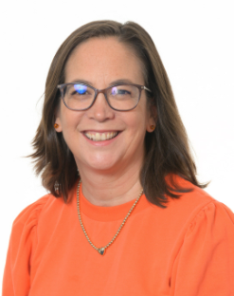
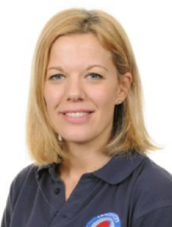
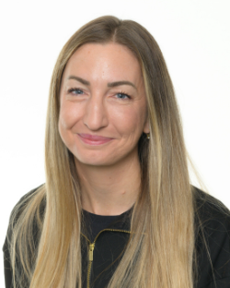
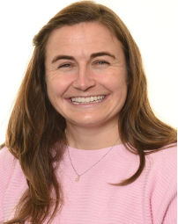
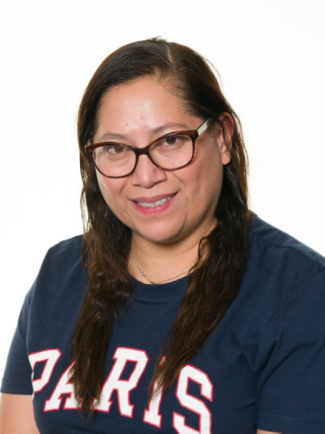
Langshott Staff on the Trip
Mrs Brooks
Mrs Felstead
Mrs Shallcrass
Mrs Sanchez
Mrs Welham
Notes:
Everyone wants to go on this trip and support your children to be successful. We will work together to make sure that everyone has a great time.

Slide 7

Personal Development
2 night stay away from home
Develop independence and self-reliance
Develop a sense of responsibility
Experience of staying in a different environment
Provide Outdoor Activities
Reciprocity Learning Power
Living with peers over extended periods
Team work
Awareness of the needs of others
Cooperation and collaboration
Notes:
For some, this maybe the first time that your child has stayed away from home and we know that you all maybe feeling anxious about it. However, this is the best year group in the school and they are going to love every minute. As parents, you are always so supportive and we know that you are probably excited about this experience too.
We can reassure you that over the 2 nights, children will gain a lot:
Independence: They will need to make their bed (from scratch), organise their belongs, ensure they are prepared for the range of activities they will be taking part in.
Responsibility: Get themselves showered and ready for bed, get up in the morning and ready for the day with everything they will need, pack their bag on returning home IMPORTANT NOTE – PLEASE DON’T PACK THEIR BAGS FOR THEM IT IS IMPORTANT THEY KNOW WHAT THEY HAVE, WHERE EVERYTHING IS AND HOW IT ALL FITS BACK IN THE BAG FOR THE WAY HOME.
Experience of living in a different environment: sharing rooms with others, different routines, expectations
Lots of learning experiences.
Even though they will be tired for a few days, they tend to come home different children. More grown up!

Slide 8
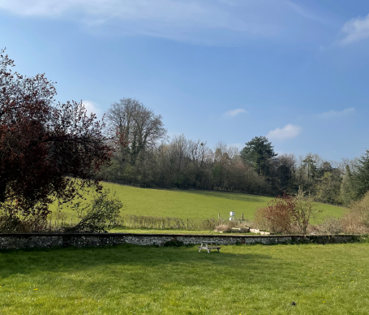


Learning opportunities
Geography & Science
Well-being
Notes:
This trip is going to offer so many learning experiences too and we have tailored it to meet our geography objectives. We also believe it to be an amazing wellbeing opportunities – nature, happy memories, spending time as a year group etc.

Slide 9
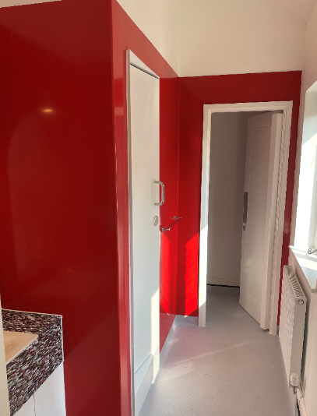
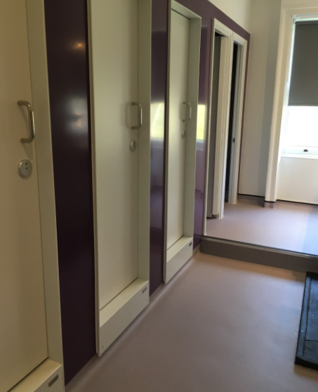
Accommodation
The house has been refurbished in the last few years
It is bright, beautiful and surrounded by nature
Juniper Hall staff will be on site the whole time to support us
The building is secure
Notes:
Private shower cubicles.
It is lovely there.

Slide 10
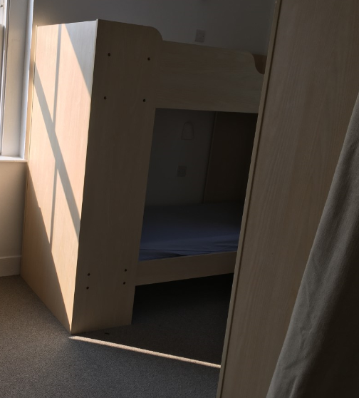
Accommodation
Girls and Boys in separate wings
Staff spread out between wings
En-suites in some rooms and communal bathrooms
Shared space inside for evening activities and space outside with boundaries for outdoor activities

Slide 11
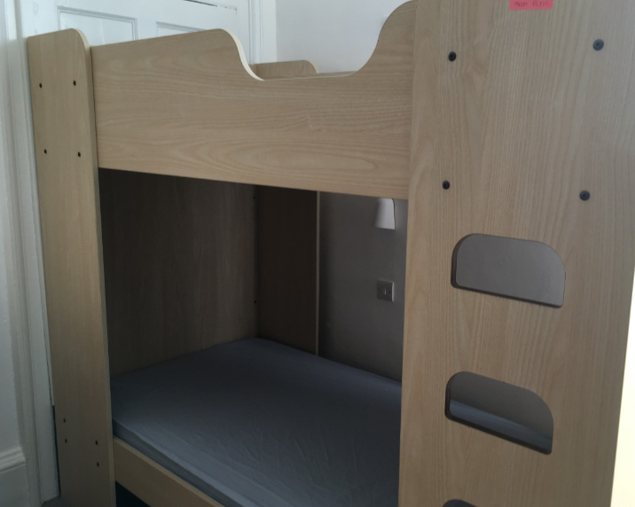
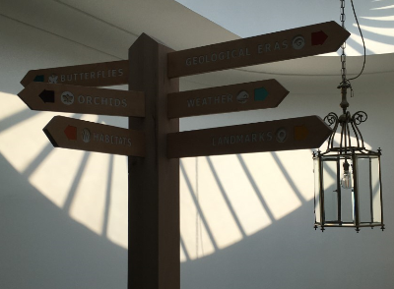
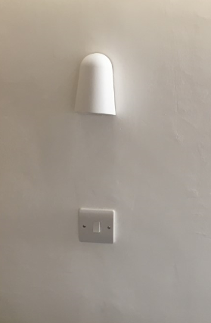
Sleeping Arrangements
Children organised into single sex rooms of around 6
We know the children well and will make sure they are in a room with at least one good friend
They will find out their rooms when we arrive at Juniper Hall after they have eaten lunch
Children will be expected to make their beds (bottom bunk only) and keep their rooms tidy!
Notes:
We will ask the children to write a list of who they would like to share with and we will make sure they are happy.
Each bed has an individual night light.
We always joke about the making of beds – this is probably our most challenging activity of the trip!

Slide 12
What are we doing?
A full timetable will be sent home to you before we go.
There will be a timetable on display for the children in their rooms
Notes:
Most activities are on site and there is a river study where we are travelling by coach.
Evening activities
We will be in 2 groups for the day activities and they will be led by Juniper staff.
Lots of support from Langshott staff too..
Compass Orienteering
Geo Journey
Rivers and the Water Cycle
Mammal Trapping
Music , Stories and Campfire

Slide 13
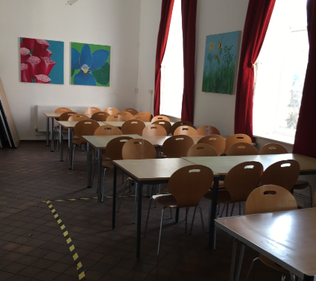
Food
Children will take a packed lunch with them on the first day (no fizzy drinks or nuts please). Please use a reusable lunch bag that can be refilled each day with their lunch.
All dietary needs will be catered for!
Evening meal will be a choice of at least two options
Breakfast options are continental and/or cooked
Lunch is a packed lunch and they will select their own at the beginning of the day (a wide range is available)
Possible evening campfire treats ☺
Notes:
You are welcome to put a little treat in the packed lunch on the first day!
Good range and choice of food available
Able to cater for dietary requirements
Nut-free centre
Breakfast – choose between continental and cooked
Lunch – choose own packed lunch
Dinner – choice of 2 hot meals, bread, cake, fruit, yoghurt
- The children are allowed to bring a few small packets of savoury snacks. No sweets

Slide 14
Kit List
  Kit list will be sent home
  You are welcome to choose the type of bag you pack everything in (not the day rucksack)
  NO school uniform
  We have considered each item carefully, if we find that a child is missing something important we are not far away!
Notes:
Kit List
Children to arrive at school dressed ready for outdoor adventurous activities.
Wellies are a must – if your child doesn’t have any then they will need to have a pair of trainers that they don’t mind getting wet.
Must be able to carry their own bags and make sure they can pack the bag themselves.

Slide 15
Kit List Notes
Life will be easier if all of their items are in one bag (which they can carry or wheel themselves)!
Pack with your child:
- They know what they have got with them
- More likely to take all of their items home
- Child needs to be able to pack own case on return
- Where possible, name items of clothing
Notes:
The children can find it hard when they are sharing a room with others and their items are new. Please don’t send anything too precious, We will make any lost property available but we cannot promise to recover all items!

Slide 16
Kit List Notes
Camera – If bringing a camera please ensure the memory card is cleared before the trip
No sweets
Any medicines – safely wrapped, labelled and named (to be handed to Mrs Brooks)
This includes if you have said that you will supply your own calpol/similar or piriton/similar
Money – they can bring up to £5 in coins to spend in the shop to buy souvenirs. This must be in an envelope and named.
Notes:
Spending money – there is a small shop available on the last day. When we talk to the children, we will remind them of how much money you have spent already and that they might want to do some jobs around the house to help you to earn it!

Slide 17
Kit List Notes - safety
Children should not bring:
sweets
nut products in pack lunches for day 1
any electronics (and that includes mobile phones)
jewellery or other valuables
Notes:
One of the best things about the trip is the absence of technology!

Slide 18
Postcard home
The postcard home is a lovely activity
We have had lovely feedback in the past ☺
It may not make it home before your child, but it will be part of the happy memories forever.

Slide 19
Meeting individual needs
All individual needs will be met/supported (including bed wetting)
We know the children very well and we will support individuals as needed
Support with medication
Support with tiredness
Water bottles are a vital part of the trip because they offer children independence with their drinking
Home sickness
Timetable
Notes:
Children can find it difficult when they are tired but we will make sure they are still successful
The children will have a timetable in each room and so will you as parents!
We have experienced it all!

Slide 20
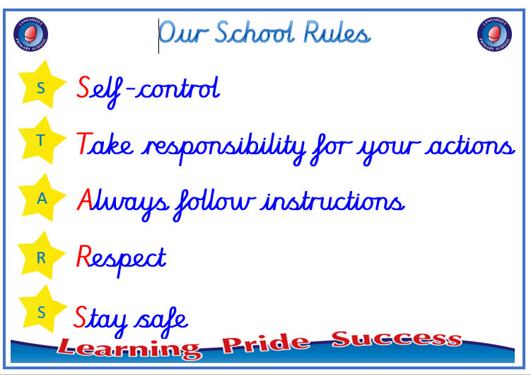
Important Information
Behaviour – School rules still apply
Children need to keep themselves safe
If a child’s behaviour is deemed unacceptable and compromises safety, we will inform parents and you may be asked to come and collect your child
Notes:
It is really important that children are able to sleep if they need to!

Slide 21
Communication
Our school office will share appropriate updates with families
You are welcome to contact the office as needed
Communication and messages get passed through duty manager at school to the group leader (Mrs Brooks) .
Please know that we will always contact you if we have a worry about your child

Slide 22
Thank you
A quick reminder that detailed medical forms mean that we can look after your child in the best way, please return if you haven’t already.
We do plan to work on an assembly to be performed in school.
We are very happy and proud to be able to take your children away on this learning adventure!
We appreciate your support!
Notes:
Assembly could be week beginning Monday 9th March (probably Weds 11th)

