Slide 1



Welcome

Slide 2
Aims
To give details of the Year 6 curriculum.
To give details of exciting Year 6 events, such as:
  WWII day
  Christingle concert
  SATs
  Residential
  Production
  Leavers’ events
  Transition to secondary school

Slide 3
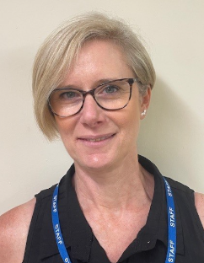
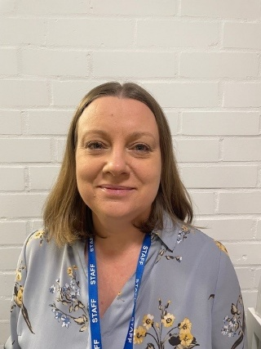
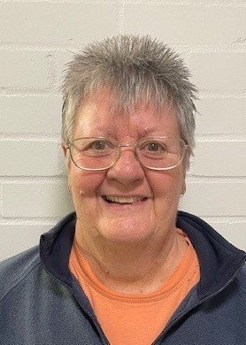
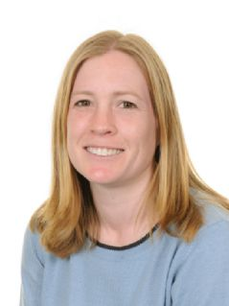
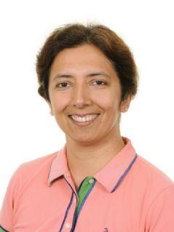
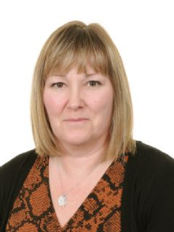
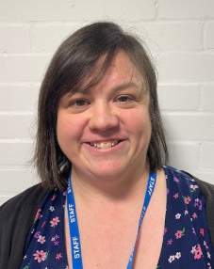
Year 6 staff
Mrs Ellis Mrs Pannell Mrs Groves
Mrs Dawes Mrs Nagpal Mrs Forster Mrs Ellis

Slide 4
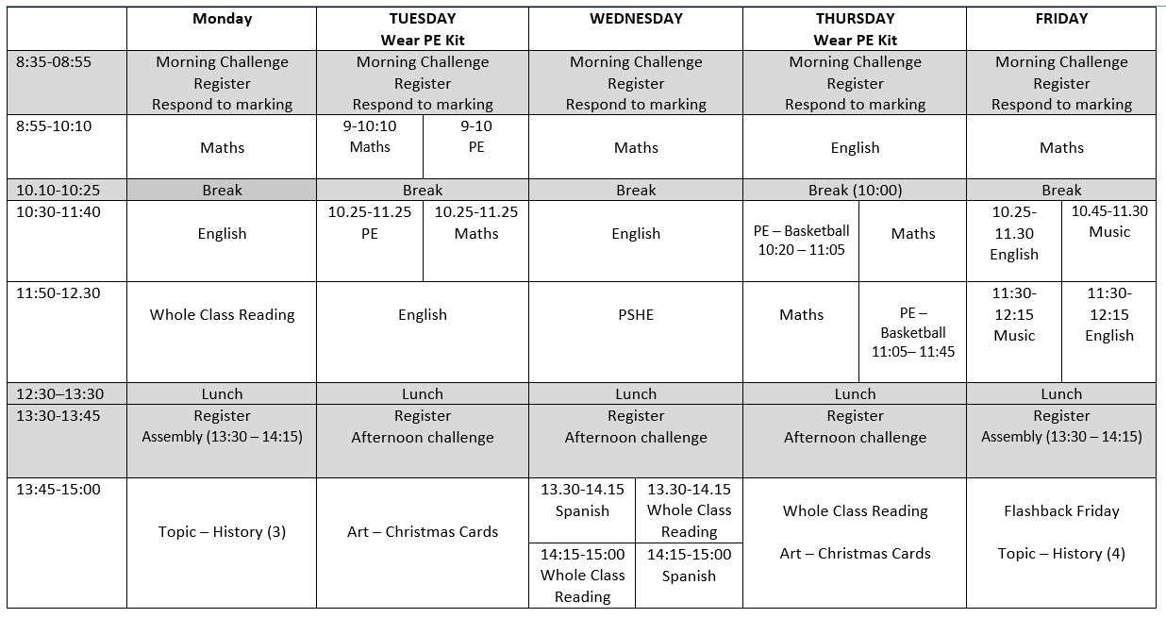
Link to Year 6 page of the website where you can find the weekly timetables and other useful information.
https://www.langshott-surrey.co.uk/page/?title=Year+6&pid=162

Slide 5
Home learning
Reading | Daily and recorded in planners
Spelling | Home learning sheets set and checked on Thursdays. No formal test.
My Maths | 2 activities every 2 weeks
TTRS | Optional
Creative topic | Half-termly tasks
For families who wish to ‘go the extra mile’ and support their child with extra home learning in core areas, CGP workbooks (Question Book bundles & 10 Minutes Book bundles) are available to purchase via Scopay.

Slide 6
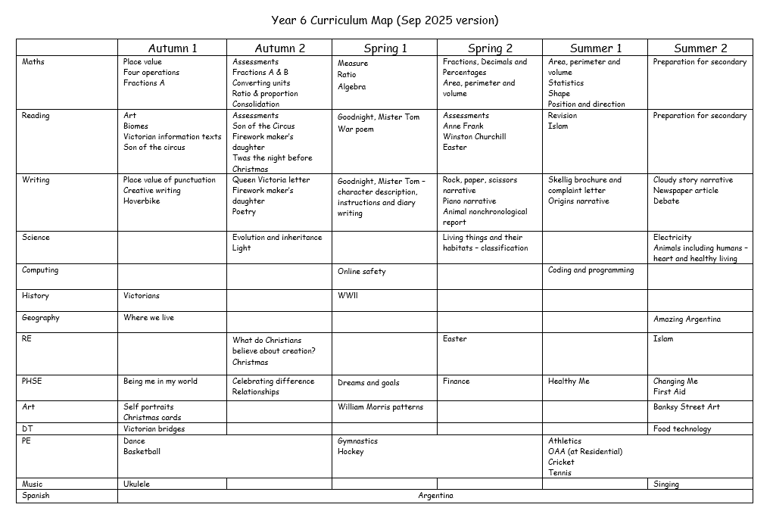

Slide 7
Reading
Reading is essential for Year 6 children as it develops vocabulary, comprehension and critical thinking, whilst also supporting writing and fostering imagination.
Spend time with your child, even when they are independent readers, to talk about their reading experiences, what they are reading and how the plot is progressing
Children are expected to read at least 4 times a week and to record this in their planners
STAR points will be given weekly for reading recorded in planners

Slide 8


End of year expectations – Reading:
Decoding/ Familiarity with texts | Apply their growing knowledge of root words, prefixes and suffixes, both to read aloud and to understand the meaning of new words they meet. Increase their familiarity with a wide range of books, including myths, legends and traditional stories, modern fiction, fiction from our literary heritage, and books from other cultures and traditions. Identify and discuss themes and conventions in and across a wide range of writing.
Vocabulary | Check that the book makes sense to them, discuss their understanding and explore the meaning of words in context. Identify how language, structure, and presentation contribute to meaning. Discuss and evaluate how authors use language, including figurative language, considering the impact on the reader.
Retrieval | Retrieve, record and present information from non-fiction. Distinguish between statements of fact and opinion.
Inference | Draw inferences such as inferring characters’ feelings, thoughts and motives from their actions, and justify inferences with evidence. Provide reasoned justifications for their views. Identify themes and conventions in a wide range of books. Make comparisons within and across books.

Slide 9




Reading
We regularly use books in class in Reading and English. If you would like to purchase these, please see below some of the books we use:

Slide 10
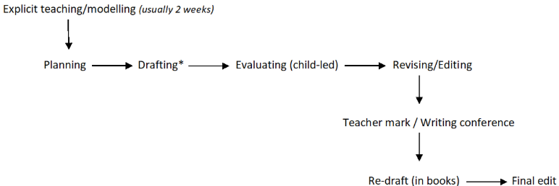
Writing
By the end of Year 6, pupils are expected to write effectively for a range of purposes and audiences. They should demonstrate secure control of grammar, punctuation and spelling with accurate sentence construction and varied sentence types. Writing should be cohesive, well-structured and organised using appropriate layout and paragraphing.
In year 6 writing is taught through a range of stimuli, including drama, poetry, films and texts.
The writing process

Slide 11
End of year expectations – Writing:
Spelling | Use a range of Year 5 and 6 spelling words in their work. Use further prefixes and suffixes and understand the guidance for adding them. Use dictionaries to check the spelling and meaning of words. Spell some words with ‘silent’ letters.
Grammar and Punctuation | Understand the differences between informal and formal language. Understand synonyms and antonyms. Use cohesive devices such as grammatical connections and adverbials. Use hyphens to avoid ambiguity. Use semicolons, colons or dashes to mark boundaries between independent clauses. Use a colon to introduce a list and punctuate bullet points consistently.
Composition | Select appropriate grammar and vocabulary and understand how such choices can change and enhance meaning. In narratives, describe settings, characters and atmosphere and integrate dialogue to advance the action. Use a wide range of devices to build cohesion within and across paragraphs. Propose changes to vocabulary, grammar and punctuation to enhance effects and clarify meaning. Ensure the consistent and correct use of tense throughout a piece of writing.

Slide 12
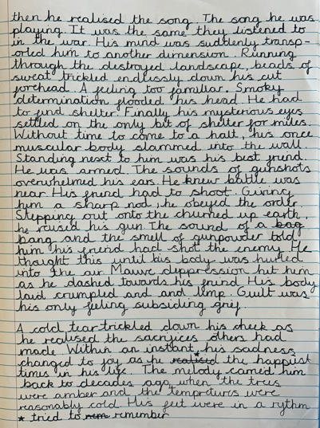
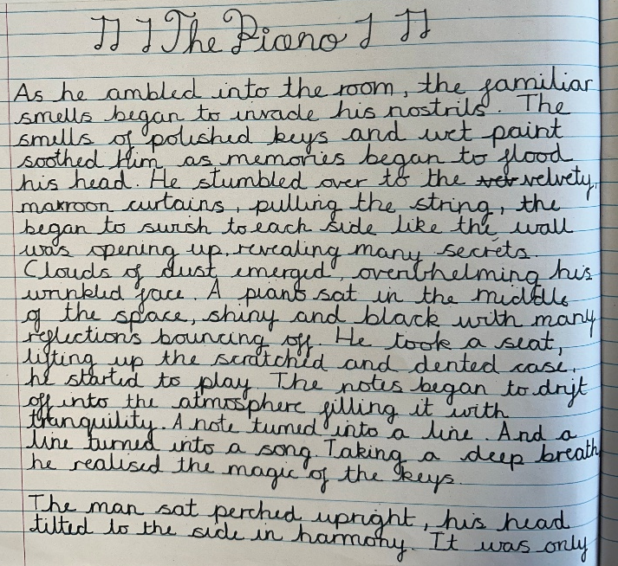
Writing
Meeting end of year 6 writing expectations.

Slide 13
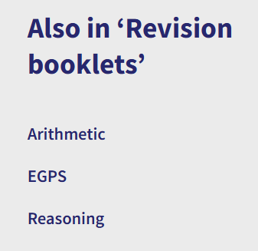

Maths
How to support at home:
Children should be fluent with all of their times tables facts.
The MyMaths tasks are set based on our current topic in order to consolidate their learning.
The children will either complete an Arithmetic or Reasoning test every fortnight. They will do their corrections with an adult at school and these will be sent home.
In addition to support maths, revision booklets are available on the website

Slide 14
End of year expectations – Maths:
Arithmetic | Add, subtract, multiply and divide whole numbers and decimals using the formal written and mental method. Use the inverse of an operation to check their answer with accuracy. Use order of operation to solve calculations. Add, subtract and multiply fractions with different denominators and mixed numbers. Multiply and divide fractions by whole numbers. Find fractions and percentages of an amount.
Problem Solving and Reasoning | Understand mathematical vocabulary (factors, multiples, prime, composite, squared and cubed). Read, write, order and compare numbers. Round any number to a required degree of accuracy. Use equivalences between fractions, decimals and percentages. Use simple formulae and find missing number problems algebraically. Solve number and practical problems that involve all of the above.

Slide 15
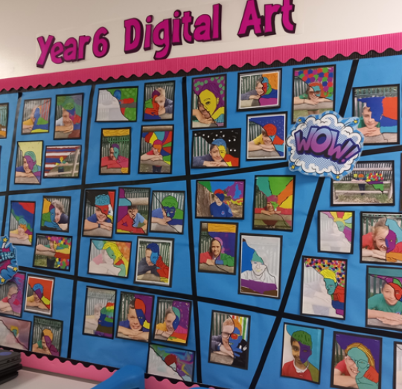
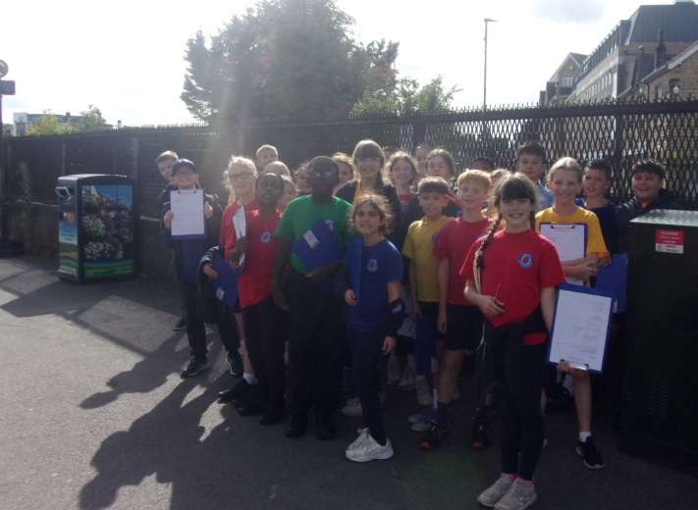
Curriculum highlights
Local Geography walk
Digital art project

Slide 16
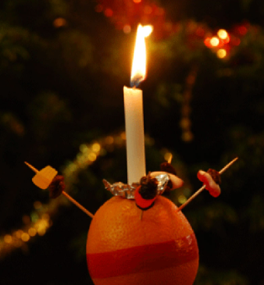
Christingle concert
Year 6 pupils will celebrate Christingle in the school hall, with parents warmly invited to join the special event. The children will create their own Christingles, learning about their symbolic meaning in the Christian tradition. Led by Reverend Vic, the hall will be filled with candlelight and reflection as families come together to mark the beginning of Advent in a joyful, meaningful way.

Slide 17

Pantomime
Tuesday 16th December

Slide 18
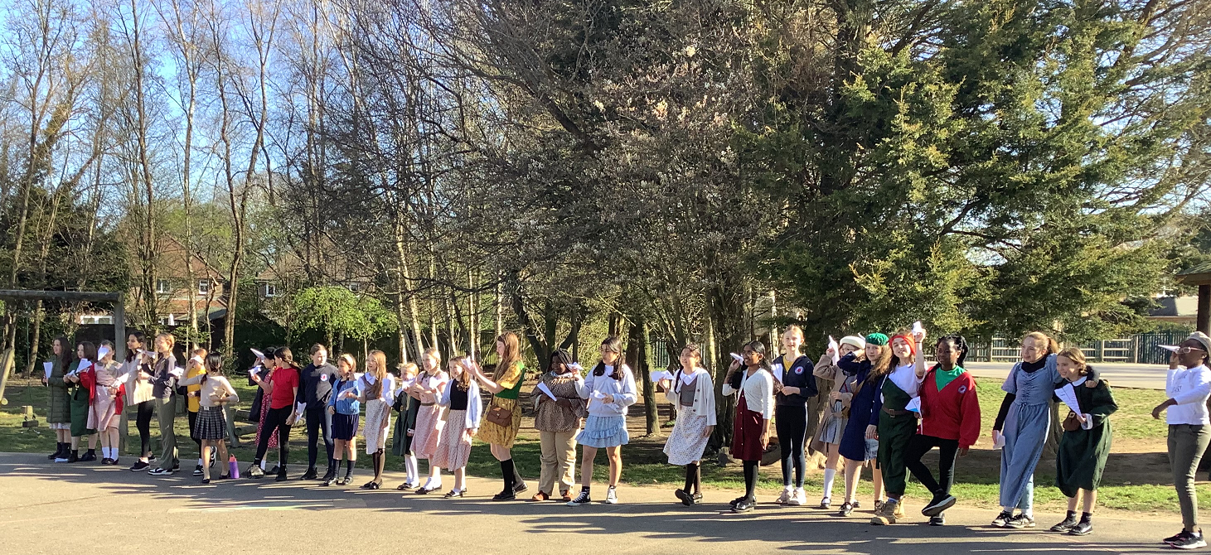
WWII Day
The children absolutely love learning about everything to do with WWII and to celebrate this we provide them with an opportunity to understand what life was like for children in the 1940s, whilst also enhancing their wellbeing at the same time. In March, we spend the day being children of that time (technology-free): playing a range of old-fashioned games; participating in a mini-sports day; enjoying a snack of fruit; being creative and learning new skills. Children are invited to dress up for the day in costume, ideally as a WWII child, but all WWII is welcome.

Slide 19
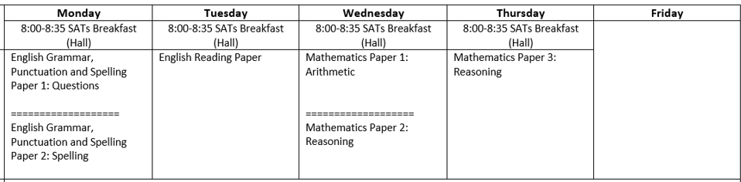
SATs – w/c 11th May 2026
Children will start revision in school in the Spring term.
We will hold an information evening for parents in the Spring term.
Children will be expected to do a little revision during the Easter holidays, using CGP guides, question books and/or past papers.
We offer an optional SATs Breakfast at 8am Mon – Thurs during SATs week.
All children sit the same tests (no higher/lower options) although some children qualify for access arrangements.
They are marked externally and you will receive the results in July.

Slide 20
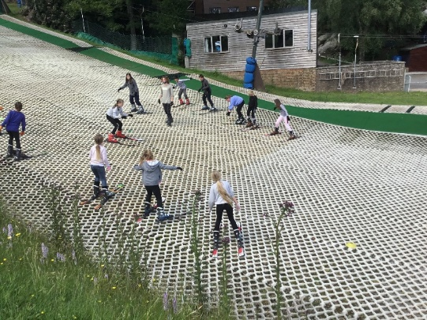
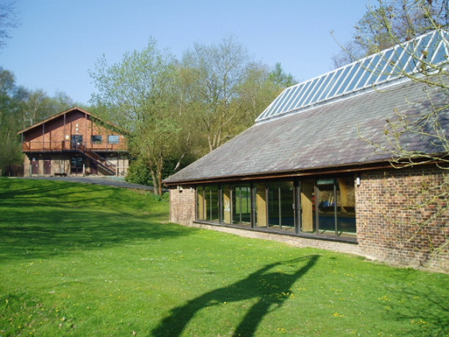
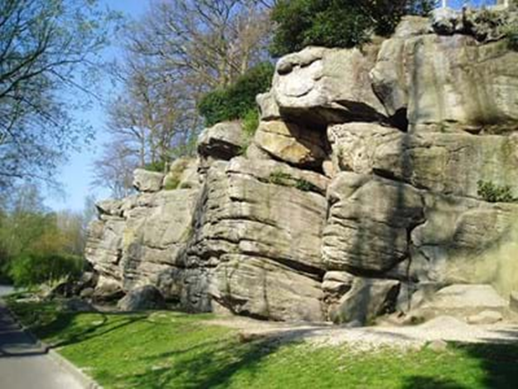
Bowles Residential
15th – 17th June 2026
Three full days of activities; including skiing, climbing, archery, water sports, camp fire, orienteering and leap of faith; run by an incredibly experienced and dedicated team of staff at Bowles and accompanied by Langshott staff.
We will hold an information evening for parents in the Spring term where we will issue a timetable, kit list and further details.

Slide 21

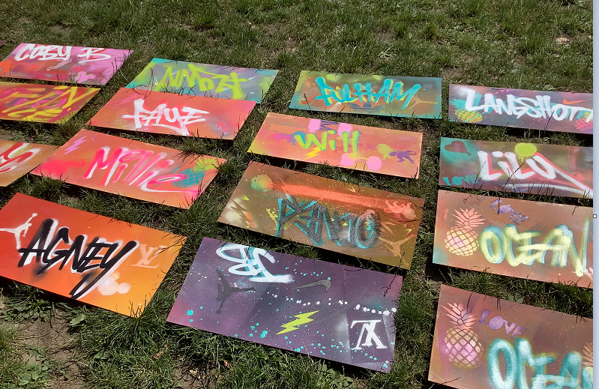
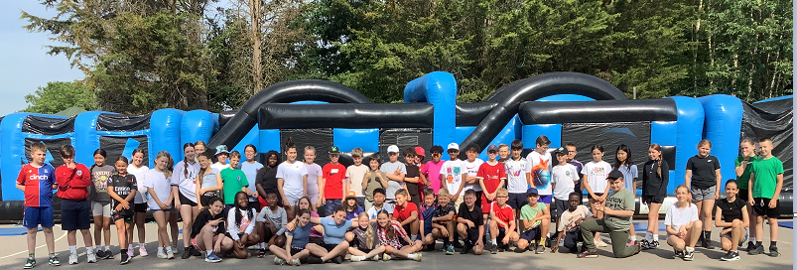
Thursday and Friday after residential
Thursday 18th June - Graffiti artist workshop and normal school lunch/packed lunch.
Friday 19th June - large inflatables on the playground and pizza and ice cream provided for lunch.

Slide 22

Sports Day
Friday 10th July

Slide 23
Production and Leavers’
Wed 8th July – Year 6 show
Mon 20th July – Leavers’ assembly (morning).
Mon 20th July – Leavers’ disco
Wed 22nd July – last day

Slide 24
Transition
We will be working closely with all secondary schools.
PSHE lessons will focus on transition during the Summer term.
Transition day – Provisional dates Tues 30th June/Wed 1st July secondary school dependent

Slide 25
Inset days
Friday 28th November
Monday 5th January
Friday 13th March
Monday 1st June

Slide 26

Thank you for your support.
Well done to your wonderful children.
There is a lot to look forward to!

