Slide 1

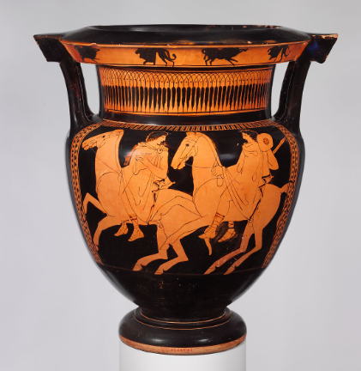
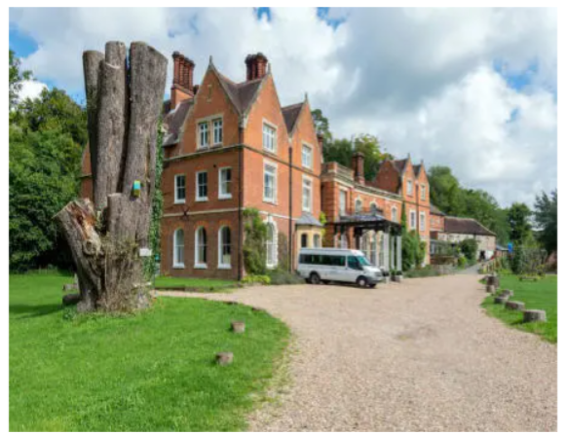

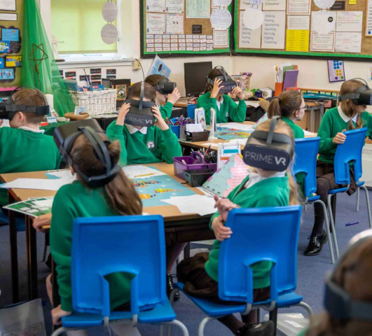
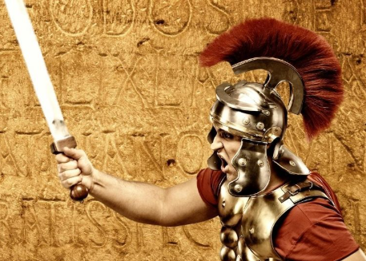

Welcome to Year 4

Slide 2
Aims
To give details of the Year 4 curriculum and expectations.
To give details of exciting Year 4 events, such as:
  Greek Day (including VR experience)
  TTRS and Multiplication Tables Check
  Residential at Juniper Hall
  Pantomime
  Roman Day
  Sports Day

Slide 3
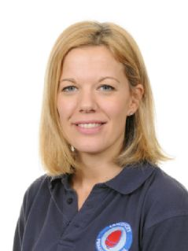
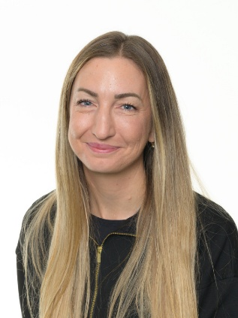
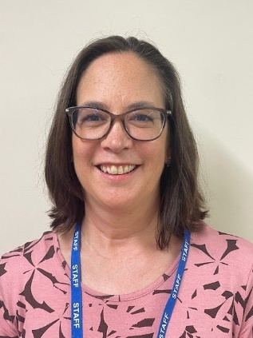
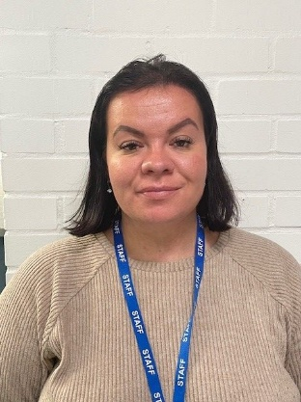
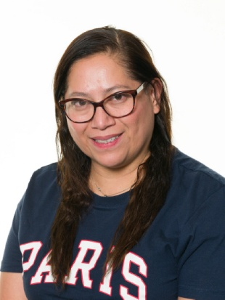
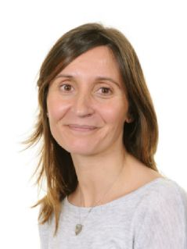
Year 4 staff
Mrs Brooks Mrs Felstead Mrs Shallcrass
Quartz Amethyst Mon – Weds Amethyst Thurs - Fri
Mrs Kennett Mrs Sanchez Miss Blanco

Slide 4
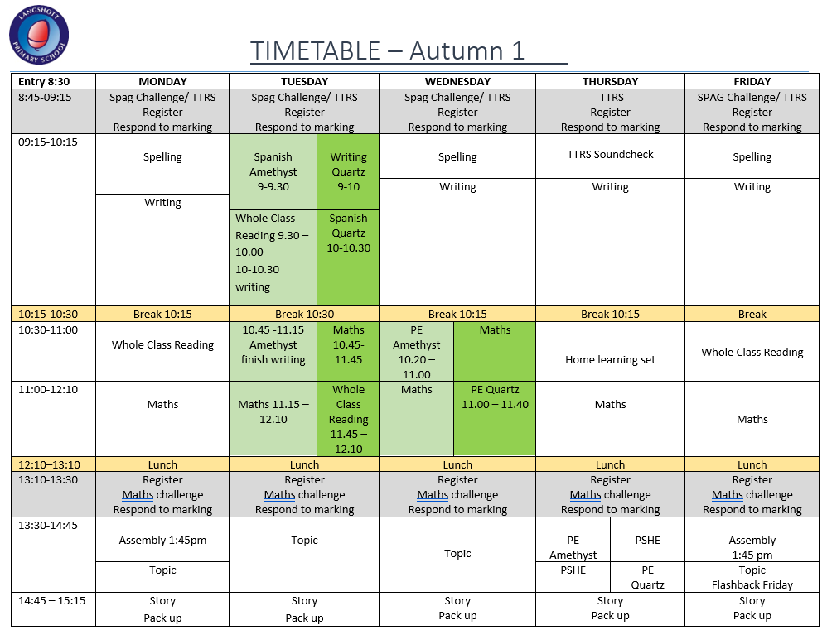
Link to Year 4 page of the website where you can find the weekly timetables and other useful information.
Langshott Primary School - Year 4

Slide 5
Home learning
Reading | Daily and recorded in planners
Spelling | Home learning sheets set and checked on Thursdays. No formal test.
TTRS | 20 minutes every week - monitored
Creative topic | Choose 3 from the half-termly tasks
Creative topic tasks can either be handed in to class teacher, completed in home learning book or uploaded to Google Classroom.
For families who wish to ‘go the extra mile’ and support their child with extra home learning in core areas, CGP workbooks (Question Book bundles & 10 Minutes Book bundles) are available to purchase via Scopay.

Slide 6
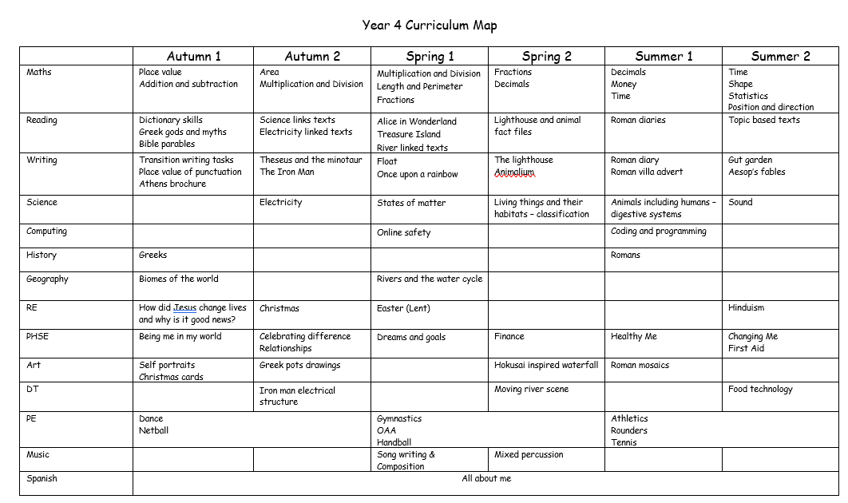

Slide 7
Maths
  We use White Rose Maths to support our teaching of the Maths National Curriculum
  Year 4 topics include Place Value up to 4 digits, Addition and subtraction of 4 digit numbers, multiplication of 3 digit number by 1 digit and division of 3 digit numbers by 1 digit as well as fractions, decimals, money, time, shape, position and direction and length and perimeter.
  Children will complete an arithmetic assessment every 2 weeks. Children will have the opportunity to correct and have support with errors and will bring a copy of the assessment home.
How to support at home:
  TTRS for 20 minutes per week on the Garage play mode (set by class teacher)

Slide 8
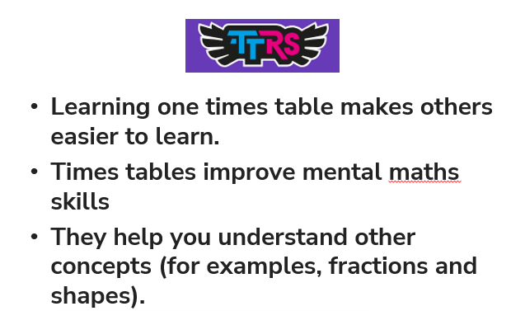
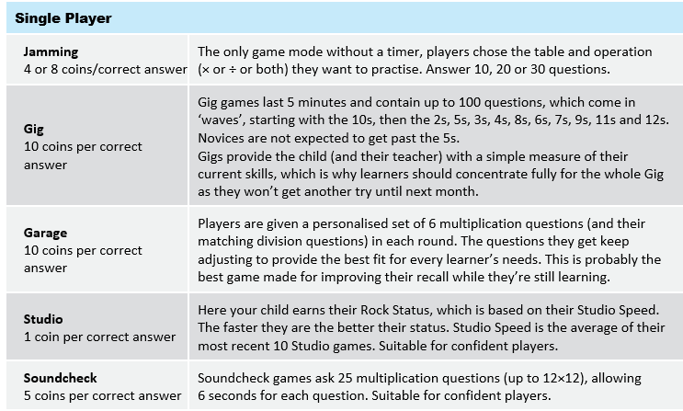
Times Tables Rock Stars
How to support at home:
  TTRS for 20 minutes per week on the Garage play mode (set by class teacher)

Slide 9
Reading
There is nothing more important than developing independence with reading. Children are expected to read at home at least 4 times per week. Reads should be recorded for checking in their planners.
Children will be issued with a reading book that matches their assessed reading level as well as a library book of their choice to read for pleasure.
We use the text ‘The Iron Man’ by Ted Hughes as part of our Writing but will also be reading this as a class text.

Slide 10
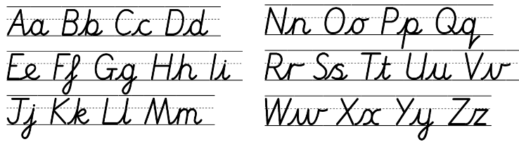
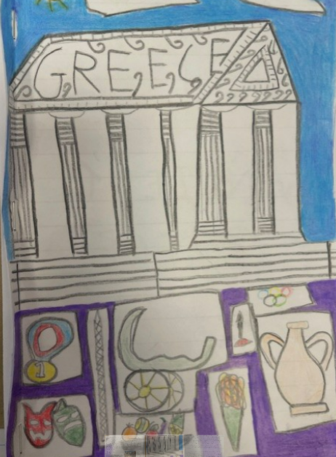
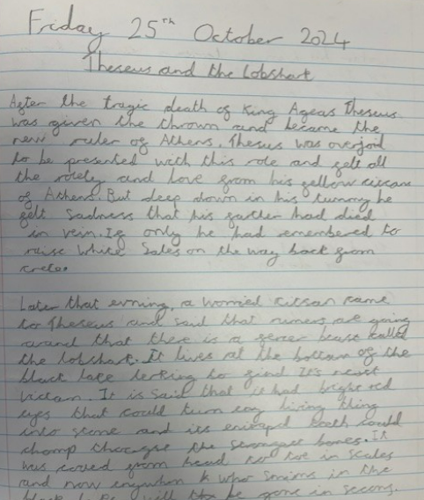
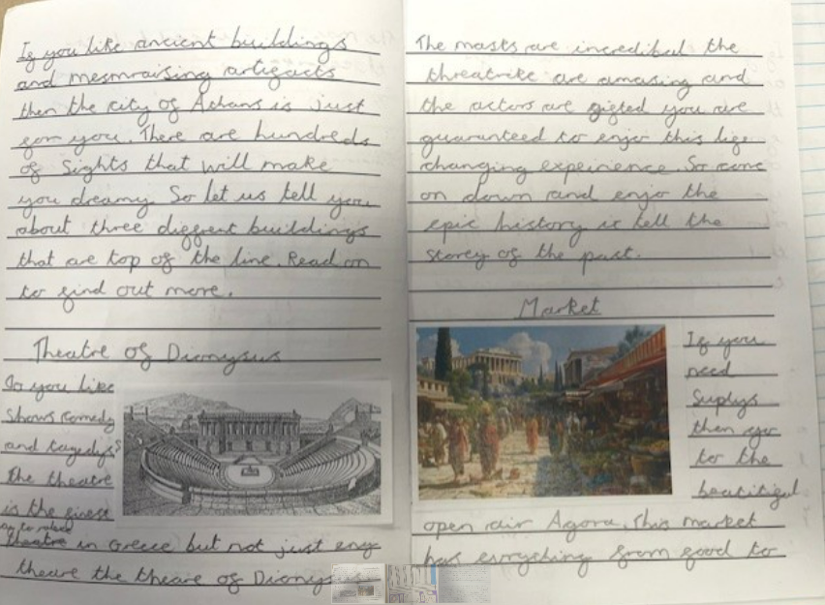
Writing

Slide 11
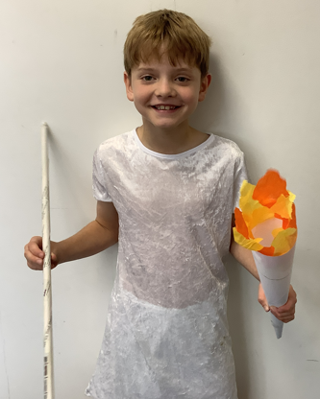
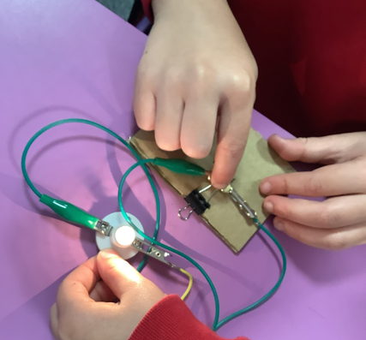
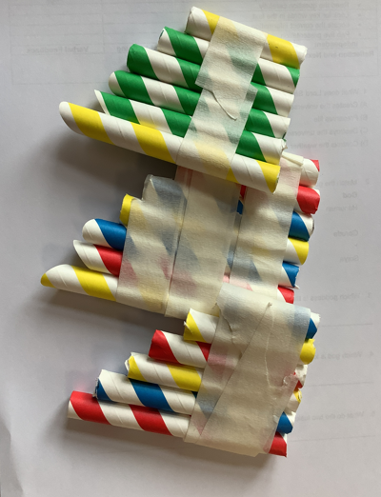
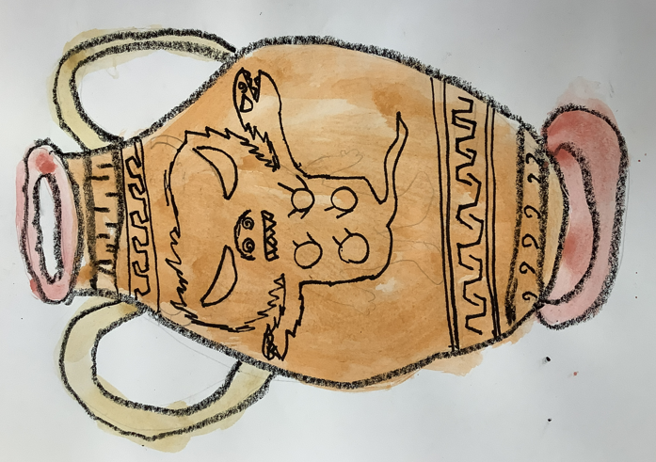
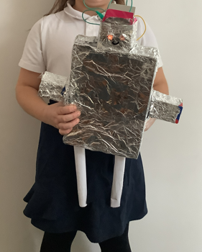
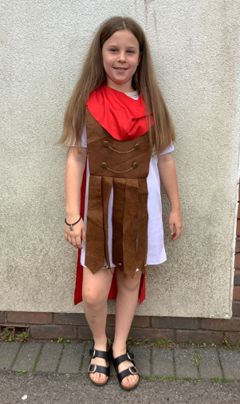
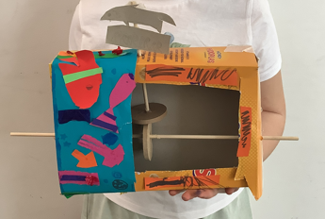

Curriculum highlights
Ancient Greek Day
Science - Electricity
Science - Sound
Art – Greek Pot
Science - Sound
Roman Day
Science - Sound
Art - Mosaics

Slide 12
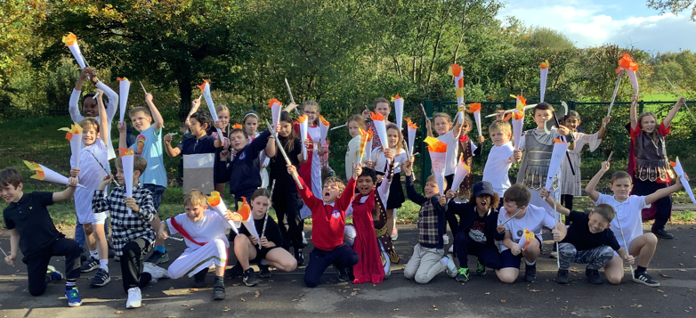
Greek Day – Friday 10th October 2025
VR headsets to experience life in Ancient Greece – (£5 per child)
Ancient Olympics
Filming of the Battle of Marathon

Slide 13
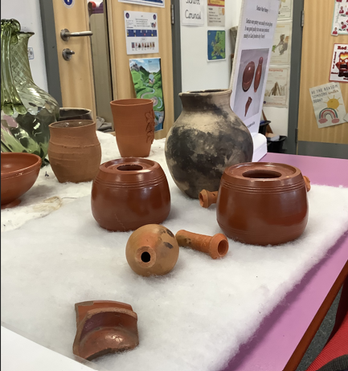
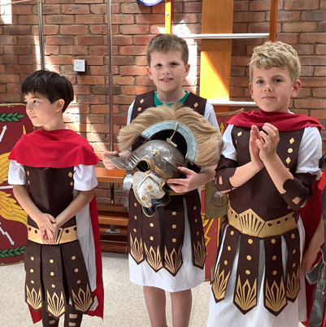
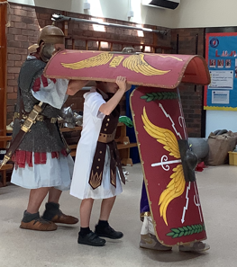
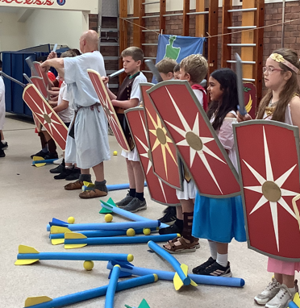
Roman Day
Life as a Roman soldier
Roman artefacts

Slide 14

Pantomime
Tuesday 16th December

Slide 15
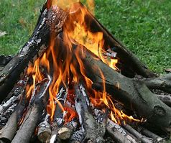
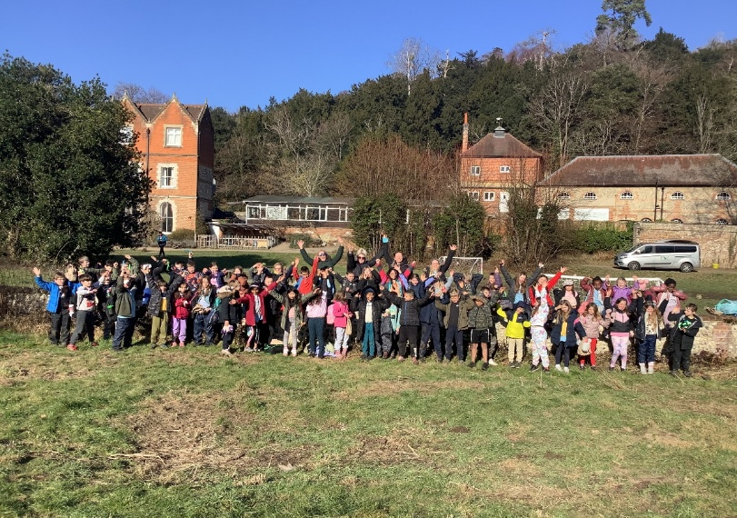
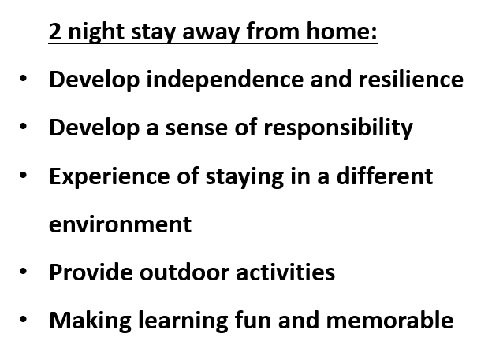
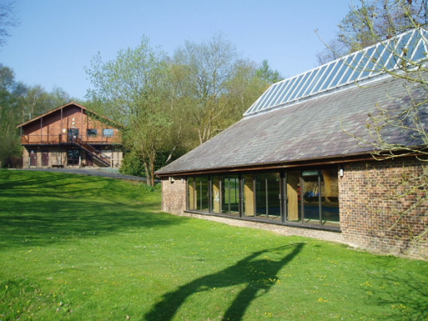
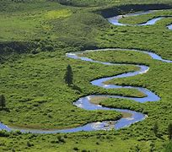
Juniper Hall Residential
25th – 27th February 2026
Three full days of activities; including skiing, climbing, archery, water sports, camp fire, orienteering and leap of faith; run by an incredibly experienced and dedicated team of staff at Bowles and accompanied by Langshott staff.
We will hold an information evening for parents in the Spring term where we will issue a timetable, kit list and further details.

Slide 16

Sports Day
Friday 10th July

Slide 17
Inset days
Friday 28th November
Monday 5th January
Friday 13th March
Monday 1st June

Slide 18

Thank you for your support.
Well done to your wonderful children.
There is a lot to look forward to!

