Slide 1




Slide 2
Aims
To give details of the Year 3 curriculum.
To give details of exciting Year 3 events, such as:
  Self-portrait art project
  Where we live project
  Carol concert
  Stone Age Day
  Egyptian Day
  Sleepover

Slide 3
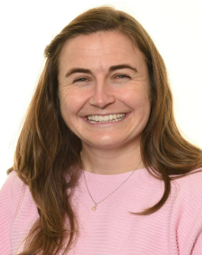
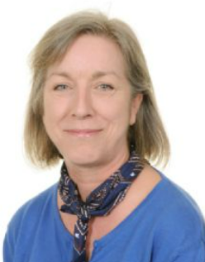
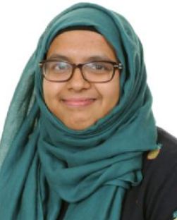
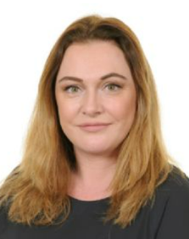
Year 3 staff
Mrs Welham
Mrs Butler
Miss Miah
Mrs Donnelly

Slide 4
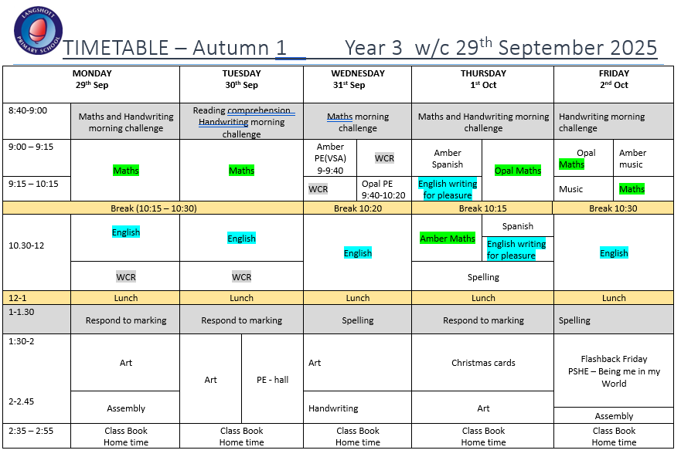
Please follow this link to the Year 3 section of the website:
https://www.langshott-surrey.co.uk/page/?title=Year+3&pid=73
Timetables will be uploaded weekly:
Autumn timetables: https://www.langshott-surrey.co.uk/page/?title=Autumn&pid=2220
Spring timetables:
https://www.langshott-surrey.co.uk/page/?title=Spring&pid=2228
Summer timetables: https://www.langshott-surrey.co.uk/page/?title=Summer&pid=2236

Slide 5
Home learning
Reading | Daily and recorded in reading diaries
Spelling | Home learning sheets set and checked on Thursdays. No formal test.
TTRockstars | 20 minutes a week
Creative topic | Half-termly tasks
For families who wish to ‘go the extra mile’ and support their child with extra home learning in core areas, CGP workbooks are available to purchase via Scopay.

Slide 6

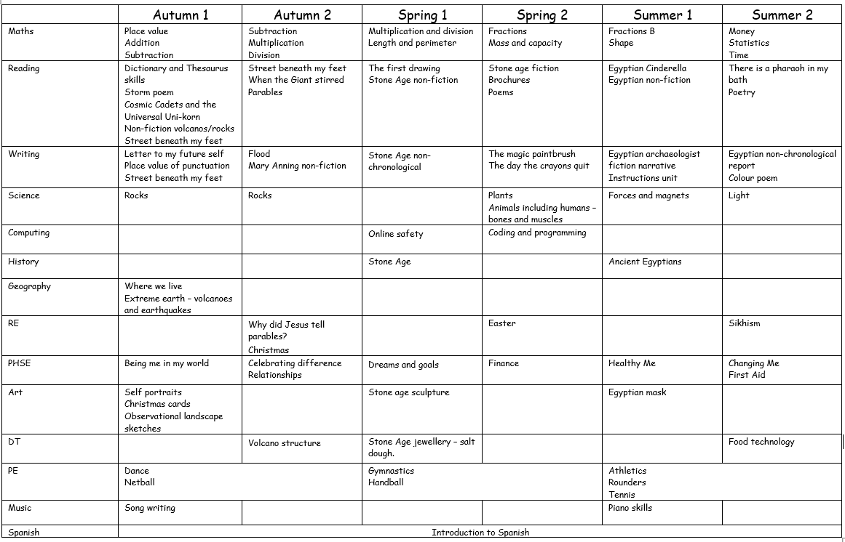
Year 3 curriculum map

Slide 7





Reading
The most important thing that you can do at home is read with your child. It is key to your child's learning that they are reading every day, even independently. Reading supports every area of the curriculum and supports accurate spelling skills. The children will have a reading book and a library book each week. In KS2, children are able to record their reading independently in their reading diary after reading to an adult.
We regularly use books in class in Reading and English. If you would like to purchase these, please see below some of the books we use:

Slide 8


End of year expectations – Reading:
Decoding/ Familiarity with texts | Apply their growing knowledge of root words, prefixes and suffixes, both to read aloud and to understand the meaning of new words they meet. Listen to and discuss a wide range of fiction, poetry, plays, non-fiction and reference books or textbooks. Read books that are structured in different ways and read for a range of purposes. Identify themes and conventions in a wide range of books. Understand what they read independently by identifying how language, structure and presentation contribute to meaning to include paragraphs, headings, subheadings and inverted commas to punctuate speech.
Vocabulary | Use dictionaries to check the meaning of words that they have read. Discuss words and phrases that capture the reader’s interest and imagination. Check that the text makes sense to them, discuss their understanding and explain the meaning of words in context.
Retrieval | Retrieve and record information from a range of texts.
Inference | Draw inferences such as inferring characters’ feelings, thoughts and motives from their actions, and justify inferences with evidence. Predict what might happen from details stated and implied.

Slide 9
What can I do to help my child in Reading:
Read books with your child and talk about the story, the poems or the information in them. What parts of the book have they enjoyed the most and why?
Have discussions about the characters’ feelings and motivations. See if your child can sequence and summarise the events.
Remember that reading isn’t just about books—make the most of shop and street signs when you are out and about. Ask them to read the back of boxes such as cereal boxes.
Listen to books being read aloud through Youtube and audio books.
Allow your child to read at their own pace and encourage them to re-read their favourite stories.

Slide 10
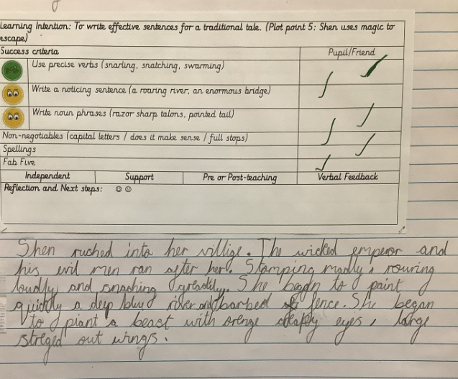
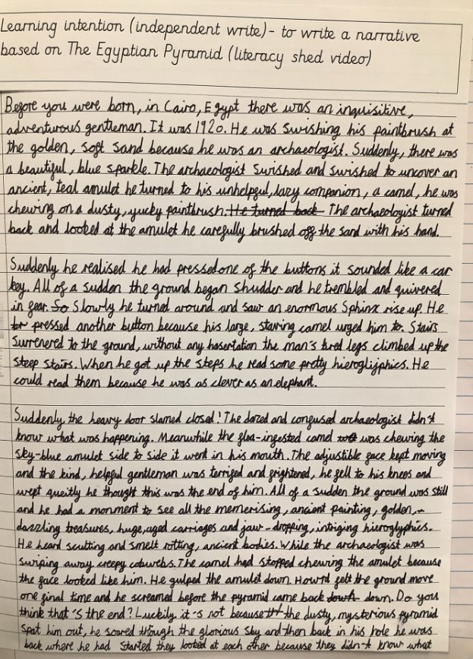
Writing
Here are some examples of the Year 3 standard of writing.

Slide 11
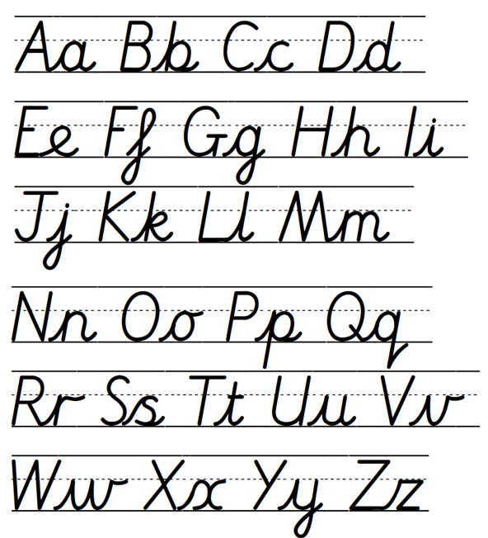
Writing
We regularly practise handwriting. Here is the Langshott Script.

Slide 12
End of year expectations – Writing:
Spelling | Use a range of Year 3 and 4 spelling words in their work. Spell homophones correctly. Use prefixes and suffixes and understand how to add them (un-, dis-, mis-, re-, pre-, -ly). Apply Year 3 spelling rules.
Grammar and Punctuation | Extend their range of sentences with more than one clause by using a wider range of conjunctions, including: when, if, because, although. Use fronted adverbials including a comma after the fronted adverbial. Punctuate direct speech using inverted commas. Understand the following terminology: article, preposition, subordinating conjunction, subordinate clause, noun phrase.
Composition | Plan their writing by discussing and recording ideas. Draft and write by composing and rehearsing sentences orally (including dialogue). Begin to use paragraphs to organise ideas around a theme. Draft and write narratives, creating settings, characters and plot. Draft and write non-narrative material, using simple organisational devices. Evaluate and edit by assessing the effectiveness of their own and others’ writing and suggesting improvements. Proofread for spelling and punctuation errors.

Slide 13
What can I do to help my child in Writing:
Encourage your child to want to write. Let them use crayons, pencils, felt-tips and paints to write stories and draw illustrations.
Find everyday opportunities to write together – make lists before you go shopping and write letters to friends and family. Help them to make their own books, posters and labels for things in their room.
Write down a story your child tells you. This means they can practise coming up with ideas, using their own choice of ambitious vocabulary. Ask them to help suggest words and phrases.
Please support your child with their weekly spelling activity.

Slide 14
Maths
Maths – what can I do to help my child in Maths?
  In Year 3, we learn the 3, 4 and 8 times tables. Children are encouraged to play TTRS regularly to boost their confidence ready for the multiplication check in Year 4. Playing timetable songs on Youtube is a great way to learn them too!
  CGP workbooks follow what we learn in school and are terrific for extra practice at home. They are available on Scopay.
  Below are some more helpful websites:
  - BBC Bitesize http://www.bbc.co.uk/education/levels/zbr9wmn
  - Topmarks https://www.topmarks.co.uk/maths-games/7-11-years/multiplication-and-division

Slide 15
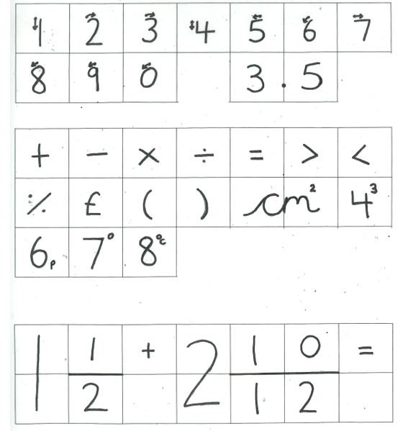
Maths
All the children are asked to use this number script.

Slide 16
End of year expectations – Maths:
Arithmetic: | Add and subtract numbers with up to 3 digits, using formal written methods. Estimate the answer to a calculation and use inverse operations to check answers. Recall and use multiplication and division facts for the 3, 4 and 8 multiplication tables. Multiply and divide two-digit numbers by a one-digit number, using mental and formal written methods. Add and subtract fractions with the same denominator within one whole.
Problem solving and reasoning: | Solve problems involving addition, subtraction, multiplication and division. Estimate and read time with increasing accuracy to the nearest minute; record and compare time in terms of seconds, minutes and hours. Measure, compare, add and subtract: lengths (m/cm/mm); mass (kg/g); volume/capacity (l/ml). Measure the perimeter of simple 2D shapes. Recognise angles as a property of shape or a description of a turn. Identify right angles and angles that are greater than or less than a right angle (acute and obtuse). Identify horizontal and vertical lines and pairs of perpendicular and parallel lines.

Slide 17
What can I do to help my child in Maths - some key topics:
Multiplication and division (3, 4 and 8 times tables)
Practise times tables in the car, walking to school, or with songs and apps.
Play quick-fire games: you say “3 × 8” and they respond with the answer.
Use real-life contexts, like “There are 4 chairs at each table—how many chairs for 6 tables?”
Time
Use an analogue clock at home; ask children to read the time to the nearest minute.
Talk about how long activities take (e.g. “It’s 5:10 now, dinner will be ready in 20 minutes – what time will that be?”).
Addition and subtraction (up to 3 digits)
Practise column addition and subtraction using real-life numbers (e.g. shopping receipts, scores in games).
Encourage children to check their answers by doing the calculation in reverse.
Measurement (length, mass, capacity, perimeter)
Get children to weigh ingredients when baking or cooking.
Compare heights of family members, or measure furniture with a tape measure.
Work out the perimeter of household objects (tables, picture frames).
Multiplying and dividing larger numbers
Encourage mental strategies (e.g. 24 ÷ 4 → “How many 4s in 24?”).
Practise short written methods for multiplying a 2-digit by a 1-digit number (e.g. 34 × 2).
Fractions
Use food to explore fractions (e.g. pizza, cake, fruit).
Practise adding fractions with the same denominator: ¼ + ¼ = 2/4.

Slide 18
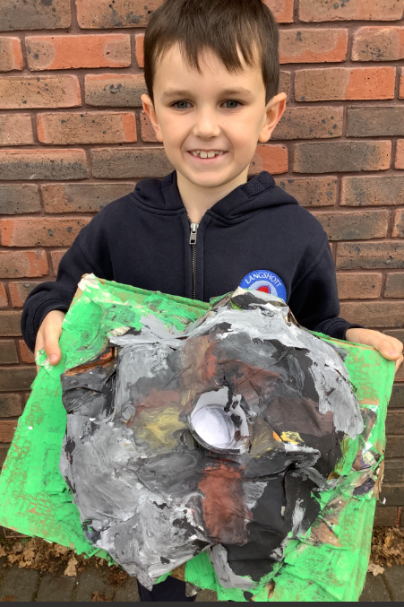
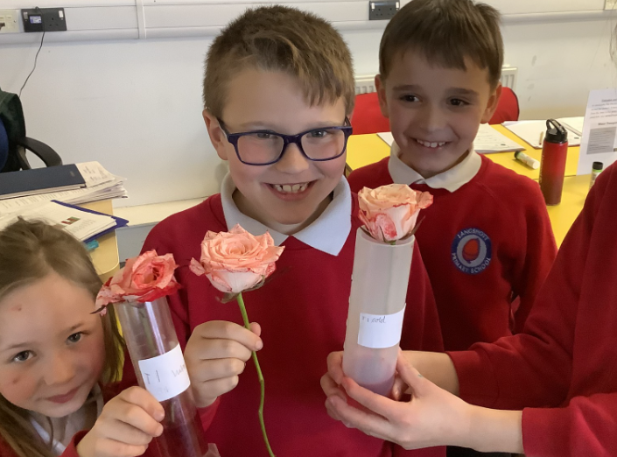
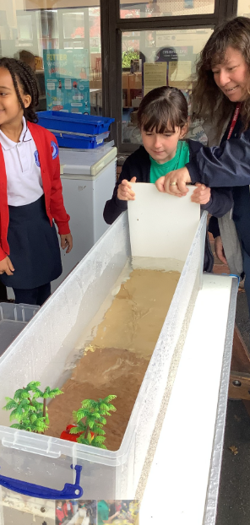
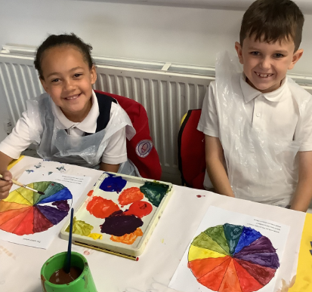
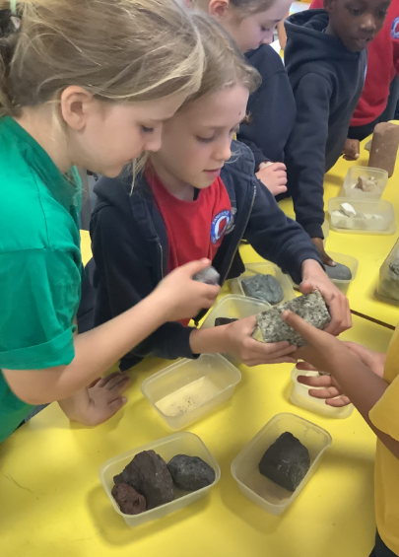
Curriculum highlights

Slide 19
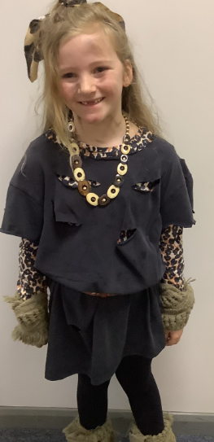
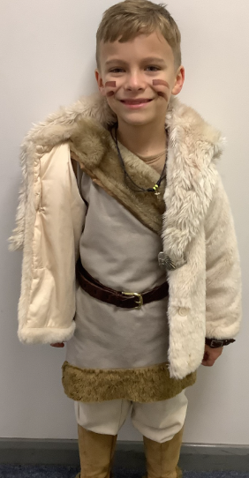
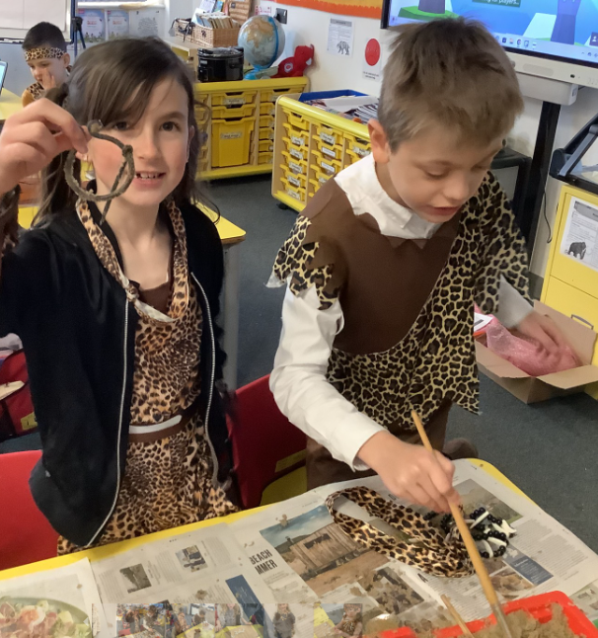
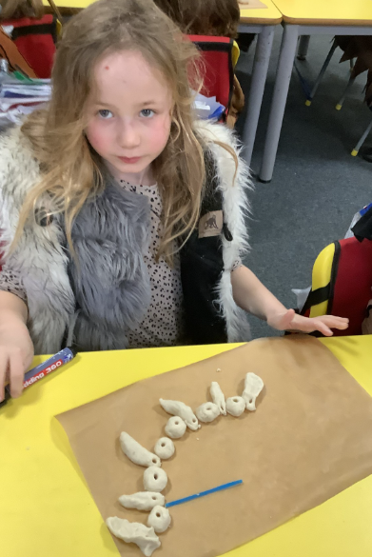
Stone Age day
On Stone Age day, the children are able to dress up in their best Stone Age costume. To save on cost, we recommend getting creative with what you have, visiting a charity shop or borrowing from someone who has dressed up before.
This is a cost free day where the children make salt dough Stone Age necklaces, become archaeologists digging for artefacts, eat berry stew and participate in a variety of other fun activities.

Slide 20
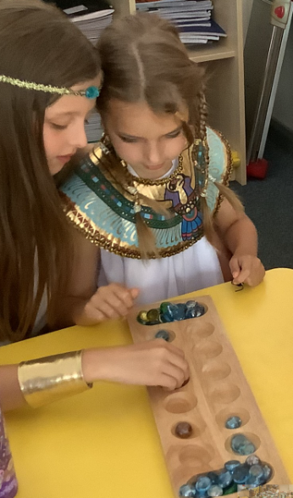
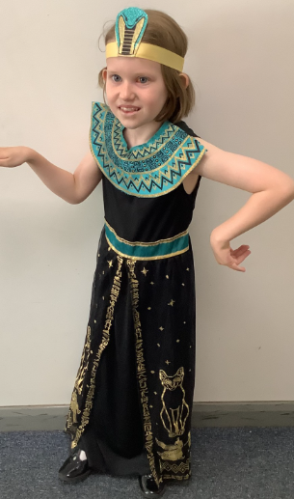
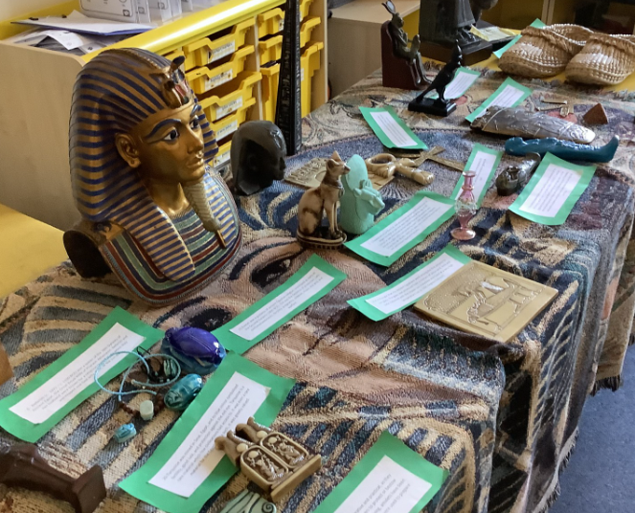
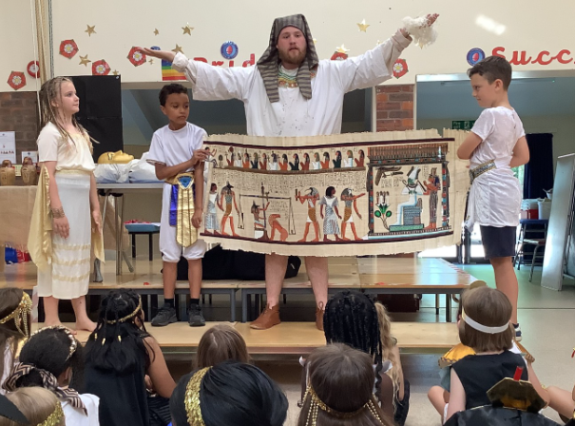
Egyptian day
On this day, we have a historical expert come into school to help our Ancient Egyptian learning come to life. They are very knowledgeable and the children have a wonderful day using drama, historical Egyptian games, hieroglyph writing and well as scavenger hunts for facts to learn more about this fascinating civilisation.
The cost of this day is covered by the Friends of Langshott.
Children can dress up in their best outfit. Again, home made is a great way to save money.

Slide 21

Pantomime
Tuesday 16th December

Slide 22

Summer term sleepover
In the summer term, on a Friday night, the children are invited into school after 7pm to spend the night - sleeping in their classrooms.
This is an opportunity for the children to experience a mini- sleepover away from home, in preparation for the Year 4 residential.
The evening and the morning are device-free and fun-filled and the children make lots of special memories.

Slide 23

Sports Day
Friday 10th July

Slide 24
Inset days
Friday 28th November
Monday 5th January
Friday 13th March
Monday 1st June

Slide 25

Thank you for your support.
Well done to your wonderful children.
There is a lot to look forward to!

