Slide 1

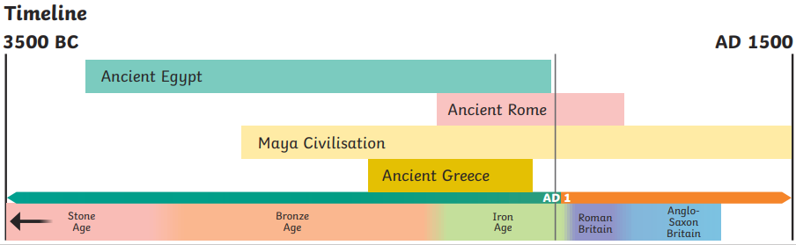
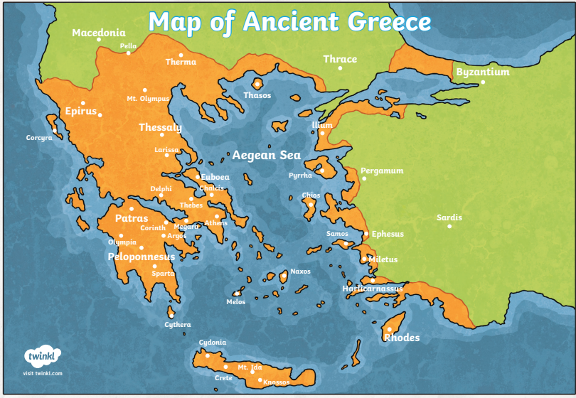
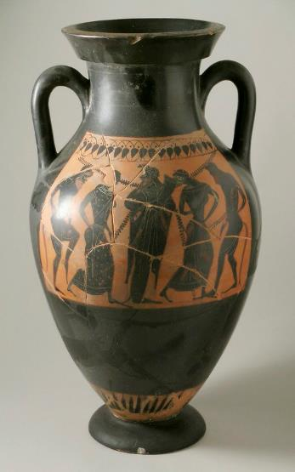
History – Year 4 – The Ancient Greeks
Ancient Greece
Did you know that Ancient Greece existed during the same time as Ancient Egyptians. What can you remember from your learning about Ancient Egypt in Y3?
Key Vocabulary
AD | noun. Used to show that a date is after the year AD 1. This is counted forwards so AD 100 is before AD 200.
acropolis | noun. the ancient citadel at Athens, containing the Parthenon and other notable buildings, mostly dating from the 5th century BC.
agora | noun. (in ancient Greece) a public open space used for assemblies and markets.
ancestors | noun. a person, typically one more remote than a grandparent, from whom one is descended.
architecture | noun. the art or practice of designing and constructing buildings.
BC | noun. Used to show that a date is before the year AD 1. This is counted backwards so 200 BC is before 100 BC.
democracy | noun. government by the people.
god/ goddesses (deities) | noun. A deity or god is a supernatural being considered to be sacred and worthy of worship due to having authority over the universe, nature or human life.
legend | noun. a traditional story sometimes popularly regarded as historical but not authenticated.
myth | noun. a traditional story, especially one concerning the early history of a people or explaining a natural or social phenomenon, and typically involving supernatural beings or events.
Olympics | noun. relating to ancient Olympia or the Olympic Games.
philosophy | noun. the study of the fundamental nature of knowledge, reality, and existence, especially when considered as an academic discipline
politician | noun. a person who is professionally involved in politics, especially as a holder of an elected office.
prophecy | noun. a prediction of what will happen in the future.
Ancient Greece
Ancient Greece was not a country. It was made up of city states. There were often battles between these city states but sometimes they would join together to defend themselves from a common enemy. Important city states of ancient Greece included Athens, Corinth and Sparta. Independent city states existed for most of the ancient Greek period. However, towards the end of this period, King Philip II of Macedonia ruled over all of ancient Greece. Following his death, his son, Alexander the Great, took over the empire along with other lands that he conquered. After Alexander the Great died, the Romans slowly took over parts of the empire
Sources
Primary sources: Information and objects that come from the time being studied. | Secondary sources: Interpretations of information and objects which are produced after the time being studied.
Enslaved people
There were many enslaved people in ancient Greece. They made many objects and goods to be sold. Many ancient Greek pots that survive today would have been made by enslaved people.

Slide 2

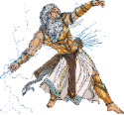
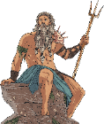
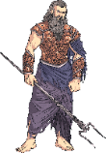
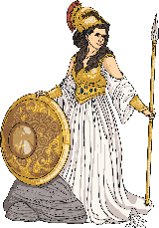
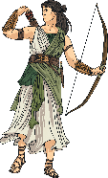

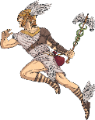
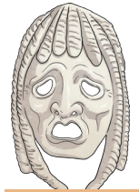
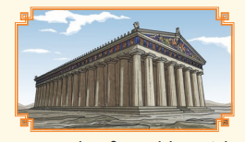
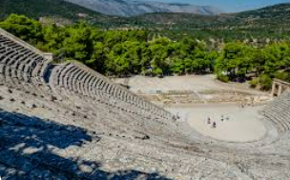
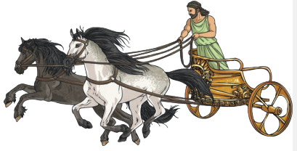
History – Year 4 – The Ancient Greeks
Religion and the ancient Greek gods
• The ancient Greeks believed in many different gods and goddesses. • Each god/goddess represented a certain aspect of humanity and each was responsible for certain parts of life too. • Festivals were held to celebrate the gods and goddesses. • It is believed that the 12 most powerful gods lived on Mount Olympus.
Zeus was the most powerful of all the gods. He was god of the sky and the King of Mount Olympus. | Poseidon was the god of the sea. He was the most powerful god except for his brother, Zeus. | Hades was the brother of Zeus and the god of the dead. He ruled the underworld, where people went when they died. | Hestia was Zeus’ sister. She was the goddess of the hearth and the home.
Athena was the daughter of Zeus. She was born directly out of his forehead. She was Zeus’ favourite child. | Artemis was the daughter of Zeus and the twin sister of Apollo. | Hera was the wife of Zeus. She was powerful and beautiful but very jealous and vain. | Hermes was Zeus’ youngest son. Hermes was very fast on his feet and clever so Zeus decided to make him a messenger.
The Parthenon The Parthenon is perhaps the most well-known ancient Greek temple. It took many years to build and was finished in 432 BC. It stands on a rocky hill in Athens known as the Acropolis and was built for the goddess Athena.
Democracy
Ancient Athens is where democracy began in around 508 BC. Listening to the opinions of other people and debating issues was an important part of this system. After debating issues, the ancient Athenians would vote. At that time, the only people allowed to take part in democracy were adult males who were citizens of Athens. The legacy of democracy still exists today in many parts of the world.
Education
• From the ages of seven to fifteen, boys in most ancient Greek city states went to school, where they learnt to read and write. • In school, boys mostly wrote on a tablet (a wooden frame filled with beeswax) using a stylus. When they wanted to start again, they held the wax near to the fire so it melted away what they had written. • They also learnt about music and how to play an instrument, such as a lyre. • In addition, boys were taught maths and physical skills: using a bow and arrow and a sling, wrestling and swimming. • Most schools had a ‘palaestra’, which was a training ground for physical education, close to the school. • In most city states, such as Athens, girls did not attend school. Some were taught to read and write at home. In many cases, girls were only taught the skills they would need for looking after a family, such as cooking and making clothes. • The Spartans were known for their strong army and ability to fight: in childhood, boys were trained to be warriors and girls were taught academic subjects and how to fight.
The Olympics
The Olympics were first held in ancient Greece in 776 BC. This is one of the legacies of ancient Greece. Events included boxing, wrestling, running and chariot racing. Women were not allowed to compete in the Olympics. This was because ancient Greek women were not treated as equals to men and had fewer freedoms. The idea for the marathon also originates from this time.
Greek theatre
Theatre was a very popular form of entertainment in ancient Greek times. Theatres were generally built into a hillside with rows of stone benches in a semicircle, one above the other, and the stage at the bottom of the hill. Some theatres in large cities could hold more than 10 000 people! All of the actors were men and they wore costumes and masks to play different characters. The masks had a variety of exaggerated expressions on them to help the audience understand the characters.

