Slide 1

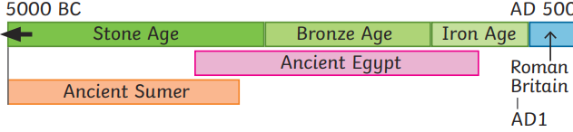
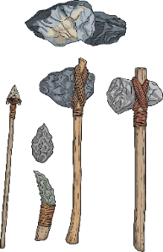
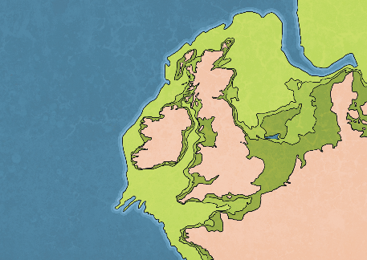
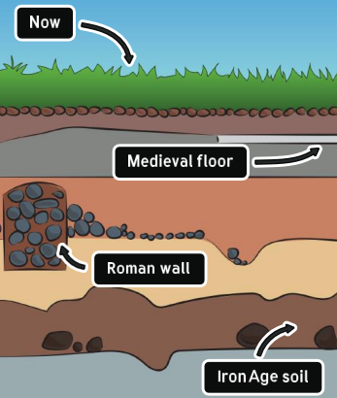
History – Year 3 – Stone Age to Iron Age
Timeline:
AD stands for Anno Domini, which is Latin for in the year of the Lord. BC stands for Before Christ, and it’s a way of counting years before the estimated birth of Jesus Christ.
Key Vocabulary
alliance | noun. a partnership or agreement between people, groups, or countries to work together.
Archaeologist | noun. a person who studies the past by excavating historical places and studying objects and remains
Celts | noun. A modern term for the people living in Europe during the Iron Age. The ‘Celts’ were made up of many different tribes.
cemetery | noun. a place where people are buried when they die.
climate | noun. the usual weather in a particular place over a long time.
cremate | verb. when a dead body is burned to ashes instead of being buried.
crop | noun. plants that are grown by farmers, like wheat or corn.
domesticated | adjective. when animals are tamed and kept by people for work, food, or as pets.
empire | noun. a large group of countries or lands that are controlled by one ruler or government.
evidence | noun. something that helps to prove or show if something is true.
forage | verb. to search for food or supplies
fossil | noun. the remains of an ancient plant or animal that have turned into roc
glacier | noun. a large, slow-moving river of ice found in very cold place
harvest | noun. the time when crops are gathered from the fields.
homo-heidelbergensis | noun. an ancient species of human that lived many years ago, before modern humans.
Hunter-gatherer | noun. a person who moves from place to place in search of food. Surviving by hunting, fishing and collecting berries, fruits and seeds.
mammoth | noun. a large, hairy, extinct elephant with long tusks that lived a long time ago.
protect | verb. to keep something or someone safe from harm.
tribe | noun. a community of people, ruled by a leader, with shared traditions, ancestors and culture
The Stone Age:
The Stone Age is a period of history that happened thousands of years ago. It is called the Stone Age because it is the era when early humans started using stone for tools, weapons and to light fires. During the Stone Age, Britain was very different. It was originally connected to the rest of Europe by a piece of land called Doggerland. Doggerland eventually disappeared when the sea level rose over thousands of years. Archaeologists believe that many people lived here during the Stone Age. The Stone Age is divided into three periods; the Palaeolithic (or Old Stone Age), Mesolithic (Or Middle Stone Age) and the Neolithic (or New Stone Age).
Doggerland
How do we know about prehistoric times?
It is generally believed that the first written records available for British history are from Roman times so the periods before the Romans arrived in Britain are classed as being prehistoric. Archaeologists have been able to work out lots about what life was like in the Stone Age, Bronze Age and Iron Age by using evidence, such as bones, jewellery and pottery, found deep in the ground. These artefacts help archaeologists piece together what life was like in different eras. The deeper in the ground that the archaeologists find artefacts, the older they are.

Slide 2
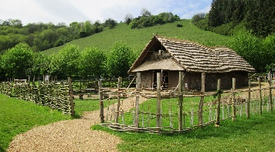
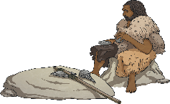
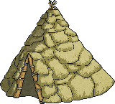
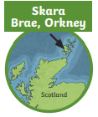
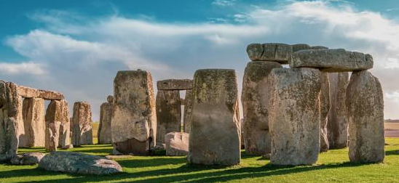
History – Year 3 – Stone Age to Iron Age
Life in the Stone Age:
The Stone Age is named after the stone tools that the earliest humans used to help them survive. They used them to kill animals, such as mammoths, for their meat, bone marrow and skins. The bones were also useful for making tools, such as needles to sew skins together. People in the Stone Age moved around from place to place with the seasons, in order to keep safe and warm and to follow the animals they hunted.
Palaeolithic | Mesolithic | Neolithic
The Palaeolithic period was significantly longer than any period of time in human history. In Britain, it is thought to have started around 800,000 BC. At this time, people were hunter-gatherers and moved on to live in a different place once they had hunted and gathered all the food available. | The Mesolithic period started in Britain from around 8000 BC around the end of the last Ice Age. People were still living as hunter-gatherers but towards the end of this time in the Stone Age, people started to learn about agriculture. The huts and tents constructed by hunter-gatherers had frames made with animal bones or wooden poles and they were covered with thatched reeds, animal skins or turf. | People started to live in permanent settlements having been introduced to agriculture by people migrating from Europe When many people started to learn about farming in the New (Neolithic) Stone Age, they lived in permanent homes in settlements. The houses were usually rectangular and constructed from timber in the Neolithic period. However, to build their homes, people used whatever natural materials they had available and often, the walls were made with wattle and daub. This is a building method where woven branches are covered with a mixture of mud and manure.
The Bronze Age:
During the Bronze Age, people developed the technology to make bronze. This was used to make bronze tools, containers and jewellery. There was a lot of migration to Britain during this period. Some of the people who arrived in Britain were from Central Europe and were called the ‘Beaker People’. It is likely, but not certain, that the Beaker People brought their knowledge of making bronze to Britain and that is how the Bronze Age in Britain started.
The Iron Age:
During the Iron Age, technology developed further across many aspects of life. People began to make tools and weapons from iron. Again, many of the new ideas came with the migration of people. People who lived at this time are now often called ‘Celts’. Celts were farmers and lived as part of a tribe. Hillforts developed during the Iron Age. Communities lived on hills for protection from when other tribes attacked.
Religion:
Druids were the priests of the tribes we call ‘Celts’. Their job was to communicate with the more than 400 gods that the people of the tribes believed in. They believed the gods lived in nature. The main festivals were based around important times in the farming year. The Druids sacrificed food, precious objects and even humans to keep the gods happy. Druids were also like doctors and lawyers. They found cures in plants and resolved disagreements. Their opinions were more important than those of the king. It took at least 20 years to train to be a Druid. However, we only know about them from what the Romans wrote down.
A reconstructed New Stone Age home at Butser Ancient Farm.
Skara Brae | Stonehenge
Skara Brae was discovered after a storm in AD 1850 removed the earth that had been covering it. It is a village of eight houses, linked by covered passageways. Not all of the houses were built at the same time. The later ones are slightly bigger but they have very similar features, such as a central firepit and stone shelves. The village tells us a lot about life in the late Stone Age, including what people ate and what sort of tools they used. | Stonehenge is a famous prehistoric monument in southern England, built at the end of the Stone Age and into the Bronze Age. Originally, it was just an earthwork and up to 150 people were buried there. The huge stones that we see were added in different stages. Some were brought from 240 miles away in Wales.

