Slide 1

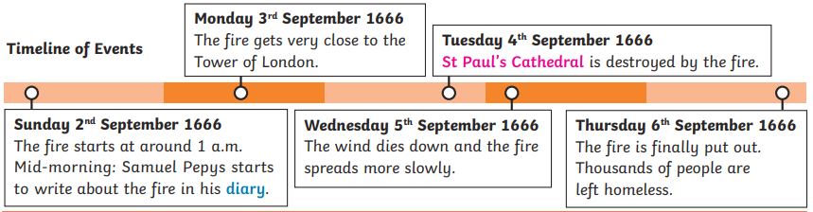
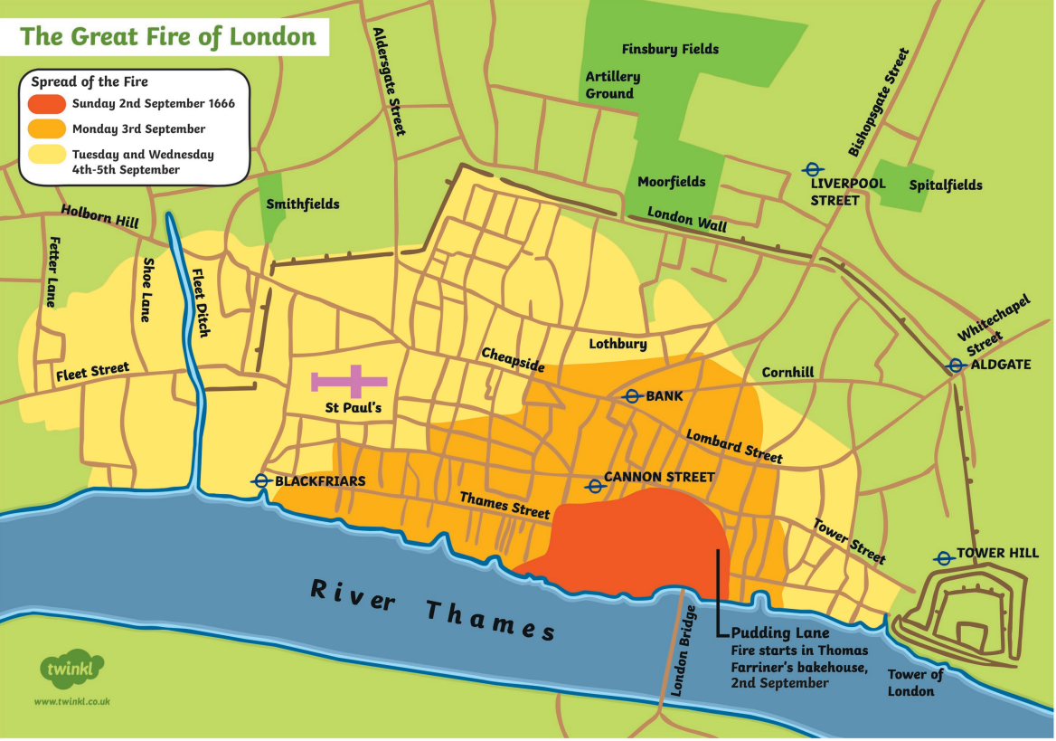
History – Year 2 – The Great Fire of London
Timeline:
The Great Fire of London started on Sunday 2nd September 1666 and ended on Thursday 6th September 1666.
Key Vocabulary
17th century | noun. From the year 1601 to 1700.
ash | noun. The soft grey powder that is left after something has been burned.
diary | noun. A daily record of a person's experiences and thoughts.
eyewitness | noun. An eyewitness is a person who has seen something happen in real life and so can describe it.
flames | noun. A part of a fire that rises up into the air when something burns.
flammable | Adj. Capable of being easily set on fire and of burning rapidly.
leather bucket | noun. Leather buckets were traditionally used as fire extinguishers back in the 17th century and earlier.
monument | noun. A monument is a statue, building, or something else made to remember a person or important event.
rebuild | verb. to build again or repair.
River Thames | noun. A river that flows through southern England including London.
St Pauls Cathedral | noun. A church that was rebuilt by Christopher Wren after the great Fire of 1666.
thatched roof | noun. A house roof made with a plant material, such as straw.
The Tower of London | noun. A historic castle on the north bank of the River Thames.
wooden beams | noun. beams are large pieces of wood that are able to bear heavy loads.
How the fire spread:
The Great Fire of London started on Sunday 2nd September 1666 in a baker’s shop on Pudding Lane. The baker was called Thomas Farriner.

Slide 2
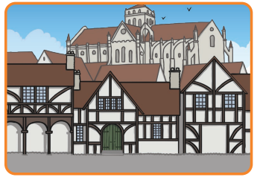
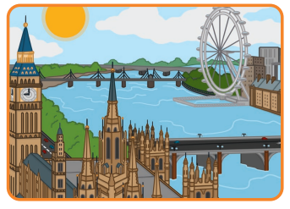
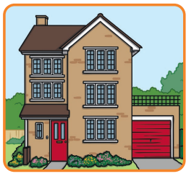
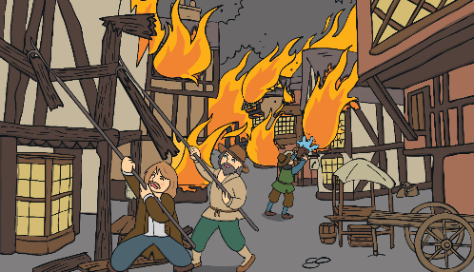
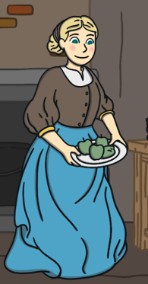
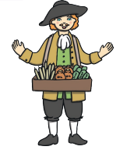
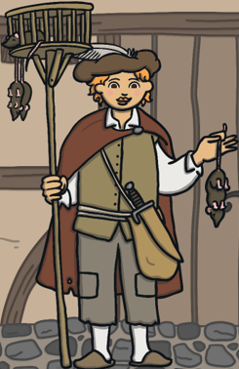

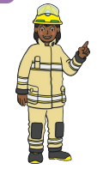

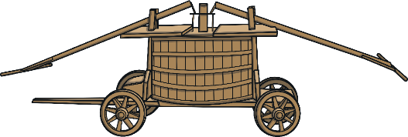
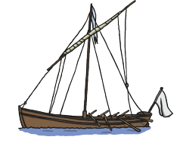
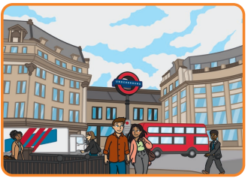
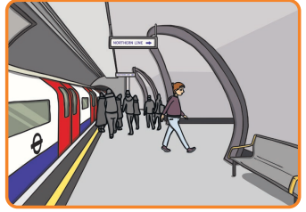
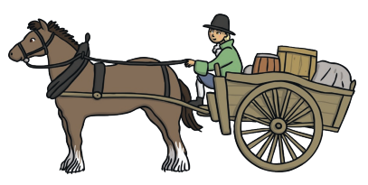
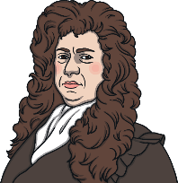

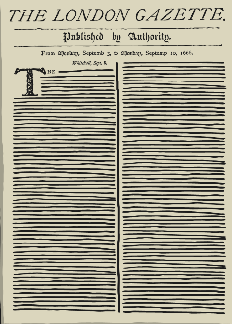
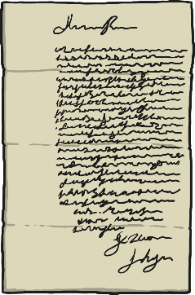
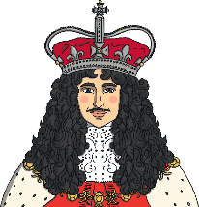
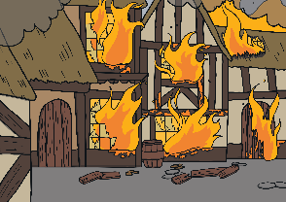
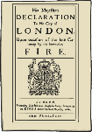
History – Year 2 – The Great Fire of London
How did they fight the fire?
London had no fire brigade. Fire posts were set up and people all joined in trying to stop the fire. Buildings were pulled down and water was thrown using leather buckets and water squirts. This water had to be carried from wells or from the river because there were no taps in houses. Fire engines in London in 1666 were made out of wood. They had to be filled up with buckets of water from the river. They needed four people to make them work and it has hard, tiring work.
Comparing life from 1666 and modern life
 | 1666 | Today
Houses and buildings
People and jobs | cook chandler (made rat catcher and sold candles) | postal worker fire fighter police office
Transport
Life before and after the fire
Before Many houses were made from wood with straw roofs. Streets were very narrow and not straight. This meant that they could become very crowded. Houses were very close together. Many tall buildings also had upper floors that ‘jutted’ out into the street. This meant the fire could spread really quickly. | After In some areas after the fire, the ground was so hot that it took a few days before people could walk there again. At least 65,000 people were left homeless. Many lived in tents in fields outside of London. Around a third of the city needed to be rebuilt King Charles ll ordered that buildings were built further apart and made of stone to make sure the fire could not happen again so easily.
Samuel Pepys
A man called Samuel Pepys kept a diary about his life in London in 1666. When the fire took place, he wrote about what was happening and what he saw. Because Samuel Pepys really saw the fire happening, his diary is an important source of information about this event in history.
Historical sources
They give us information about things that happened in the past. Some are more useful than others. London Gazette newspaper report from 3rd September 1666 An eyewitness statement about the fire, signed by John Morgan in 1668

