Slide 1

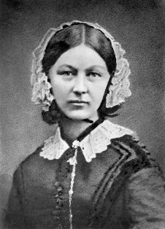
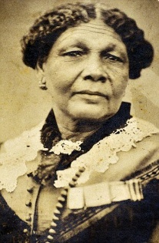
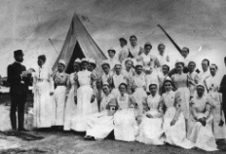
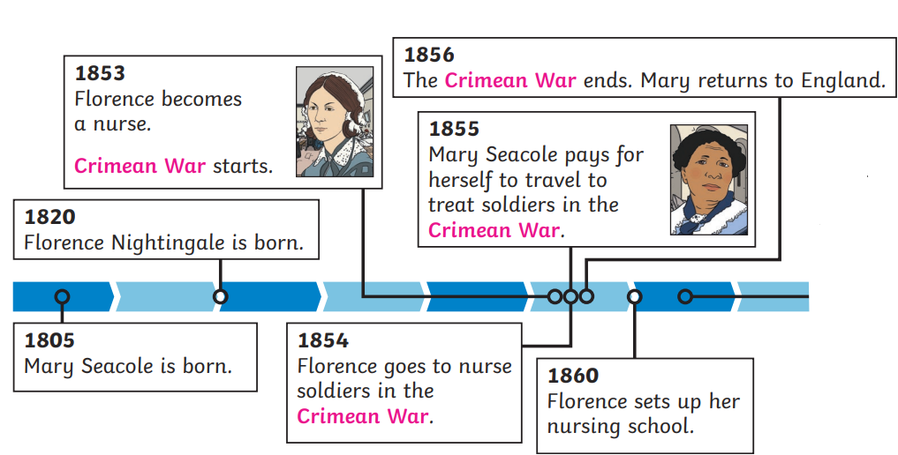




Year 2 – History - Significant people in the past
Nurturing Nurses:
Florence Nightingale was a nurse who saved many lives during the Crimean War. She worked to make hospitals safer and cleaner. Florence would check on her patients at night. She carried a lamp and so became known as ‘the lady with the lamp’ | Mary Seacole was a British-Jamaican businesswoman and nurse who is well known for her work in the Crimean War. Mary was called Mother Seacole by many of the soldiers.
The Crimean War: A war between Russia on one side and Britain, France, the Ottoman Empire (now Türkiye) and Sardinia on the other. This started in 1853 and ended in 1856. Lots of nurses helped out in the war.
Key Vocabulary
achievement | noun. something important or difficult that someone has done or finished successfully.
contribution | noun. something that someone gives or does to help make something better.
Florence Nightingale | noun. a nurse from Britain who helped make hospitals cleaner and safer during a big war.
healers | noun. people who help others get better from illness or injury, often using medicine or special care.
hygiene | noun. keeping things clean to stay healthy and stop the spread of germs.
Mary Seacole | noun. a nurse from Jamaica who looked after sick soldiers during the Crimean War and helped people despite facing challenges.
medicine | noun. a substance or treatment that helps people feel better when they are sick.
nursing | noun. the job of looking after sick or injured people and helping them get better.
pioneer | noun. someone who does something first and leads the way for others.
revolutionised | verb. to completely change something to make it much better.
significant | adjective. very important or special.
soldiers | noun. people who serve in an army and fight in wars to protect their country.
war | noun. a time when countries or groups fight each other using soldiers and weapons.
Timeline: |  | Talking about time passing
 |  | after after that before eventually first finally in the beginning in the end at that moment just then later meanwhile next second several months later suddenly while
Primary sources are information and objects that come from the time being studied. | Secondary sources of historical information are people’s views of information and objects which are made after the time being studied.

Slide 2
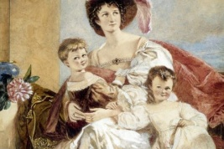
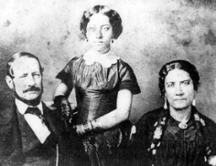
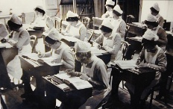
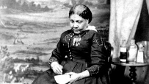
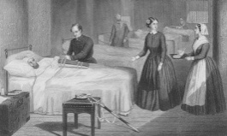
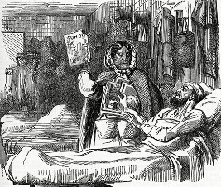
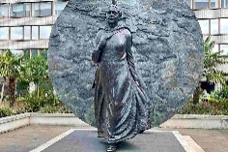
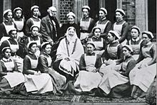
Year 2 – History - Significant people in the past
Florence Nightingale (1820-1910)
Early Life | Florence was born in 1820 in Florence, Italy. Her parents were British but were travelling in Italy at the time. Florence was named after the Italian city she was born in. She had an older sister. Florence grew up in England and was home schooled by her father. She studied subjects including German, French, Italian and maths.
Training to be a nurse | Florence’s parents wanted her to get married and have a family. This was what was usually expected of wealthy women at the time. Florence wanted to be a nurse instead and believed it was a calling from God. Her parents disagreed at first. Florence studied nursing in Germany in 1851. She returned home in 1853 and was a nurse at a women’s hospital. She later became a superintendent.
The Crimean War | Florence was asked to travel to the Crimean War to manage nurses who would treat wounded soldiers. They arrived at the hospital in 1854. Many soldiers were ill with infection. The sewer underneath the hospital wasn’t working properly and this was causing illness. Florence helped arrange for it to be fixed, as well as focusing on cleaning, hand washing, better food and more comfort. The number of soldiers dying went down a lot.
After the Crimean War | Florence returned to England with many ideas for improving hospitals. She met with Queen Victoria to talk about what she had found out. Florence published a book called ‘Notes on Nursing’ to help teach others about what she had learnt. She set up the Nightingale Training School for Nurses at St Thomas’ Hospital in London. Florence was unwell and could not leave her home often but she kept working for change. She died on 13th August 1910.
Mary Seacole (1805-1881)
Early Life | Mary Jane Grant was born in 1805 in Kingston, Jamaica. Her mother was Jamaican and her father was Scottish. She learnt about traditional Jamaican medicine from her mother. At this time, many Black people in the Caribbean were sold into enslavement. Even though Mary was born free, she experienced racism and wasn’t given the same rights as White people. She became Mary Seacole when she married Edwin Seacole in 1836. Edwin was very ill and she spent the next few years nursing him. He died in 1844.
Training to be a nurse | Mary became a skilled nurse while helping her mother (who was a healer) treat sick and injured soldiers at their boarding house. She spent time travelling and learning more about medicine. A disease called cholera spread across Kingston in Jamaica. Mary helped care for people who were sick.
The Crimean War | Mary travelled to London to ask if she could go to the war to work as a nurse but was not allowed. Mary decided to pay for herself to go to Crimea. In 1855, she set up a hotel (called the British Hotel) to care for wounded and sick soldier in. She bravely took medicine and bandages out to wounded soldiers on the battlefield. Many nurses helped in Crimea but Mary was known for her incredible bravery; she would often ride a horse through the battlefields to bring food and medicine to the injured and sick.
After the Crimean War | When the war was over, Mary travelled back to London; she was very sick and had little money. Many soldiers wrote to newspapers about her efforts and a charity gala was held in 1857 to raise money for her and around 80,000 people attended. She also had a book about her travels published, called ‘The Wonderful Adventures of Mrs Seacole in Many Lands.’ She died on 14th May 1881 in Paddington, London. In 2016, a statue built in her honour was unveiled at St Thomas’ Hospital in London. It is the first statue in Britain dedicated to a named Black woman

