Slide 1

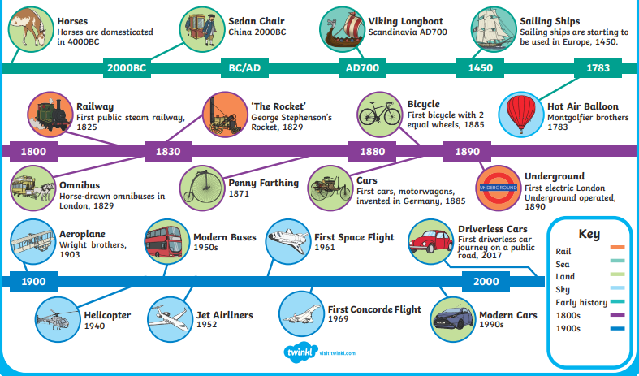
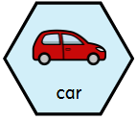
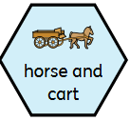
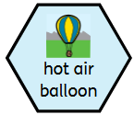
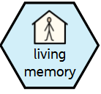
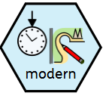

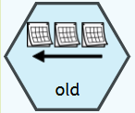
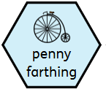
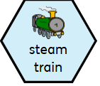
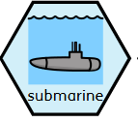
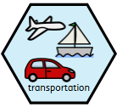
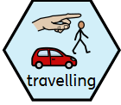
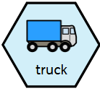
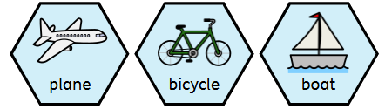
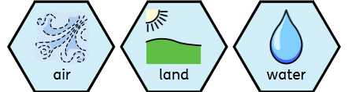
Year 1 – History – Travel and Transport
Timeline:
Key Vocabulary
noun. a vehicle that people drive to travel on roads. | noun. A two-wheeled horse-drawn vehicle is a cart. | noun. a large balloon that flies in the sky using hot air, carrying people in a basket.
phrase. events or things that happened in the past, but people are still alive today to remember them. | adjective. something that is new or from the present time. | adjective. something that has been made or created recently
noun. the way people or things move from one place to another, like cars, trains, and buses. | gerund. To go from from one place to another. | noun. a large vehicle used to carry heavy things.
adjective. something from a long time ago | noun. an old type of bicycle with one big wheel at the front and a small one at the back. | noun. a train that runs on steam power, using coal to move along tracks. | noun. a special boat that can travel underwater.
What type of transport might you use to travel by air, land or water?

Slide 2
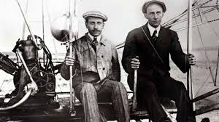
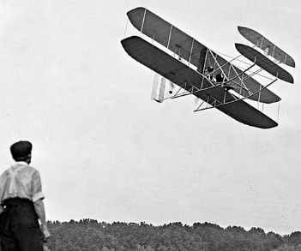
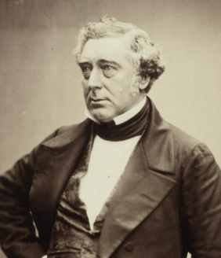
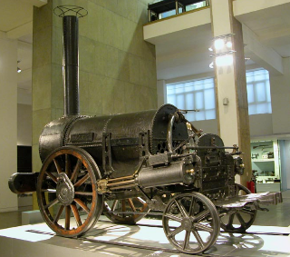


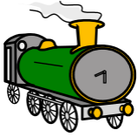
Year 1 – History – Travel and Transport
The Wright brothers
Who were the Wright brothers? | Wilbur and Orville Wright were brothers who grew up in the United States. They are famous for inventing and testing the first aeroplane.
How did they become inventors? | Wilbur and Orville became interested in flying because of a toy helicopter their father gave them as children. They were interested in birds and how they flew. This gave them the idea for the wings of their aeroplane. The Wright brothers also discovered how to make engines. This gave their aeroplane the power it needed to fly.
When was the first airplane flight? | The first test flight was in December 1903 and the plane was called the Wright Flyer. Wilbur tried to fly the plane but it did not work. They spent three days trying to fix it and waited for good weather to try again. Orville flew the plane the second time. This time it worked and the plane flew for 12 seconds.
What happened after the first flight? | The Flyer II was a new aircraft that the brothers invented. Wilbur flew this in November 1904 and the flight lasted for over five minutes. They invented a plane which could fly for 39 minutes by 1905. The brothers went on to build planes for the army. They also opened up a school to teach pilots to fly.
Where is the Wright Flyer now? | The Wright Flyer can be seen in the Smithsonian National Air and Space Museum
George Stephenson
What was his early life like? | George was born in 1781 in Northumberland, England. He didn’t go to school and he worked in a coal mine from young age.
What work did he do? | George learned how to read and write when he became an adult. He earner money by: Fixing clocks Mending shoes Being a railway mechanic
How did he contribute to railways? | In 1820, George started building the first railway that would not be powered by animals. At 8 miles (13km) in length, the Hetton colliery railway was opened in 1822.
What engines did he build? | Blucher | Date: 1814 | Speed: 4 mph
 | Locomotion No1 | Date:1825 | Speed: 15 mph
 | Rocket | Date: 1829 | Speed: 30 mph
What was the story of the rocket? | After the first public railway for passengers opened in 1825, a competition was held in 1829 to find the best way to pull trains over long distances. George and his son Robert entered the competition with their steam locomotive, Rocket. Rocket reached an impressive top speed of 30 mph and won. The clever design of Rocket was an important step forward in rail travel. He is known as the ‘Father of Railways’
Where is the Rocket now? | The Rocket can be seen at the Locomotion Museum in Shildon, County Durham.
To know who the Wright brothers were and how they contributed to national and global achievement.
To know who George Stephenson was and his achievements.
To recognise the impact of transport to people’s lives and how people use transport in different ways.
To compare types of transportation, identifying similarities and differences.
To explore developments of transport over time.
To use a range of historical sources to make comparisons between transport past and present (photos/artefacts)
To use a timeline to represent events in order.
To build chronological skills and understanding by sequencing a few events, pictures and objects.

