Slide 1

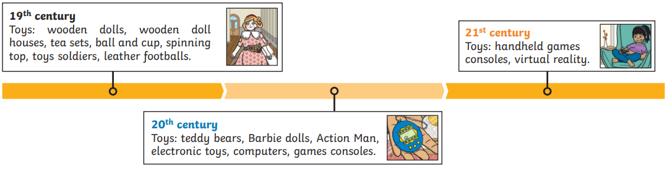

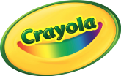
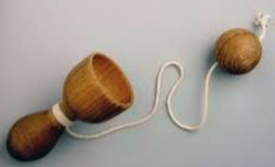
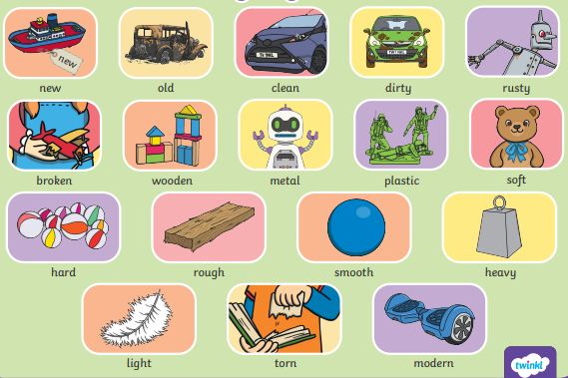
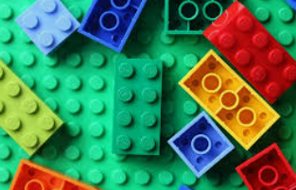
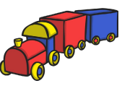
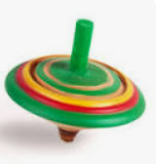
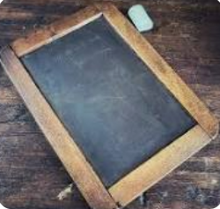
History – Year 1 – Toys in the past
How long have toys existed?
Toys have existed for thousands of years. They were made out of the materials that were available at the time. Even stones and string have been made into toys.
Key Vocabulary
19th, 20th and 21st century | The 19th century was 1800-1899. The 20th century was 1900-1999. We are now in the 21st century which started in the year 2000.
Abacus | noun. A simple device for calculating, consisting of a frame with rows of wires or grooves along which beads are slid.
acrobat | noun. An entertainer who performs spectacular gymnastic feats.
crayola | noun. Binney and Smith made a set of 8 wax crayons in 1903. Binney’s wife named them Crayola.
cup and ball | noun. A toy where you catch the ball in a cup.
entertainment | noun. the action of providing or being provided with amusement or enjoyment.
Lego | noun. Ole Kirk Christiansen called his toy company ‘Lego’ in 1939. The plastic blocks were made in 1949.
new/ modern | adjective. Things made now or recently.
old | adjective. From a former time (in the past).
Spinning top | noun. A game in which each player spins a spinning top with a string, to knock down skittles and earn points.
slate and chalk | nouns. Slate and chalk were used to write and draw on slate boards.
Victorian | noun. The time of Queen Victoria’s reign. 1837-1901.
Timeline of toys
What were toys made of during the Victorian age? | What are modern toys made of?
Toys were mainly made of wood, paper and metal during the Victorian age. | Modern toys are mainly made of plastic. This is because it is usually safer and easier to make things with.
Describing toys word mat
Rich versus poor families during Victorian times
Children from rich families played with train sets, tea sets, dolls and toy soldiers. Children from poor families played with homemade toys such as ragdolls and wooden boats.
How are modern toys different?
Many modern toys use electricity to work. Computers and consoles were invented in the 20th century.

