Slide 1

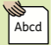
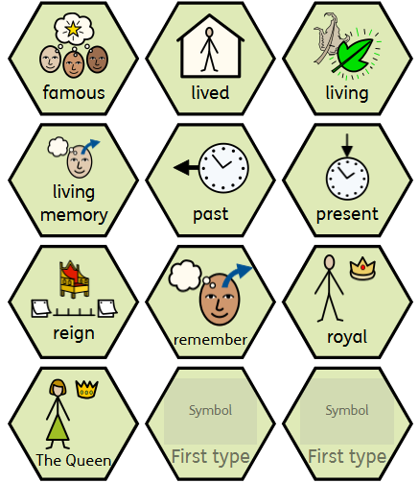
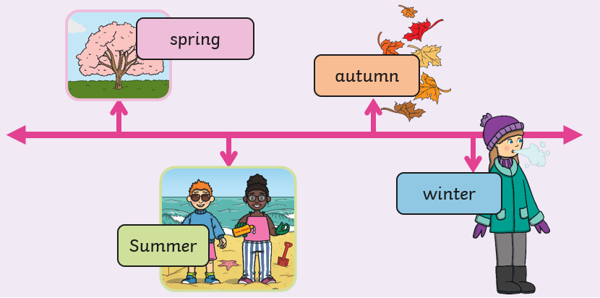
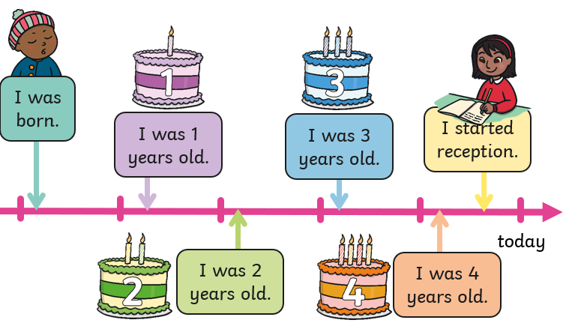
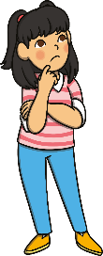
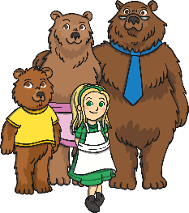
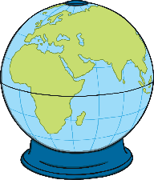

History – Reception - Compare and contrast characters from the past
Timelines
Timelines help us to remember the order that events happen in. They also help us to see how long ago things happen.
Key vocabulary
famous adjective. someone or something that many people know about. | lived verb. to have been alive in the past.
living verb. being alive right now. | living memory noun. things that people can remember from their own life.
past noun. the time that has already happened. | present noun. the time that is happening right now.
reign noun. the time when a king or queen is in charge of a country. | remember verb. to think about something that happened before.
royal adjective. something that is about a king or queen. | The Queen noun. the woman who is/ was the ruler of a country, like Queen Elizabeth II.
Fiction versus non-fiction: what is the difference?
Fiction Books contain made up stories. | Non-Fiction Books contain true facts and information.
Fiction books are filled with made up stories, created from the imagination of the author. They are not real and sometimes they even include talking animals! There are many different kinds of fiction books and texts. These are just some of the different examples: Fairy tales and nursery rhymes Picture story books Chapter books Novels | Non-fiction books are based in fact, they give the reader information and help us to learn more about different things. There are so many different kinds of non-fiction books and texts. These are just some of the different examples: Dictionary Biographies and autobiographies General knowledge books Animal books Nature books History books Science books Travel books Art books
We can learn important things from stories, such as how to be kind, how to be brave and how to make difficult choices.

