Slide 1

History – Year 6 – WWII – Glossary
Key Vocabulary
air raid | noun. a an attack by aircraft, often involving the dropping of bombs on a target area.
army | noun. a large group of soldiers who are trained to fight on land as part of a country's military forces.
blackout | noun. a period when lights were turned off or hidden to prevent enemy aircraft from spotting targets during the night, especially during WWII.
evacuees | noun. people, especially children, who were sent away from danger areas to safer locations during WWII, often as part of the evacuation plans.
gas mask | noun. a mask worn to protect the wearer from inhaling dangerous gases, such as those used in chemical warfare.
Germany | noun. a country in Europe, which was led by Adolf Hitler during WWII and played a central role in the conflict.
Hitler | noun. Adolf Hitler, the leader of Nazi Germany during WWII, known for his role in starting the war and for his responsibility in the Holocaust.
Holocaust | noun. the systematic, state-sponsored persecution and murder of six million Jews and millions of others by the Nazi regime during WWII.
Nazi | noun. a member of the National Socialist German Workers' Party, led by Adolf Hitler, responsible for starting WWII and committing atrocities, including the Holocaust.
propaganda | noun. information, especially biased or misleading, used to promote a particular political cause or point of view, often used during WWII to influence public opinion.
Key Vocabulary
propaganda posters | noun. posters designed to spread specific messages to promote or discourage certain behaviours or ideas, often used during WWII to encourage war effort participation and national unity.
rations | noun. the fixed amount of food or supplies allowed to people, particularly during wartime when resources were limited.
rationing | noun. the controlled distribution of scarce resources, goods, or services, used during WWII to ensure that everyone had access to limited supplies.
ration books | noun. books given to people during WWII to record their entitlement to food and other rations.
restrictions | noun. rules or limitations placed on certain activities or supplies, such as food, clothing, or travel, during wartime.
siren | noun. a loud warning device used to alert people of danger, such as air raids or bombings, during WWII.
shelters | noun. structures built to protect people from bombs and air raids, often in backyards or underground, during WWII.
suitcase | noun. a portable container used for carrying clothes and personal items, commonly used by evacuees during WWII when they were sent to safer locations.
spitfire | noun. a type of British fighter plane used during WWII, known for its speed and agility, playing a crucial role in the Battle of Britain.
victory | noun. the successful outcome of a battle, war, or contest, often used to describe the final triumph of the Allies over the Axis powers in WWII.
Winston Churchill | noun. the Prime Minister of the United Kingdom during WWII, known for his leadership and inspiring speeches that helped rally the British people during the war.

Slide 2
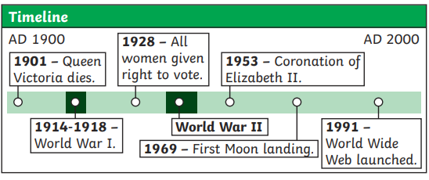
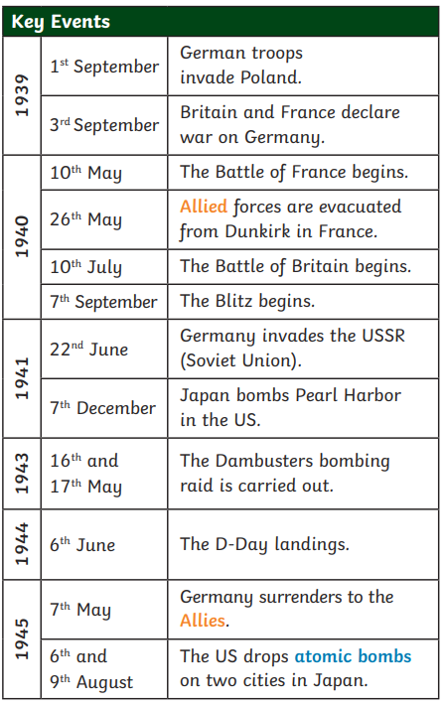
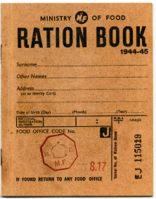
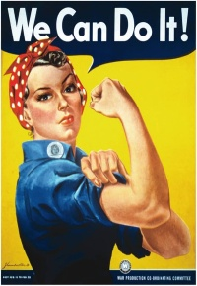
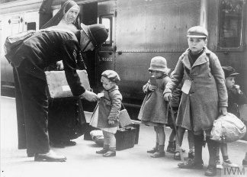
History – Year 6 – WWII
How did the war begin?
The leader of Germany, Adolf Hitler, had plans to take over other countries. In March 1938, Germany invaded and annexed Austria, which made other countries worried. On 30th September 1938, British, French, German and Italian leaders signed a treaty which allowed Hitler to annex the Sudetenland (an area of Czechoslovakia) if he agreed not to invade anywhere else. However, Hitler broke the agreement, first invading the rest of Czechoslovakia and then Poland on 1st September. The Allies (Britain, France and Poland) had made a pact to support each other, so Britain and France declared war on Germany.
Life on the home front
World War II changed everyday life in many ways
Rationing: During WWII, food and goods were rationed due to shortages caused by the war. Each person had a ration book, limiting items like sugar, butter, and meat. For example, a typical weekly meat allowance was just a few ounces. People had to get creative with recipes, and "victory gardens" were encouraged to grow vegetables. Rationing didn’t end with the war—it continued until 1954. The government’s ‘Dig for Victory’ campaign encouraged people to grow their own food. Some people also reared their own animals for meat and eggs. Clothes and other items were mended or made into new things. | Entertainment: With many cinemas closed and radios being the main source of news, people found new ways to entertain themselves. Family games, knitting for soldiers, and community events became popular. Dance halls remained open, providing a way to lift spirits. The BBC aired radio shows like "It's That Man Again" to keep morale high during these tough times. Although national sports events were suspended during the war, there was plenty of entertainment. The radio was very popular and people also went to the cinema or dance halls. Children played outside or with board games, cards or handmade toys.
Male and Female Roles: As men left to fight in the war, women took on jobs traditionally done by men. They worked in factories (known as munitions factories or “munitionettes"), on farms as part of the Women’s Land Army, and even as mechanics or bus drivers. This marked a major shift in gender roles, showing women could do jobs previously reserved for men. Rosie the Riveter in the US became a symbol of this change. | Evacuation: At the start of the war, many children were evacuated from cities like London to the countryside to avoid the bombings. Operation Pied Piper in 1939 relocated over a million children. These children lived with host families and often had very different experiences, from missing home to discovering new ways of life. Over 3.5 million people, mostly children, were evacuated from the cities to the countryside, where it was believed they would be safer from bombing

Slide 3
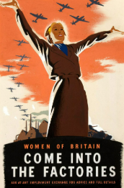
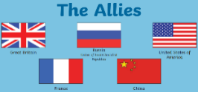
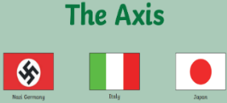
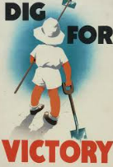
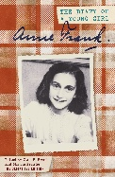
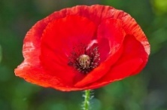
History – Year 6 – WWII
The War Effort and People's Responsibilities:
During the war, everyone had responsibilities to help the war effort. Soldiers fought on the front lines, while people at home worked in factories, farmed, or helped care for those affected by the war. Citizens also took part in civil defence activities, such as fire watching or serving as air raid wardens. Everyone, from the young to the elderly, had to contribute in some way. Propaganda posters were used to encourage people to support with the war effort.
The Outbreak and Global Impact of War:
The outbreak of WWII in 1939 had a massive impact both in the UK and across the globe. Two sides, the Allies and the Axis powers, fought each other all over the world. The main Axis powers were Germany, Italy, and Japan, while the main Allies were Great Britain, France, the Soviet Union, and the United States. In addition, a few nations stayed neutral and didn't fight.
During World War Two, forces from the British Commonwealth of Nations, then still informally called the British Empire, were involved in all the major aspects of war, as well as serving on their own and on the British home fronts. Today, they are a voluntary association of 56 countries that work together and support each other.
Life for Different Social Classes and Groups:
Different social classes and groups experienced WWII in unique ways. Wealthier families could often afford better shelters or move to safer areas, while poorer families struggled more with rationing and the effects of bombings. Women, children, and minority groups all played different roles and had varied experiences during the war. African, Caribbean, and South Asian people contributed to the war effort, though they sometimes faced discrimination.
Historical evidence
To understand life during WWII, historians use a wide range of evidence (making sure they are reliable). This includes letters, government records, video and radio recordings, photographs, newspapers, and personal accounts. By examining these sources, we can draw conclusions and make judgements about what life was like and how people coped with the challenges of the time.
The Holocaust
The Holocaust was a period of time during the Second World War when millions of people were persecuted and killed in Europe. On 27th January each year, the Holocaust is commemorated on Holocaust Memorial Day. The victims of the Holocaust were killed because they were followers of the Jewish faith. The Nazis wanted all Jewish people removed from Europe. It is estimated that around 6 million European Jewish people lost their lives. Alongside the Jewish people, the Nazis also murdered people for other reasons, including people of colour, people with disabilities and people they believed to be criminals. Anyone who disagreed with Hitler and the Nazi Party were also put to death, including teachers and German citizens who spoke out against them. Anne Frank’s diary is a source used by historians to learn more about this time.
Comparing time periods (pre and post war)
Before WWII, Britain was recovering from the effects of the Great Depression. After the war, some things stayed in place, such as rationing; however, for many women, the could not keep the new jobs that they had during the war. Overall, there were many changes, including the creation of the NHS, the welfare state, and the rebuilding of bomb-damaged cities. Comparing life before and after the war helps us understand how society transformed.
Commemorative events
Every year, special celebrations are planned to honour and remember the people whose lives were affected by the war. Large commemorations are usually held for events including the evacuation from Dunkirk, Holocaust Memorial Day, VE Day, D-Day and the Battle of Britain, as well as for Remembrance Day.

