Slide 1

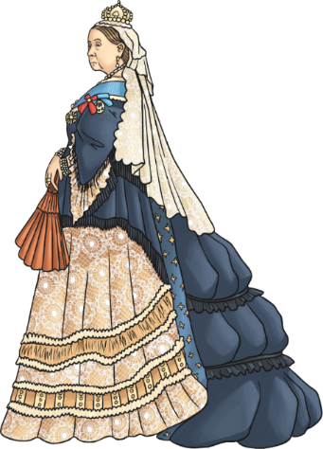
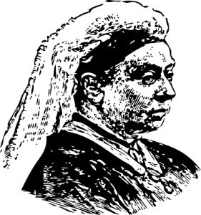
History – Y6 – The Victorians
Key Vocabulary
Camera | noun. a device for recording visual images in the form of photographs, film, or video signals.
Chimney sweep | noun. a person whose job is cleaning out the soot from chimneys.
Industrial Revolution | noun. a time of major change in the way products were made
Industry | noun. A group of companies that all produce the same thing.
Inventions | noun. A new thing that someone has made.
Iron | noun. a strong, hard magnetic silvery-grey metal which is much used as a material for construction and manufacturing, especially in the form of steel.
Migrate | noun. move to a different area to find work or better living conditions
Mining | noun. the process or industry of obtaining coal or other minerals from a mine.
Poverty | noun. the state of being extremely poor.
Social class | noun. a social class is a group of people who are similar in terms of their income, the kind of job they do, and their level of education, among other factors. Social class is mainly about wealth, but it's also connected to status within society.
Steam train | noun. a train pulled by an engine powered by steam
Reign | noun. the authority or rule of a monarch
Rural | noun. the countryside.
typhoid | noun. a bacterial infection that can spread through the body.
workhouse | noun. the workhouse was a place which offered housing and work to people who did not have any.
The Victorian Era
The period of time between 1837 to 1901 when Queen Victoria reigned over Britain. During her 63 year reign, there was a huge contrast between how the rich and poor Victorians lived. Queen Victoria led the expansion of the British empire and saw major changes to all aspects of Britain due to exciting discoveries and inventions.
Key Dates
1838 | Queen Victoria crowned aged 18.
1840 | Queen Victoria married Prince Albert.
1842 | Children under 10 can no longer work in underground mines.
1844 | Children aged 8-13 can no longer work for more than 6.5 hours per day.
1856 | Each county has to have its own police force.
1861 | Prince Albert died of typhoid.
1864 | Children under 10 can no longer work as chimney sweeps.
1870 | Schools are built for children aged 5-10.
1872 | The first FA Cup Final takes place.
1880 | The Education Act makes schooling compulsory for all children aged 5-10.
1901 | Queen Victoria dies and Edward VII becomes King.
Key Victorians
Queen Victoria Queen Victoria was born on 24 May 1819 in Kensington Palace in London, England. Her full name was Alexandrina Victoria. |  | Prince Albert On August 26, 1819, Prince Albert of Saxe-Coburg and Gotha was born near Coburg, Germany. In 1840, when Albert was just 20 years old, he married Queen Victoria. | Dr Barnardo Dr Bernado was a 19th century philanthropist who helped over 60,000 children to find home and education. He founded numerous homes for poor, orphan or sick children.

Slide 2
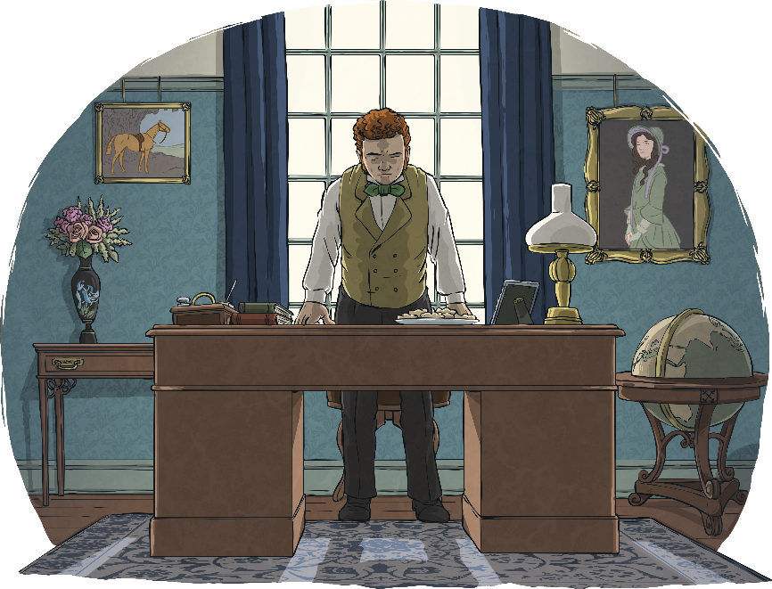
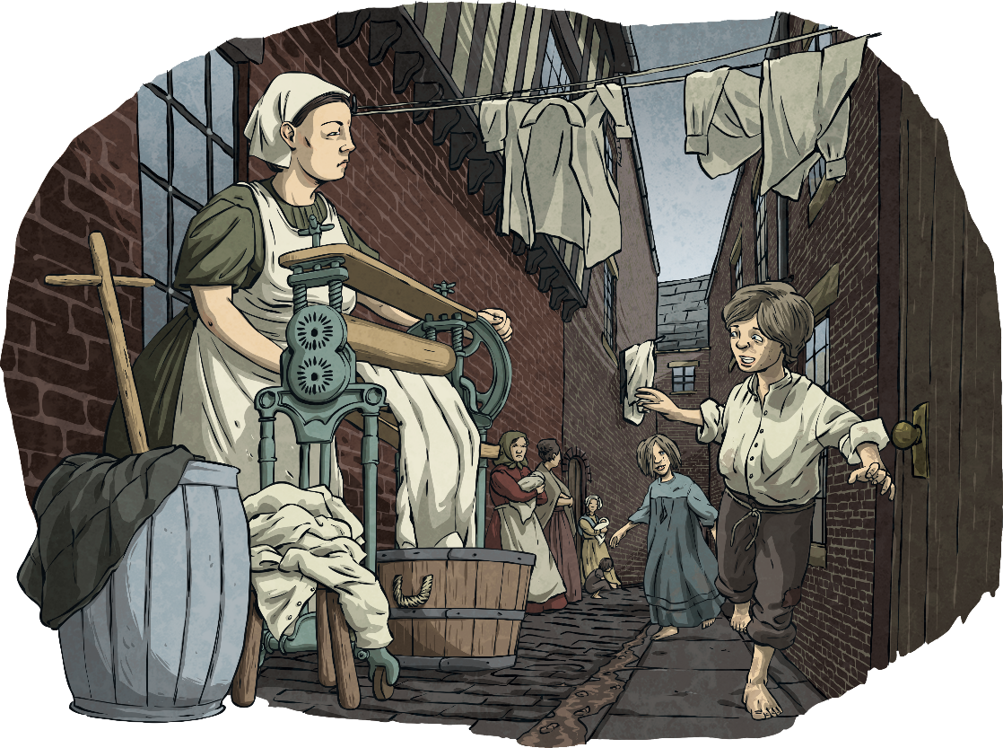
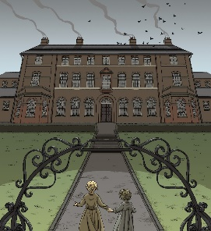



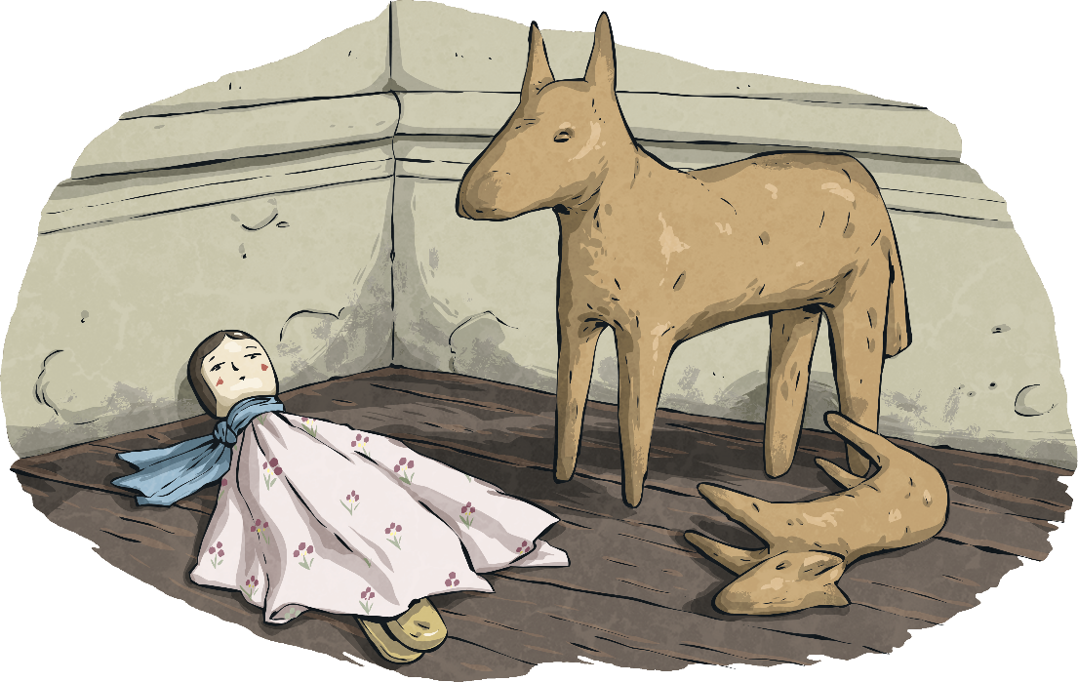
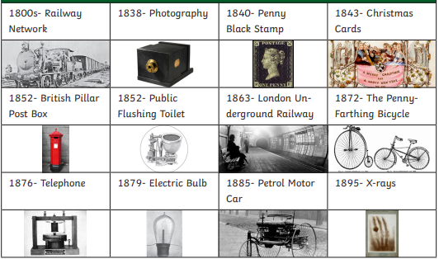
History – Y6 – The Victorians
What was life like during the Victorian period (social classes)?
 | Wealthier families | Poorer families
Homes | Victorian homes were filled with beautiful furniture and ornate decoration. They might have large grounds or a garden. They had flushing toilets, inside bathrooms and running water. They could even have gas lighting! Wealthy families might have had servants or staff to cook and clean for them. Servant quarters might be in the attic or top floor with much less luxury. | Poorer families lived in much smaller houses (rows of back-to-back terraced houses). Inside, the conditions would have been basic. They didn’t have gardens (some had small yards). In the yards, there would have been a shared outdoor toilet. Some houses had more than one family. Streets were dirty and contained sewage because there were no underground sewers.
Clothes | Wealthy Victorian women would have worn long dresses or skirts with hoops and petticoats, while the men would have worn suits, waistcoats and bowler hats. | Poor families did not have the luxury of new clothes and would often wear practical, hard-wearing items that would last for a long time. Some children in the slums might not have been able to afford shoes.
Toys | Children from wealthy families would have toys such as rocking horses, dolls’ houses or train sets. | Children from poorer families would often make their own toys, such as peg dolls.
Life in the workhouses
Huge buildings built for very poor people to live and work. Whole families would move in together but men, women and children were all kept separate. Jobs for men included working the field, breaking stones and chopping wood. Jobs for women included laundry, sewing and scrubbing the floors. Food was very basic including bread, porridge (gruel), watered down milk and occasionally meat and potatoes. Children had to have 3 hours of reading, writing, arithmetic and Christian religion lessons. Girls’ education was learning to sew, knit and how to be a servant. In 1930, workhouses were closed for good. Some of the buildings were used as part of the National Health Service.
Life in schools
In the early Victorian period, only rich boys went to school. Poorer boys would be expected to begin working to support the family from a very early age. Girls were not educated but learned to look after the home or serve richer families. Both the teachers and children wrote with chalk or slate pencils onto a blackboard or slate. School punishments were very harsh and could include being struck with a cane or made to stand wearing a ‘dunce’ hat. Learning was done by chanting or copying out facts many times until they had been remembered. The most important lessons were the three Rs: reading, writing and arithmetic. Lessons such as music, art or PE were not taught like they are today. Drill was physical exercise performed in the classroom or outside and involved activities such as marching.
Key Inventions
The Industrial revolution
•A period of huge change in Britain between 1750 and 1900. • Before the Industrial Revolution, Britain was a rural country where most people lived off the land with livestock. • People began to realise that coal and steam could be used to power factories, large machines, flour and cotton mills. This reduced the time it took to make something and increased the amount that could be made and so the Industrial Revolution began. • Huge factories were built and towns expanded. • People would migrate to the towns attracted by reliable work and pay from the factories. • Houses for workers were built closer to the factories. • Better transport links helped boost trade by transporting people and goods quickly and cheaply all across the country.

