Slide 1

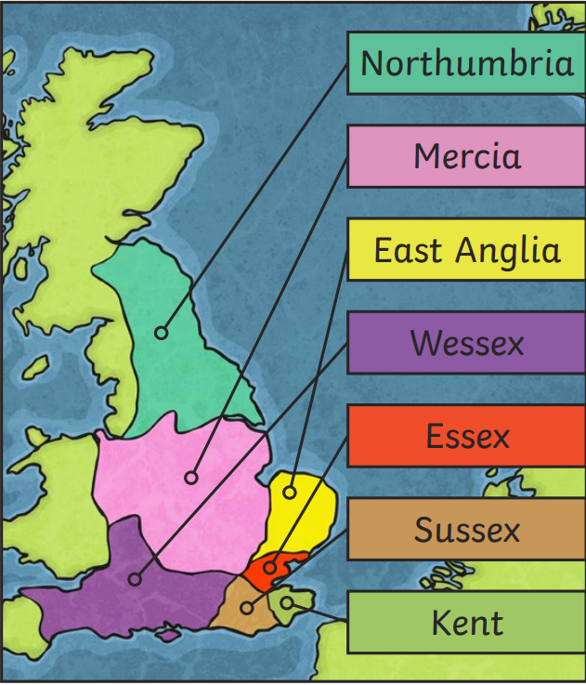
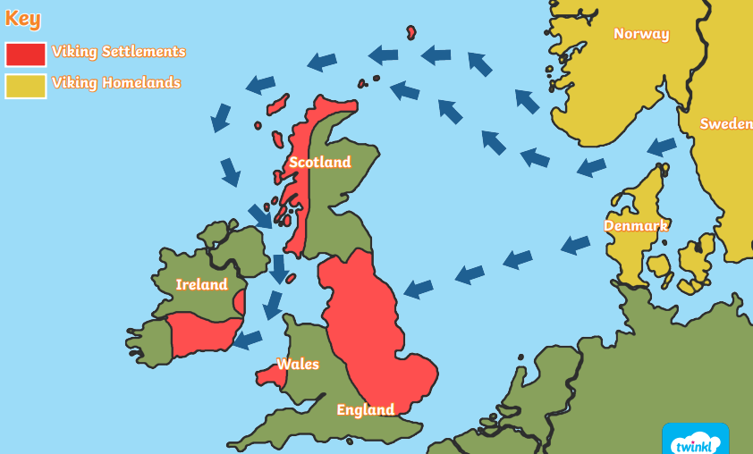
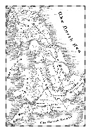
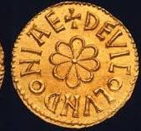
History – Year 5 – The Anglo-Saxons and the Vikings
The Viking Invasion
The fall of the Roman Empire in 410 CE left England in an unprotected state which led to the Angles, Saxons and Jutes invading from Germany, Denmark and the Netherlands. When they settled in England, they became known as Anglo-Saxons. From the 5th century up until 927 CE, England was not a united country like today and instead it was separated into many kingdoms. Historians refer to the seven largest kingdoms as the 'heptarchy'. Each kingdom had its own king and they would often fight between each other and sometimes the people who lived in the kingdom would rebel against the king’s power. So, being in complete control of an Anglo-Saxon kingdom required power, influence, and lots of money
The Vikings came from the countries of Norway, Sweden and Denmark. The Vikings first came to Britain in AD 787 and raided religious buildings called monasteries for their treasures, such as jewels, gold and books. In 793 CE, a small island (known as Holy Island) o the coast of Northumbria was home to Lindisfarne priory – a Christian settlement of monks. The priory held many great treasures like gold goblets, silver crosses and jewel-encrusted bibles. It became the target of a Viking raid (possibly originating from Norway) because it was not protected by soldiers, as only monks and villagers lived there. In AD 865, the Vikings came to Britain again, this time not just to raid it but also to conquer the land.
The Vikings’ overwhelming strength and power controlled most of Britain by the end of the 9th century, even though kings like Alfred the Great tried to defeat them. The land they controlled has been named the Danelaw because the rules of these lands came from the Danish (Danes) and Norse overlords who had settled from Scandinavia. Living as an Anglo-Saxon under the Danelaw was very difficult because the lives of Anglo-Saxons were considered less than that of the Dane/Norse people. This all changed after King Alfred the Great made a treaty with invaders saying that the lives of both the Anglo-Saxon and Scandinavians will be treated as equal. It also clearly marked out the territories of Wessex and the Danelaw.
Key Vocabulary
Angles | noun: A Germanic people who migrated to England in the early Middle Ages, forming part of the Anglo-Saxons.
archaeological | adjective: Relating to archaeology, the study of human history through the excavation of sites and the analysis of artefacts.
armoury | noun. a place where weapons and military equipment are stored.
Bretwalda | noun. an Old English term referring to a king who had overlordship over multiple kingdoms in Anglo-Saxon England.
Britons | noun. the native Celtic inhabitants of Britain before and during the Roman period and early medieval times.
blood-fued | noun. a long-standing conflict or vendetta between families or groups, often involving acts of revenge.
Danelaw | noun. the region of England under the control of Danish laws and governance during the Viking Age.
Kingdom | noun. a country or territory ruled by a king or queen.
King Alfred | noun. Alfred the Great, the King of Wessex from 871 to 899, known for defending England against Viking invasions.
long boats | noun. narrow, long ships used by Vikings, especially for raiding and warfare.
Jutes | noun. a Germanic tribe who, along with the Angles and Saxons, invaded and settled in parts of England in the 5th century.
raids | noun. sudden attacks or incursions into enemy territory, often for the purpose of stealing or causing damage.
Picts | noun. an ancient people who lived in what is now Scotland during the early medieval period.
settlements | noun. communities established in a new area where people live and build homes.
Laws and punishments
The Anglo-Saxon laws were very similar to some we have today, although the punishments were very different. These were often very brutal and would be carried in public to act as deterrents, to discourage others from committing such crimes. Stoning, whipping and exile were common punishments, as well as paying a fine (wergild), or receiving reparations in the form of hot or cold water ordeals. Each local community had a moot (meeting) where disputes were settled, often with the help of local leaders or elders. | In Viking-controlled areas (Danelaw), Viking laws were based on community assemblies called things, where people could present disputes, and a group of free men made decisions. This system was different from the Anglo-Saxon approach and placed emphasis on community justice and settlements rather than compensation. Viking laws were not written down but passed on by word of mouth. Punishments could include fines, being semi-outlawed, fighting to the death, or revenge on someone who has killed a family member.
Religion
Pre-Christian: Early Anglo-Saxons were pagans, worshipping gods like Woden (Odin), Thunor (Thor), and Frigg (Freya). They believed in an afterlife and had burial customs that included grave goods to be used in the next life. Christianisation of the Anglo-Saxons: By the 7th century, Christianity had spread across much of Anglo-Saxon England, largely thanks to missionaries like St. Augustine. Monasteries were built, and the Church became a powerful force in society, influencing laws, education, and culture. | Viking Religion (Pre-Christian): The Vikings were also pagans, believing in gods like Odin, Thor, and Freya. They had rituals and ceremonies to honour their gods, and they believed that warriors who died in battle would go to Valhalla, a great hall in the afterlife. However, by the end of the Viking era, many Vikings, particularly in Danelaw, had converted to Christianity, especially as it became important in trade and diplomacy.

Slide 2

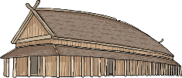
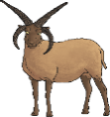
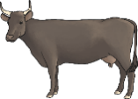
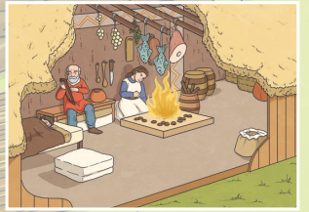

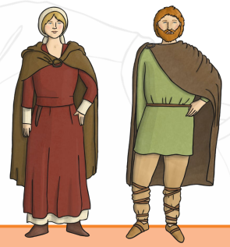
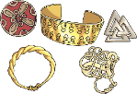
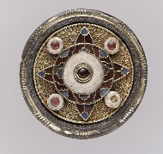
History – Year 5 – The Anglo-Saxons and the Vikings
Key kings and what they did:
1. King Aethelberht of Kent (560–616): One of the first Anglo-Saxon kings to convert to Christianity, influenced by St. Augustine’s mission in 597 AD. Aethelberht’s conversion helped spread Christianity in southern England.
2. King Offa of Mercia (757–796): Offa was one of the most powerful Anglo-Saxon kings. He is famous for constructing Offa’s Dyke, a large earthwork separating Mercia from Welsh lands. He also established trade connections with Europe and issued coins, helping develop a stable currency system.
3. King Alfred the Great (871–899): Alfred is best known for defending England against Viking invasions. He won a crucial victory at the Battle of Edington in 878, leading to the peace treaty with the Vikings and the creation of the Danelaw. Alfred promoted education, law, and translated important texts into Old English.
4. King Edward the Elder (899–924): Son of Alfred the Great, Edward continued his father’s work of unifying England. He recaptured lands from the Vikings and expanded the power of Wessex, laying the foundation for a united England.
5. King Athelstan (924–939): Athelstan was the first king to rule over a united England. He is known for defeating an alliance of Vikings, Scots, and Welsh at the Battle of Brunanburh in 937, securing England’s borders and consolidating his rule.
6. King Edgar the Peaceful (959–975): Edgar’s reign was marked by peace and stability. He worked to strengthen the authority of the monarchy, maintain control over the Church, and unify the different regions of England. Edgar also promoted the use of a single coinage system across the country.
7. King Æthelred the Unready (978–1016): Æthelred struggled with continuous Viking invasions, leading to his nickname “Unready” (which means poorly advised). He paid large sums of Danegeld (a tax to pay off the Vikings), but this only delayed further attacks. His reign ended in Viking control of England.
8. King Sweyn Forkbeard (1013–1014): A Viking king of Denmark, Sweyn invaded England and successfully claimed the English throne in 1013. He ruled for a short period before his death in 1014.
9. King Cnut the Great (1016–1035): Cnut, son of Sweyn Forkbeard, became king after Æthelred’s death. He united England, Denmark, and Norway under his rule, creating a North Sea Empire. Cnut is remembered as a wise ruler who brought stability to England after years of Viking invasions.
10. King Edward the Confessor (1042–1066): Edward was the last Anglo-Saxon king before the Norman Conquest. His reign was relatively peaceful, but his lack of an heir led to a succession crisis. His death in 1066 set the stage for the Battle of Hastings and the end of Anglo-Saxon rule.
11. King Harold Godwinson (1066): The rule of the Anglo-Saxons and Vikings in England came to an end in 1066 with the Battle of Hastings. King Harold II, the last Anglo-Saxon king of England, was defeated by William, Duke of Normandy (later known as William the Conqueror). This battle marked the start of Norman rule in England. The Normans introduced many changes to English life, including building castles and changing the way the land was divided.
Everyday Life
Houses | Anglo-Saxon houses were made from wood with thatched roofs. They were one room buildings with a heart in the centre for cooking and heating. Villages were surround by farming land and space for livestock. | Viking houses were called longhouses that had multiple families, even animals, living in them. These were made from wood but could have turfed roofs for extra insulation.
Food | Anglo-Saxons relied on farming and ate grains, vegetables and meat from the animals they raised. Bread and stew were common meals and honey was used as a sweetener. | Vikings were similar but their diet also included a lot of fish, especially in coastal areas. They were skilled at smoking and drying meat and fish to preserve it. Some Vikings drank beer from horns which had been scraped out.
 | Over time, Viking techniques for preserving food influenced the Anglo-Saxon diet.
Clothing | Anglo-Saxon men wore tunics with belts and trousers, while women wore long dresses with an overdress or apron. Both men and women would often wear cloaks, fastened with brooches. Clothes were made from wool or linen, and dyes made from plants were used to add colour. |  | Viking clothing was similar to the Anglo-Saxons, but Viking men also wore long tunics and trousers, often with leg bindings for added warmth. Viking women wore long dresses, often layered, and cloaks fastened with brooches. The Vikings’ clothing was practical and designed for cold weather, with fur and leather for extra warmth.
Jobs | The majority of Anglo-Saxons were farmers, growing crops and raising animals. Other jobs included blacksmiths, carpenters, and weavers. There were also some tradespeople and merchants in larger towns who specialised in goods like pottery or jewellery. |  | Like the Anglo-Saxons, most Vikings were farmers, but they were also known for being skilled sailors, traders, and warriors. In the Danelaw, Viking settlers took on similar jobs to the Anglo-Saxons but maintained a strong warrior culture.
Craft | Anglo-Saxon craftsmen were skilled in metalworking, producing weapons, tools, and intricate jewellery (like brooches). Pottery, weaving, and embroidery were also important crafts, with objects often decorated with geometric patterns or animal motifs. |  | The Vikings were also talented metalworkers and are particularly known for their detailed brooches, amulets, and swords. They would carve in runes. They were also master shipbuilders, creating longships that allowed them to raid and trade across Europe. Viking art often featured interwoven animal shapes and patterns.

