Slide 1

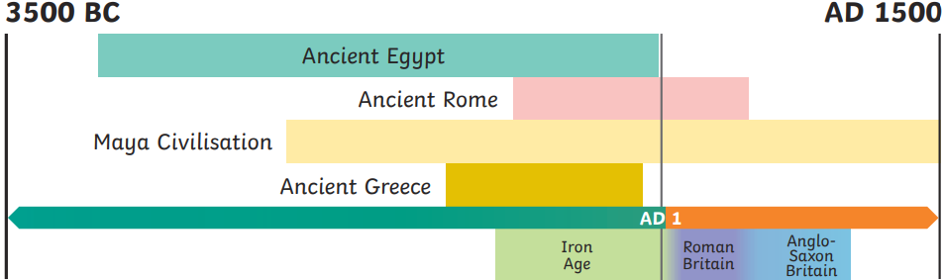
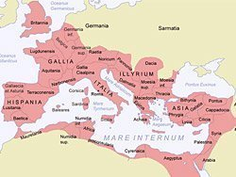
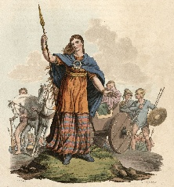
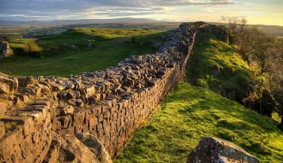
History – Year 4 – The Romans
Timeline:
AD stands for Anno Domini, which is Latin for in the year of the Lord. BC stands for Before Christ, and it’s a way of counting years before the estimated birth of Jesus Christ. AD starts with year 1 and counts forwards whilst BC starts with the year before Christ’s birth, 1 BC, and counts backwards.
Key Vocabulary
Boudicaa | noun. a queen of the ancient British Iceni tribe, who led a failed uprising against the conquering forces of the Roman Empire in AD 60-61.
Celts | noun. people living in Britain in tribes, including the Iceni, Brigantes and Catuvellauni.
chariot | noun. a two-wheeled vehicle drawn by horses, used in ancient racing and warfare.
emperor | noun. the ruler of an empire.
empire | noun. a group of countries controlled by one ruler (emperor or empress) or government.
raids | noun. a rapid surprise attack on an enemy
religion | noun. the belief in and/or worship of a superhuman controlling power, especially a personal God or gods.
Settlement | noun. a place, typically one which has previously been uninhabited, where people establish a community.
Invasion and conquest of Britian:
The first Romans lived in Italy nearly 3000 years ago. They founded the city of Rome in 753 BC and, over the centuries, conquered many lands to create a huge empire. As the empire expanded, there were several attempts to invade and conquer Britain. The Roman General, Julius Caesar, made two attempts to conquer Britain. He wanted to add the rich land to the Roman Empire and punish the Celts for helping his enemies. His legions weren’t able to overcome the Celts in 55 BC or 54 BC, but some leaders did pay tributes (a tax) so the Romans would leave. This meant the Celts could continue to live as they were. In AD 43, Emperor Claudius launched a third attack on Britain. He sent a powerful and well-organised army of around 40,000 men (that landed in southern England) to conquer the Celtic tribes. This time, much of Britain (or Britannia as the Romans called it) did become another province of Rome. Londinium (London) was founded and became an important centre for international trade. Later, it became the largest Roman city in Britannia.
Boudicca
The Romans seized the land and wealth of the Iceni tribe after King Prasutagus died. Queen Boudicca objected and she led a rebellion against the Romans. At first, her army was very successful, but in the Battle of Watling Street, the Roman army finally defeated Boudicca and the Celts in AD 61. Many people were killed in the rebellion.
Hadrian’s Wall
In AD 122, Emperor Hadrian gave an order to build a wall in the north of the country. Roman legions had tried to conquer Caledonia (Scotland), but the Picts would not give up their lands and they also raided land that the Romans controlled. Hadrian’s Wall took around six years to build and it was 73 miles long. Around 15,000 troops lived at Hadrian’s Wall so they could defend this northern border of the Roman Empire.
Religion
Native Britons were pagans (who believed in lots of different gods and spirits). The Romans were also pagans but they didn't believe in the same gods as the pagans from Britain. Pagans in Britain were allowed to worship their own gods as long as they remained respectful to the Roman gods too. Christianity arrived in Britain during the second century. When it got popular, the Romans banned it as Christians refused to worship the Roman emperor. Anyone who was caught following Christianity could be whipped or even executed by the Romans. By the start of the 4th century, more and more people were following Christianity and by AD 391, Christianity was the official Roman religion.

Slide 2
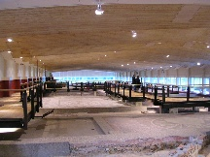
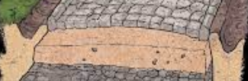
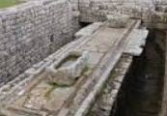

History – Year 4 – The Romans
Towns and settlements:
Agricola, the Roman governor of Britain, encouraged Britons to adopt the lifestyle of the Romans. Many Roman-style towns and villas were constructed, particularly in the south of the country. Before the Romans invaded Britian, people lived in small settlements. The Romans built new towns all over Britain. Each one had a marketplace, town hall, shops, temples and homes; larger towns had an amphitheatre. Bath houses were elaborately designed and were popular places to relax and meet friends. Wealthy Romans and some Celts built large homes in the countryside called villas. The land attached to these homes was used for farming as agriculture was an important business for the Romans. Countryside villa complexes included a main house, bath house, workshops and gardens. In AD 75, Fishbourne Roman Palace, a magnificent villa complex with gardens and intricately laid mosaic floors, was built in Sussex. This is an excellent source of historical evidence to who us what life in a Roman Villa is like..
Roads:
The Roman army are famous for building long, straight roads. Special engineers planned these roads and they criss-crossed the whole Roman Empire. The roads helped trade and communication with the Emperor; they also helped the legions to keep control of all the different provinces.
Before: When the Romans arrived in Britain, the roads were just muddy tracks used by horses and carts and people would walk alongside these tracks. The Romans built over 16,000km (10,000 miles) of new roads all over Britain. | During: The Romans built straight roads so they could get around quickly and efficiently. Roman roads were built on foundations of clay and were designed so that water could drain away. Many Roman roads were paved for people to walk. | Today: Roads today are built using the same basic design as the first Roman roads. In some places, there is still evidence of the original Roman roads and some of the main roads and motorways that we use today are converted Roman roads. This shows how well they were built.
What else did the Romans bring with them?
Language: Not many people could read or write in Britain before the Romans came. Information was usually shared by word of mouth. Much of the history that we have about pre-Roman and Roman Britain was recorded by the Romans as they wrote a lot of information down. The Romans spoke and wrote in Latin. Over time, some people living in the new Roman towns of Britain started to use Latin too but people living in the countryside continued to speak their old Celtic language. Today, we still use many words and phrases that come from Latin; for example, ‘exit’, which means ‘he or she goes out’ and ‘pedestrian’, which means ‘going on foot’. | Flushing toilets The Romans introduced the first ‘flushing’ toilets to Britain. The Roman bathhouses had large public latrines (toilets). However, they were very different to toilets today. They were lines of seats over channels in which a continuous flow of water would run to carry away the waste. This made them the first 'flush toilets' in Britain. There was also a shallow water channel or several buckets of water in front of the seats containing sponges attached to sticks for people to wipe their bottoms with. People would share these sticks as they would sit and use the toilet side by side. | Food The Romans introduced many fruits and vegetables to Britain. In Britain, many of these are still eaten today, including: asparagus, turnips, peas, garlic, cabbages, celery, onions, leeks, cucumbers, globe artichokes, figs, sweet chestnuts, cherries, grapes and plums. The Romans also used many herbs and spices that were introduced to Britain and are still used today: mint, coriander, rosemary and garlic.
Education
Education started at home for most children. Boys learnt reading, writing, arithmetic and rhetoric (the art of speaking and debating), while girls learnt domestic skills. Boys from wealthier families often had private tutors, whereas those of a lower status attended a ludus. Boys learnt trades such as carpentry or leatherworking or prepared for careers in politics or the military. Girls were expected to help with household duties. Marriages were often arranged and children could be married at the age of 14.
Common Roman names
Female names: Aelia, Claudia, Julia, Marcella, Octavia, Valentina | Male names: Antonius, Fabius, Hadrianus, Julius, Marcus, Maximus

