Slide 1

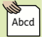
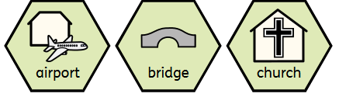
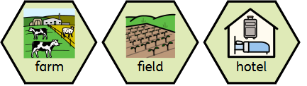
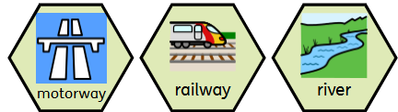
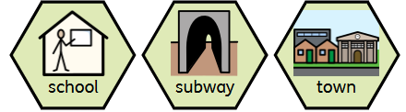
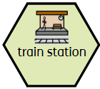

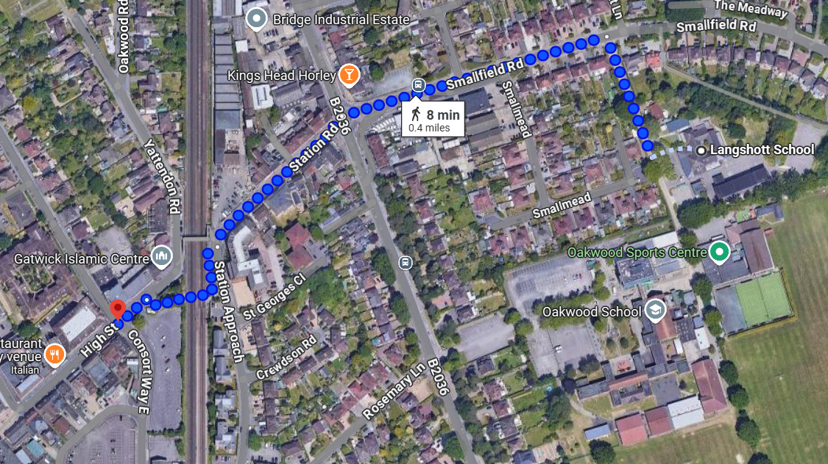
Geography – Where We Live – Y1 - Horley
Key vocabulary | noun. a place where planes take off and land. | noun. a structure built over a river, road, or railway to allow people or vehicles to cross. | noun. a building where Christians go to worship. | noun. a place where crops are grown, and animals are kept for food and other products. | noun. an open area of land, often used for growing crops or keeping animals. | noun. a building where people pay to stay overnight when they are away from home.
noun. a wide road designed for fast travel, with multiple lanes for cars and other vehicles. | noun. a system of tracks that trains travel on. | noun. a large, flowing body of water that moves across the land into another body of water, like a sea. | noun. a place where children go to learn. | noun. an underground railway system, or a tunnel under a road for people to walk through. | noun. a place where many people live, with houses, shops, and buildings, but smaller than a city. | noun. a place where trains stop for passengers to get on and off.
Map of Horley
Recap: What is a map? A view from above a place Sometimes have a key with symbols which show what different things or places can be found in an area Show the distance between places Sometimes have a compass Can use colour | This map shows the walking journey from Langshott Primary School to Horley High Street.
Stay Safe during fieldwork!
 | Be safe! Listen to instructions and follow what an adult is asking you to do. | Be aware of the roads. Keep to pavements at all times. Only cross roads when you are told to do so by an adult.
Be polite and show respect. Move to one side of the pavement if other people are walking. Show how amazing Langshott children are! | Be observant and pay attention. Follow any signposts that may be helpful on the walk. Walk with your partner. | Use your map to follow the route. See if you can spot any familiar symbols! Look, listen and smell. Use your senses to observe the area.

Slide 2
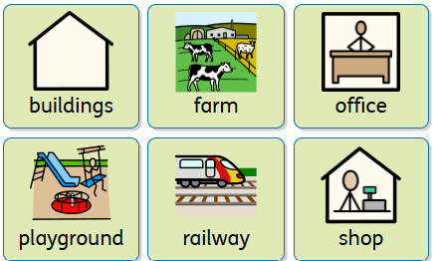
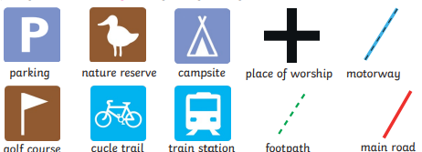
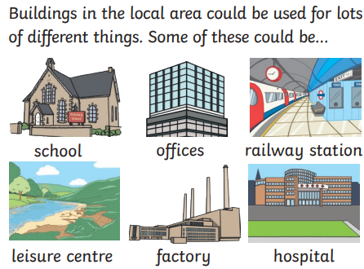
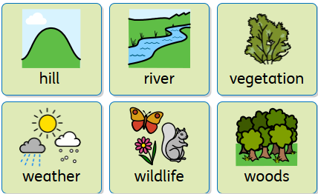

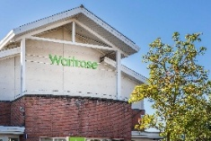
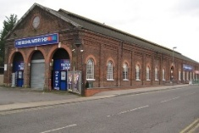
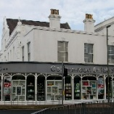
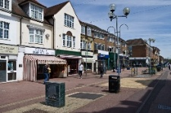
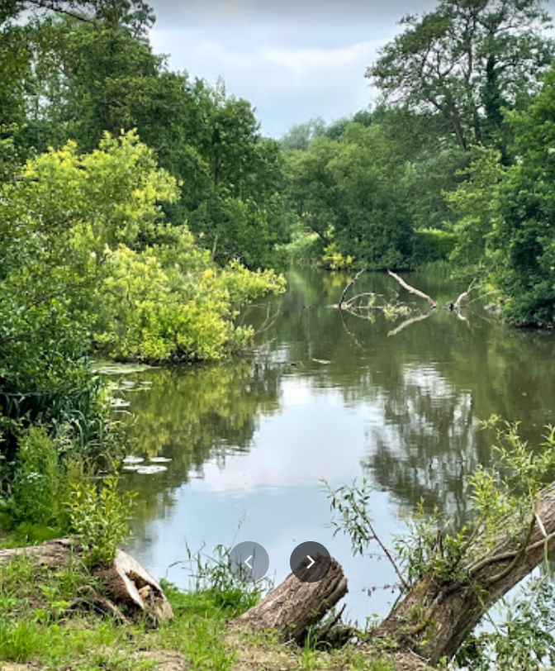
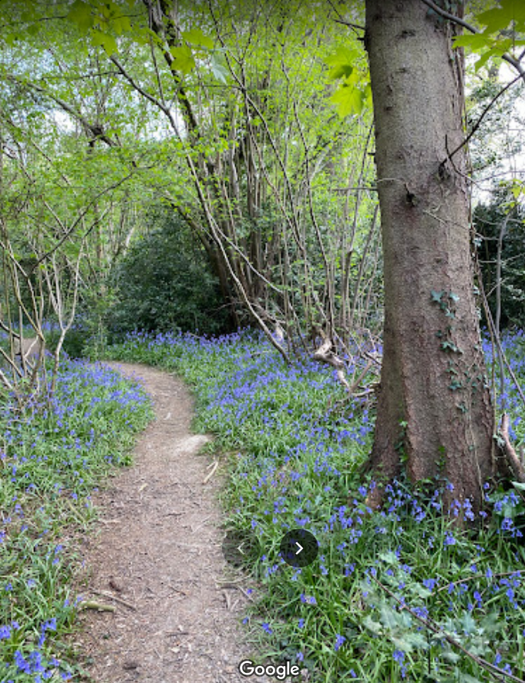
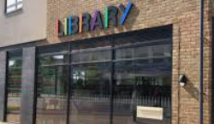
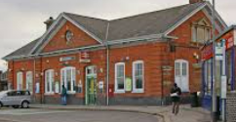
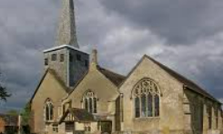
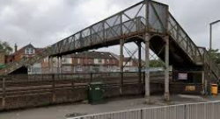
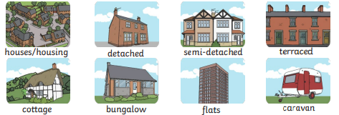
Geography – Where We Live – Y1 - Horley
Symbols
To make it easier, maps use symbols instead of words so that you can find things quickly. Here are some symbols you might recognise.
Human features that you might spot in Horley
Types of buildings in Horley
Buildings in the local area could be used for lots of different things. Some could be: Which of these do we have in Horley?
Schools in Horley
Shops in Horley
Other human features: The Library Horley Railway Station St Bart’s Church Bridge and subway
Houses: You might have lots of different types of houses in your local area.
Physical features you might spot in Horley
The River Mole Langshott woods

