Slide 1

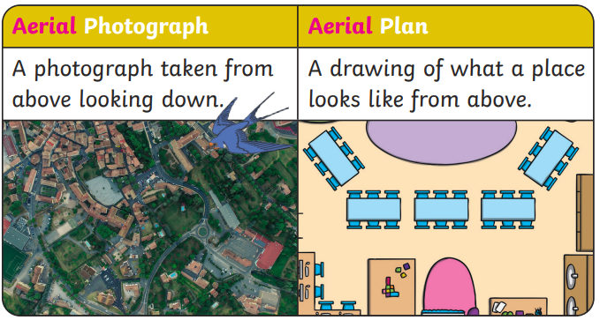


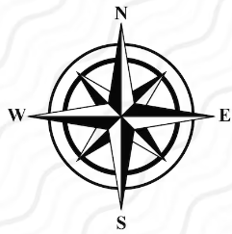
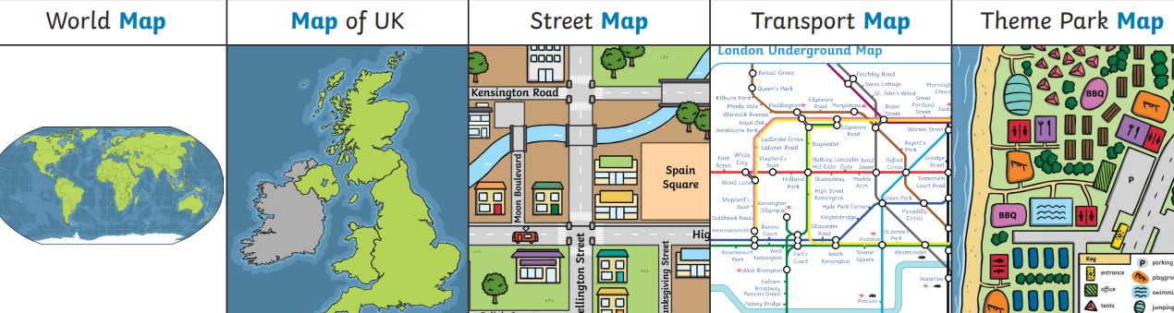








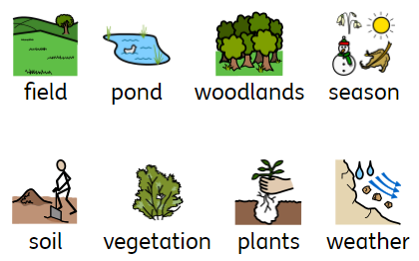
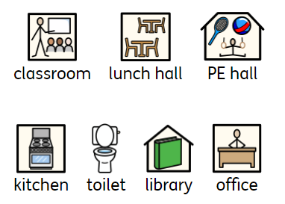



Geography – Reception– Where We Live – Our School
Our school address
An address needs to be written in a certain way.
Name -> Road -> Town -> County -> Post code -> | Langshott Primary School Smallfield Road Horley Surrey RH6 9AU
Aerial view (bird’s eye view)
Key Vocabulary:
aerial view | noun. What somewhere would look like from above, looking down.
building | noun. A structure with a roof and walls.
compass | noun. A compass can be used to help you find your way. It shows four directions - north, east, south and west.
distance | noun. How far away something is.
features | noun. A part or quality of something
fieldwork | noun. Working outside to collect information.
location | noun. The area where something is.
map | noun. A drawing of an area shown from above.
observe | verb. To watch/look at something carefully.
office | noun. A place where business or professional work is done.
place | noun. A location.
playground | noun. An outdoor area where children can play.
pond | noun. A pond is a small area of still, fresh water.
school | noun. Where children go to learn.
route | noun. How you get to somewhere.
Maps
• A view from above a place • Sometimes have a key with symbols • Show the distance between places • Sometimes have a compass • Can use colour • Symbols show what different things or places can be found in an area. • There are lots of different types of maps.
Human and physical features
Human and physical features are things that you can see all around you. •Physical features like seas, mountains and rivers are natural. They would be here even if there were no people around. •Human features are things like houses, roads and bridges. They have been built by people.
Human features all plant life | Physical features

Slide 2
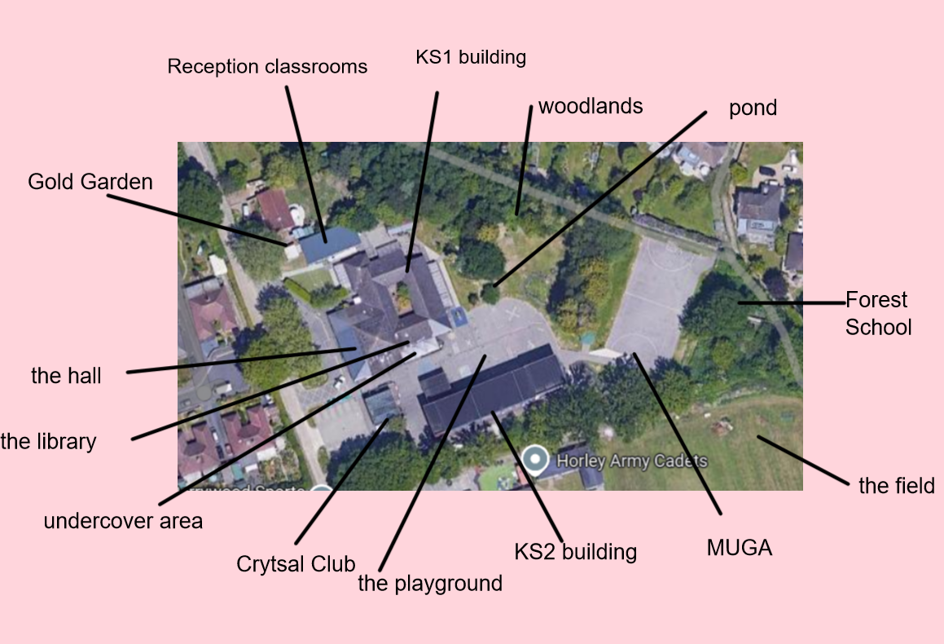
Geography – Reception– Where We Live – Our School

