Slide 1

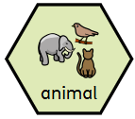
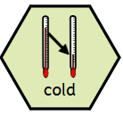
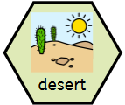
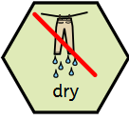
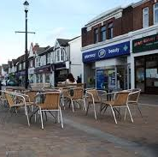
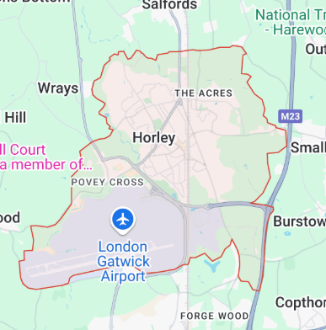
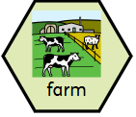
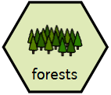
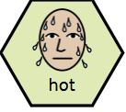
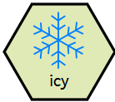
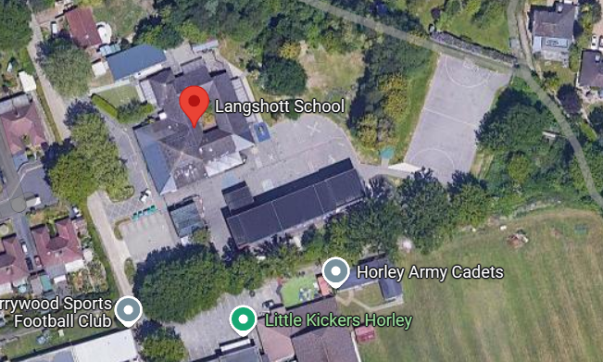
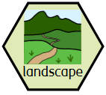
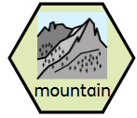
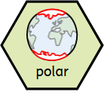
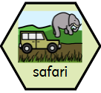
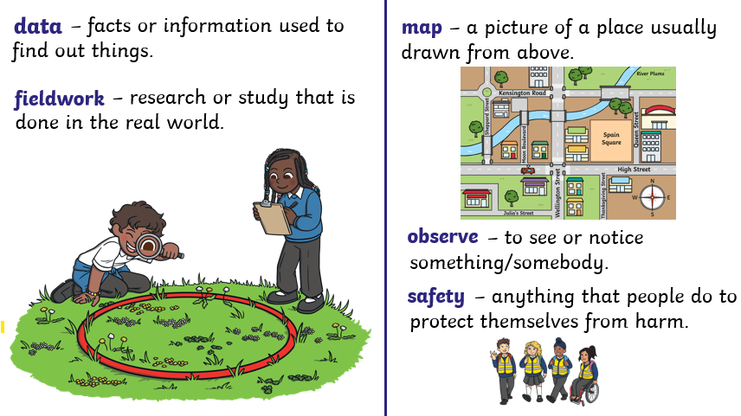
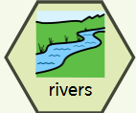
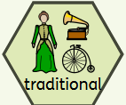
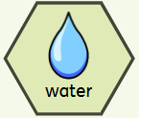
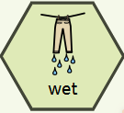
Year Reception – Geography – Around the world
Our local area:
Horley
Map of Langshott Primary School
Fieldwork skills:
Key vocabulary
noun. a living thing that moves around and eats food, like a dog or a bird. | adjective. when something is very chilly, like ice or snow. | noun. A place that is very hot and dry with lots of sand. It can also be very cold at night. | adjective. when there is no water like in a desert.
noun. A place where people grow plants and keep animals like cows and chickens. | noun. A large area filled with lots of trees and plants. | adjective. when something feels very warm, like the sun. | Adjective. when something is covered in ice or feels freezing cold.
noun. The way a place looks, with hills, rivers, trees, or buildings. | noun. A very high piece or land that is much taller than a hill. | noun. Places near the North or South Pole that are very cold. | noun. A trip where people travel to see wild animals in their natural home.
noun. Long flowing bodies of water that move across the land. | adjective. something that has been done or used in the same way for many years. | noun. a clear liquid that we drink and that helps plants grown. | adjective. when something is covered in water, like after the rain.

Slide 2
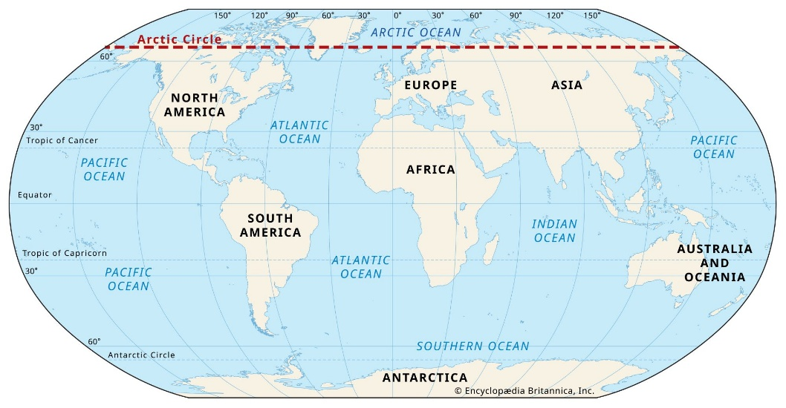
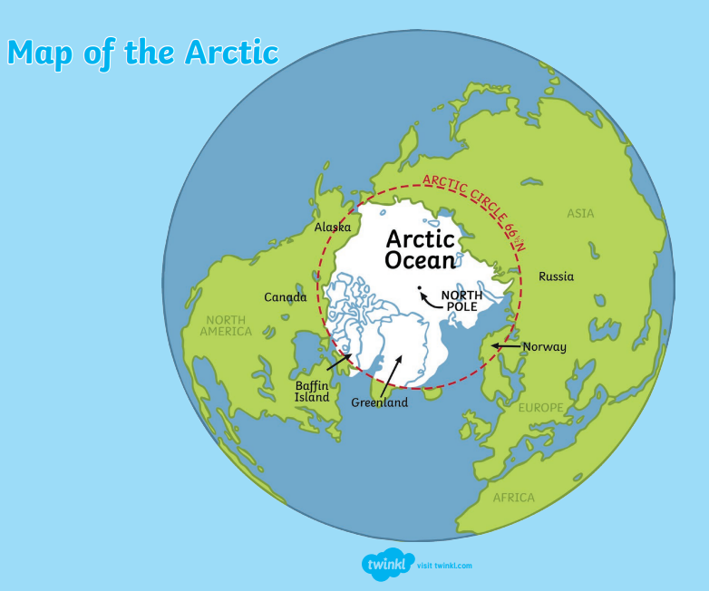
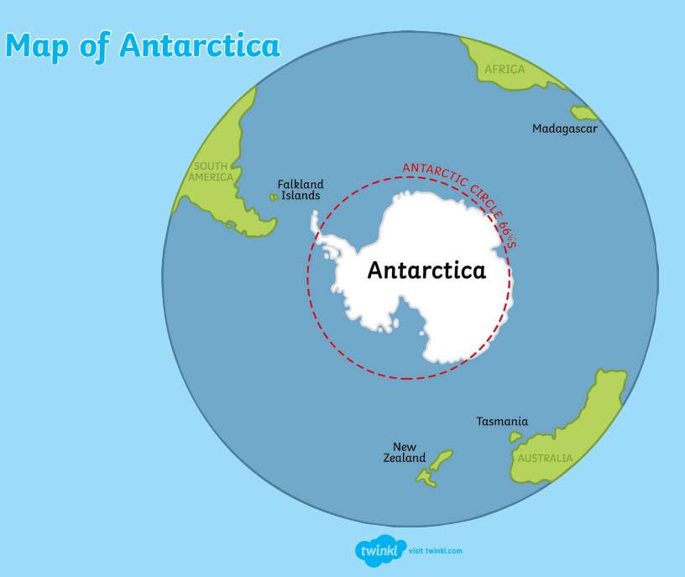
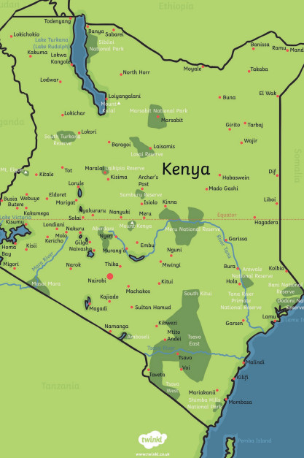
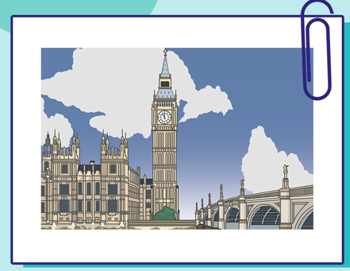
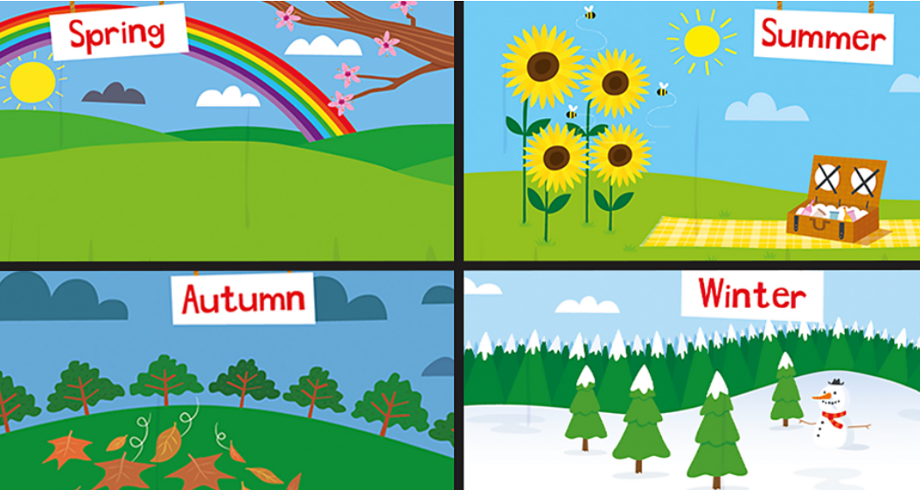

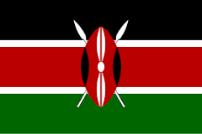
Year Reception – Geography – Around the world
Polar regions
The Arctic The Arctic is at the very top of the Earth and is sometimes called the Arctic circle. | Antarctica Antarctica is a continent found at the bottom of the Earth. It is not called a country because there is no government, town or cities.
Climate and weather: The Arctic has two seasons: winter and summer. Small colourful plants grow in the Arctic during the summer. The temperature can reach 12°C. The winter is cold and dark because the sun doesn’t rise. It can reach -34°C. | Climate and weather: Antarctica has two seasons. These are winter and summer. Antarctica is the coldest and windiest place on Earth. Nearly all of Antarctica is covered in ice. The coldest temperature ever recorded here is -89°C.
Animals: Animals you can find in the Arctic are: the arctic fox, polar bears, snowy owls and lynxes. | Animals: Animals you can find in Antarctica are: emperor penguins, orcas, elephant seals and dusky dolphins.
Kenya
Where - Kenya is on the continent of Africa. Its capital city is Nairobi. Official Languages - Swahili and English Flag - It has a shield and two spears on it. | Climate and weather: Kenya has a tropical climate. It is warm all year round but there is a lot of rain between March and June. The coldest month is July and the hottest month is February. Kenya is mostly tropical. It stays hot all year. It has wet and dry seasons. The desert areas have less rain.
 | Animals: Kenya is famous for the ‘Big Five’. These are large animals including the rhino, elephant, lion, leopard and buffalo. You can also find lots of zebras, cheetahs and hippos. Many animals live in the forests here that you can’t find anywhere else in the world. Watch out for crocodiles! The national animal is a lion!
 | Landmarks: Mount Kenya is the highest mountain in Kenya and the second highest mountain in Africa. Tsavo National Park is the largest nature reserve in Kenya and one of the largest in the world. The Nairobi National Museum reflects Kenya’s history, nature and culture.
England
Climate and weather: England has four seasons. England gets cool, wet winters and warm, wet summers. | Animals: Wildlife includes badgers, foxes, deer and owls. The water vole is an animal in danger of extinction. The lion is England’s unofficial national animal. | Landmarks: The highest mountain peak is Scafell Pike. It is 978 metres tall. The longest river is the Thames. The Angel of the North, Stonehenge and the Eden Project are famous landmarks. The London Eye, Buckingham Palace and Big Ben are in London.
Around the world
to observe the differences in weather from Horley, England to African, Kenya/Polar region.
to recreate landmarks/places of interest in their play.
introduce and develop their knowledge of the local area (Horley)
discuss what features /landmarks the children know
to say what is similar and different between where they live and Kenya/polar region
Use a simple map to locate Horley and compare to where other countries the children know are located.
Use simple fieldwork and observational skills to study the geography of the school and its grounds.

