Slide 1

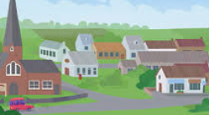
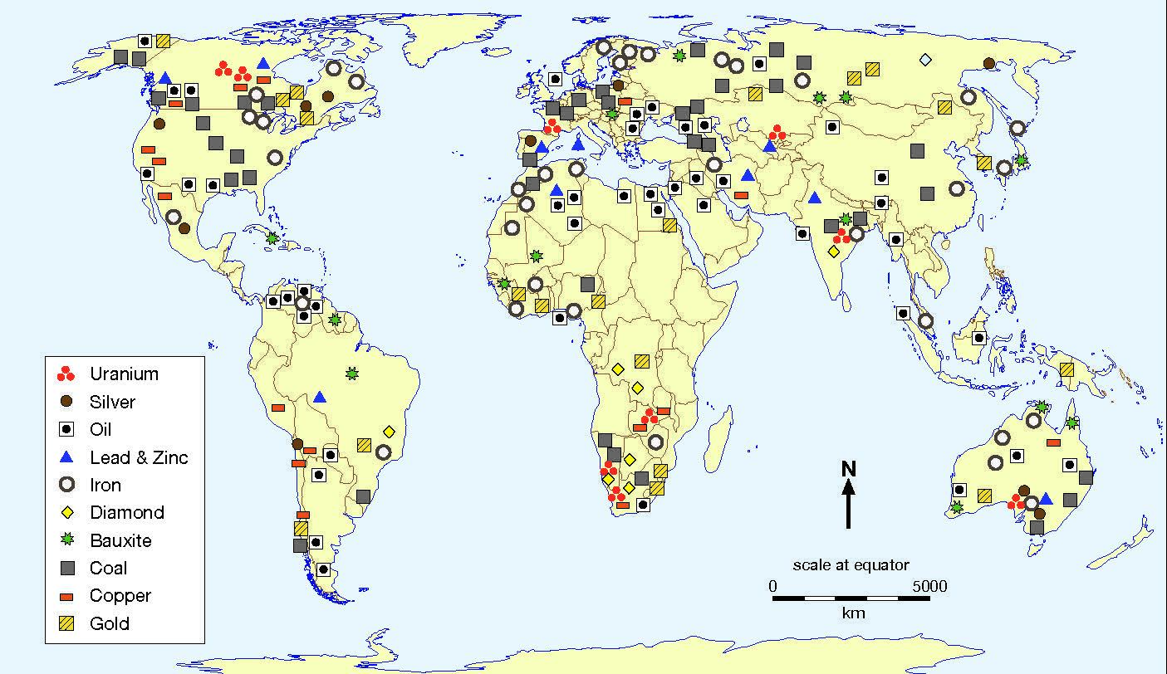
Year 5 – Geography – Protecting the planet
Settlements
When people are looking to find a new home or new places are being built for people to live, there are many different needs to consider: basic needs - food, water and shelter additional needs - electricity, internet access, healthcare, entertainment, friends, transport links, information and news For the very first settlers, finding the right place to settle was essential for survival. Their needs included: site - flat ground, easy to defend aspect - sheltered from weather resources - food and water supply, woods nearby for food and materials, fertile land links - transport links
Key Vocabulary
carbon footprint | noun. the total amount of greenhouse gases (including carbon dioxide and methane) that are generated by our actions.
conserve | verb. to use as few resources as possible.
consume | verb. to use, eat or drink something.
export | noun. selling products and goods to other countries.
fertile land | noun. land that is rich in nutrients and very good for growing crops.
food miles | noun. the distance an item has travelled from where it was produced to where it was consumed.
import | verb. buying products and goods from abroad.
non-renewable energy | noun. a source of energy that will eventually run out as it cannot be made as quickly as it is consumed, such as coal.
renewable energy | noun. a source of energy made from resources which nature can replace. It is more environmentally friendly as it does not pollute the air or water
sources of energy | noun. a source from which energy can be obtained to provide heat, light, or power.
sustainability | noun. using natural resources in a way that we could keep doing for a long time. We can be more sustainable by reducing our use of natural resources.
turbine | noun. a machine for producing continuous power.
Resource distribution:
The natural resources that you have readily available to you depends on where you live in the world. Here are some examples of natural resources: water, oil, meat, plants, sand, gas, diamonds, aluminium. The UK has a plentiful supply of natural gas, oil and coal. In the last two centuries, coal was the UK’s biggest energy provider, but since the 1990s, the UK’s biggest energy provider is natural gas.
Different places trade the natural resources that they have in exchange for something that they need. However, natural resources are unequally distributed around the world. This map shows where mineral resources can be found.
Conservation:
It is important to conserve food, water and energy supplies because it is good for the planet and for future generations. We can do this by: using resources as wisely/efficiently as possible conserving resources by using as little/few as possible Increased pollution is causing global warming. As our planet heats up, extreme weather, floods and droughts are more likely to occur. These in turn affect farming, food production and access to drinking water. These events can have a knock on effect around the whole world.
There are many different ways to save resources and be sustainable: turn off the tap when brushing teeth turn the heating down and wear layers holiday in the UK rather than abroad switch things off when not in use have a shower instead of a bath
Notes:
https://www.carbonbrief.org/mapped-how-the-uk-generates-its-electricity/

Slide 2
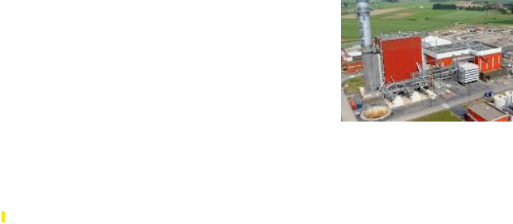
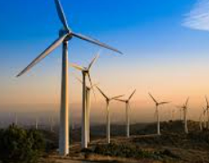
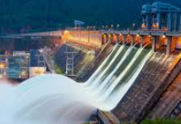
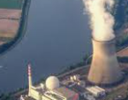
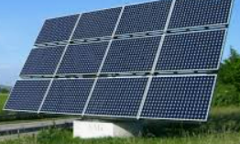

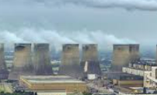
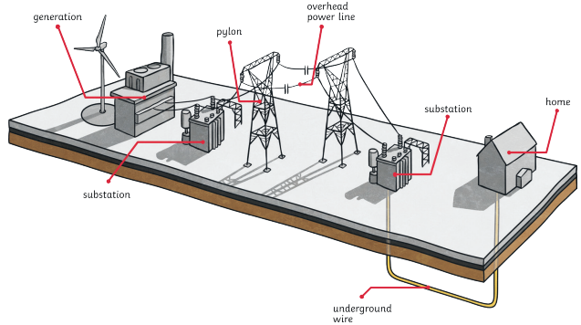
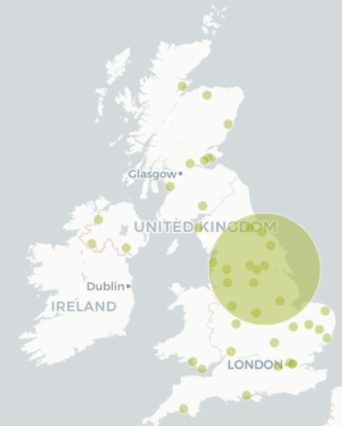
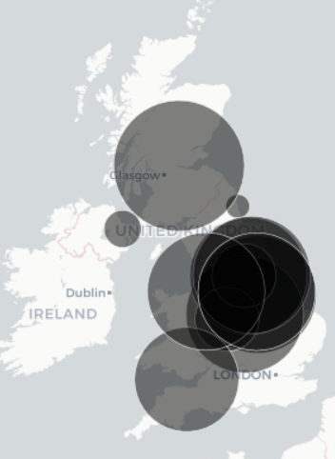
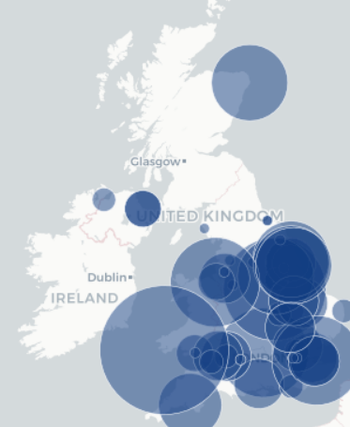
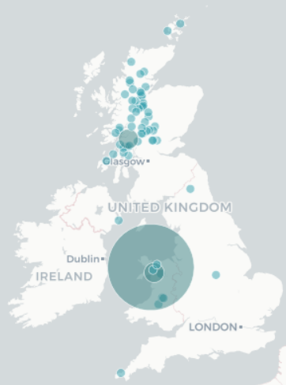
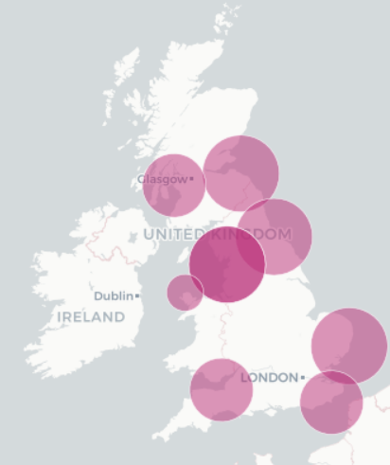
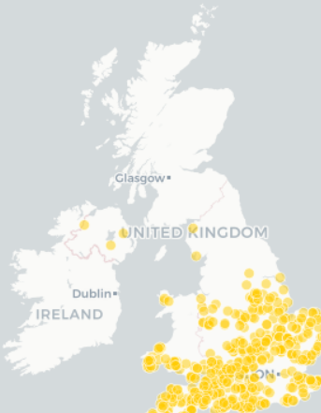
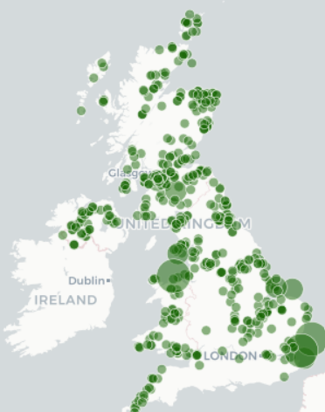
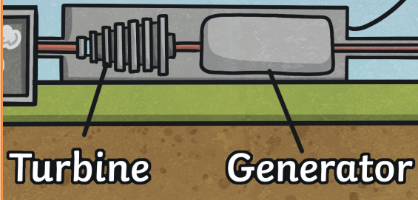
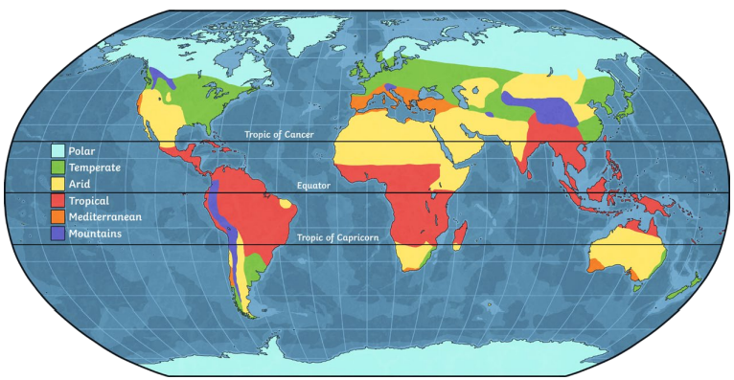
Year 5 – Geography – Protecting the planet
Generating electricity
Electricity generation often involves turbines and generators. Turbines are machines that can rotate. Steam, water, gas and wind can be used to do this. Turbines then connect to machinery called generators. Generators convert the kinetic (movement) energy (from the turbine spinning) into electricity. Oil, natural gas and coal are referred to as fossil fuels. They are formed from the remains of plants and animals that lived millions of years ago. Fossil fuels can be burnt to generate electricity. Generally, the heat from burning them is used to produce steam (via heating water). This spins a turbine that then drives a generator to generate electricity.
Sources of energy
Renewable |  |  |  | Non-renewable
Wind power A form of energy that harnesses the power of the wind to generate electricity. | Solar power This converts energy from the sun into electricity through the use of solar panels. | Hydro power This uses the natural flow of moving water to generate electricity. | Pumped Storage Water in dams used to turn turbines. | Coal Power is generated by burning coal. | Combined Cycle Gas Turbine (CCGT) – Power is generated by burning gas. | Nuclear Uranium atoms split in a process called nuclear fission.
Where the UK generate its energy:
biomass | coal | gas | hydro | nuclear | solar | wind
Food and food miles:
Our food comes from all over the world. How far our food has travelled is called food miles. Food is often transported in container ships or planes. The further our food travels from where it is produced, the more CO2 is likely to be released, contributing to climate change. However, there are many benefits of importing food: more variety which supports a healthy diet boosts foreign economies by providing a market for foreign farmers protects against possible poor harvests supermarkets can negotiate lower prices foods that only grow seasonally in the UK are available all year round The UK also export foods around the world such as chocolate and cheese. | There are six main climate zones. Countries with the same latitude lines often have a similar climate. Different foods require certain conditions to grow, including temperature, rainfall, the type of soil and sunlight. Climate zones can help farmers understand what will grow best in their area. Temperate: Produce: grain, oat, barley, wheat and rapeseed. Tropical: Fruits: bananas and mangoes. Plants: cocoa. Mediterranean: Food that grows on vines or trees: grapes, lemons and olives.
Notes:
https://www.carbonbrief.org/mapped-how-the-uk-generates-its-electricity/

