Slide 1

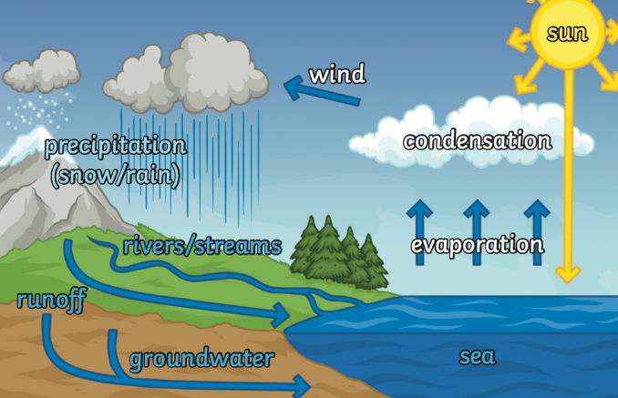
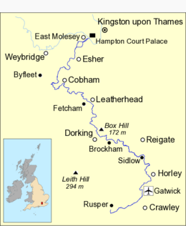
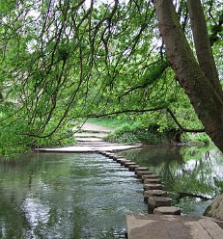
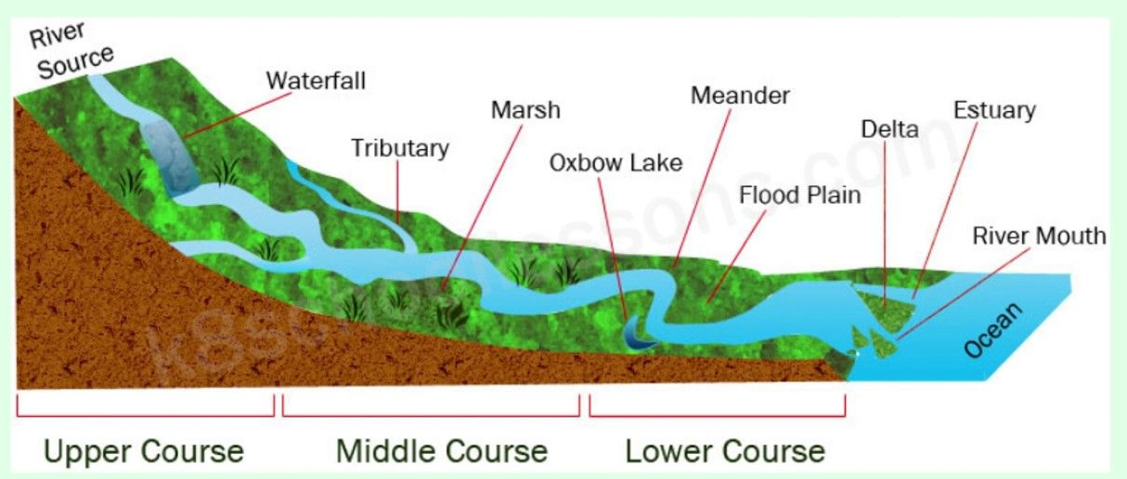
Geography – Year 4 – Rivers and the Water Cycle
The Water Cycle
Clouds form when warm, moist air is cooled. When it is cooled, it condenses into tiny water droplets which appear as clouds. Heat from the sun evaporates water, which rises, condenses in the cool air and then falls back down to earth.
The River Mole
The River Mole is a tributary of the River Thames in southern England. It rises in West Sussex near Gatwick Airport and flows northwest through Surrey for 80 km (50 miles) to the Thames at Hampton Court Palace.
Key Vocabulary
arable farming | noun. When people grow crops e.g. wheat, barley, fruit.
channel | noun. The course in the ground that a river or water flows through.
condensation | noun. When a gas cools and changes to a liquid.
dam | noun. A barrier built to hold back water.
deposition/ deposit | noun. When rocks and other materials that have been eroded are dropped off further along the river.
discharge | noun. The amount of water flowing along a river per second.
erosion | noun. Rocks and other river materials are picked up by the water and moved to another place along the river.
evaporation | noun. Evaporation occurs when a liquid changes into a gas or water vapour.
fertiliser | noun. A substance that helps make plants grow.
mouth | noun. The point where a river joins the sea.
particles | noun. Everything is made up of matter. Particles are tiny bits of matter.
pesticides | noun. A substance used to destroy pests such as small animals, insects and weeds.
pollution | noun. Anything that is introduced into a habitat which has a harmful effect on plants and animals living there.
precipitation | noun. Any liquid or frozen water that forms in the atmosphere and falls back to the earth (rain, sleet)/
reservoir | noun. Reservoir a man made lake that is used to store water.
source | noun. The place where a river begins.
tidal bore | noun. A strong tide from the coast that pushes the river against the current causing waves along the river.
tributaries | noun. Rivers that join up with another river.
valley | noun. A long ditch in the earth’s surface between ranges of hills or mountains
water vapour | noun. Water that is in the form of a gas.
Rivers
The source of most rivers is on high ground or in the mountains Some rivers join up with other rivers (tributaries). The point where they meet is called a confluence. Rivers in England, at their mouth, will flow into either the: North Sea, Irish Sea, English Channel or Atlantic Ocean.
River Mole: Key Facts:
Counties: Surrey, West Sussex Towns: Crawley, Horley, Dorking, Leatherhead, Cobham, Surrey, Esher, Walton-on-Thames, Hersham. Main source: Baldhorns Copse, Rusper, Horsham, West Sussex Mouth: River Thames, East Molesey, Elmbridge, Surrey

Slide 2
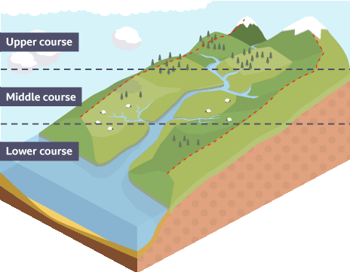
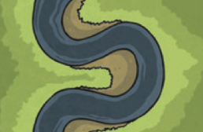
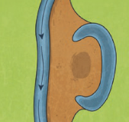
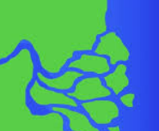
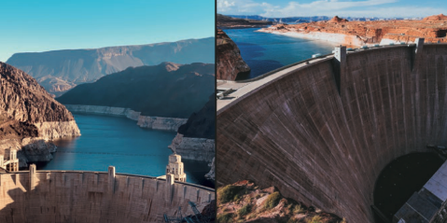
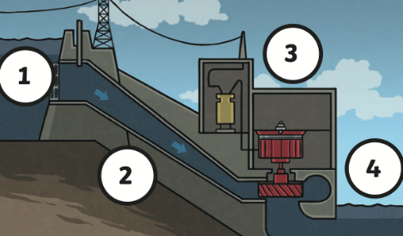
Geography– Year 4 – Rivers and the Water Cycle
Features of rivers: physical geography:
The course of a river (physical features) The Upper Course Rain falling on high ground collects in channels and flows downwards forming a stream. Streams run downhill and join other streams, increasing in size and speed, forming a river. The river here flows quickly and the channel has steep sides and runs through valleys. Features include - waterfalls and rapids. The Middle Course Fast flowing water causes erosion making the river deeper and wider. Features include - meanders The Lower Course Rivers flow with less force due to being on flat land. The river deposits the eroded material that it has carried. Riverbanks have shallower sides. Features include - floodplains, deltas and estuaries | Meander – a curve in the river. As meanders grow, two meanders can merge together through erosion. The water takes this newer, shorter course. The river deposits eroded materials which block off the old part of the river forming an oxbow lake. | Oxbow lakes – a U shaped lake. Eroded materials are carried by the river and released, building up the land on the inside of the bend where the water flows more slowly. | Delta – a landform shaped like a triangle. It is where the mouth of a river flowers into an ocean or even into a desert. It is formed by sediment carried by the river being deposited in the wider mouth.
Human geography: how humans use rivers:
Humans use rivers in a variety of ways, but there can be positives and negatives impacts from our usage: Leisure e.g. fishing ☺ Controlled population of fish ☹ May leave litters and pollute the water Industry e.g. factories ☺ Sections of rivers maintained ☹ Chemicals pollute the water and habitats Tourism e.g. walking routes ☺ Conservation and education about local wildlife ☹ Too many people near wildlife habitats.
Features of rivers: human geography: dam
Dams are built to hold water back, usually in a reservoir. Dams might be built to: • control the flow of a river to prevent flooding. • generate power.
Features of rivers: human geography: hydroelectric power
Water is held behind a dam. When needed, some of the water is released and flows through a pipe (penstock). The falling water turns a water wheel (turbine) which is linked to a generator which produces electricity. The water continues into the river on the other side of the dam.

