Slide 1

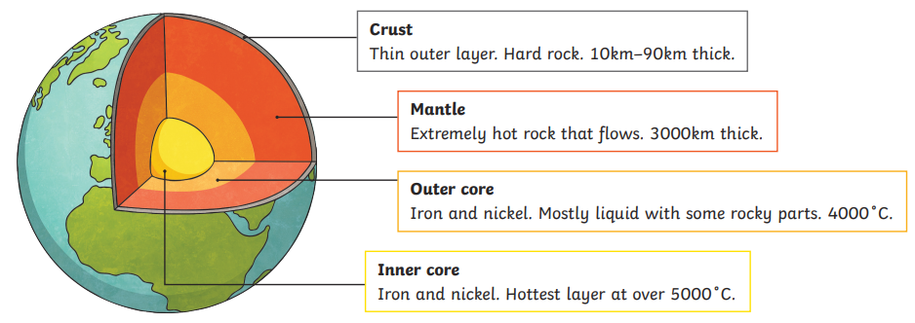
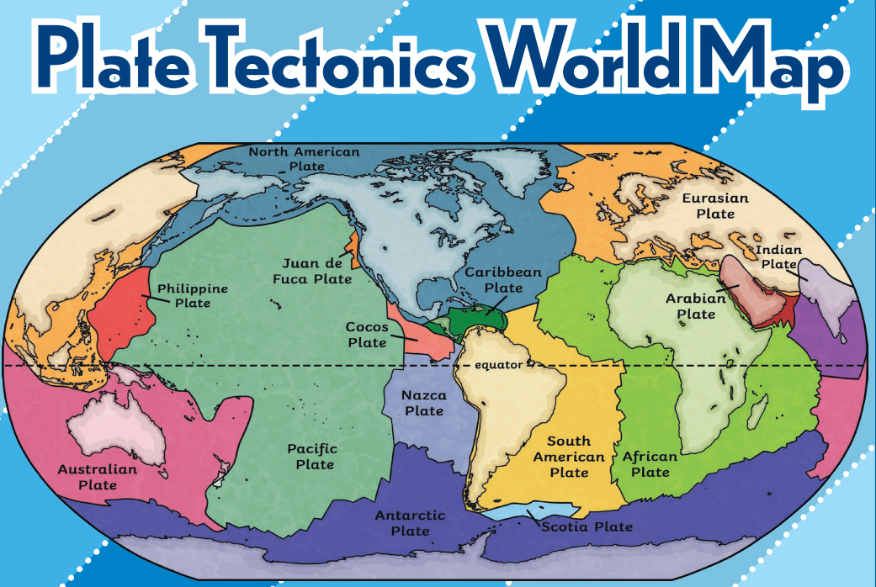
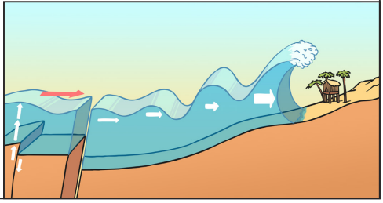
Geography – Year 3 – Extreme Earth - Volcanoes
Layers of the Earth
Starting at the centre, Earth is composed of four distinct layers. They are, from deepest to shallowest, the inner core, the outer core, the mantle and the crust.
Key Vocabulary
aftershock | noun. smaller tremors that occur after the main earthquake.
cone | noun. the mountain-shaped structure formed by volcanic material like ash and lava around the volcano's opening.
crater | noun. a bowl-shaped opening at the top of a volcano, formed by past eruptions.
epicentre | noun. the point on Earth's surface directly above the earthquake's focus, where the shaking is strongest.
eruption | noun. explosive: a violent type of volcanic eruption that blasts lava, ash, and gases high into the air; effusive: a type of volcanic eruption where lava flows gently and steadily.
focus | noun. the exact point inside the Earth where an earthquake begins.
foreshock | noun. smaller tremors that happen before the main earthquake.
geothermal energy | noun. energy generated from the heat stored inside the Earth, often used for heating and electricity.
lava | noun. molten rock that flows out of a volcano during an eruption.
magma | noun. molten rock found beneath the Earth's surface, which becomes lava when it erupts.
magma chamber | noun. a reservoir of molten rock beneath a volcano.
main event | noun. the largest shock in an earthquake sequence.
plate boundary | noun. plate boundaries are the edges where two plates meet. Most geologic activities, including volcanoes, earthquakes, and mountain building, take place at plate boundaries.
Richter scale | noun. a scale that measures the strength or magnitude of an earthquake.
tectonic plates | noun. large pieces of the Earth's crust that move and interact with each other, causing earthquakes, volcanoes, and mountain building.
Earthquakes:
•Earthquakes are caused when the earth’s tectonic plates (made up of the crust and the mantle) suddenly move. This movement causes faults or areas of stress where crushed rocks along the edges of the plates move in relation to one another. This causes a break in the surface and the energy released moves in waves through the earth. • Most earthquakes occur near the tectonic plate boundaries. • Earthquakes can cause lots of damage to roads, buildings and property. • Seismometers measure the vibrations of the earth during an earthquake. • The Richter scale measures the magnitude of an earthquake (how powerful it is).
Tsunamis:
• A tsunami is a giant wave caused by the energy in tsunami waves caused by an underwater volcanic eruption, an underwater landslide or an earthquake on the ocean’s floor • The earthquake causes a large amount of water to be displaced very quickly causing a series of waves. • As the waves travel through shallower water near land, they get bigger and bigger. • Defences built by humans cannot stand up the sheer power of the tsunami so the waves cause a lot of damage. Boulders are lifted, buildings are destroyed and vehicles are swept away as the water races up to one mile • A tsunami warning system (TWS) is used to detect tsunamis in advance and issue the warnings to prevent loss of life and damage to property.

Slide 2
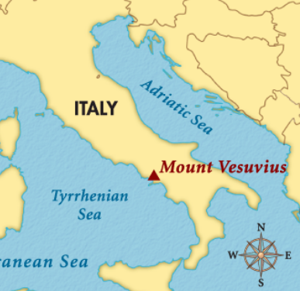
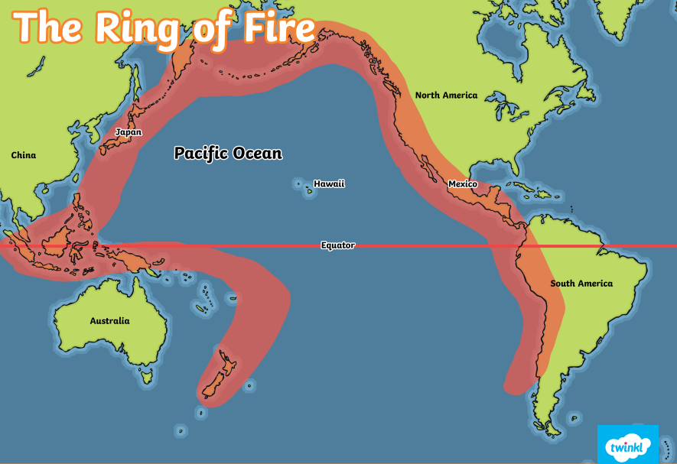
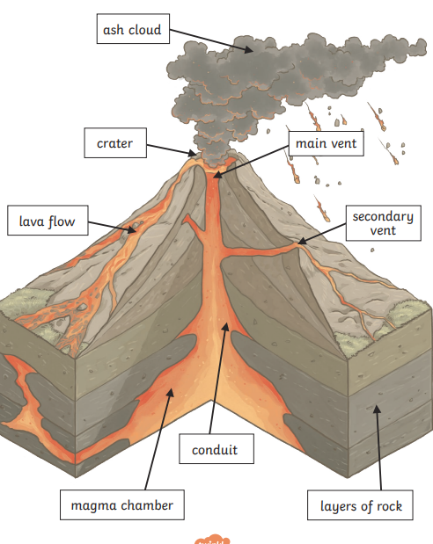
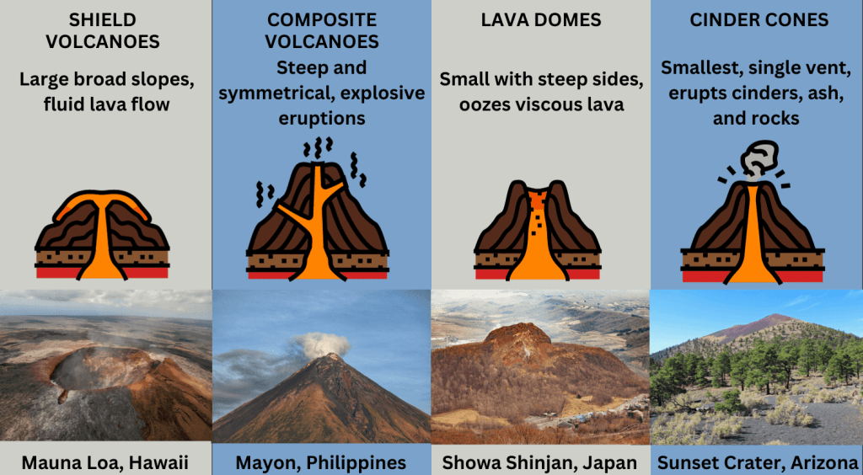
Geography – Year 3 – Extreme Earth - Volcanoes
Volcanoes:
A volcano is an opening in the Earth’s surface that leads downwards to a pool of molten rock. They often look like a hill or mountain. Rock deep in the Earth’s crust gets extremely hot and melts to form magma. This makes up the mantle, which mixes and moves to create pressure. When this leaks out onto the surface, this is called a volcano. Over time, as more magma leaks out, the volcano becomes bigger and bigger. The magma from the Earth’s crust that erupts from a volcano is called lava.
Mount Vesuvius
Mount Vesuvius is an active volcano in southern Italy. It is famous for an eruption that happened in 79 AD. Thousands of people died when lava, ashes, and mud buried the cities of Pompeii, Herculaneum, and Stabiae. The cities were forgotten until archaeologists began digging up their ruins in the 1700s.
Ring of Fire:
This is an area of the Pacific Ocean that is shaped like a horseshoe. The Ring of Fire has more than 450 volcanoes. It stretches along the western edge of the South and North American continents, across the Pacific Ocean, through Japan and southwards towards New Zealand. It covers a distance of around 25,000 miles (40,000km) in total. Around 75% of the world’s volcanoes and 90% of the world’s earthquakes are located within the Ring of Fire.
Types of volcanoes:
Volcanoes are categorised into three types: active, dormant or extinct.
A volcano is classed as active if it has erupted in the last 10,000 years or has had some kind of activity meaning it may erupt. | A dormant volcano has not erupted in the last 10,000 years but has potential to erupt in the future. | When a volcano is extinct, this means it has not erupted in the last 10,000 years and is unlikely to in the future.
In terms of their physical shape and reaction, there are four main types of volcanoes:
Parts of an erupting volcano (key vocabulary)
Ash cloud/ eruption cloud: The cloud of ash formed above the volcano from the force of the volcanic explosion. Crater: The mouth of the volcano. It is bowl-shaped hole at the top of volcano that is formed as a result of the explosion. Main vent: The main vent is the primary opening of the volcano through which the magma and other rocks and gases flow out. Secondary vent: Another vent through which the magma and other rocks and gases can flow out. Lava flow: after erupting, some of the hot lava will flow down the sides of the volcano. Conduit: An underground passage which magma travels through. Large volcanoes may have multiple conduits underground. Layers of rock: The earth's crust is made of several layers of rock. Magma reservoir/ chamber: A large chamber where magma builds and pools awaiting eruption.

