Slide 1

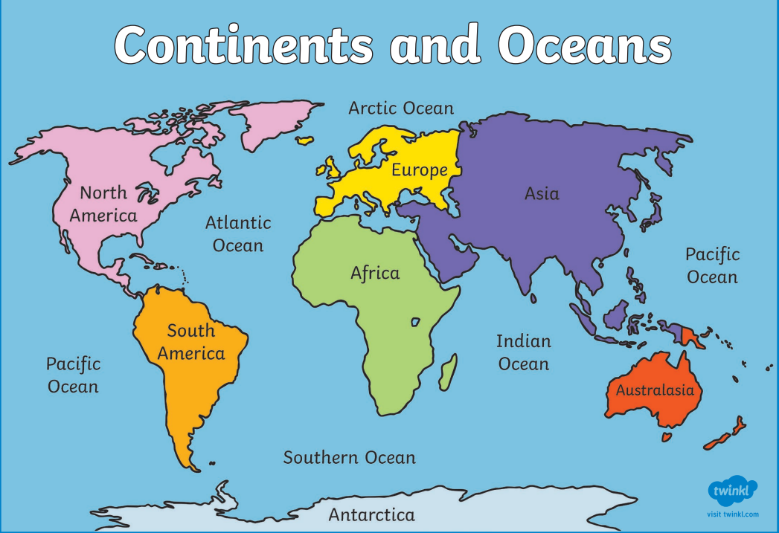
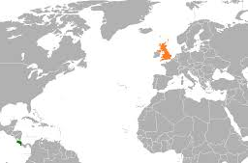
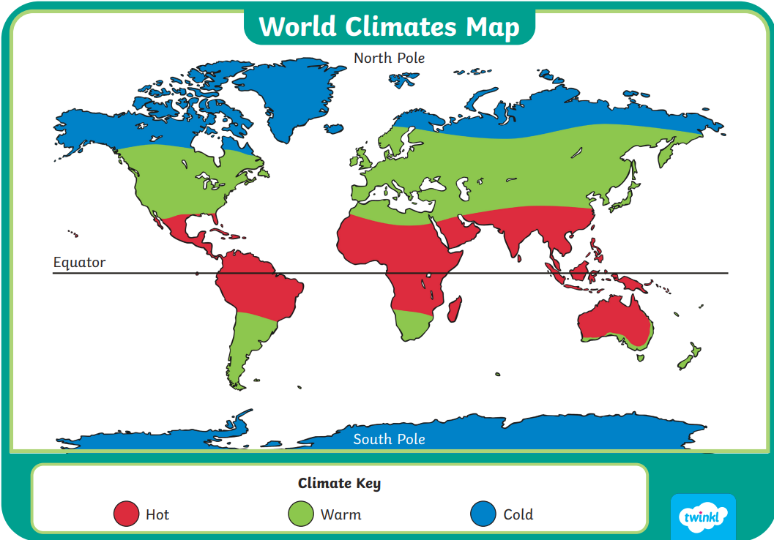
Geography – Year 2 – Costa Rica
Key Vocabulary:
continents | noun. a large area of land. There are seven continents in the world.
countries | noun. a nation with its own government.
directional language | noun. the way something points or moves (north, south, east, west).
equator | noun. an imaginary line around the middle of the Earth. Costa Rica is near the Equator.
oceans: | noun. a large body of saltwater.
Human geography:
attractions | noun. a piece of land used to grow crops and/or raise animals for produce thing that makes people want to come to it.
farms | noun. land used to grow crops or raise animals for produce.
plantations | noun. a large farm which is specialized on farming one type of crop.
shops | noun. a building or part of a building where goods or services are sold.
tourism | noun. when people travel to a particular destination to explore, relax or learn.
Settlement- types | noun. a town is a place where people live that is bigger than a village.
Physical geography:
climate | noun. the usual weather of a place.
forests | noun. a large area with many trees. Monteverde has a famous cloud forest (woods are small forest).
hill | noun. a raised area of land that is smaller than a mountain.
mountain | noun. areas of land that are much higher than the land surrounding them (over 600 metres high).
river | noun. a large stream of water that flows through land.
soil | noun. a mixture of tiny rocks, dead plants and animals, air, water.
vegetation | noun. the plants in an area.
wildlife | noun. animals and plants that live in the wild.
weather | noun. what the air and sky are like on a day (rainy, sunny, windy).
Weather and climate
The weather is the day to day changes that we see happen. So, it can be sunny one day and rainy the next. The climate is the average weather usually taken over 30 years of a particular place. The world map can be split into climate zones. The closer a country is to the equator, the hotter it is. The further away it is from the equator, the colder it is.
The seasonal and daily weather patterns in the United Kingdom: There are four seasons in the UK: Spring (March, April and May) is a time for sudden rain showers, blossoming trees and flowering plants. Summer (June, July and August) is the UK's warmest season, with long sunny days, occasional thunderstorms and, in some years, heatwaves. Autumn (September, October and November) can be mild and dry or wet and windy. Winter (December, January and February) can be quite stormy, wet and windy. Other winters are much colder and calmer with lots of fog, frost and even snow. |  | The seasonal and daily weather patterns in Costa Rica: Costa Rica weather consists of two seasons: dry and rainy. The dry season lasts from December to April, and the rainy season lasts from May to November. Monteverde is cooler compared to the low lands of Costa Rica. Monteverde tropical climate can be describes as: misty, wet, breezy, cool.

Slide 2


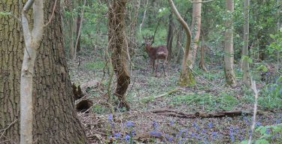


Geography – Year 2 – Costa Rica
Key physical features | Key physical features
 | Horley, UK: | Monteverde, Costa Rica:
Landscape
Hill: Horley is surrounded by gentle hills and countryside. River: The River Mole flows near Horley. Woods: Langshott Woods is a small woodland in Horley. | Hill: Horley is surrounded by gentle hills and countryside. River: The River Mole flows near Horley. Woods: Langshott Woods is a small woodland in Horley. | Mountains: Monteverde is high up in the mountains of Costa Rica. Monteverde translates to “green mountain” River: Small rivers flow through the forests and valleys of Monteverde. Forest: Monteverde has a famous cloud forest, which is a type of rainforest filled with tall trees, vines, and mist.
Vegetation
Trees: oak, ash, silver birch and willows. Flowers: roses, daisies, and bluebells and daffodils. | Trees: oak, ash, silver birch and willows. Flowers: roses, daisies, and bluebells and daffodils. | Plants: mosses, lichens, orchids, and bromeliads, ferns, Passiflora. Trees: aguacate lauraceae, hymenaea, ficus (fig).
Soil
The soil in Horley is a mix of clay and loam. Clay soil is heavy and can hold a lot of water, making it sticky when it rains. Loam soil is a mix of sand, silt, and clay, and it is good for growing plants because it holds both water and nutrients well. | The soil in Horley is a mix of clay and loam. Clay soil is heavy and can hold a lot of water, making it sticky when it rains. Loam soil is a mix of sand, silt, and clay, and it is good for growing plants because it holds both water and nutrients well. | The soil in Monteverde is rich and dark because the cloud forest has a lot of rain and fallen leaves that make the soil healthy for plants. This type of soil is called volcanic soil because the area was once shaped by volcanoes a long time ago, making it very good for growing plants and trees.
Wildlife
Birds: British woodland birds include: robins, blackbirds, and woodpeckers and owls. Mammals: squirrels, hedgehogs, rabbits, foxes and badges. Insects: bees, butterflies, dragonflies, ladybirds, and ants. | Birds: British woodland birds include: robins, blackbirds, and woodpeckers and owls Mammals: squirrels, hedgehogs, rabbits, foxes and badges Insects: bees, butterflies, dragonflies, ladybirds, and ants | Birds: resplendent quetzal, Emerald toucanet, purple-throated mountain-gem. Mammals: monkeys, bats, sloths, soricomorpha. Insects: spittlebugs, treehoppers, rove beetles, scarab beetles, longhorn beetles, butterflies.
Key human features | Key human features
 | Horley, UK: | Monteverde, Costa Rica:
Settlement type | Horley is a town with houses, schools, and parks. People live and work in the town. | Monteverde is a small village with houses and shops. It is also a tourist destination.
Farms | The countryside around Horley has farms that grow crops or raise animals. | There are many farms in the countryside around Monteverde. Some farms grow coffee and others raise animals.
Shops | There are lots of shops in Horley where people can buy food and clothes. | Monteverde is near the town of Santa Elena, where people go for bigger shops and services.
Attractions | Horley is not as famous for tourism, but people do visit the area, especially because it's near Gatwick Airport. There are lots of hotels for visitors to stay at. Some attractions include: Gatwick Aviation Museum. Horley Recreation Ground. Local Shops and Markets: Horley has small shops and markets where visitors can buy local goods and crafts. Places nearby: Visitors can easily travel to London or the countryside of Surrey to visit famous attractions, like castles or gardens. Horley has lots of Hotels as it is so close to Gatwick Airport. | People visit Monteverde to see the forest and nature. There are lots of small hotels and eco-lodges for visitors. Cloud Forest Reserve: A protected area where tourists can walk through the misty forest on trails and hanging bridges to see exotic birds, monkeys, and butterflies. Canopy Tours: Tourists can go zip-lining above the trees or walk on hanging bridges high in the forest to feel like they’re part of the jungle. Hummingbird Garden: A special place where people can watch hummingbirds fly around and drink nectar. Coffee Plantations: Visitors can tour coffee farms to learn how coffee is grown and harvested in Monteverde.
Use directional language to describe where things are in Monteverde. The Monteverde Canopy Tour is to the north of Monteverde.

