Slide 1

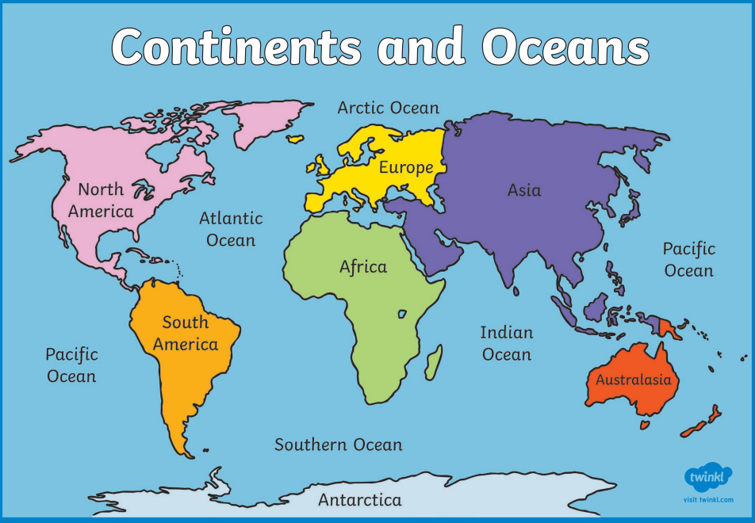
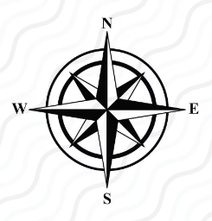
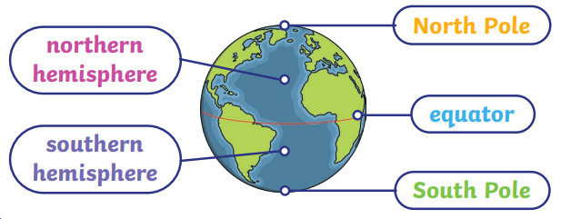
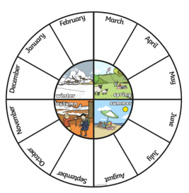
Geography – Year 1 – UK, continents and oceans
The World’s Seven Continents and Five Oceans
Continents: There are seven continents: Africa, Antarctica, Asia, Australasia (Oceania), Europe, North America and South America. Some continents have many countries, others do not Oceans: There are five oceans in the world: the Arctic Ocean, the Atlantic Ocean, the Indian Ocean, the Pacific Ocean and the Southern Ocean. Facts: • Half the world’s population live in Asia. • The largest desert in the world (the Sahara) is in Africa. • North America is twice the size of Europe. • Over half of Australia is desert or receives little rain. • The Amazon rainforest is in South America. Antarctica is known as the ‘frozen continent.’ • The Pacific Ocean is the largest ocean. • The Arctic Ocean is the smallest ocean.
Key Vocabulary:
capital city | noun. An important city, often where the government works.
continent | noun. A very large area of land made up of lots of countries including islands
country | noun. A large area of land where people live under the same government or have the same culture/
climate | noun. The long-term weather conditions of an area.
equator | noun. An imaginary line which runs around the centre of the globe at an equal distance between the north and south poles. The north half of the earth is the northern hemisphere and the south half of the earth is the southern hemisphere.
human features | noun. Features of our world that have been made by humans.
Landmark | noun. A feature of a landscape or place that is easily recognised, either a human feature or a physical feature
ocean | noun. A large area of salt water.
physical features | noun. Features of our world that are natural.
river | noun. A river is a flowing stream of fresh water that leads to the sea, a lake or another river.
sea | noun. A sea is a body of saltwater much smaller than an ocean
Climates
• Countries around the world have different climates. • Climates can be sorted into the following zones: warm, cold (or polar), tropical and temperate. • Countries near the equator tend to have a hotter climate. • Different animals are better suited to living in countries with a particular climate.
Weather in the UK
There are changes in weather in each season. • In spring, it is often rainy and the temperature begins to get warmer. • In summer, the sun is much stronger. The temperature is warmer than in any other season. • In the autumn, the weather turns chillier, windier and there is often rain. • In the winter, it is often cold and frosty. It has to be freezing cold to snow.

Slide 2
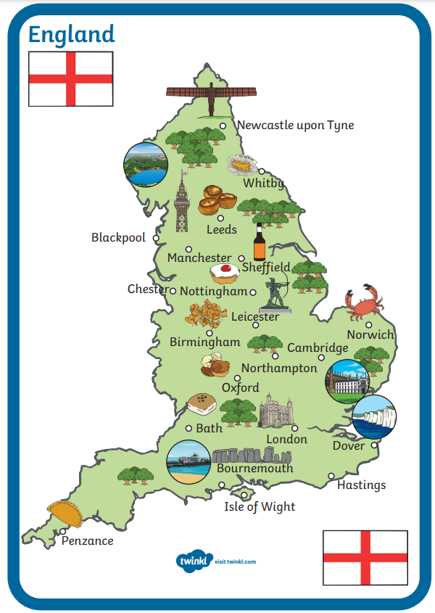
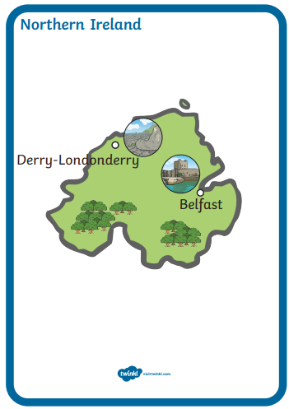
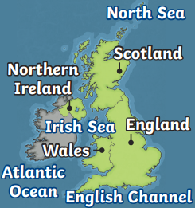
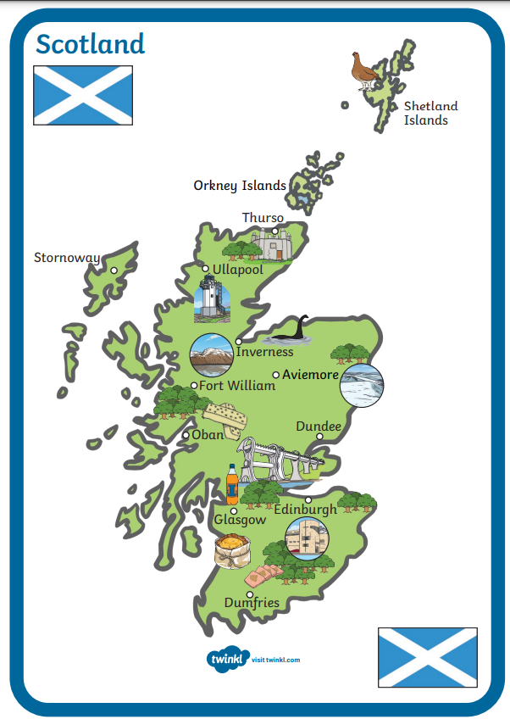
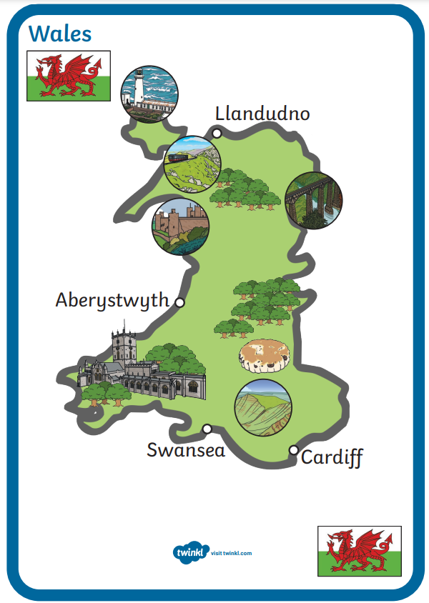

Geography – Year 1 – UK, continents and oceans
The UK
• The United Kingdom is in Europe. Europe is the second smallest continent. It lies north of the equator, in the northern hemisphere. • The official name of the UK is ‘The United Kingdom of Great Britain and Northern Ireland’. It is made of four countries: England, Northern Ireland, Scotland, Wales. • The Irish sea, Atlantic Ocean, English Channel, North Sea surround the UK. • The official flag is the Union Flag, nicknamed the ‘Union Jack’. It was designed to include the flags that represented Scotland, England and Ireland at the time.
England
Capital city: London Physical features: • The highest mountain peak is Scafell Pike. It is 978 metres tall. • The longest river is the Severn. Human features: • The Angel of the North, Stonehenge and the Eden Project are famous landmarks. • The London Eye, Buckingham Palace and Big Ben are in London.
Northern Ireland
Capital city: Belfast Physical features: • Lough Neagh is the largest lake in the UK. • The high peaks include the Sperrin Mountains and Mourne Mountains. • On the coast is the incredible rock formation, the Giant’s Causeway. It is made from tens of thousands of stone columns. Human features: Titanic Belfast is a museum showing Titanic’s history.
Scotland
Capital city: Edingburgh Physical features: • Scotland has the highest mountain in the United Kingdom, Ben Nevis. • Tourists visit the banks of Loch Ness to hopefully see the Loch Ness Monster, Nessie. Human features: • Scotland has over 1000 castles to visit. One of it’s most famous castles is Edinburgh Castle. It sits on top of an extinct volcano. • Burns Cottage in Alloway is famous for being the home of Robert Burns (a poet). He was born there in 1759.
Wales
Capital city: Cardiff Sights to see: Physical features: • Mount Snowdon can be found in Snowdonia National Park. Human features: • Caernarfon Castle, that has a fishing town within the castle’s stone walls. • The Principality Stadium, which is the national stadium of Wales. • The Menai Bridge, which connects mainland north Wales with the Isle of Anglesey.

