Slide 1

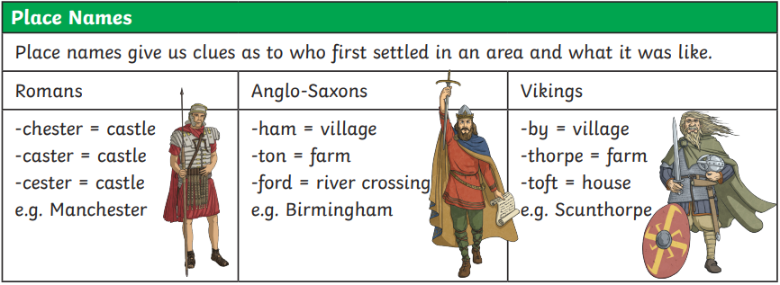
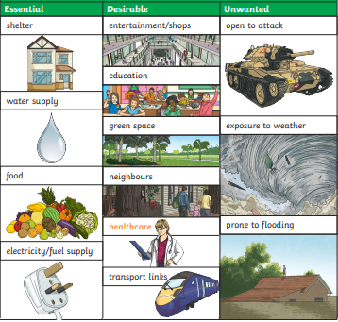
Year 6 – Geography – Where we live – Settling in Horley
History of settlements:
Many of the places where people live today have existed for hundreds or even thousands of years. They were created by early settlers to the UK including Romans, Vikings, Anglo-Saxons. London – AD 43, Grimsby – AD 800, Milton Keynes - AD 1967
What did settlers need?
What did early settlers need to have? Shelter Water Food What did early settles liked to have had? Transport links Healthcare Electricity What did early settles not have needed? Entertainment Friends Shops
Key Vocabulary
amenities | noun. A desirable or useful feature or facility of a building or place.
biome | noun. A large naturally occurring community of flora and fauna occupying a major habitat, e.g. forest or tundra
fauna | noun. All of the animal life present in a particular region or time
flora | noun. All the plants of a particular place or from a particular time in history
OS map | noun. Maps produced by the national mapping agency of Great Britain, the Ordnance Survey. OS maps are widely used for a variety of purposes, including outdoor recreation, planning, and navigation
topography | noun. The study and description of the physical features of an area, for example its hills, valleys, or rivers, or the representation of these features on maps.
trade links | noun. Any transaction or exchange of goods and services. This might be one country trading with another country, eg Kenya selling fruit and flowers to the UK; it might be trade between villages or even between individuals
vegetation belt | An area with distinct plant types, determined by climate, soil, drainage and elevation.
Planning a settlement:
How is land used in Horley?
Agriculture | Agriculture and farming is a type of land use mainly found in rural areas.
Residential | Residential land use is where housing has been built for people to live in.
Commercial | Retail: shops and restaurants Industrial: factories, power plants Business: banks, company head offices
Recreational | Parks, playgrounds and other outdoor open spaces, sporting facilities, cinemas and zoos.
Transport | Areas of land used for transport include roads, airports and railways.
Other | Forest, open land and water can be used for different purposes such as conservation, leisure or commercial use. Areas of land classed as institutional can include schools, universities and hospitals. Protected land refers to places such as wetlands and national parks that have been given special status due to their natural and cultural importance.

Slide 2

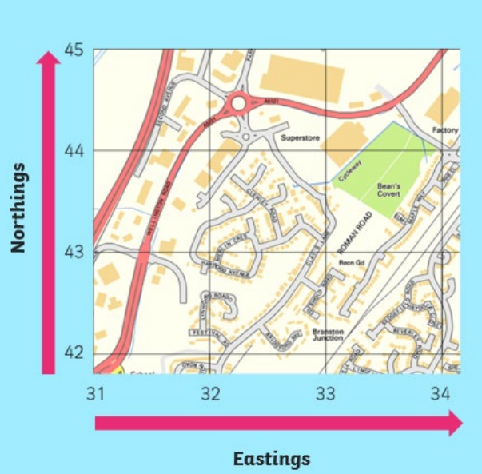
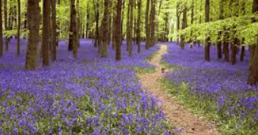
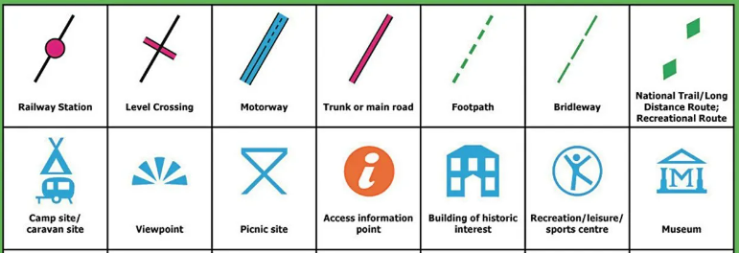
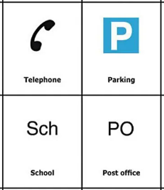
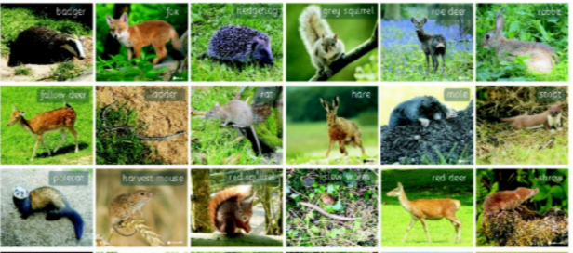
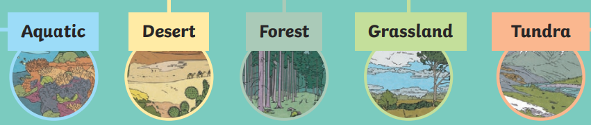
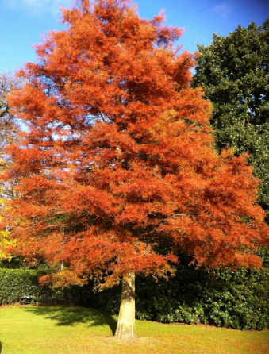
Year 6 – Geography – Where we live – Settling in Horley
OS Maps
An OS (Ordnance Survey) Map is a useful tool if you are planning a route for a long walk off-road. It has symbols to explain the features of different areas so walkers know where and where not to go. OS maps have a scale. On some smaller maps, 1cm on the map equals 250m in real life. On some larger maps, 1cm on the map equals 500m. Different maps might have different scales, so check on your map to find its scale. OS maps have faint blue lines which divide the map into square. Along the edges of each map there are numbers. These numbers help you work out where a location is on a map. This would be helpful if you were lost and needed to call for help. Northings are numbers that go from bottom to top, Eastings go from left to right. OS Symbols:
Temperate forest biome,
The UK has a temperate forest biome. Temperate means ‘not to extremes’ or ‘in moderation’. In this case, temperate refers to the temperature in the UK. What is it like in a temperate forest biome? It often rains but not too much this is called precipitation the average really rainfall in the UK is 108 cm. This means plants get the water they need to grow. Most of the trees are deciduous meaning they lose their leaves in winter but there are many evergreens here too. Rotted leaves and other decaying matter provide rich deep fertile soil for trees to grow strong roots.
What animals are found in the temperate biome in the UK ?
Various animals live here, including badgers, foxes, deer, squirrels, rabbits, bats, adders, frogs, newts and toads. The UK is also home to many species of invertebrate such as spiders, insects mother and butterflies and many birds and fish Some animals, like birds migrate to a warmer place for winter. Some other species migrate to the UK for the winter as it is warmer than their homes further north. Some animals (such as hedgehogs) hibernate or rest during the winter.
Biomes
A biome is an area of the world that has a particular climate and is where animals and plants sharing similar characteristics live together. What lives there depends on temperature, rainfall and the fertility of the soil.
Aquatic This is Earth’s largest biome covering nearly 75% of the planet. It has two main categories: freshwater and saltwater. | Desert These biomes are extremely dry (the average rainfall is 25cm per year). They can be hot or cold depending on the location. | Forest The forest biomes are home to a variety of trees and plants and so are extremely important to our ecosystem. | Grassland Most of this biome is made up of a variety of grasses and is a popular biome for framing due to its rich, fertile soil. | Tundra The tundra is the coldest biome (include the Arctic, Antarctica and some alpine areas (in high mountains).
Vegetation belts
Like a biome, a vegetation belt is an area with the same type of plant life or vegetation. Whereas the biome refers to all living things, a vegetation belt is only the trees and plants that grow there. What vegetation belt is the UK? In the UK we live in a deciduous forest vegetation belt . A deciduous forest vegetation felt is where most trees and plants are deciduous (although there are some evergreen trees). This means they lose their leaves or Flora in Autumn and Winter and fresh growth grows in Spring and Summer. They do this to save energy like how some animals hibernates.

