Slide 1

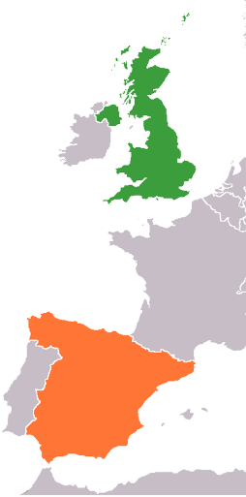
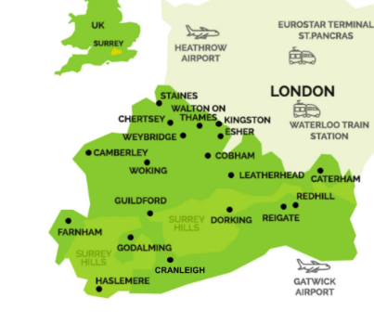
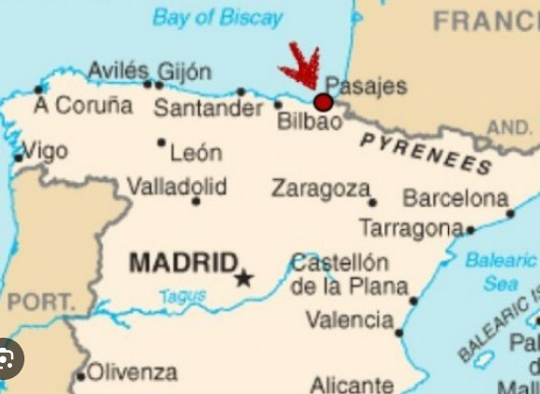
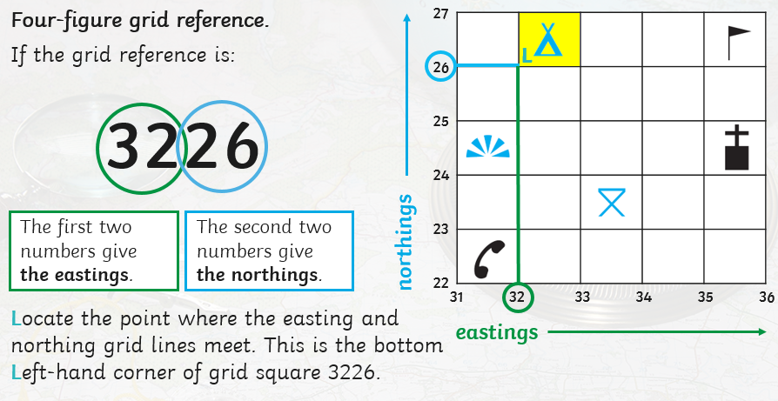
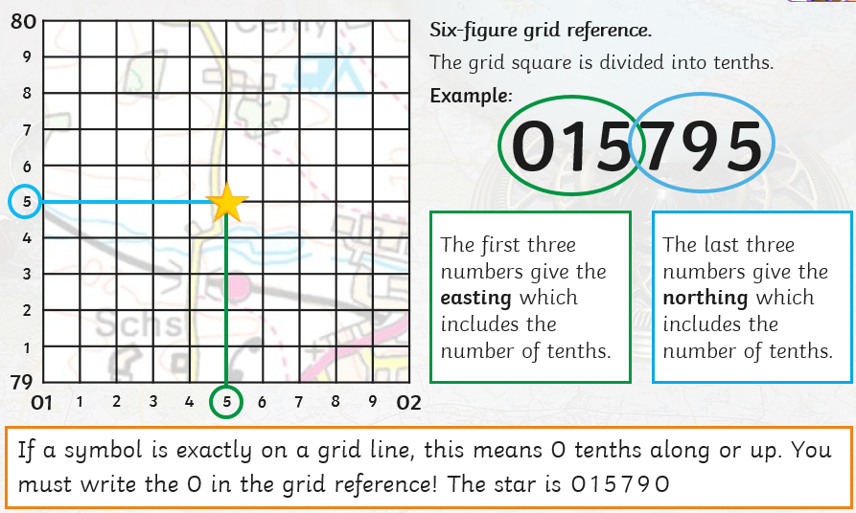
Geography – Year 5 – Where We Live – Comparing places: Surrey and Bilbao
 | UK | Spain
Capital City | London | Madrid
Population | 47,519,628 (2023) | 47,519,628 (2023)
Area | 242 000 km² | 506,030 km²
Language spoken | English | Castilian Spanish
Main type of land use | Agriculture | agriculture
Average warmest month | July 20ºC | July 36°C
Average coldest month | January 6ºC | January 6ºC
Average annual precipitation | 900mm | 551.43mm
Seasons
UK and Spain are both in the northern hemisphere which means they have four seasons.
Key Vocabulary:
The Basque Country | noun. The name given to the home of the Basque people. The Basque Country is located in the western Pyrenees, straddling the border between France and Spain on the coast of the Bay of Biscay.
bay | noun. A coastal body of water connected to a larger body of water, such as a sea or lake. Bays are usually semicircular or nearly circular in shape.
beach | noun. A landform found along the coast of an ocean, sea, or lake (which forms from the accumulation of sediment).
climate | Noun. The usual weather conditions of an area. An area's climate determines what kinds of plants can grow and what kinds of animals can survive there.
city | noun. A large stettlement (larger than a town). In the UK, a place is a city if our monarch has awarded it the status of city.
county | noun. A county is a group of towns and cities that runs services such as transport, education, policing, waste management, etc.
estuary | noun. An estuary is an area at the end of a river that is in between land and the ocean. In estuaries, fresh water from a river mixes with salt water from the ocean, creating water that we call brackish.
industry | noun. A group of businesses that make or sell similar products or perform similar services. Farms are part of the agricultural industry.
muncipality | noun. An administrative unit that governs a specific urban area, such as a town or city.
ocean | noun. A huge body of salt water
river | noun. A fresh, flowing stream of water that leads to the sea, a lake or another river.
tourism | noun. When people travel from where they live to another place for pleasure or relaxation
Surrey, UK | Bilbao, Spain
Surrey is a county in South East England and one of the home counties. It is bordered by Greater London to the northeast, Kent to the east, East and West Sussex to the south, and Hampshire and Berkshire to the west. During the 5th and 6th centuries Surrey was conquered and settled by Saxons. The county now has an area of 1,663 km2 (642 sq mi) and a population of 1,196,236. Its largest town is Woking with a population of 105,367. | Bilbao is a city in Northern Spain, the largest city in the province of Biscay and in the Basque Country as a whole. Bilbao is the tenth largest city in Spain, with a population of more than 347,000 as of 2023. The Bilbao metropolitan area (wider area around the city) has 1,037,847 inhabitants, making it the most populous metropolitan area in northern Spain; with a population of 875,552.
What are four and six figure grid references?

Slide 2


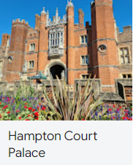
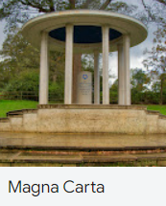
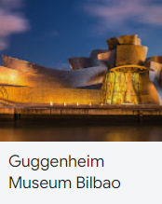
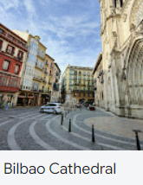
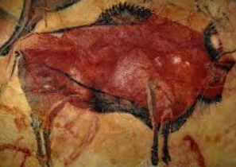
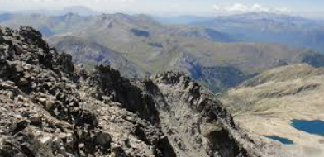
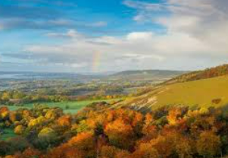
Geography – Year 5 – Where We Live – Comparing places: Surrey and Bilbao
Comparing places:
Some features you might compare to start with are: capital city, location, famous landmarks/ national symbols.
You can compare human features: Language, currency, religion, history, cuisine (food), population, transport, museums, theatres, entertainments/ attractions, sports. | You can compare physical features: Climate, daily weather, vegetation, wildlife, mountains, rivers, biomes/ vegetation belts
History of Bilbao:
Bilbao originated as a settlement of seafaring people on the banks of the Nervión’s estuary. The inhabitants began to export both the iron ore found in large quantities along the river’s eastern bank and the products of their ironworks, which became well known in Europe. Bilbao is divided into two distinctive areas: the left (eastern) bank of the Nervión River, which includes factories and working-class neighbourhoods, and the right (western) bank, including commercial, historic, and residential areas. The old part of Bilbao lies on the right bank with Siete Calles (“Seven Streets”), a series of parallel streets leading to the riverbank. The old city’s notable landmarks include the Gothic-style Cathedral of Santiago (14th century), the Plaza Nueva (early 19th century), and the Renaissance-style churches of San Antonio, Santos Juanes, and San Nicholas. Several towns on the left bank of the river were annexed to the municipality after 1890, forming the modern extension of the city. This section is a banking and commercial centre and is the site of the provincial government’s offices. Nine bridges cross the Nervión to link the old and new parts of the city.
Physical features:
Surrey Like the rest of the British Isles, Surrey has a maritime climate with warm summers and cool winters. The Met Office weather station at Wisley, has recorded temperatures between 37.8 °C (August 2003) and −15.1 °C (4.8 °F) (January 1982) As the longest river in England, the River Thames spans an incredible 215 miles, with Surrey enjoying around 20 miles of it along its northern border. Rivers Wey and Mole run through Surrey (both tributaries of Thames). The Surrey Hills stretch across a quarter of the county of Surrey, from the chalk North Downs that run from Farnham in the west above Guildford, Dorking and Reigate, to Oxted in the east. North Downs – a ridge of chalk hills in south east England that stretch from Farnham in Surrey to the White Cliffs of Dover in Kent Box Hill is a summit in the North Downs Densest woodland cover in England with 22.4% | Bilbao Bilbao has an oceanic climate with mild winters and warm summers. Its average annual temperature is 19.1 °C during the day and 9.4 °C at night. It has low sunshine and high rain. The Nervión river, which ends in the Bay of Biscay, runs through Bilbao. The Pyrenees mountains, stretch 450km between the Atlantic Ocean and the Mediterranean Sea, forming a natural frontier between France and Spain. In the Hautes (high) Pyrenees, the border between these two countries is a high ridge of wild peaks, often more than 3000m high.
Human features:
Surrey Historic sights: Hampton Court Palace, Guildford Castle, Guildford Cathedral, Runneymede Magna Charter Museums: Rural Life Living Museum, Haslemere Educational Museum, Museum of Farnham Theatres: Yvonne Arnaud in Guildford and Rose Theatre in Kingston, New Victoria Theatre in Woking. Festivals: The Surrey Hills International Music Festival Local food: wine, dairy, cheese, eggs and vegetables, farm shops, ethically reared meat. Amusements and theme parks: Thorpe Park and Chessignton World of Adventures, Guildford Spectrum Transport: M25, M3, M23 | Bilbao Historic sites: the Santimamiñe Caves has cave paintings dating (between 14,000 and 9,000 years BC. These paintings contain 47 paintings representing animals: 32 bison, 7 capridae, 6 horses, a deer and a bear. Bilbao Cathedral. Museums: Guggenheim Museum, Bilbao Fine Arts Museum Theatres: Arruga Theatre, Campos Eliseos Theatres, Euskalduna Concert Hall Festivals: Big Week of the city (Aste Nagusia), celebrated annually since 1978 and lasting nine days. It is the city's main festival, attracting over 1,500,000 people every year. Events include: concerts, stage plays, Basque rural sports and bullfighting, as well as nightly firework displays Local food: bacalao al pil pil (cod fish cooked with olive oil, garlic and guindilla peppers) and desserts such as canutillos de Bilbao (puff pastries filled with custard or chocolate) Transport: Bilbao is a relevant transport hub for northern Spain. It has a port on Bay of Biscay.

