Slide 1

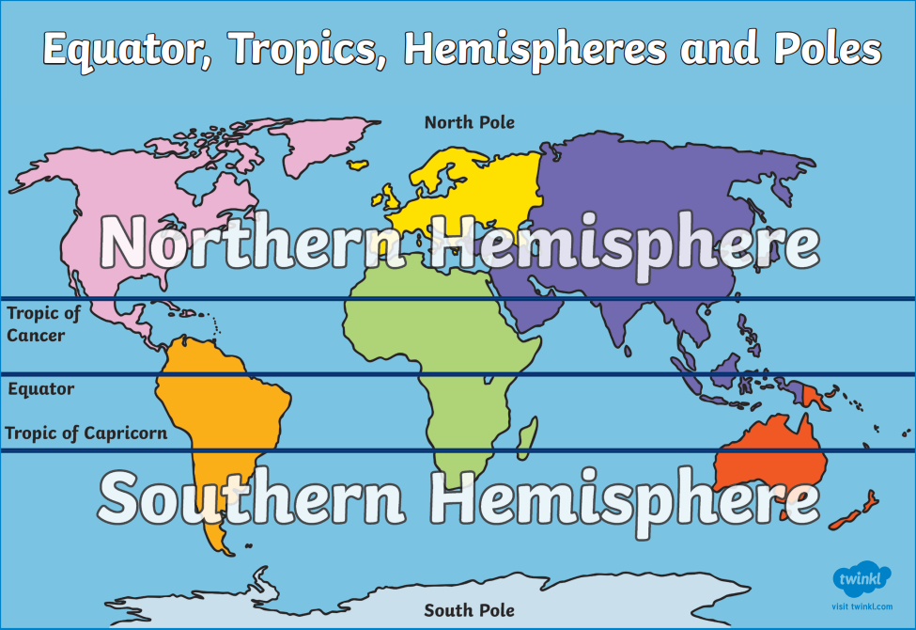
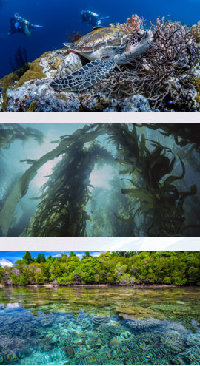
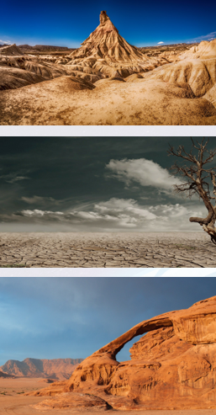
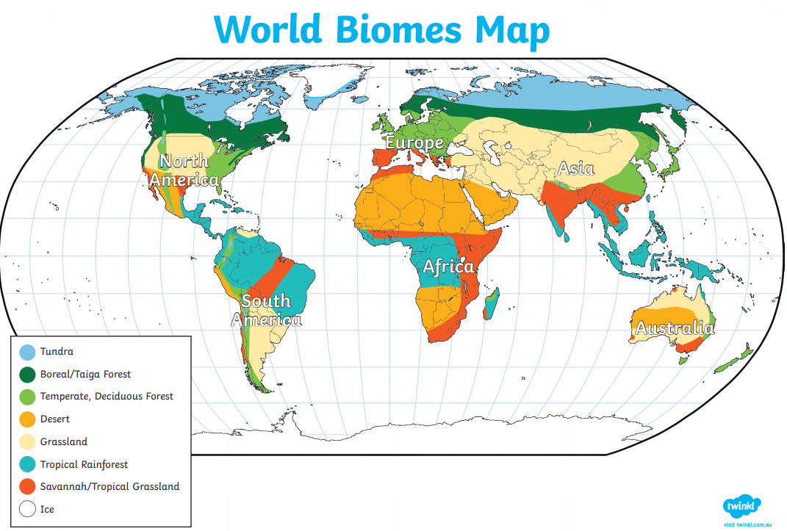
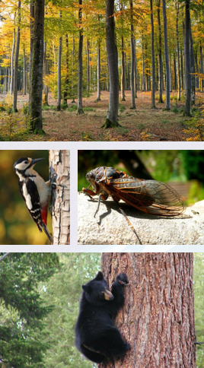
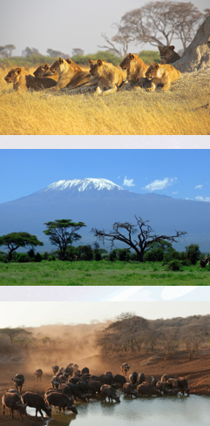
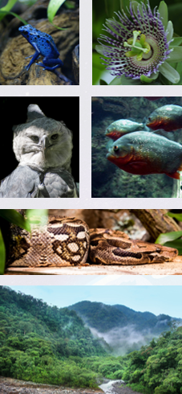
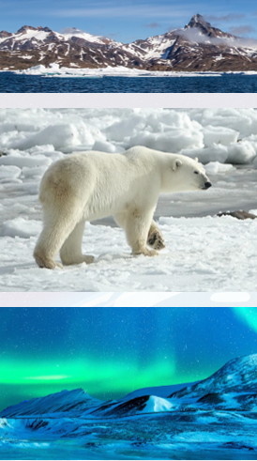
Geography – Year 4 – Where We Live – Our natural Earth
Equator, Hemispheres, Tropics and Poles
A hemisphere is half of a sphere. The equator (0° latitude) divides the Earth into the Northern and Southern Hemispheres. There are differences in climate in the Northern and Southern Hemispheres because of the Earth's tilt toward and away from the sun. In the Northern Hemisphere, the warmer summer months are from June through September. In the Southern Hemisphere, summer begins in December and ends in March. 80% of the world’s population lives in the Northern Hemisphere. 90% of land is in the Northern Hemisphere. The Northern Hemisphere includes all of north America, Europe and most of Asia and Africa. The Southern Hemisphere includes all of Australia, Antarctica and most of South America. 90% of the planet’s water is in the Southern Hemisphere.
Key Vocabulary:
adapt | verb. make (something) suitable for a new use or purpose; modify.
alpine | adj. relating to high mountains.
aquatic | adj. relating to water.
biomes | noun. the weather conditions prevailing in an area in general or over a long period.
climate | noun. the weather found in a certain place over a long period of time is known as the climate. an area's climate determines what kinds of plants can grow and what kinds of animals can survive there.
coniferous | adj. (of a tree) producing cones, and having leaves that do not fall off in the winter:
deciduous | adj. (of a tree or shrub) shedding its leaves annually.
desert | noun a waterless, desolate area of land with little or no vegetation, typically one covered with sand.
ecosystem | noun.an ecosystem is made up of all of the living and nonliving things in an area.
polar | adj. relating to the north or south pole.
taiga | noun. a moist northern forest that consists mostly of cone-producing trees (as pines, spruces, and firs) and begins where the tundra ends.
tropical | adj. fo, relating to, occurring in, or suitable for use in the tropics. tropical forests
tundra | noun. a treeless plain especially of arctic regions having a permanently frozen layer below the surface soil and plant life made up mostly of mosses, lichens, herbs, and very small shrubs.
vegetation | noun. plants considered collectively, especially those found in a particular area or habitat.
vegetation belt | nouns. a vegetation belt is an area with distinct plant types, determined by climate, soil, drainage and elevation.
Biomes:
Biomes are areas across the world which have a similar environment. This means they have similar climates, landscapes, animals and plants. The whole world is split into different biomes. There is some disagreement on exactly how many types of biomes there are but most people think there are six: aquatic, desert, forest, grassland, rainforest and tundra.
Aquatic:
The aquatic biome is the largest type - it covers over 70% of Earth! This biome can be further divided into two main types: freshwater and saltwater.
Desert:
Desert biomes cover around one-third of the Earth and are the driest type of biome. They can be hot or cold, depending on where on the planet they are. Plants and animals have adapted to live in these harsh conditions. Plants found in desert biomes include cacti and creosote bushes while animals that survive here include snakes and lizards.
Forest:
Forest biomes cover approximately 30% of the planet and are home to a wide range of trees and plants. There are three main forest biomes: temperate, tropical and taiga. Animals such as moose, deer, bears and squirrels can all be found in forest biomes.
Grasslands:
Grassland biomes are areas which have enough rainfall for grasses to grow but not enough for forests to develop. Farming often takes place in grassland biomes because of the rich soil. The tropical grasslands in Africa are home to giraffes, zebras and lions.
Rainforest:
Sadly, this biome covers less than 6% of Earth but produces nearly 33% of all of our oxygen. This type of biome is hot and wet all year long and is home to half of all the different types of animals and plants on the planet.
Tundra:
The coldest of the biomes! Due to the low temperatures and dry conditions, these biomes are home to very few plants and animals. However, mosses and short grasses still grow here and Arctic foxes and reindeer make their homes in tundra biomes. This type of biome covers one-fifth of the planet.

Slide 2
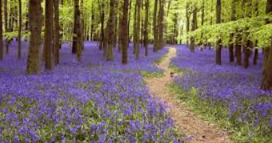
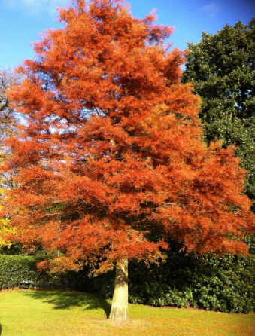
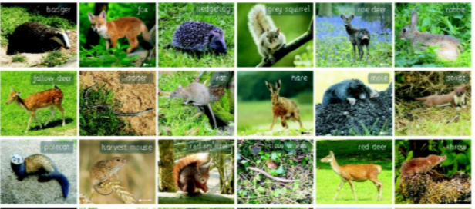
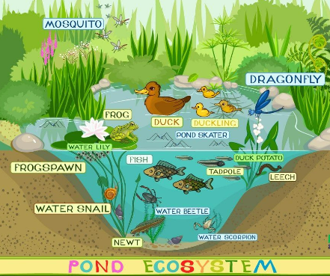
Geography – Year 4 – Where We Live – Our natural Earth
Temperate forest biome,
The UK has a temperate forest biome. Temperate means ‘not to extremes’ or ‘in moderation’. In this case, temperate refers to the temperature in the UK. What is it like in a temperate forest biome? It often rains but not too much this is called precipitation the average really rainfall in the UK is 108 cm. This means plants get the water they need to grow. Most of the trees are deciduous meaning they lose their leaves in winter but there are many evergreens here too. Rotted leaves and other decaying matter provide rich deep fertile soil for trees to grow strong roots.
What animals are found in the temperate biome in the UK ?
Various animals live here, including badgers, foxes, deer, squirrels, rabbits, bats, adders, frogs, newts and toads. The UK is also home to many species of invertebrate such as spiders, insects mother and butterflies and many birds and fish Some animals, like birds migrate to a warmer place for winter. Some other species migrate to the UK for the winter as it is warmer than their homes further north. Some animals (such as hedgehogs) hibernate or rest during the winter.
Vegetation belts
Like a biome, a vegetation belt is an area with the same type of plant life or vegetation. Whereas the biome refers to all living things, a vegetation belt is only the trees and plants that grow there. What vegetation belt is the UK? In the UK we live in a deciduous forest vegetation belt . A deciduous forest vegetation felt is where most trees and plants are deciduous (although there are some evergreen trees). This means they lose their leaves or Flora in Autumn and Winter and fresh growth grows in Spring and Summer. They do this to save energy like how some animals hibernates.
Ecyosystems
An ecosystem is the interaction of animals, plants and microorganisms within an environment. It contains everything that the organisms living there need to survive. For example, a pond ecosystem could include a pond habitat with ducks, frogs, fish, bulrushes and bacteria. Ecosystems can be very big (that Amazon Rainforest) or very small (like a pond). Ecosystems can be divided into three main groups: Freshwater ecosystems (include areas like ponds, lakes, rivers and wetlands. Because this type of water is drinkable, these areas can attract many types of animals including amphibians, mammals and birds. A wide variety of plants can often be found in and around the water. Microorganisms like algae and bacteria are often found in these ecosystems too. Marine ecosystems are different from freshwater ecosystems because the water contains salt. These include coral reefs, rock pools and the deep sea. Some areas contain hundreds of species of fish as well as mammals like seals and dolphins. Plants in marine ecosystems may include seagrasses and mangroves. Microorganisms like plankton are common. Terrestrial ecosystems are those found on land such as forests, grasslands and deserts. There is oxygen in the air for animals to breathe and carbon dioxide for plants to absorb, so a wide variety of organisms can thrive. However, there are greater changes in temperature than in other ecosystems so organisms need to be able to adapt to this. In the UK, there are lots of ecosystems including: farmland urban areas (such as towns and cities) mountains moorland heathland grasslands woodlands and forests coastlines wetlands floodplains Ecosystems can be easily affected by human activity. For example, overfishing and water pollution can damage freshwater and marine ecosystems. Terrestrial ecosystems are vulnerable to activities like deforestation and air pollution.
Conducting fieldwork
Data collections skills include: observing - looking at something carefully to find out about it measuring - using different tools to find out about something accurately record making - make a careful notes and keep an accurate records about what you found out Types of data Qualitative field work is when we collect data that can give you in-depth information about specific things e.g. detailed annotated drawings, photographs, audio recordings, interviews, sketches and sample collections. Quantitative field work is when we collect data which involves numerical information e.g. Counting, timing, measuring.
Presenting data skills include: Analysing - trying to understand the information the data is showing Presenting - explaining what you found out by adding graphs to make it easier to understand, as well as labelling maps, making sketches and taking photographs. Evaluating - thinking about how well you carried out your investigation and thinking about what you will improve next time

