Slide 1

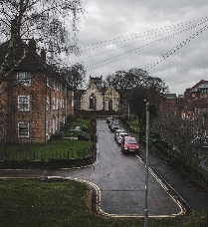
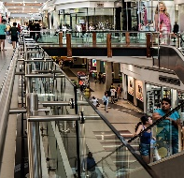
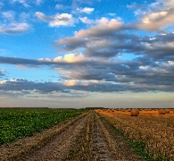
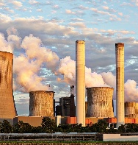
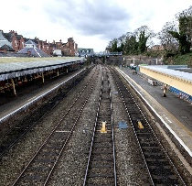
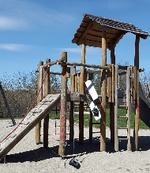
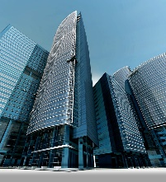
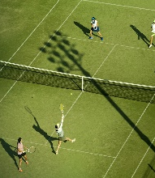
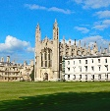

Geography – Year 3 – Where We Live – How is land used?
Land Use
Land use describes how a piece of land is used. This can vary depending on where the land is situated. Sometimes, land is used in its natural state, such as a lake being used for fishing and swimming. It can also be changed to meet particular needs, such as a new housing estate being built on a field.
Key Vocabulary:
agriculture | noun. Another word for farming. The growing and harvesting of crops and/or breeding animals.
airport | noun. A place where all airplanes land, take off in the sky, and stay when not flying.
counties | noun. Areas that countries or states are divided into
development | noun. the process of converting land to a new purpose by constructing buildings or making use of its resources.
farming | noun. the activity or business of: growing fruit and vegetables growing flowers growing grass breeding animals for meat and other produce e.g. milk and eggs
housing | noun. houses and flats considered collectively.
land use | noun. The purpose for which an area of land is being used, such as residential, agricultural, commercial, retail, or industrial.
location | noun. a particular place or position.
recreation | noun. An activity done for pleasure e.g. playing golf, hiking.
retail | noun. Shops where people can buy items
rural | adj. Rural land is a term used to describe areas in the countryside and is often used for agriculture and forestry. 90% of land in the UK is rural.
settlement | noun. a place, typically one which has previously been uninhabited, where people establish a community.
transport | noun. a system or means of conveying people or goods from place to place..
urban | adj. in, relating to, or characteristic of a town or city. 10% of the UK is urban
Types of land use
Agriculture Agriculture and farming is a type of land use mainly found in rural areas. This type of land use can cover a large percentage of a country. Food is produced to feed a country’s people and also to export to other countries. | Residential Residential land use is where housing has been built for people to live in. The size of residential areas can vary depending on whether they are in a village, town or city. | Commercial – retail Retail land use is usually found within or close to residential areas and includes shops and restaurants. A piece of land used for retail can vary in size from small streets lined with shops to large shopping centres. | Commercial – industrial Factories and power plants are found on industrial areas of land. These areas are often quite large and are usually situated somewhere with good transport links so that goods that have been manufactured can be sent to other places.
Commercial – business Commercial land use also includes business (banks, company head offices. Some buildings used for business can be very large and some much smaller. In cities, business areas often include very tall buildings grouped together. | Recreational Recreational land use is where areas are used for leisure activities. These areas can be natural or human-made and include parks, playgrounds and other outdoor open spaces, sporting facilities, cinemas and zoos. | Transport Areas of land used for transport include roads, airports and railways. These areas are important for people and goods to be transported around, into and out of the country. | Other uses: Forest, open land and water can be used for different purposes such as conservation, leisure or commercial use. Areas of land classed as institutional can include schools, universities and hospitals. Protected land refers to places such as wetlands and national parks that have been given special status due to their natural and cultural importance.

Slide 2
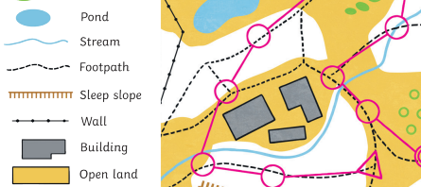
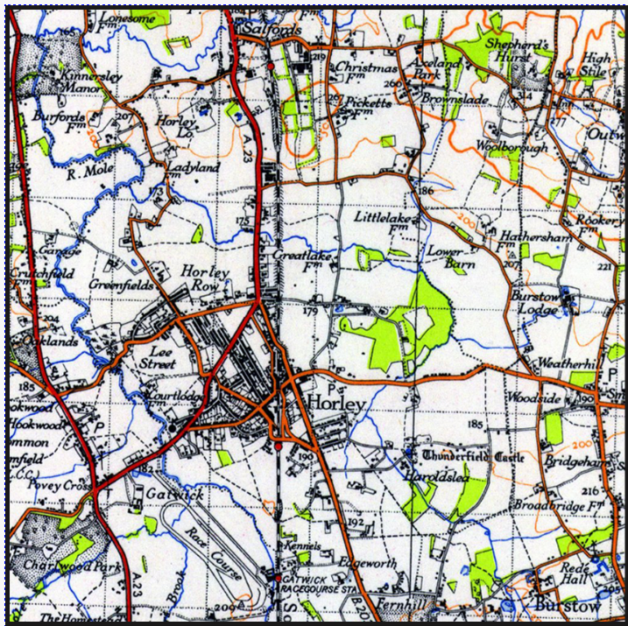
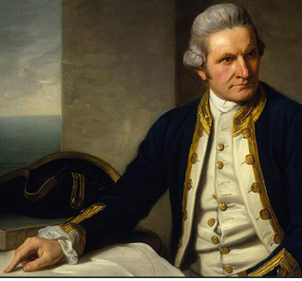
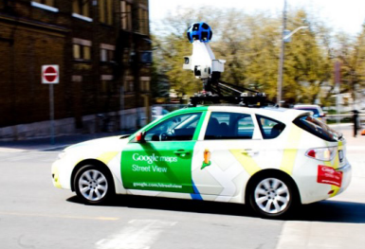
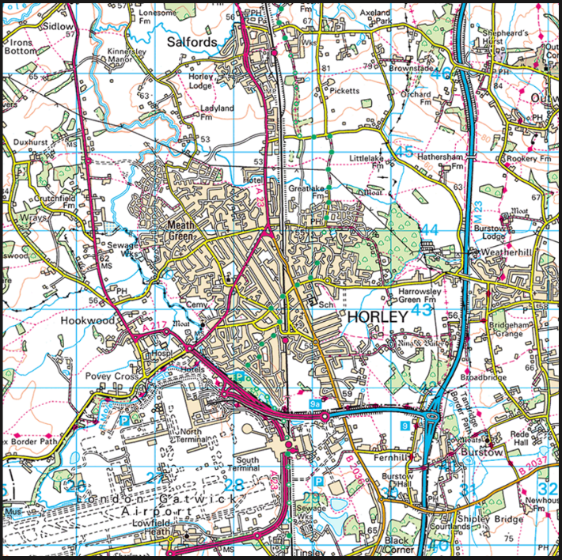
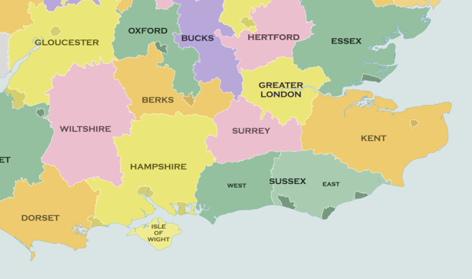
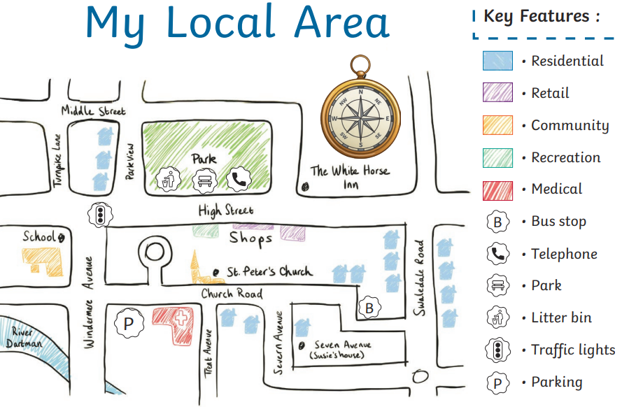
Geography – Year 3 – Where We Live – How is land used?
Land use changes over time
An area’s land use can change over time depending on the needs of the population. For example, a small village may grow over time to be a busy town as more people move to live and work there. Land which was once agricultural, open space or forest in the surrounding area is then used for residential, travel, commercial and recreational purposes.
History of Horley and its human geography
A settlement is a village, town or city. Settlements developed in various places. For example, London expanded during the industrial revolution offering lots of jobs to people in the countryside. Brighton expanded as it was a popular holiday destination. A long time ago, Horley was covered in thick forests and swamps, so people couldn’t farm there. During the Saxon times, an abbey (a big church) called St Peter's at Chertsey owned the land. When King Henry VIII took over many church lands in 1539, Horley was one of them and changed owners several times over the next 60 years. In 1602, the land was given to a school in London called Christ’s Hospital. At that time, Horley was made up of three small villages around a big open area called a common. Later, in 1812, the common was divided up, new roads were built, and some of the land was sold. In the early 1800s, special roads called turnpikes were built for horse-drawn coaches to travel between London and Brighton. In 1841, a railway was added, and a station was built in Horley, which helped the town grow slowly until 1950, when more people started moving there.
Symbols
Maps often use symbols to represent things. The key explains what the symbol shows.
Horley then and now maps
These two Ordinance Survey maps show Horley in the 1920s and the 2020s. Once upon a time Gatwick was known only for its equestrian race course, for which a dedicated railway station was built. https://horleyhandymen.com/horley/
Map Making
A cartographer is someone who draws or produces maps. James Cook (1728 – 1779) was a British explorer and cartographer. Today, technology helps to produce maps using photographs and videos of the area.
What to include in a sketch map:
Title Labels/ annotations and a key Simple lines Enough detail to give a rough idea A ‘not to scale’ note A compass rose
Counties
Horley is in Surrey. Nearby counties include: Sussex, Kent, Greater London, Hampshire, Essex, Berkshire

