Slide 1

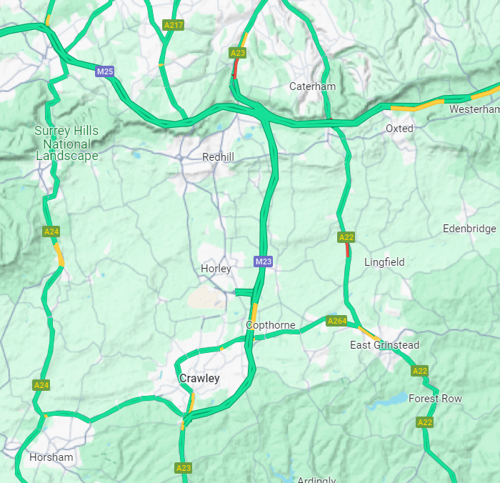
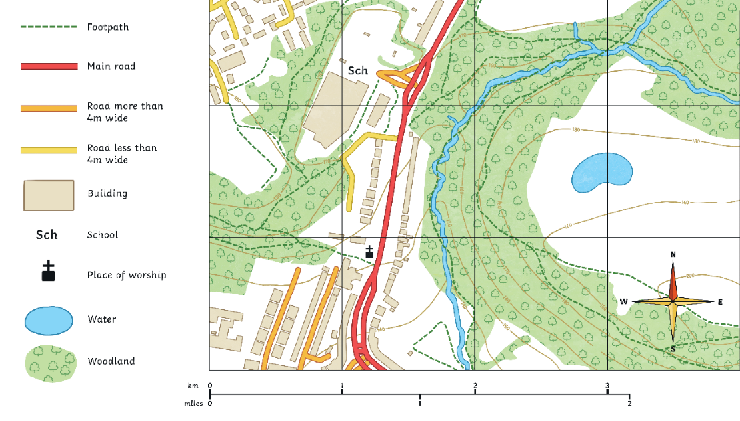
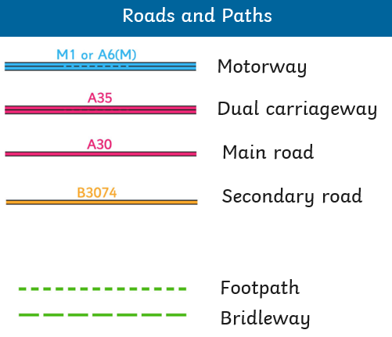
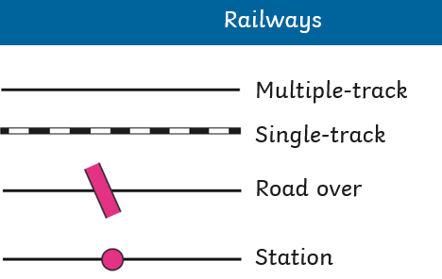

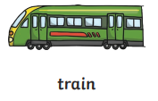

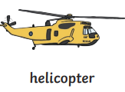
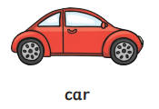
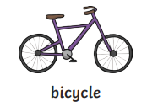

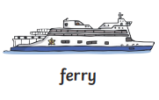
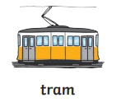


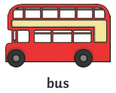
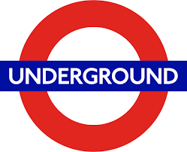
Geography – Year 2 – Where We Live - Transport
Horley
 | Physical features: River Mole Langshott Woods Humans features: Schools e.g. Langshott Primary School Horley Library Supermarkets e.g. Lidls, Waitrose, Icelands Horley train station Churches e.g. Horley Methodist Church Horley Leisure Centre
Travelling around Horley
When travelling around Horley, people might: Walk Ride their bike Ride their scooter Use a car / park & stride Take a bus All these methods are suitable for shorter distances.
Key Vocabulary:
airport | noun. A place where all airplanes land, take off in the sky, and stay when not flying.
countries | noun. A large area of land where people live under the same government or have the same culture.
farms | noun. A piece of land used to grow crops and/or raise animals for produce.
features | noun. A place to stay overnight.
fields | noun. An area of grass, for example in a park or on a farm.
journey | noun. Travel from one place to another.
school | noun. A place where children go to learn.
sights | noun. The interesting landmarks in a place, which people often go to see
station | noun. a regular stopping place in a transportation route
town | noun. A large group of houses, shops and factories where people live. Towns are larger than villages but smaller than cities.
rail line | noun. A railway track or railway line is a set of two parallel rows of long pieces of steel. They are used by trains to transport people and things.
world links | noun. How the world is connected and how we can travel to different parts of the world.
Transport links on a map
A map is a 2D drawing of an area. They are used to help plan routes from one place to another or to find certain features. | Maps show different transport links. Here are some of the key symbols used:
Types of transport
The four main modes of transport are air, road, sea and rail. Different modes are suitable for different distances e.g. bike (bicycles) for shorter distances and trains for longer distances).

Slide 2
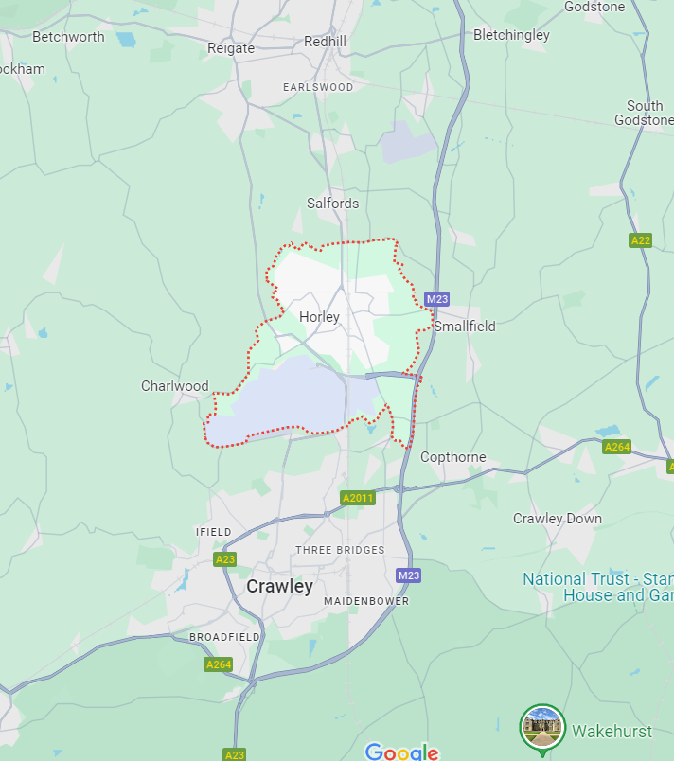
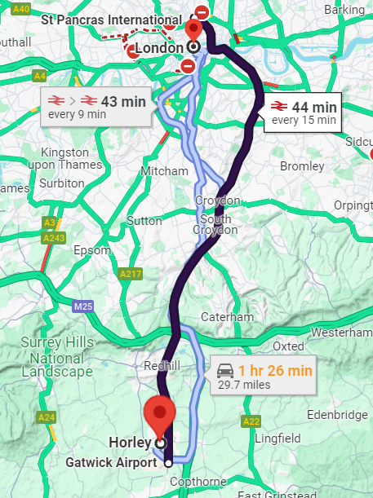
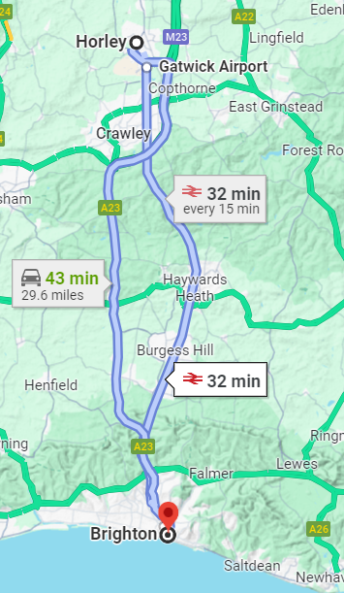

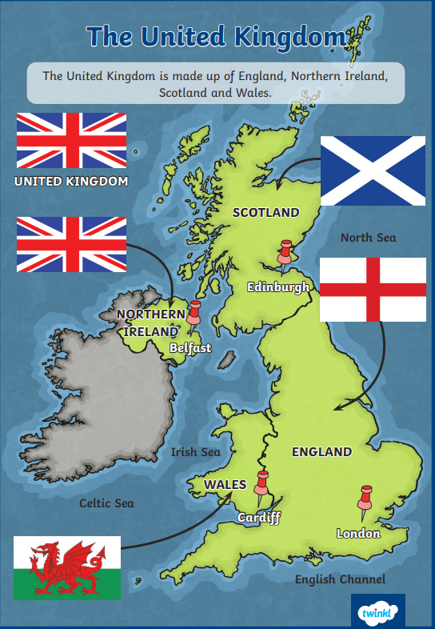
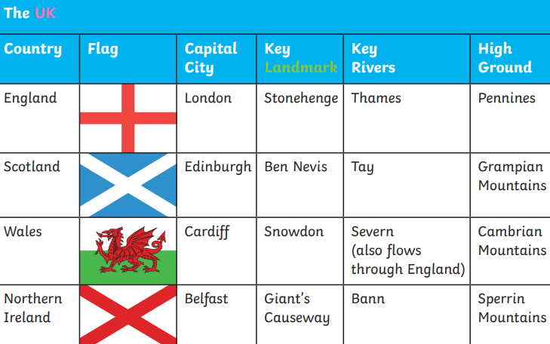
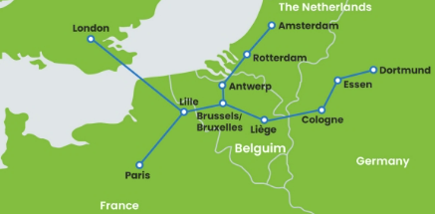
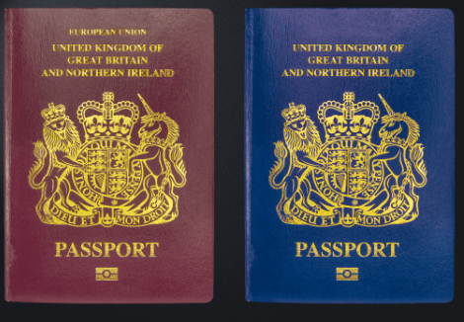
Geography – Year 2 – Where We Live - Transport
Travelling from Horley
A compass has four main directions, which are north, east, south and west. We can use these directions to help us understand where things. | Redhill is to the north of Horley and Crawley is to the south of Horley. To travel to Redhill or Crawley, people might take a bike, a car, a bus or a train. | London is to the north of Horley. People usually travel by car, bus or train. This map shows transport links by car and trains from Horley to London. | Brighton is to the south of Horley. People usually travel by car, bus or train. This map shows transport links by car and trains from Horley to Brighton.
Travelling around the UK
To travel to Scotland and Wales, people may take a coach, car, train or plane. To travel to Ireland , people may use rail and sail (train and ferry) or a plane. In London, people may also use the underground to get around. Here are some key features people may want to see:
Travelling around the world
People can travel from Horley to other countries through different modes of transports. They could: Take a plane - Gatwick Airport is nearby Horley and there are also lots of other airports around the UK. This is a popular way for people to travel abroad to different countries around the world. Some plane journeys can be short (it takes an hour to travel to Paris, France). Other plane journeys can be very long (it takes nearly 17 hours to reach Perth, Australia from London Heathrow). Take a ferry (a large boat for passengers) – A journey to Netherlands can take six and a half hours. Some ferries also allow you to take your car on board. Take a train - The Eurostar is a special train that goes through a tunnel under water. This is called the Channel Tunnel. It links England to France and Belgium. Car or coach – People can drive straight onto a special train that takes them across the Channel Tunnel. To travel to different countries, a passport is needed. This is an official travel document which shows that the persons is a citizen of a particular country. The old British passport was red and the new passport is blue.

