Slide 1

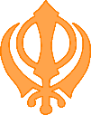

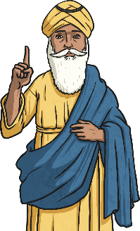

RE – Year 3 – Sikhism – What do Sikhs value?
Sikhism
 | Sikhism is a religion that started in India about 500 years ago. Sikhs are people who follow Sikhism. They believe in one God and try to live kind, honest lives by helping others, praying, and working hard. Below are their key beliefs:
There is only one God and Sikhs only worship and pray to this one God; God cannot be described as either male nor female; God is both sargun and nirgun; God created the world for people to enjoy; God created people to know the difference between right and wrong; Images of God are forbidden, as is worshipping them; All people are equal.
sargun – The belief that God is everywhere and within everything. |  | nirgun – The belief that God is above and beyond the range of human experience.
Key Vocabulary
Equality | noun. the belief that everyone is equal, no matter who they are. In Sikhism, this means treating all people the same, regardless of their background, gender, or wealth.
Five Ks | noun. five special items that Sikhs wear to show their faith
Gurdwara | noun. a Sikh place of worship where people go to pray, learn, and share meals. Anyone is welcome to visit a Gurdwara.
Guru | noun. a teacher or guide. In Sikhism, there were 10 human Gurus who taught important lessons about God and how to live a good life.
Ill Onkar (Oneness of God) | a phrase meaning there is only one God. Sikhs believe that this one God created everything and is present in everything.
Khanda | noun. a symbol of Sikhism made up of three parts: a double-edged sword in the middle, a circle around it, and two single-edged swords on the sides. It represents the power of truth, unity, and justice.
Langar | noun. a free meal served to everyone, regardless of who they are, at a Gurdwara. It shows equality and the Sikh value of helping others.
Naam | noun. the name of God. Sikhs focus on remembering and repeating God's name as a way to bring themselves closer to God.
Guru Nanak Ji
Guru Nanak Ji started Sikhism because he wanted to teach people about God and how to live good lives. Sikhs do not worship Guru Nanak as a god, but they respect him as a very wise teacher who showed them the way to God. Growing up, many people thought Nanak was a dreamer as he spent lots of time thinking about God. One day, his father sent him with some money to the city and told him to make more money. But when Nanak came across a group of poor, hungry monks, he used the money to buy them food instead. His father was angry, but Nanak knew he had done the right thing. While working as a shopkeeper, Nanak began telling people his ideas about loving and following God. Some people began to call him ‘Guru’ which means ‘teacher’. One morning, Nanak got up early and went to the river to wash and say prayers. He disappeared and only his clothes were left. The villagers looked everywhere but he was nowhere to be found. Three days later, Nanak reappeared. He stayed silent for a whole day. When he spoke, he told the people that he had been with God and had been sent back to teach them how to become closer to God. He taught them everyone was equal in the eyes of God, no matter what they believed. Nanak travelled across India, teaching people about God. Those who listened were called Sikhs (meaning learners) and Nanak became Guru Nanak Dev Ji (meaning God’s teacher). Finally, he settled on the banks of River Ravi. He and his people would gather together to pray and share food. Everyone was welcome, whether rich or poor.
The word ‘guru’
The word ‘guru’ means ‘teacher’ in Sikhism. There were ten human Gurus in Sikh history who helped guide Sikhs on how to live: Guru Nanak, Guru Angad, Guru Amar Das, Guru Ram Das, Guru Arjan, Guru Hargobind, Guru Har Rai, Guru Harkrishan, Guru Tegh Bahadur and Guru Gobind Singh. They shared important lessons about God, equality, and kindness.

Slide 2
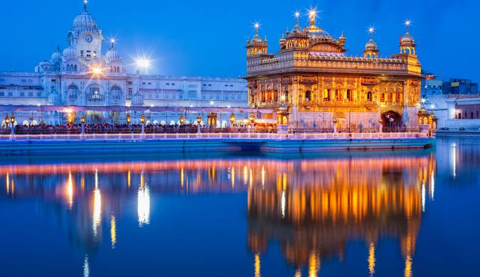
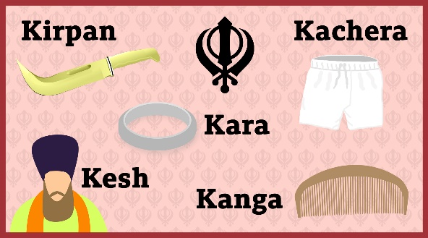
RE – Year 3 – Sikhism – What do Sikhs value?
Guru Granth Sahib Ji
The holy book of the Sikhs is called the Guru Granth Sahib Ji. It contains prayers, hymns, and teachings from Sikh Gurus and other spiritual leaders. Sikhs treat the book with great respect because they believe it is their guide for life.
Worship
Sikhs worship God at home by praying and reading from their holy book. They also gather at a special place called a Gurdwara, where they pray together, listen to teachings, and share food with others. Shoes must be removed and hair covered before entering the main prayer hall to worship. Men and women sit crosslegged on opposite sides, facing the Guru Granth Sahib. | The Sri Harmandir Sahib is also known as the Golden Temple. It is located in Amritsar, India. Its doors open from all sides to welcome people of all faiths
The Five Ks
Sikhs have five special symbols that show their faith, called the Five Ks. Kesh (uncut hair): Sikhs keep their hair uncut to show respect for the way God made them. It reminds them to accept themselves as they are. Kanga (wooden comb): A small comb used to keep their hair tidy. It reminds Sikhs to keep their thoughts and actions clean and organized. Kara (steel bracelet): A bracelet made of steel that Sikhs wear on their wrist. It reminds them that God has no beginning or end, like the circle of the bracelet, and to always do good things with their hands. Kachera (cotton underwear): A special type of comfortable, loose underwear. They are a symbol of leaving old ideas behind and following new, better ones and of modesty. Kirpan (small sword): A small sword that symbolizes bravery and the Sikh duty to protect the weak and stand up for justice. Each of these symbols helps Sikhs remember their faith and how to live good, honest lives.
The Khalsa
The Khalsa is a special group within Sikhism that Sikhs can choose to join. They go through a ceremony where they promise to live by Sikh values like being brave, honest, and helping others. They also start wearing the Five Ks to show their commitment.
Equality
Sikhs believe that everyone is equal, and no one should be treated differently because of their background, wealth, or gender. In Sikh society, equality is important, and everyone is welcomed and treated with respect.
Sikh Duties
Sikhs believe in praying to God to feel close to Him, working hard to earn an honest living, and giving to others to help those in need. These three duties are the main ways Sikhs practice their faith every day. Pray: Keep God in mind at all times (Nam Japna). Work: Earn an honest living, avoiding crime, gambling and begging (Kirt Karni). Give: Give to those less fortunate and care for others (Vand Chhakna).
Community
Communities and cooperation within them are among some of the most important principles of Sikhism. Sikhs believe that there should be a fellowship, which involves worshipping, eating and serving together. ‘Seva’ means an act of selfless service. In Sikhism, ‘seva’ refers to giving a service for unselfish purposes on behalf of, and for the benefit of, a community.

