Slide 1

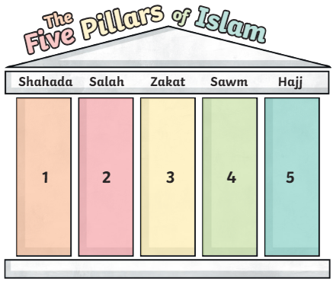
RE – Year 6 – What helps Muslims to live a good life?
Key beliefs
Muslims believe that there is only one God called Allah. They believe Allah is the only ruler of the universe. The word ‘Islam’ means submission and obedience to Allah. Muslims believe that Allah has 99 names/ qualities. They believe he is omniscient, omnipotent and eternal. Muhammad (pbuh) is so highly respected by Muslims that they will say “peace be upon him” after his name is spoken. Muhammad (pbuh) was born in the city of Mecca in Saudi Arabia. Muslims believe that he is the last prophet, or messenger, of Allah. Others included Moses and Jesus. Muslims do not draw images of Allah or Muhammad (pbuh).
Key Vocabulary
Allah | noun. the Arabic name that Muslims use for God.
alms | noun. money or food given to poor people.
angels | noun. Muslims believe that angels are with them at all times. They have two angels, which sit on either shoulder and are known as Al-Kiram and Al-Katibun. One of the angels records the good things the person has done and the other records the bad things the person has done.
eternal | adjective. lasting or existing forever; without end.
fast | noun. a period of time when Muslims do not eat.
The Five Pillars of Islam | noun. the five things that Muslims are expected to do.
monotheistic | adjective. relating to or characterized by the belief that there is only one God.
omnipotent | adjective. (of a deity) having unlimited power.
omniscient | adjective. knowing everything.
prayer | noun. Muslims pray Salah, make duas (genuine requests) and perform dhikr (praises of Allah)
Qur’an | noun. the holy book of Islam.
Six Main beliefs
Muslims have 6 main beliefs: Muslims believe that Allah is the one and only God. Muslims believe in angels. They believe in the Qur’an (the holy book). Muslims believe in the Prophets, special messengers between Allah and the people. They believe in the Day of Judgement. This is the day when it is decided if a person will go to heaven by looking back at what that person has done in their life. Muslims believe that Allah already knows what will happen in their lives.
The Five Pillars of Islam
As well as the six main beliefs, there are Five Pillars of Islam. Shahadah: The main belief of all Muslims. This pillar declares a Muslim’s faith in Allah. There is a special statement that Muslims say. This is: “There is no god but Allah, and Muhammad (Peace Be Upon Him) is the Messenger of Allah.” Salah: Muslims pray five times a day. Before prayer, they must wash themselves and then face Mecca whilst praying. The five prayers are called: Fajr, Zuhr, Asr, Maghrib, Isha. Zakat: Muslims must donate to charities. Sawm: Muslims fast for one month during a time called Ramadan. Hajj: Muslims have to travel to Makkah once in their lifetime, if they can afford to.

Slide 2
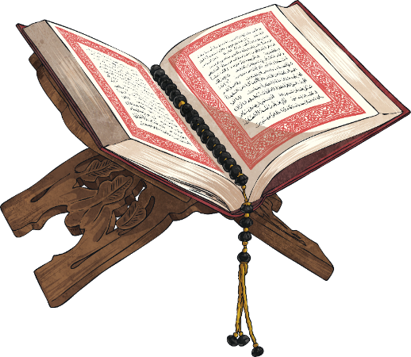


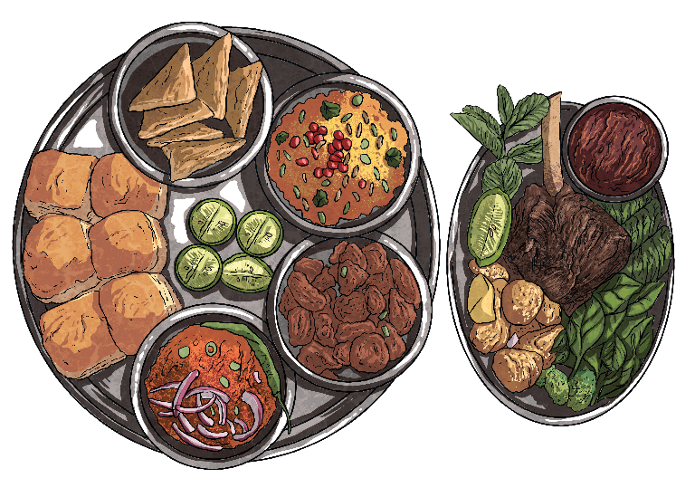
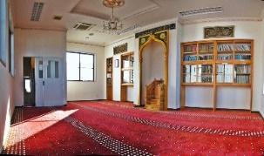
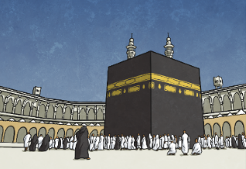
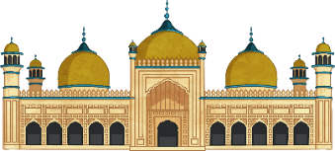
RE – Year 6 – What helps Muslims to live a good life?
The Qur’an
The Muslim holy book is called the Qur’an. Muslims believe that it is a record of the unaltered (exact) words that Allah said. Muhammad (pbuh) went to the mountains around Mecca. One night, he heard the Angel Gabriel speaking to him. He realised that these were words from Allah. Muhammad (pbuh) was the Messenger of Allah, so he remembered the words carefully. During his life, Muhammad (pbuh) was sent many other revelations from Allah for over 23 years. These words make up the Qur’an, the Muslim holy book. Muslims treat the Qur’an with a huge amount of respect, as they believe it is from Allah and therefore every word is sacred. The Qur’an is placed on a special wooden stand called a rehal to be read. It teaches Muslims how to live good lives. It teaches Muslims how to treat other people. There are some Muslims who are called the Hafiz. The Hafiz learn parts of the Qur’an by heart to recite to others. As well as the Qur’an, the other sacred sources in Islam are the Sunnah (soo-n-uh), which contains the practices and examples of the Prophet Muhammad (PBUH) and Hadith (hah-deeth), which contains the things that Prophet Muhammad (PBUH) said or did.
Ramadan and Eid Al-Fitr
Throughout the month of Ramadan, Muslims (from around the age of 14) don't eat or drink daylight hours. Ramadan marks the month the Qur’an (Muslim holy book) was first revealed to the Prophet Muhammad (pbuh). It is the holiest time of the year and begins the morning after the crescent moon. Muslims show their commitment and dedication to the Islamic faith by fasting during Ramadan. It helps them to practise patience and to feel closer to Allah. Muslims can eat a very early breakfast before sunrise, also called the Suhoor. As the sun sets, Muslims break their fast with dates and water. Then, a prayer is said. Once the sun has set, Muslims eat a larger meal. Ramadan isn’t just about fasting. Many Muslims spend more time praying and reading the Qur’an. It’s also a time to give up bad habits and to do good deeds for others, e.g. donating your time or money to help a charity. The end of Ramadan is marked by one of the holiest festivals of the year - Eid Al-Fitr. On this day, Muslims wear their best clothes and decorate their homes. There are special services in the mosque (place of worship), celebrations in the street and food eaten in the daytime.
Mecca | Eid al-Adha
Hajj, Pilgrimage to Mecca Every Muslim is expected to make the journey (pilgrimage) to Mecca at least once in their life (as long as they are well enough and able to afford it). This is known as Hajj. Eid al-Adha also takes place during Hajj. Mecca is the heart of Islam and is a very special place to all Muslims. Every day, Muslims pray in the direction of this city no matter where they are in the world. Sometimes, Muslim perform the lesser pilgrimage called Umrah which can take place at any time, the rest of the year. | Eid al-adha means ‘Feast of the Sacrifice.’ It is a celebration of the Prophet Ibrahim’s (pbuh) willingness to sacrifice his son, Isma’il, to show Allah the strength of his faith. Ibrahim was willing to give up Ismai’l, his favourite person in the world, to show Allah his devotion. Because God replaced Ibrahim’s sacrifice of Isma'il with a ram, many Muslims sacrifice a similar animal during Eid al-Adha. If they can afford it, Muslims sacrifice a sheep, a ram, a camel or a cow during Eid al-Adha. They share this with the poor.
Mosques
The Muslim place of worship is called a mosque. Services are held in mosques every day. The most important service for Muslims is on a Friday. Mosques often have a domed roof. There are no images of people or animals in mosques. They are decorated with patterns and words from the Qur’an. Muslims take off their shoes before going into the mosque and wash before they pray. Muslims pray kneeling on the floor on a prayer mat. The wall of the mosque which faces Makkah is called the qibla wall. It has an empty arch to show the direction of Makkah.

