Slide 1

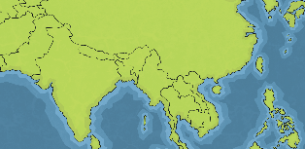
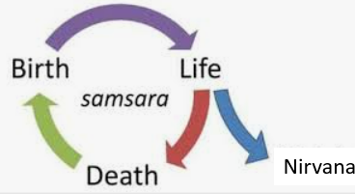
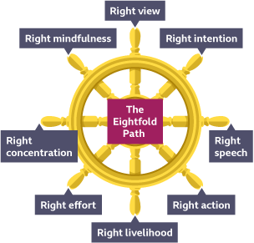
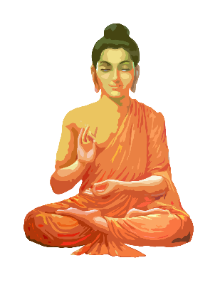

RE – Year 5 – What is the ‘Buddhist way of life?’
Buddhism originated in Northeast India and now has followers from all over the world. The Dharmachakra is a symbol used in Buddhism.
Key Vocabulary
Buddha (Siddhartha Gautama) | noun. The teacher and creator of Buddhism. He is the awakened one. Buddha is not a god.
Eightfold Path | noun. The rules laid out by Buddha which will lead to Nirvana.
enlightenment | noun. Breaking the Buddhist cycle of rebirth and reaching Nirvana.
Four Noble Truths | noun. Buddha’s key teachings. They explain the problems that humans face and why.
meditation | noun. When Buddhists close their eyes and breathe deeply, trying to empty their minds of thoughts.
Nirvana | noun. Perfect peace with no suffering.
Rebirth | noun. Buddhists believe in the cycle of reincarnation, which means a living being is ‘reborn’ as another living being after their death. Their soul is eternal and enters a new body. The
Shrine | noun. A special place that is linked with a holy object or person
The Wheel of Dharma | noun. Dharmachakra: Represents the Eightfold Path
Siddartha Gautama and Samsara
 | As a young prince, Siddartha saw the Four Sights: an old man; a sick man; a dead man and a poor, holy man, meditating. Siddartha realised that we all suffer. We are trapped in Samsara. Cultivating good karma and avoiding bad karma is the only way to break free from samsara into Nirvana: release from suffering. The Triple Gems are sources of knowledge on how to break free of karma & samsara: Buddha, Dhamma (teachings) and sangha (community).
The four noble truths
Dukka: the truth of suffering Accepting that all life is impermanent and will involve suffering
Samudaya: the truth of the origin of suffering Knowing that there are things in life that cause suffering, such as craving and desire.
Nirodha: the truth of the end of suffering Understanding that we can end suffering and achieve nirvana if we detach ourselves from what we crave and are content with what we have.
Magga: the truth of the path to the end of suffering Knowing we can end suffering by following the Eightfold path or ‘the middle way.’
The Eightfold Path:
The Eightfold Path is the heart of Buddhist practice. Buddhists are told to: Avoid evil: Right action, Right speech, Right Livelihood Do only good: Right View, Right Intention, Right Effort Purify the mind: Right Mindfulness, Right Concentration Siddartha attained Nirvana (end of suffering) through practising all elements of the Noble Eightfold Path. He then became Buddha (the awakened one).
Buddhists live by five rules:
Never take the life of a living creature. Do not steal. Be faithful to your partner. Do not lie. Do not drink alcohol.

Slide 2
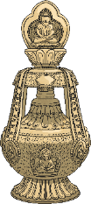
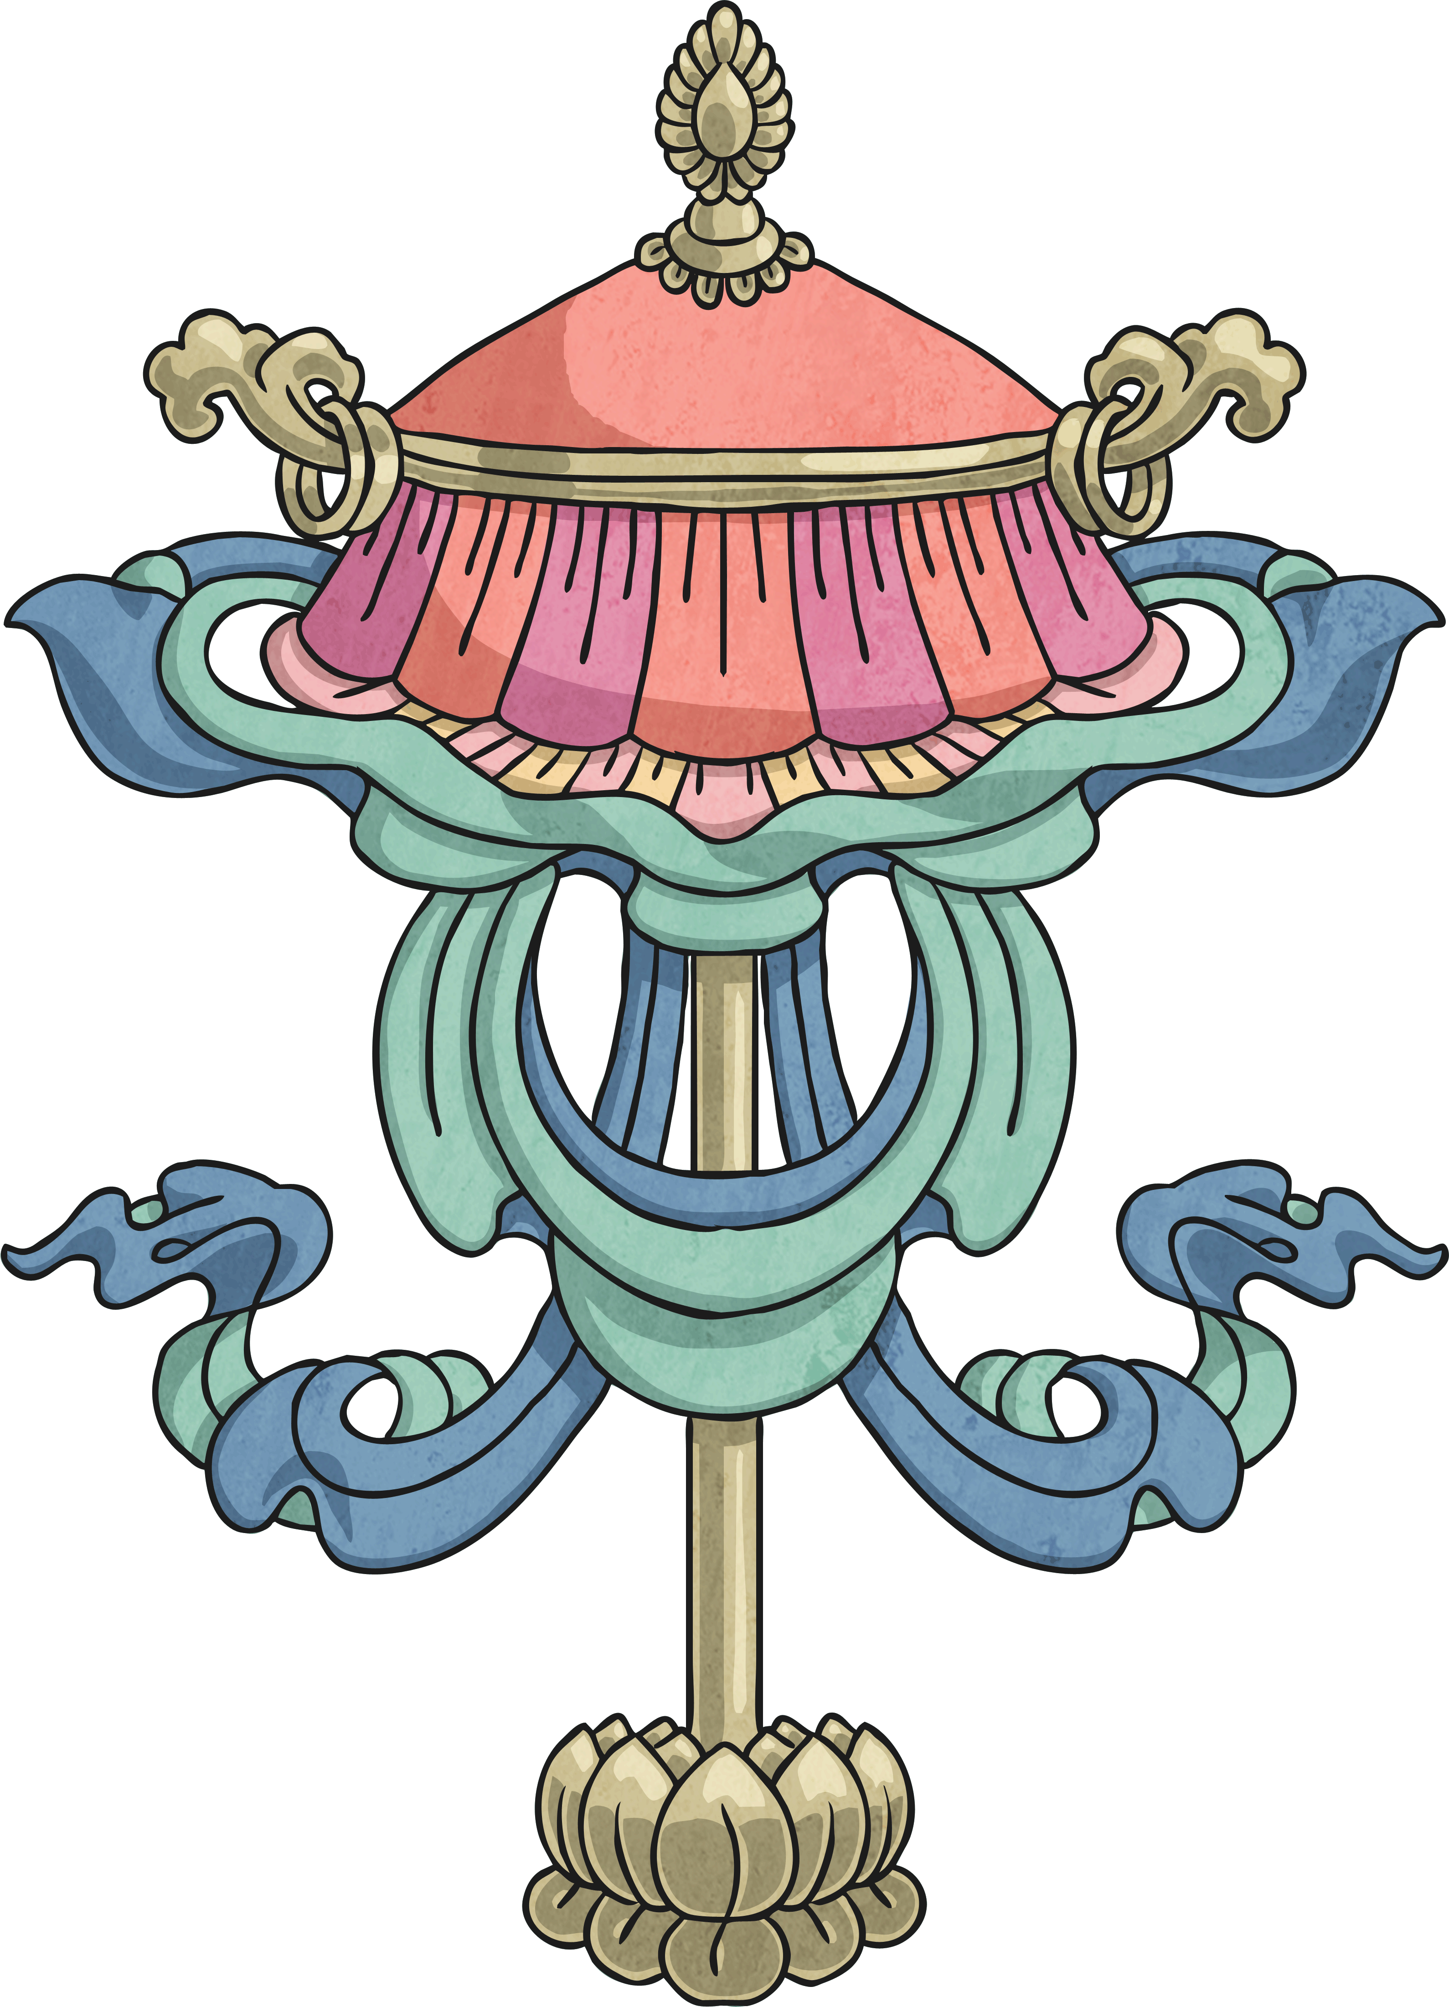
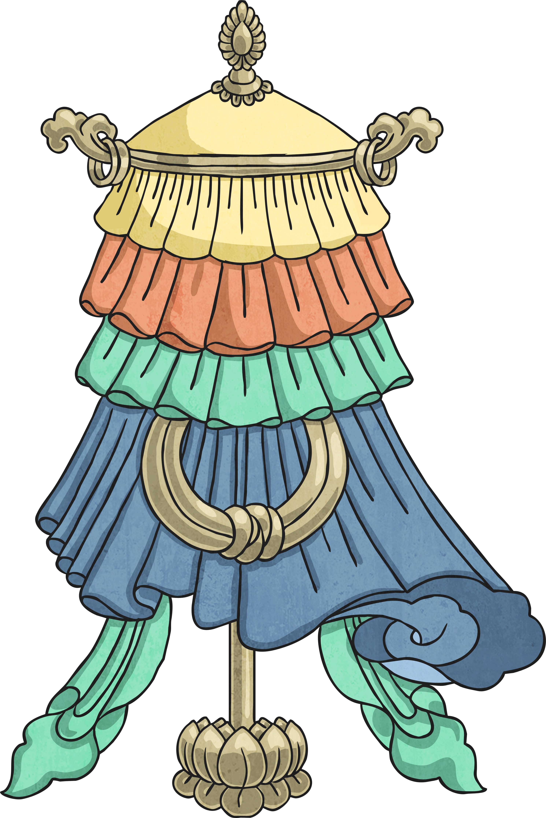
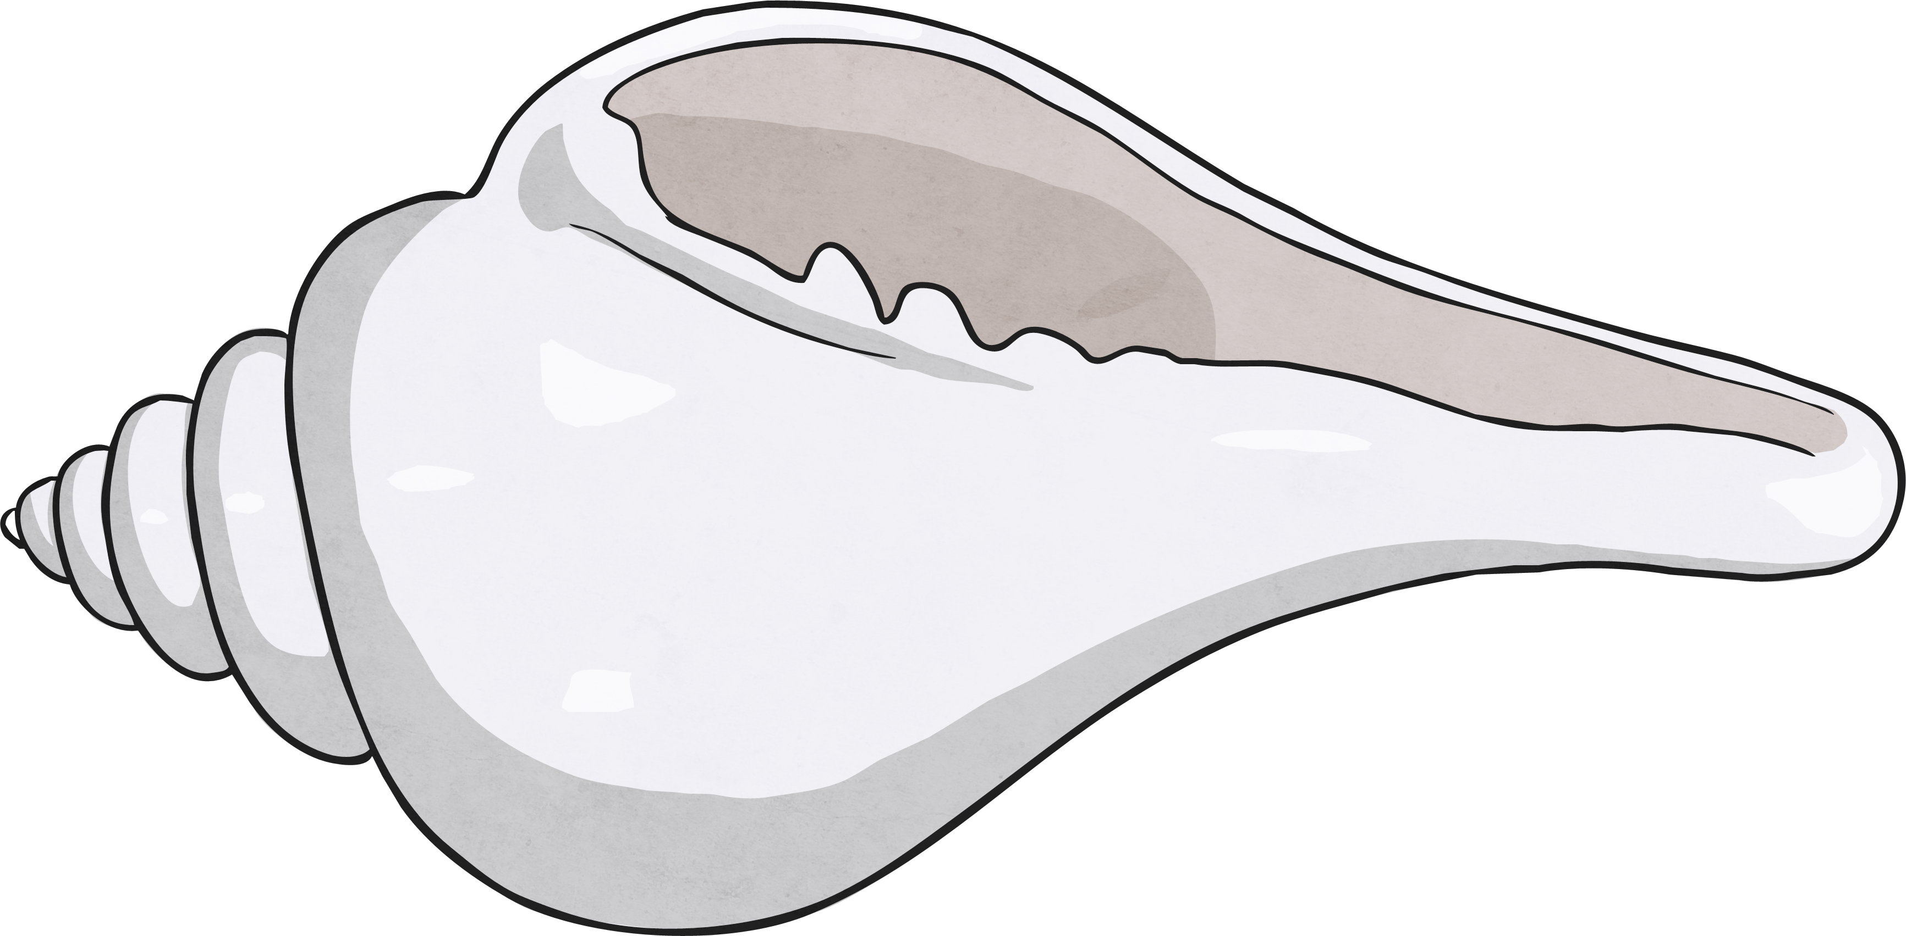
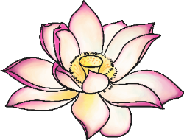
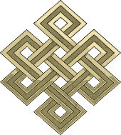
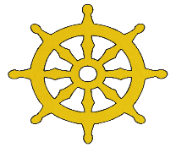
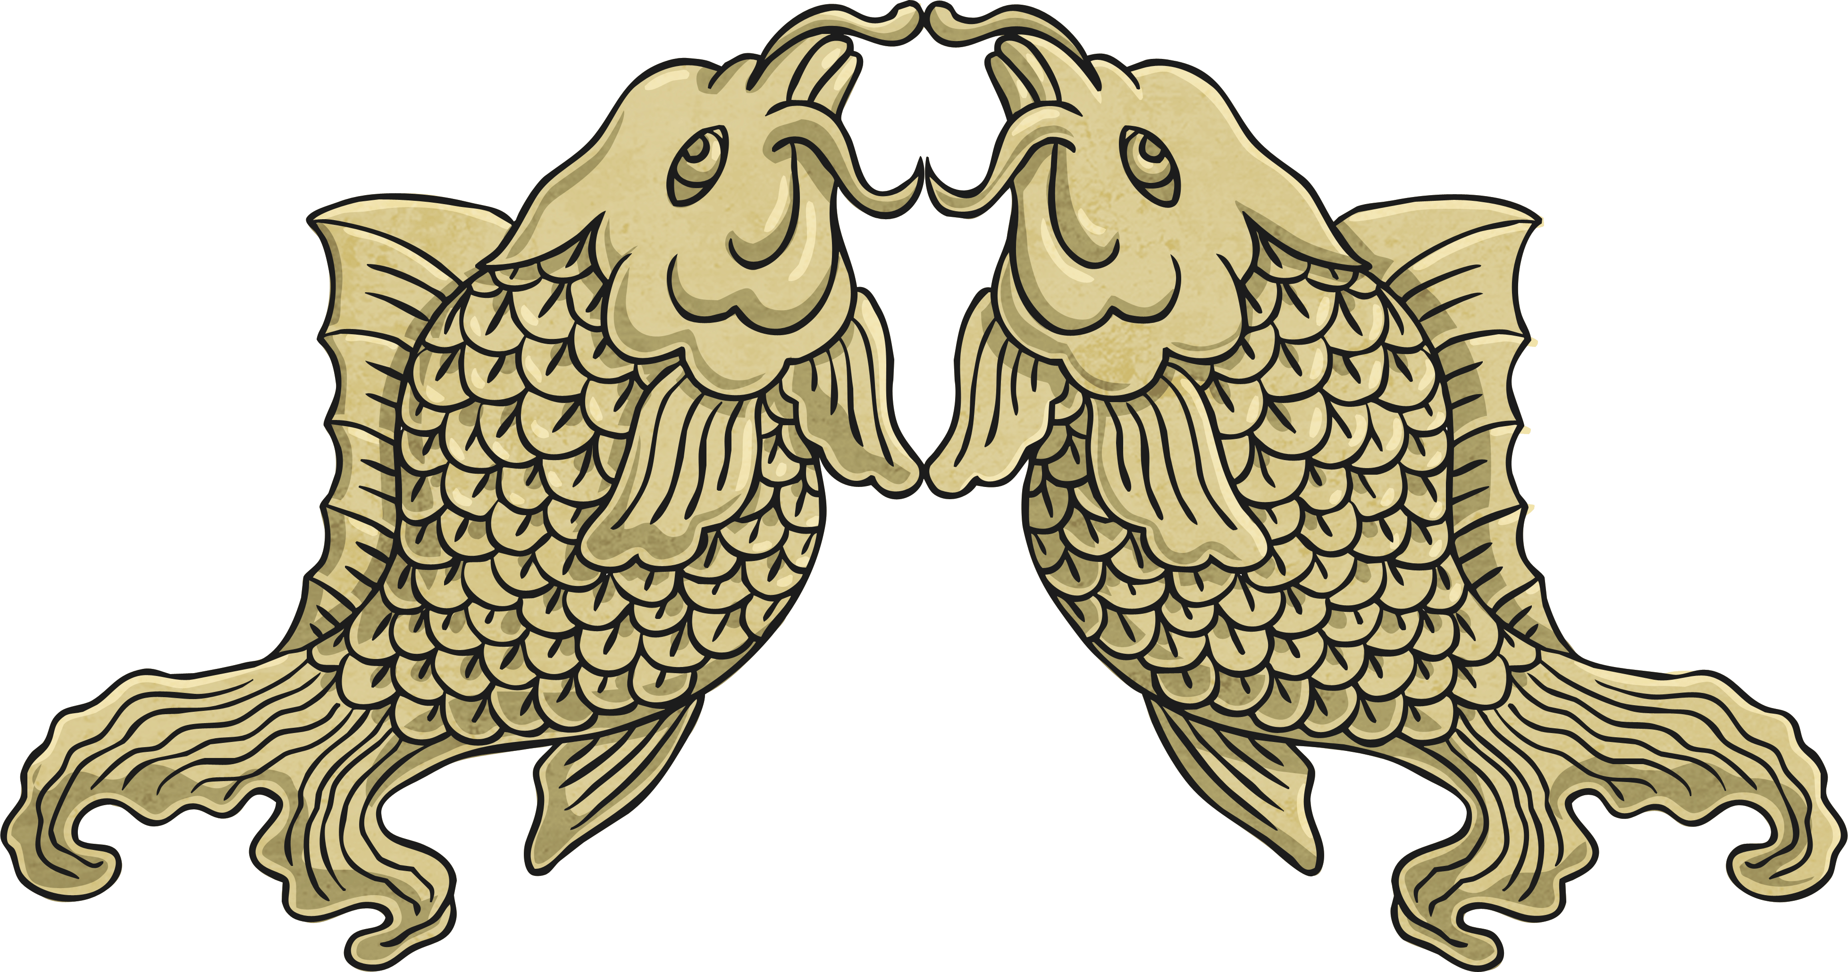
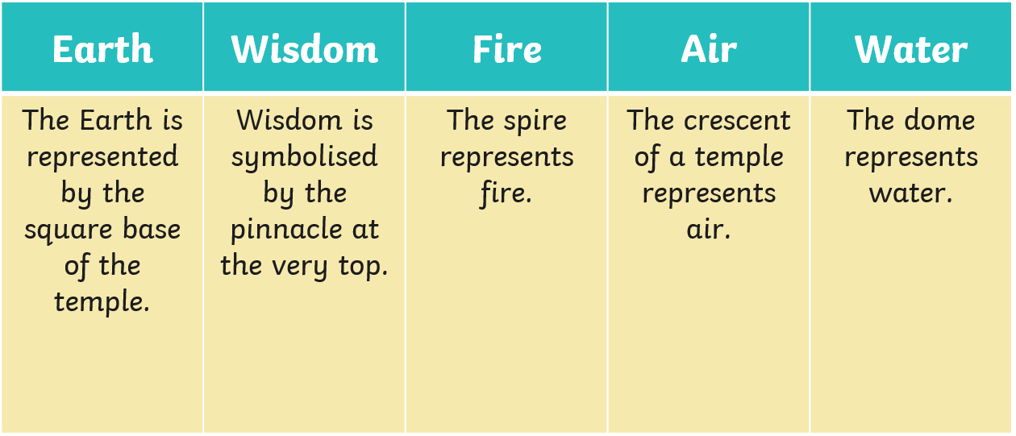
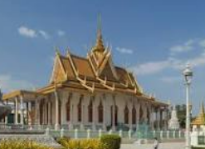

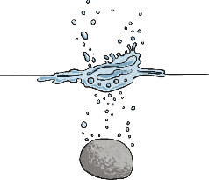

RE – Year 5 – What is the ‘Buddhist way of life?’
Symbols in Buddhism
Puja
Puja is important as it is carried out both at home and in the temple. Buddhists use a variety of different methods in their devotional practice. Examples are: Mantras - Buddhists may chant repetitively, as this is a form of mediation. Chanting - Buddhists may sing the scriptures. Mala - Buddhists may use a string of beads to help them focus during worship. Meditation - Buddhists may use meditation to open themselves to a higher state of awareness. Meditation is central to Buddhism. Bowing - Mahayana Buddhists often bow as a sign of respect. Offerings - Buddhists may leave gifts as a mark of respect and reverence to the Buddha. These gifts may include flowers, which are beautiful but fade and serve as a reminder of the impermanence of things. They may also include candles, which are a mark of light and wisdom.
The Kalasha
(The Treasure Vase)
This
symbol is
also known
as ‘the vase of inexhaustible treasures’. The belief is that it doesn’t matter how much is taken from the vase; it is continuously full.
The Dhvaja
(The Banner of Victory)
This symbol signifies spiritual victory. It often appears on banners of warriors.
The Sankha
(The Conch Shell)
This symbolises the blessedness received when a person turns to the right. A shell which spirals to the right is considered to be very rare and therefore sacred.
The Chattra
(The Parasol)
This
symbolises
keeping
away the
heat of evil
desires. The parasol symbolises protection from suffering, desire, obstacles, illness and harmful forces.
The Padma
(The Lotus Flower)
This is a symbol of purity, renunciation and divinity.
The Shrivasta
(The Endless Knot)
This is a symbol of the never ending cycle of rebirths.
The Dharmachakra
(The Wheel of Life)
This signifies the journey to perfection (Nirvana).
The Matsyayugma
(The Golden Fish)
This is a symbol of fertility and happiness.
A Wat is a Buddhist temple that most Buddhists visit on special religious days (often when it is a full moon).

