Slide 1

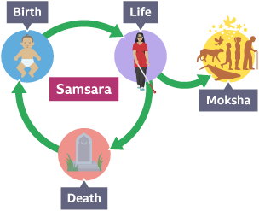
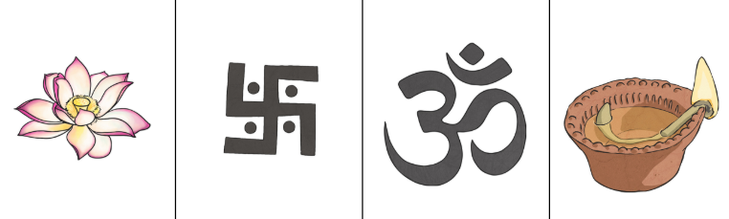
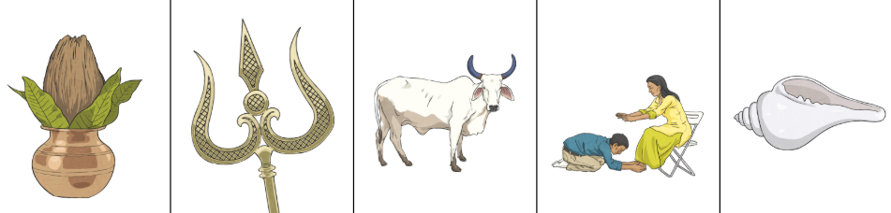
RE – Year 4 – What does it mean to be a Hindu and how do they live a good life?
Hinduism:
Hinduism is the oldest of the world’s religions. It is now practised all over the world but originated in South East Asia. It is a mix of different beliefs, cultures and traditions dating back over 4000 years.
Key Vocabulary
Atman | noun. Atman refers to a person's 'soul' or 'spirit'. Hindus believe that atman is part of the spirit of Brahman, their ultimate God. Hindus also believe the atman is eternal, meaning it never dies.
Brahman | noun. Hindus recognise one God, One Ultimate Reality or Life Force
Dharma (duties) | noun. Dharma means to do the right thing with good behaviour. duty – fulfilling these duties are the first step towards breaking the samsara cycle.
Karma | noun. the belief that actions have consequences; law of cause and effect
moksha | noun. Moksha is the ultimate goal. It happens when a soul stops being reincarnated and is reunited with Brahman.
Rama | noun. Rama, the Hindu god, is the seventh avatar of the god Vishnu.
sanatana | adjective. ‘Sanatana' means eternal and 'Dharma' signifies the path of righteousness. It lays down an eternal set of duties for every individual irrespective of his caste, class or sect that have evolved over thousands of years.
samsara | noun. the cycle of birth and rebirth.
Sita | noun. Sita is a goddess born from the earth in the epic Sanskrit tale Ramayana. She is also the incarnation of Lakshmi, goddess of prosperity, wealth, and beauty in Hinduism.
reincarnation | noun. Hindus believe a soul cannot be destroyed, so when a Hindu dies, their soul enters a new living being.
Samsara (the cycle of life)
Karma is central to samsara, which means 'reincarnation'. This is a core Hindu belief and is defined as a continuing cycle where the soul (atman) is reborn and life renews over and over as a result of karma. If you behave in accordance with dharma, this will result in positive outcomes that allow your soul to be reborn. A soul can be reborn into a physical body, or an animal.
There are 4 Hindu goals Pparushathas) for living a good life :
Artha Artha refers to having the materials you need to support yourself and your family. It's the basis for dharma and kama. | Kama Kama relates to pleasure in general. To practice kama, a person's pleasures, such as art, music or kindness, must align with that person's life purpose and duty. | Dharma These are moral values. Fulfilling these duties are the first step towards breaking the samsara cycle. | Moksha The ultimate goal of atman (soul) is moksha: to be released from the cycle of samsara and re-united with Brahman. One can achieve this by doing dharma (its duty) in each lifetime and when artha and kama are practised correctly.
Hindu symbols Lotus flower, swastika, Aum, diva lamp, Kalasha, Trishul, Indian cow, pranama, conch shell

Slide 2
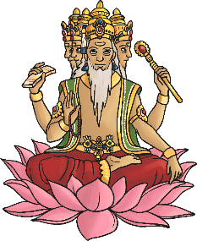
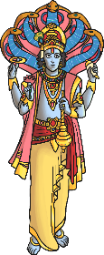
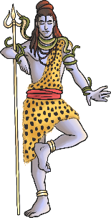
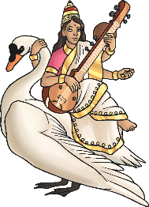
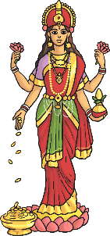
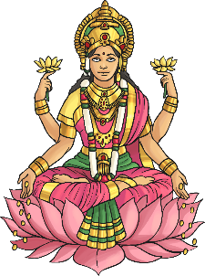
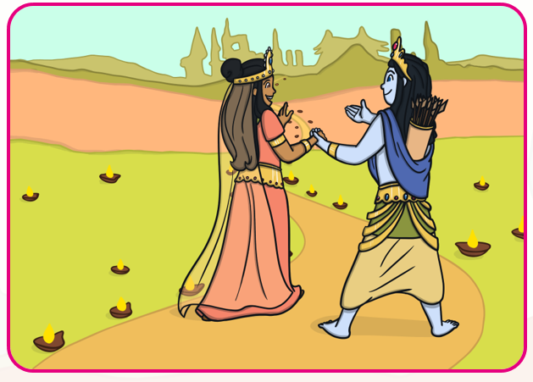
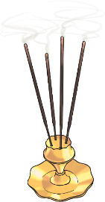
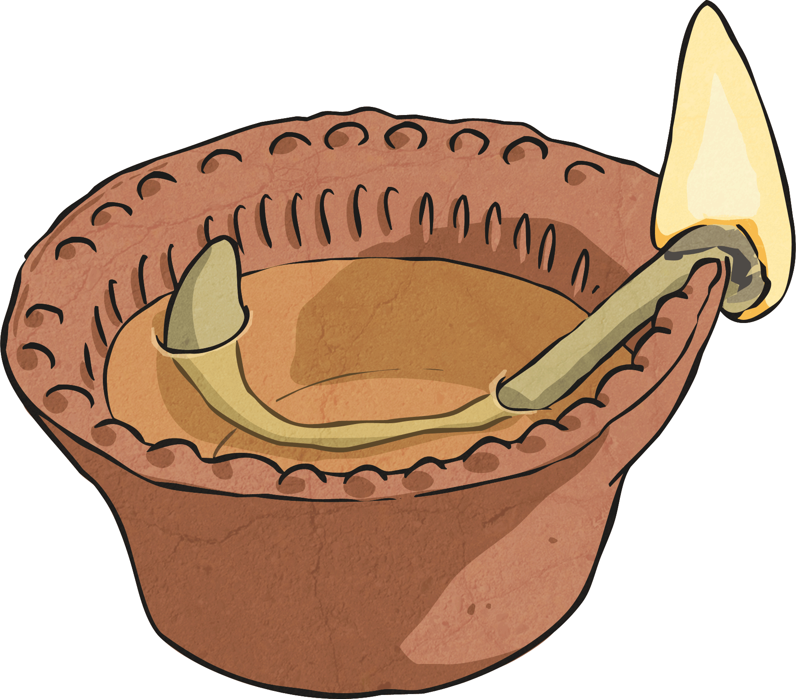
RE – Year 4 – What does it mean to be a Hindu and how do they live a good life?
Brahman: One Ultimate Reality or Life Force
Every living thing contains a spark of Brahman that give it its life: the atman or soul. Many different deities (deva: gods, devi: goddesses) help Hindus understand he nature of about Brahman, the One Ultimate Reality. The Trimurti: These three key deities represent the cycle of life, samsara to help Hindus understand more about Brahman, the One Ultimate Reality: Brahman: the Creator (associated with the beginning of life); Vishnu: the Preserver (associated with the living of life); Shiva: the Destroyer (associated with the ending of life). The Tridevi: Saraswati: the goddess of knowledge and the arts; Lakshmi: goddess of wealth and purity; Shakti: the mother goddess – the source of all energy, power and creativity in the universe.
The story of Rama and Sita
Once upon a time there was a great warrior, Prince Rama, who had a beautiful wife named Sita. One day, Rama and Sita were banished from their home by the King. Rama’s brother, Lakshmana, joined them in exile. Living nearby was a terrible demon king, Ravana. He had ten heads and twenty arms, and was feared throughout the land. One day, Ravana kidnapped Sita and took her away in his chariot. Clever Sita left a trail of her jewellery for Rama to follow. Rama and Lakshmana followed the trail of glittering jewellery until they met the monkey king, Hanuman, who became their friend and agreed to help find Sita. Messages were sent to all the monkeys in the world who set out to find Sita. After a very long search, Hanuman found Sita imprisoned on an island. The army of monkeys couldn’t reach the island, so they began to build a bridge. Soon all the animals of the world, large and small, came to help. When the bridge was built, they rushed across it and fought a mighty battle. When Rama killed the evil Ravana with a magic arrow, the whole world rejoiced. Rama and Sita were reunited and they began their long journey back to their land, and everybody lit lamps to guide them on their way and welcome them back. Ever since, people light lamps at Diwali to remember that light triumphs over dark and good triumphs over evil..
Brahma Vishnu Shiva Saraswati Lakshmi Shakti
Worship
Hindus worship one or more of the deities, but it doesn’t matter which because they are all seen as different aspects of the one supreme God. This worship is called puja. A Hindu’s place of worship is called a Mandir. They can also worship at home using a home shrine. The important features of a Mandir are: the main shrine, murtis, Aum, Bell and Vedus. Puja involves: -praying to an image of a diety (murthi) -giving offerings to a diety Worshippers take off their shoes to worship. They usually begin with the sacred word ‘Aum’ then repeat prayers (mantras) and the name of their favourite gods or goddesses. Offerings such as fruit, incense, water and flowers are made. Blessed food, which is known as ‘prashad’, is eaten once the worship has finished.

