Slide 1


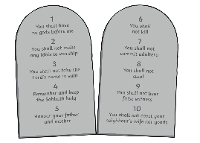
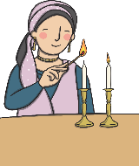
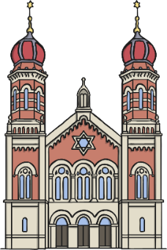
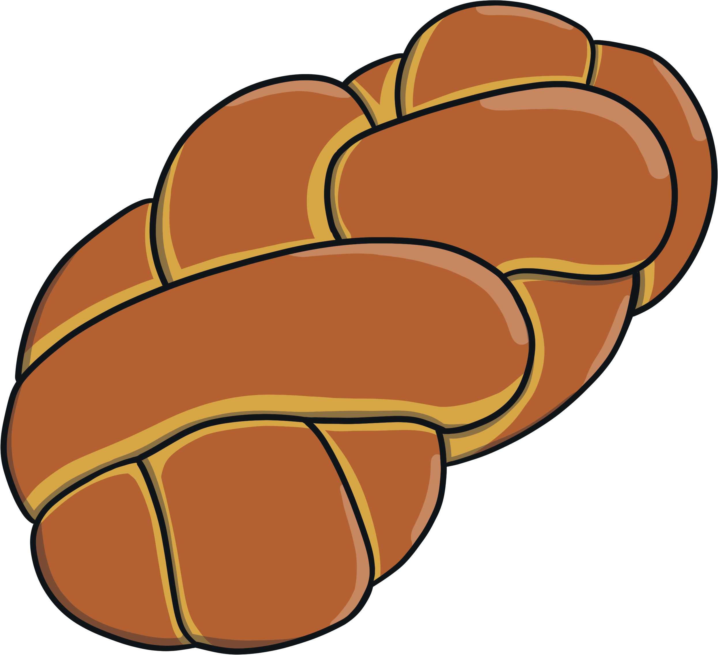
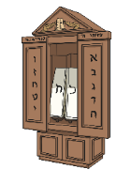

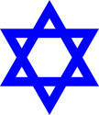
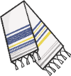
RE – Year 2 – What is the Torah and why do Jewish families celebrate Shabbat?
Judaism
Judaism began around 4000 years ago in the Middle East. Jerusalem is a place where many Jews go to on pilgrimage.
The Shabbat
Shabbat is a time of rest and a commandment from the Torah. The Sabbath lasts from sundown on Friday to sundown on Saturday. Jews celebrate as a family. When Shabbat begins on Friday evening, everyone puts on their best clothes and gather for a special meal. Other family members or friends may join the family for this special occasion. There are lots of traditions that take place on Shabbat: Shabbat candles are lit on the dinner table. Wine (or grape juice) is shared in a Kiddush cup. Challah bread is eaten. Blessings are recited. Families will visit a synagogue during Shabbat. No work can be done. Including homework! Families enjoy talking together. Children can stay up late and tell and listen to stories and singing.
Key Vocabulary
Holy | adjective. dedicated to God or a religious purpose; sacred
Kippah (dome hat) | noun. a kippah is a special cap worn by Jewish men and boys to show respect to God.
Hebrew | noun. Hebrew is a special language for Jews. Jews believe God gave the Ten Commandments to Moses in Hebrew. The Torah is written in Hebrew and Jews learn to read it. The Torah can be found in the Old Testament.
precious | adjective. of great value; not to be wasted or treated carelessly.
respect | noun. a feeling of deep admiration for someone or something
scroll | noun. a roll of parchment or paper for writing on.
Shabbat | noun. Shabbat is the Jewish Day of Rest. Shabbat happens each week from sunset on Friday to sunset on Saturday.
Star of David | noun. the six-pointed Star of David is the symbol of the Jewish community.
synagogue | noun. a Jewish place of worship.
Tallit (cloak) | noun. a tallit is a special prayer shawl used by Jewish men to pray.
Torah | noun. the Jewish holy book. The word Torah means ‘to teach.’
value / valuable | noun. the importance, worth, or usefulness of something.
Main beliefs
Jews believe in one God. They also try to live by the Ten Commandments. These ten laws were written in stone and God asked Moses to teach them to all of the Jewish people. They include using God’s name with respect, remembering the Sabbath, respecting your parents and not lying or stealing. Jews believe God gave the Ten Commandments to Moses.
Synagogues
 | Jewish people go to a synagogue to worship. Men and women sit separately in some synagogues. | The most important part of the synagogue is the Ark. This is where the Sefer Torah is kept. This is a Torah written out by a specially trained scribe onto a special scroll.
The Torah
The Sefer Torah is treated with great respect. It is not allowed to be touched by human hands. When it is being read, a special stick called a yad is used to point to the words. The Torah is read in the synagogue every week. It is a very great honour to be asked to read from the Torah. The Torah is very special to Jewish people as it includes all of the instructions that God gave to Moses. Jewish people today use the Torah to help guide them in their lives. This can also be found in the Old Testament. Some Jewish households have a mezuzah. This is a tiny scroll with writing from the Torah that is placed in a case and hung on a doorpost. It is a reminder that God is always there.

