Slide 1


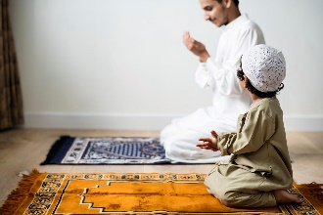
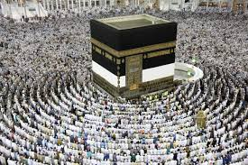
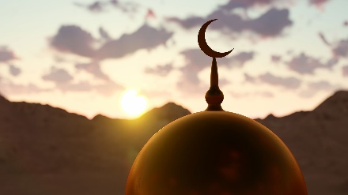
Year 1 – RE – Islam - Who is Allah and how do Muslims worship Him?
What is Islam and who are Muslims?
Islam is a religion that teaches people to believe in one God, called Allah. Muslims follow the teachings of Islam, which help them live good lives by being kind, praying, and helping others. Islam teaches Muslims to be peaceful and to care for everyone. Muslims are people who follow the religion of Islam. They believe in Allah and try to live their lives in a way that pleases Him. Muslims pray, give to charity, and treat others kindly, because these are important teachings in Islam. Muslims come from all around the world!
Key Vocabulary
Allah | noun. the name for God in Islam. Example: "Muslims pray to Allah."
beautiful names | noun phrase. the 99 names that describe Allah in Islam.
Makkah | noun. the holiest city for Muslims. All Muslims pray in the direction of Makkah
mosque | noun.a mosque is an Islamic place of worship for Muslims. The word mosque comes from the Arabic word masjid.
pray | verb. to talk to God or Allah.
prayer | noun. the act of talking to God or Allah.
Who is Allah?
Muslims believe that Allah is the only God, and they worship Him by praying, being kind, and following His rules. They pray five times a day and do good deeds to show their love for Allah. Muslims believe Allah has 99 special names that describe who He is. Each name shows something important about Allah, like "The Merciful" to show He is kind or "The Creator" because He made everything. These names help Muslims understand more about Allah. Muslims believe that Allah is kind, loving, powerful, and fair. They say that Allah knows everything and helps people who ask Him for guidance. They use the 99 names of Allah to describe all the good things about Him. Muslims believe that Allah is so special that it's better to talk or write about Him using words rather than drawing pictures. They think no picture could ever show how great and powerful Allah really is.
How can we show that something is important to us?
We can show someone or something is important to us by what we do. For example, we might take care of our toys if they are important, or be kind to our friends and family if they are special to us.
Praying to Allah
Before Muslims pray, they wash in a special way to make sure they are clean. This washing is called "wudu" and helps them get ready to talk to Allah in their prayers. | Muslims worship Allah by praying to Him every day. These prayers, called "Salah," help Muslims feel close to Allah and remember to follow His teachings. Muslims talk to Allah through their prayers, called "Salah." They can also make "du'a," which is when they ask Allah for help or say thank you for something. Muslims believe Allah always listens to them. | When Muslims pray, they always face the city of Makkah, which is a very special place for them. They also use different positions like standing, bowing, and kneeling to help them focus on Allah during their prayers. | Fridays are a special day for Muslims to gather at the mosque to pray together. Praying with others can make people feel part of a community, and it helps them support each other in their faith.

