Slide 1

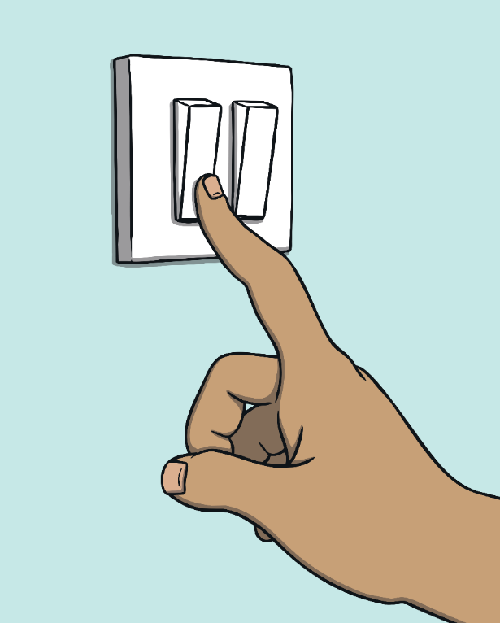
Year 1 – RE – Why should we look after our world?
The world is a place of wonder
The world is full of amazing things, like colourful flowers, tall trees, animals, and mountains. There are so many beautiful places and creatures that make the world special! What do you love about our beautiful world?
Key Vocabulary
Bible | noun. A special book for Christians that tells them about God and stories from long ago.
Changes | noun. when something becomes different.
creator | noun. someone who makes something.
creative | adjective. Using the imagination or original ideas to create something.
environment | noun. the natural world around us, like trees, rivers, and animals.
non-religious: | adjective. People who do not believe in a religion.
psalm | noun. a song or prayer found in the Bible.
verse | noun. a small part of a poem or a song.
wonder | noun. something that makes you feel amazed or happy because it’s so special.
The Creation Story
Christians believe God created the world in seven days. Each day He made another part of the world. He created light to make night and day and all the land, sky, and oceans. He made humans, animals and all living things. On the seventh day, God rested. Christians believe that this day, Sunday, is a special day. It is a day of rest when many Christians will attend church. Christians believe that God gave humans the special job of caring for the animals and the world. Humans must look after all creatures, however small.
Different religions have different stories about the creation of the world. Some people who don’t follow a religion have different ideas about how the world was made. They might believe that the world came from nature, not from a god.
Looking after the world
Sadly, Some people have not taken care of the world by throwing away too much rubbish, wasting things, or being greedy | Many people, whether they have a religion or not, are worried about how this harms nature. Everyone lives in the world so it is everyone's job to keep it safe and clean. | We can choose to recycle our waste, put litter in the bin and save natural resources. Or, we can choose to drop litter on the ground and harm plants, animals and other people. | We can choose to switch off lights and electrical items when we leave a room to save energy. Or, we can leave them all on and waste energy. | We can turn off the tap while we are brushing our teeth to save water. Or, we can leave the tap running and waste water. | We can ignore what's happening in other countries. Or, we can choose to support charities that are working to protect the environment throughout the world.

