Slide 1



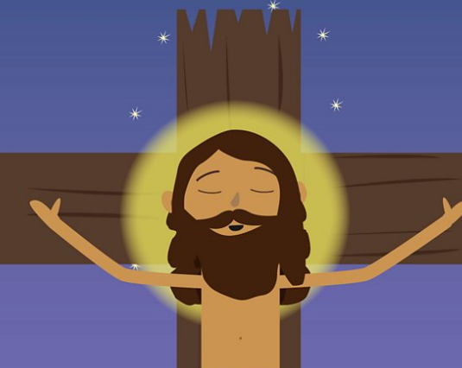



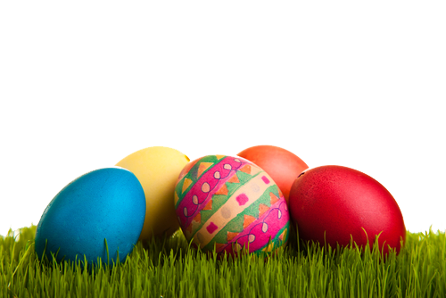

Year Reception – RE – Easter – What makes something special?
Stories
Think about your favourite story. Is it about a brave hero, a magical place, or a funny adventure? Everyone has stories that are special to them because they make them feel happy, excited, or comforted. Why do you love your favourite story? Does it make you laugh or feel brave? Stories can teach us lessons, make us feel happy, or even inspire us to be better people. Stories can teach us important lessons. For example, "The Tortoise and the Hare" teaches us that slow and steady wins the race. The Easter story teaches Christians about love, forgiveness, and hope.
Special to people from different religions and beliefs.
Just like you have a favourite story, many people have special books that are important to their religion. Christians have the Bible, Muslims have the Quran, and Jewish people have the Torah. These books help people learn about their faith and guide them in life.
Key Vocabulary
 | noun. an acceptance that something exists or is true, especially one without proof.
 | noun. come into existence as a result of birth.
 | noun. Easter is the most important festival in the Christian calendar. It celebrates Jesus rising from the dead.
 | noun. a festival is an event celebrated by a community.
 | noun. who Christians believe to be the Son of God.
 | noun. something that is alive, or all living things as a group.
The Easter Story
The Easter story is very important to Christians. It tells the story of Jesus, who died on a cross to save people and then came back to life three days later. Christians celebrate Easter because they believe it shows how much Jesus loves everyone. In the Easter story, Jesus is crucified, but Christians believe that he didn’t stay dead. They believe he rose from the dead on Easter Sunday, showing that he is stronger than death. Key people in the Easter story include Jesus, his friends the disciples, the people who didn’t believe in him, and the women who found his tomb empty. https://www.bbc.co.uk/teach/class-clips-video/articles/zhgv47h#:~:text=After%20about%20seven%20weeks%20of,place%20in%20Heaven%20with%20God.
Easter celebrations
Easter today is celebrated with church services, songs, and sometimes Easter eggs, which represent new life. Christians remember Jesus’ love and how his resurrection gives them hope for the future.

