Slide 1

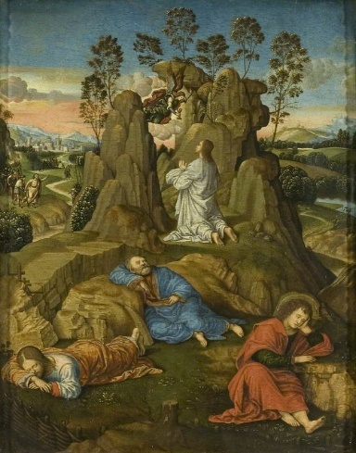
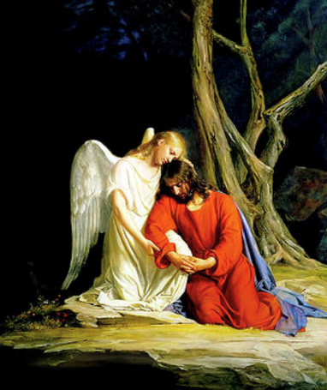

RE – Year 6 – Why is the idea of rescue so important to Christians?
Atonement and reconciliation
For Christians, Jesus’ death was part of a divine plan to save humanity. It is through Jesus's death that people's broken relationship with God is restored. This is known as the Atonement (at-one-ment). But why was reconciliation needed? According to the Bible, Adam and Eve were separated from God when they were cast out of the Garden of Eden and so everybody carries this original sin with them which separates them from God. John the Baptist describes Jesus as "the lamb of God that takes away the sins of the world". (John 1:29) So, Jesus chose to die (and sacrifice himself) to reconcile everyone with God.) Jesus’s death shows how much God loves people and wants to be reconciled with them.
Key Vocabulary
atonement (at-one-ment) | noun. The reconciliation of God and humankind through the sacrificial death of Jesus Christ suffering.
Gethsemane | noun. The garden outside Jerusalem mentioned in Mark 14 as the scene of the agony and arrest of Jesusalem. A place or occasion of great mental or spiritual suffering.
Passover | noun. A Jewish holiday beginning on the 14th of Nisan and commemorating the Hebrews' liberation from slavery in Egypt.
reconciliation | noun. The action of reconciling. The state of being reconciled (to restore to friendship or harmony
sacrifice | noun. Something offered in sacrifice or a surrender of something for the sake of something else
salvation | noun. The saving of a person from sin.
sin | noun. an offense against religious or moral law.
Jesus’ seven last sayings (last words) As Jesus hung on the Cross, he made seven statements (from the Gospel accounts) ,each teaching us more about Jesus and His character.
“Father, forgive them, for they know not what they do.” — Luke 23:34 “Today shalt thou be with Me in paradise.” — Luke 23:43 “Woman, behold thy Son.” — John 19:26 “My God, my God, why hast Thou forsaken Me?” — Mark 15:34 “I thirst.” — John 19:28 “It is finished.” — John 19:30 “Father, into Thy hands I commend My spirit.” — Luke 23:46
What are we looking for when we want to atone?
What do you feel when you make a mistake, and you hurt someone - especially someone you love? You feel bad, right? And you feel guilty and sometimes ashamed. You know you made a mistake. So, you get angry at yourself. Sometimes, you even lecture yourself. But the only way to really be at peace again is to make it better. Not just for yourself but for the other person too. You want to repair the relationship you've broken. You need to repair the relationship, or you will never be at ease again. This is Atonement. This desire that propels you to make things right and the action you take to actually make things right - this is what atonement essentially is. Sometimes, simply saying sorry is all you need. Other times, you need to make a grander gesture. However you choose to atone for your mistake, it's often essential to the reparation of the broken relationship.
Christ in Gethsemane, Timoteo Viti (1469–1523)
Gethsemane 1873, Carl Bloch

