Slide 1


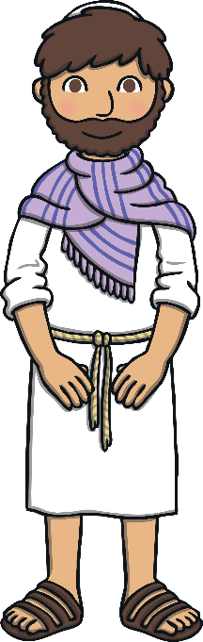


RE – Year 4 – How does Lent help Christians prepare for Easter?
When Jesus went to the desert
Before Jesus began his teaching, he spent 40 days and 40 nights in the desert, to be with God. During this time, he had no food. Whilst Jesus was in the desert, the Devil appeared, trying to tempt Jesus. The Devil knew that Jesus was hungry, so he told him that if he was indeed the Son of God, to turn the rocks nearby into bread. The Devil knew Jesus could do this, but Jesus knew it was a trap and told him ‘No!’. Next, the Devil took Jesus to the Holy City and to the top of a temple. He told Jesus to throw himself off the temple. “If you are the Son of God,” he told Jesus, “then the angels will save you.” But Jesus knew it was a trick and he told the Devil that he was not to test God. Finally, the Devil took Jesus to a very high mountain and told him, “All the kingdoms of the world will be yours if you worship me.” But Jesus told him to leave and that he only worshipped and served God. God was very pleased with Jesus and how he resisted the Devil’s temptations. Jesus spent 40 days and 40 nights in the desert. He had no food. Whilst he was in the desert, the Devil tried to tempt him with food. The Devil made Jesus many promises, but each time Jesus told him ‘No!’. Lent lasts 40 days, to remind Christians of Jesus’ sacrifices when he was in the desert and also of his refusal to be tempted by the Devil.
No!

Slide 2


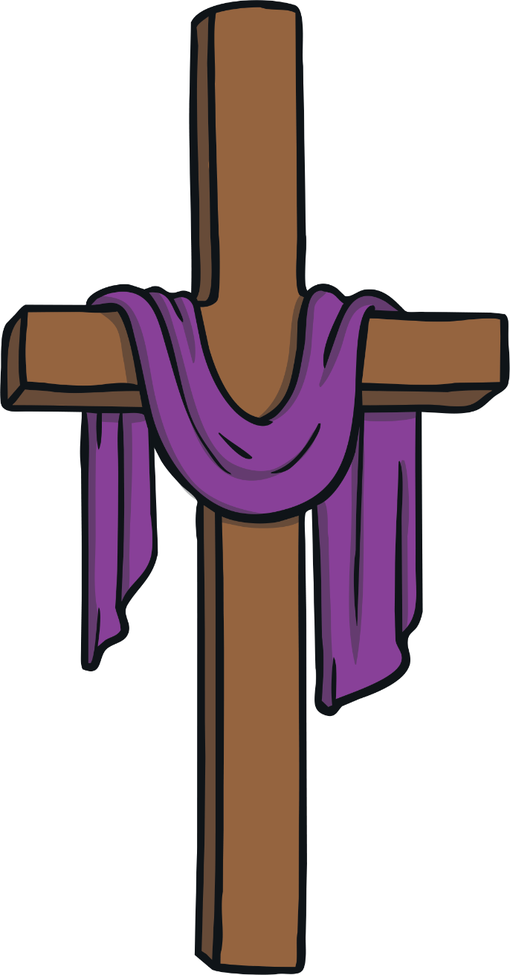
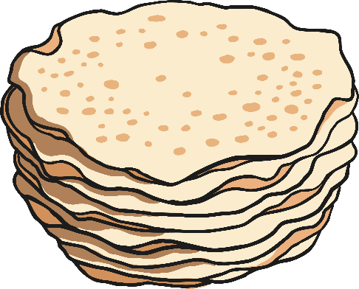
RE – Year 4 – How does Lent help Christians prepare for Easter?
What is Lent?
Lent is an important time for many Christians and it lasts for 40 days but doesn’t include Sundays. The Bible says that this is the length of time that Jesus spent in the desert fasting and being tempted by the devil. Many Christians used to fast in Lent to reflect on Jesus’ life but now many choose to give up a luxury item like chocolate instead.
Ash Wednesday
Ash Wednesday is the first day of Lent for many Christians and it is a time for forgiveness. Ashes are blessed in church and then a cross-shaped mark is placed on worshippers’ foreheads.
Key Vocabulary
Ash Wednesday | noun. The first day of Lent.
confession | noun. a formal statement admitting that one is guilty.
forgiveness | noun. The action of forgiving or being forgiven.
Lent | noun. Lent is a time of preparation for Easter, when Christians observe a 40-day period of fasting, prayer, and
Mardi Gras | noun. Mardi Gras is the final day of Carnival or Shrovetide before Ash Wednesday. Mardi Gras is French for "Fat Tuesday."
pancakes | noun. A pancake is a flat cake, often thin and round, prepared from a starch-based batter that may contain eggs, milk and butter and cooked on a hot surface.
Shrove Tuesday | noun. The day before Ash Wednesday, also known as Pancake Day or Mardi Gras.
temptation | noun. The desire to do something, especially something wrong or unwise.
Using Lent to prepare for Easter.
Today, many Christians mark Lent by trying to ‘give up’ something they like. It might be chocolate or something like video games. They do this to remember Jesus’ sacrifice when he was in the desert and to test their own self-discipline: to see if they can say no to temptation, just as Jesus did.
Shrove Tuesday
Shrove Tuesday is also known as Pancake Day. It is also known as Mardi Gras or Fat Tuesday in other parts of the world. In Christianity, Shrove Tuesday is the feast day before the beginning of Lent on the following day (Ash Wednesday). On Shrove Tuesday, people went to church to confess their sins and were called by a bell, which came to be known as the ‘pancake bell’. In the past, Christians would give up all ‘rich’ food and drink during Lent. This meant food such as meat, eggs, fats and milk products weren’t eaten. People used up their ‘rich’ foods before Lent began, by making pancakes; this is why we have Pancake Day.
Symbols and rituals during Lent
The priest wears purple garments and a purple cloth is placed on the altar during Lent. Purple symbolises both pain and suffering leading up to the crucifixion of Jesus. It also symbolises the suffering of all humans and the world under sin. Purple is also the colour of royalty. This reminds people that Jesus is King. Lent is the time of new beginnings, new growth and a time to go get fit and to live the life of a Christian.
Lent comes from the Middle English word ‘lenten’ or the Old English ‘lencten’, both of which mean spring (the season)

