Slide 1

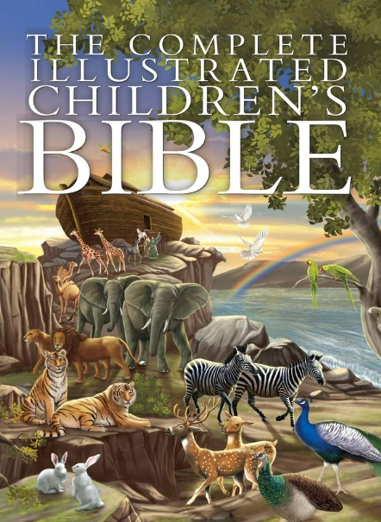
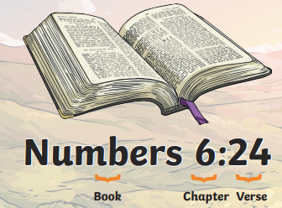
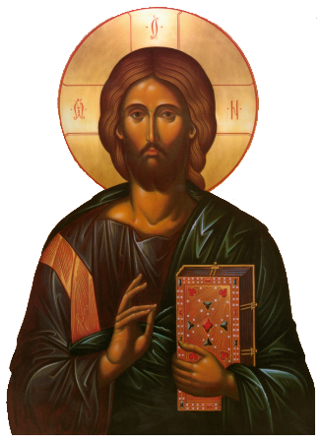
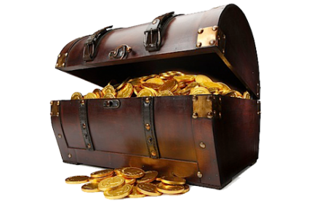
RE – Year 3 – Easter - What is the Bible’s big story?
The Bible and its stories:
The Bible isn’t just one book—it’s more like a library filled with different types of books, including stories, poems, laws, and letters. Each part helps Christians understand more about God and how He wants people to live. The Bible starts with God creating the world and ends with a promise that Jesus will come back to make everything right. In between, there are stories of people who followed God, made mistakes, and learned important lessons about forgiveness and love. Christians believe that the stories in the Bible are connected. For example, the story of Adam and Eve shows how sin entered the world, and the story of Jesus shows how God provided a way for people to be forgiven. Christians see Jesus as the fulfilment of the Bible’s big story.
Key Vocabulary
communion | noun. A special Christian ceremony where bread and wine are shared to remember Jesus' sacrifice.
Crucifixion | noun. The method of execution where a person is nailed to a cross; it refers to how Jesus died.
Last / Lord’s Supper | noun. The final meal that Jesus shared with his disciples before his crucifixion, where he gave them bread and wine as symbols of his body and blood.
Maundy Thursday | noun. The Thursday before Easter, which remembers the Last Supper and Jesus washing his disciples' feet.
Palm Sunday | noun. The Sunday before Easter, celebrating Jesus' triumphal entry into Jerusalem when people waved palm branches to greet him.
Passover | noun. A Jewish festival that remembers how God saved the Israelites from slavery in Egypt, often linked to the time of Jesus' Last Supper.
Resurrection | noun. The event when Jesus came back to life three days after his crucifixion, celebrated on Easter Sunday
Sacrifice | noun. When something valuable is given up for the sake of something or someone else. In Christianity, it refers to Jesus giving his life for others.
Triumphal entry | noun. The event when Jesus entered Jerusalem riding a donkey, and people welcomed him by laying down palm branches.
Bible organisation:
The Bible is split into two main parts, the Old Testament and the New Testament. Each part is separated into sections called books. Each book is split into chapters and each chapter is then split into smaller sections called verses. A section of the Bible might be written like this: John 3:16. This means John chapter three, verse 16.
Jesus in the Bible:
For Christians, the most important part of the Bible is the story of Jesus. His birth (which Christians celebrate at Christmas), His teachings, His death on the cross, and His resurrection on Easter Sunday are all central to their faith.
Why is the Bible like a treasure to Christians?
Christians try to live according to what the Bible teaches. For example, Jesus taught people to love their neighbors and forgive others, and many Christians try to follow these teachings in their daily lives. The Bible is therefore like a treasure to Christians: The Bible is precious to Christians because it helps them understand who God is and how they should live. They believe it contains wisdom and guidance for every part of life, like how to be kind, honest, and forgiving.

Slide 2
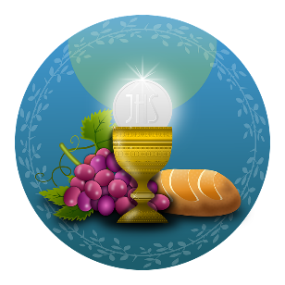

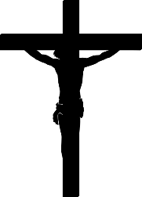
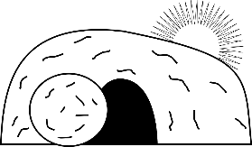
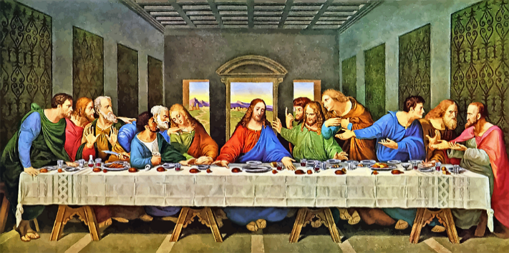
RE – Year 3 – Easter - What is the Bible’s big story?
The Holy Week
Holy Week is the week leading up to Easter. The Easter story is very important to Christians as it reminds them of Jesus’ death and celebrates his resurrection. There are four important days during Holy Week: Palm Sunday, Maundy Thursday, Good Friday and Easter Sunday.
Palm Sunday | Maundy Thursday and the Last Supper | The Holy Communion. | Good Friday | Easter Sunday
Palm Sunday marks the start of Holy Week. Christians remember when Jesus rode into Jerusalem on a donkey(his triumphal entry) and was welcomed by people waving palm leaves and placing them on the ground in front of him. Palm leaves symbolise goodness and well-being. | On Maundy Thursday, the story of the Last Supper is remembered. ‘Maundy’ comes from a word that means command. At his last supper, Jesus told his disciples to love one another. Jesus washed the feet of his 12 disciples and this ritual of washing the feet also takes place at other Christian churches. Jesus knew that this would be his last supper and that one of his disciples (Judas), would betray him. | During the Last Supper, Jesus shared some bread and wine with his disciples. Jesus said the bread was his body and the wine was his blood. During Holy Communion, Christians re-enact this special moment from the Last Supper. | On Good Friday, Christians remember the day that Jesus was crucified. Leaders in Jerusalem were jealous that people listened to Jesus and so they had him crucified. Christians believe it is ‘good’, because Jesus showed great love and died for the sins of others. When he died, his body was put in a stone tomb. | Some of Jesus’ friends went to visit his tomb on the Sunday after he died. They were surprised to find it empty. After his resurrection Jesus visited his disciples before going up to heaven to live with God. On Easter Sunday, Christians celebrate Jesus’ resurrection. The resurrection of Jesus gives Christians the promise of eternal life in heaven.
The Last Supper Painting
The Last Supper is a painting by Leonardo da Vinci. It is a picture of the last supper of Jesus and his disciples. It shows how they reacted when Jesus said that one of them would betray him. Each disciple has their own expression showing their own reaction to what Jesus has just told them. The painting is a mural on the wall of the Santa Maria delle Grazie rectory in the dining room in Milan, Italy. It measures 460 X 880 cm. Da Vinci began painting it in 1495 and finished it in 1498. He did not work on it all the time between these years. Some people think the painting has secret messages.

