Slide 1

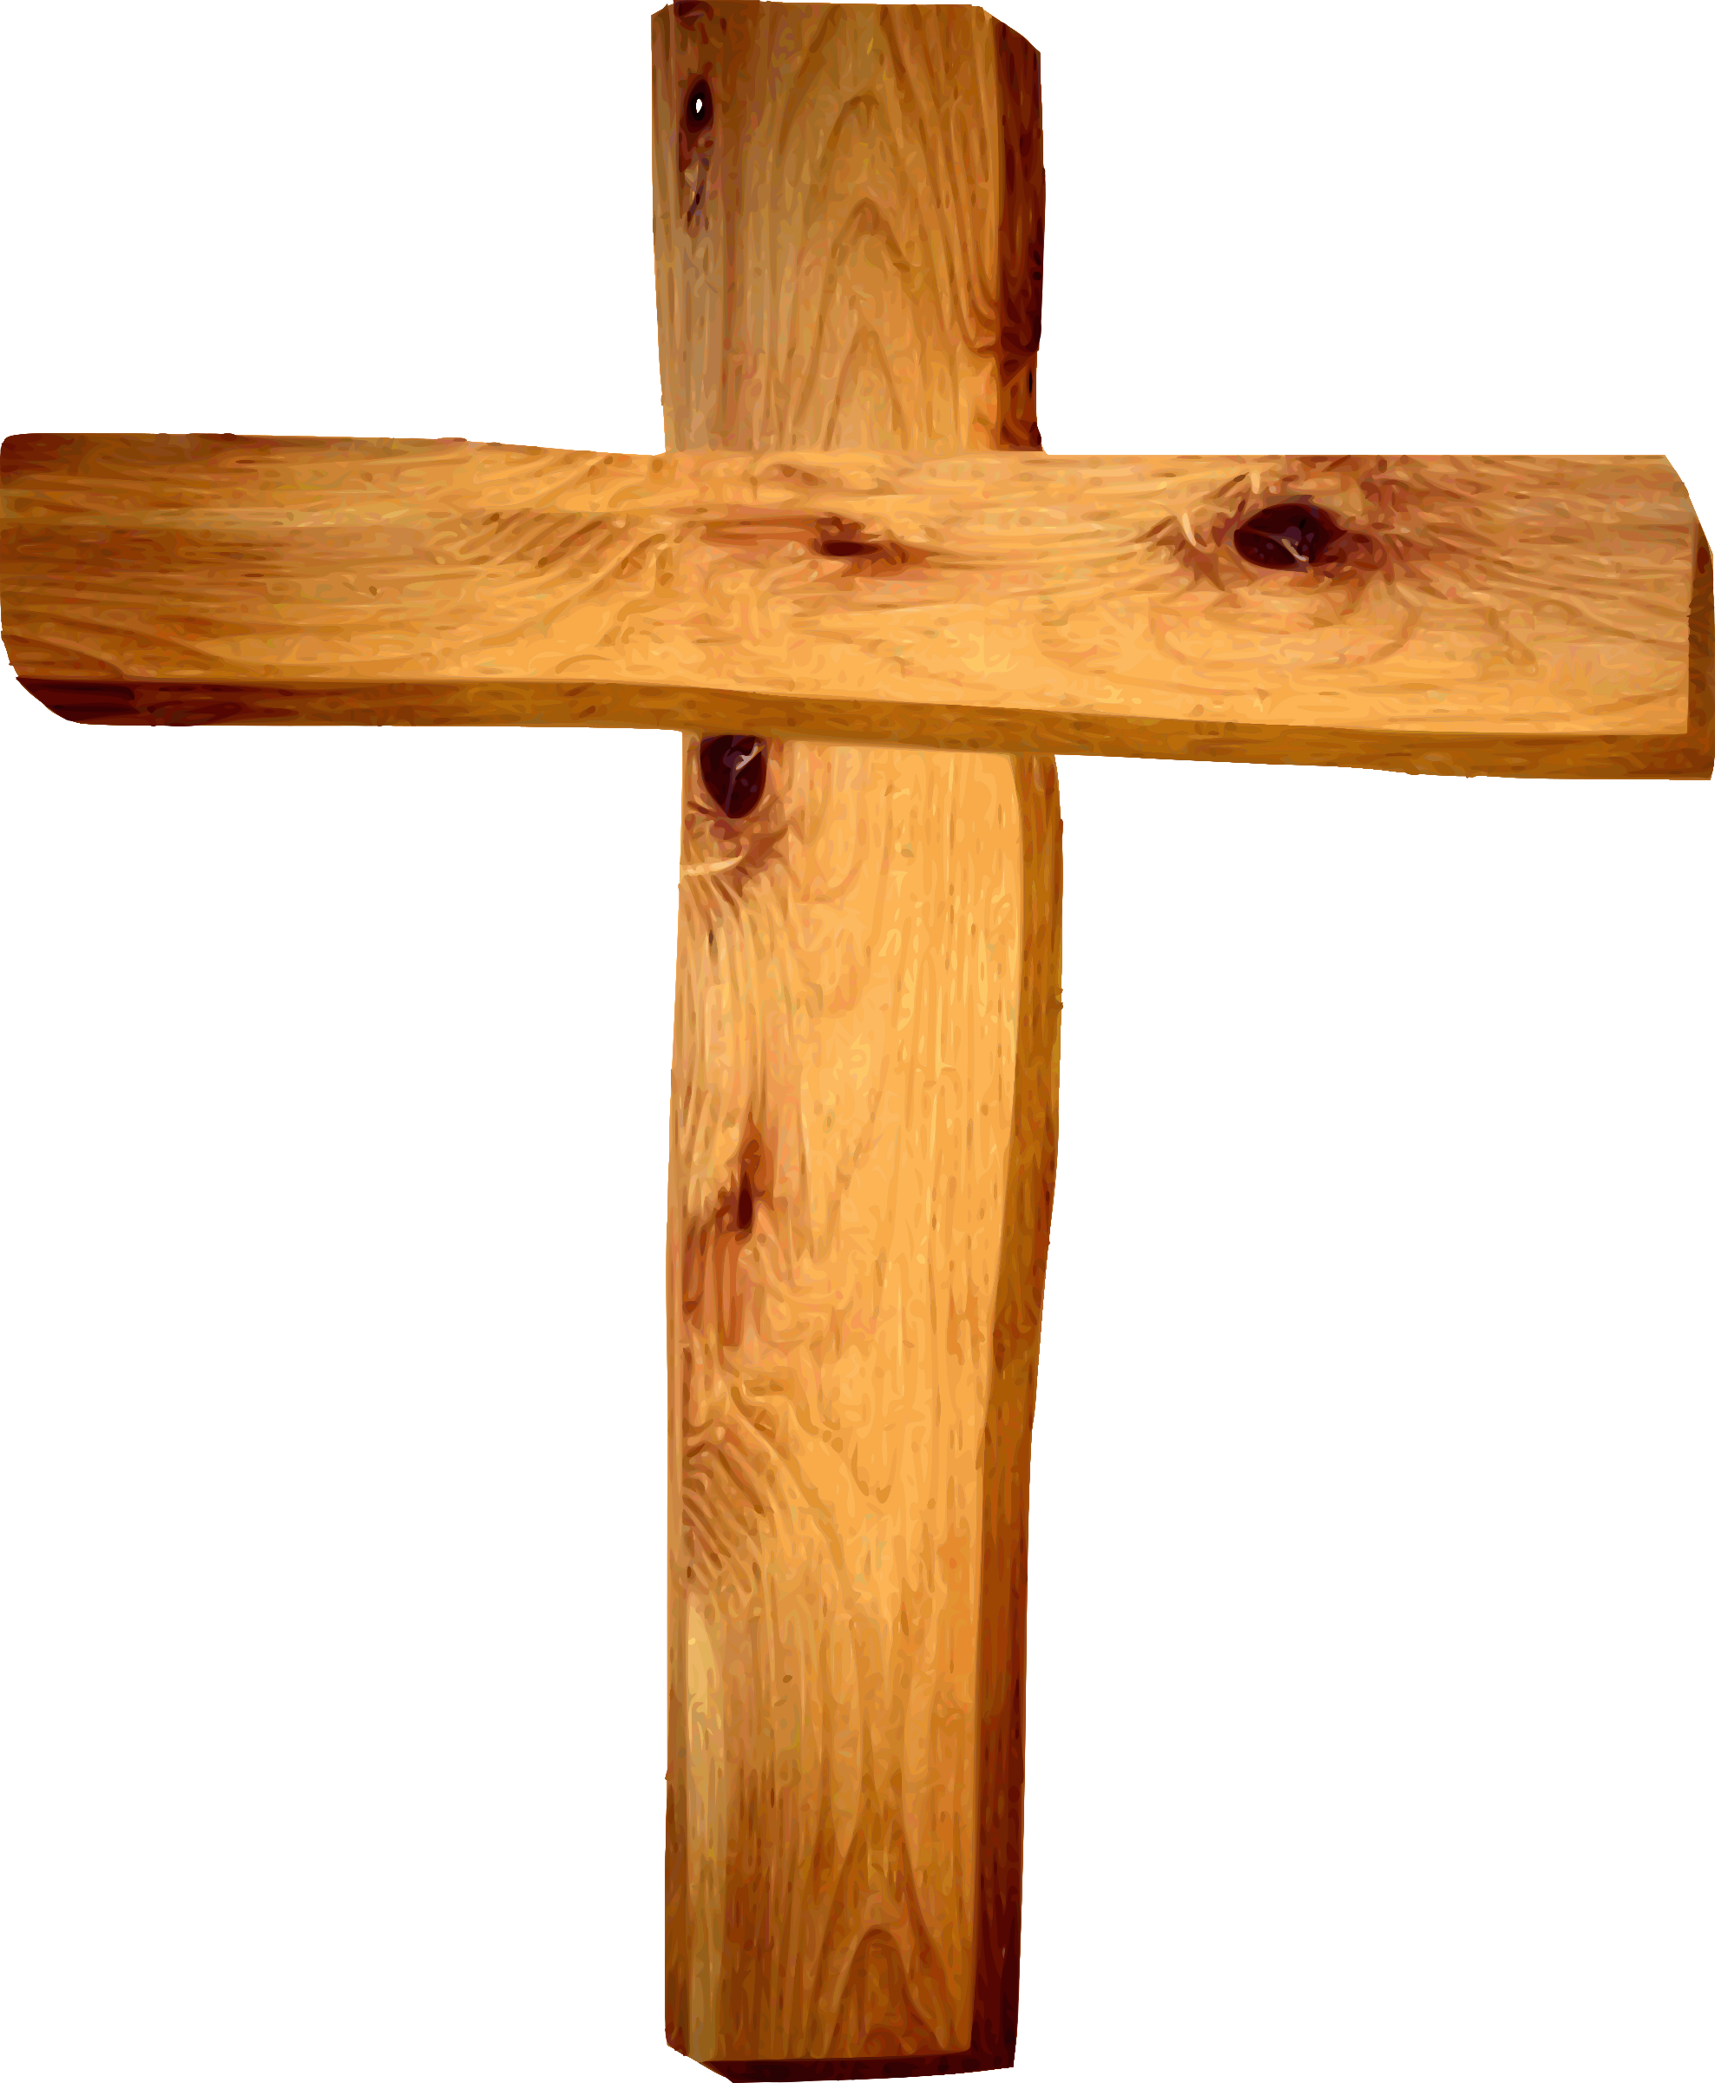
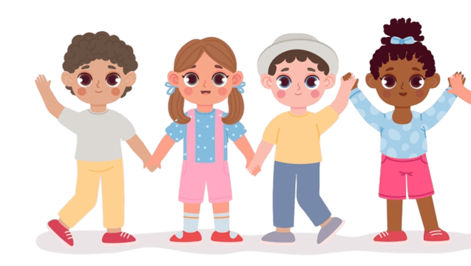
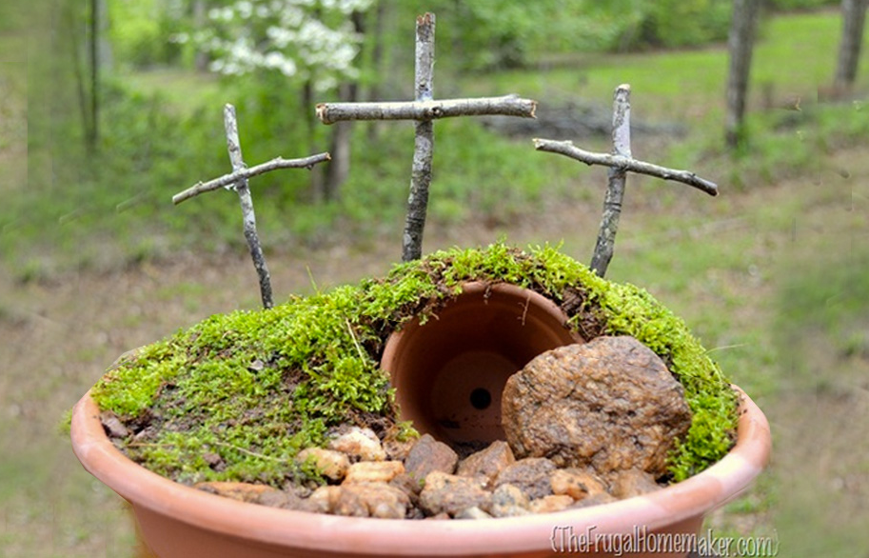
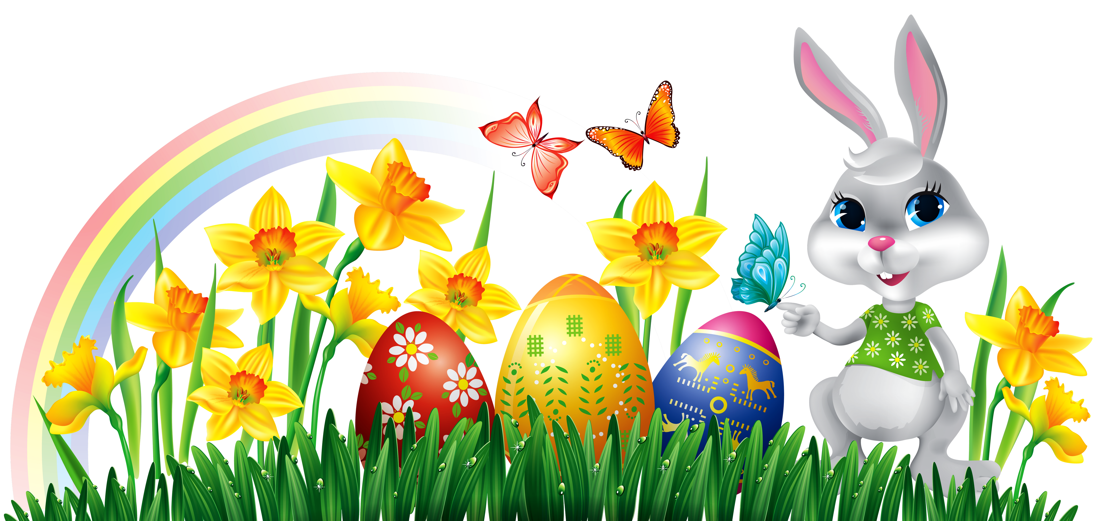
RE – Year 2 – Why is Easter important to Christians?
Friendship
A good friend may have particular qualities. They might be: kind humorous cheerful helpful caring trustworthy
Friendship is a precious thing and can get damaged
Sometimes friends might have a disagreement, When we fall out, we have a choice about how to resolve it. We might not always agree with our friends but that is okay. We must listen to and respect the ideas of others, even if they are not the same as ours. We can then think about how to say sorry if we need to. Sometimes, we can stop being friends and make new friends.
Key Vocabulary
cross | noun. The cross is used as a symbol of Christianity. Jesus died on the cross and was resurrected on Easter Sunday.
crucifixion | noun. To be put to death on the cross.
damage | verb. If you damage something, you harm or spoil it.
Easter Garden | noun. An Easter garden is a model that represents the morning when Christians believe Jesus came back to life.
forgiveness | noun. The action of forgiving or being forgiven.
friendship | noun. The state of being friends.
qualities | noun. An attribute/ characteristic held by someone or something.
restoration | noun. The action of returning something to a former condition.
sin | noun. A bad action
tomb | noun. A place cut into rock or underground, where the dead are buried.
Easter Gardens
The story of Easter, especially the transformation from deep sadness of Good Friday to the happiness of Easter Sunday, is remembered through an Easter garden. In the garden, there are different parts that represent parts of the Easter story. For example: Grass or soil: This represents the ground where Jesus was buried after he died. Rocks or stones: These symbolize the big stone that was rolled away from Jesus' tomb when he rose from the dead. Flowers: Flowers represent new life and hope, just like how Jesus came back to life on Easter Day. Cross: Some Easter gardens have a small cross to remind us of Jesus' crucifixion, which happened before Easter. Figurines or small toys: People might put little figures or toys in the garden to show Jesus, his friends, and other characters from the Easter story. By looking at the Easter garden, people can remember the important parts of the Easter story and think about what it means for them. It's like a special way to tell the story of Easter using nature and symbols.
Friendship and God
Christians believe that God loves all people and wants to be their friend. When a Christian does something wrong or commits a sin, they can damage their friendship with God. Christians believe that Jesus chose to die on the cross to take away the wrong things people have done, so they can be forgiven and have a close relationship with God. Jesus' death is a big part of the Easter story, but the good news is that he didn't stay dead - he came back to life, which Christians celebrate on Easter Day. Christians believe that Jesus’ resurrection means that death is not the end.

