Slide 1


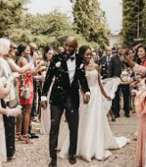
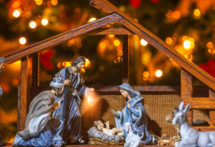
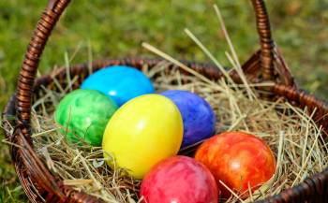
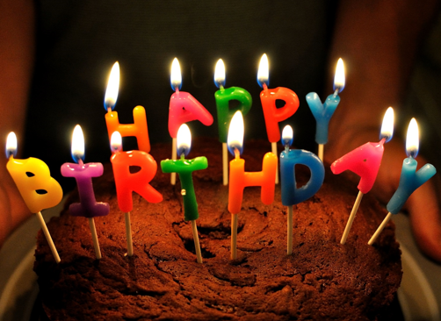
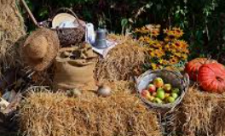
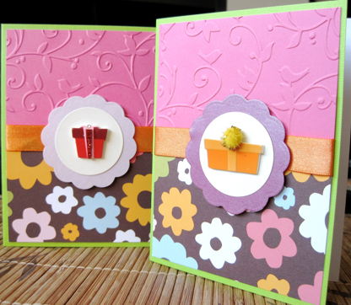
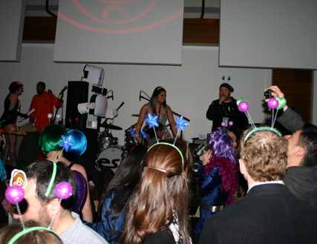
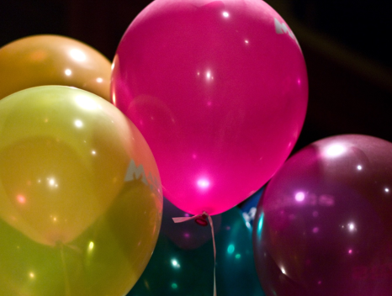
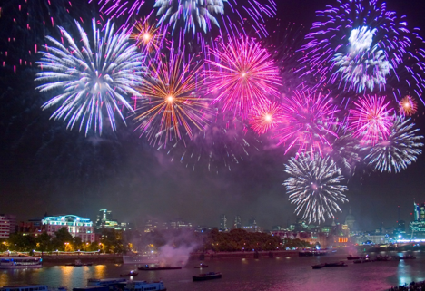
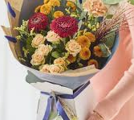
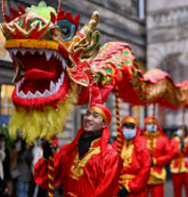
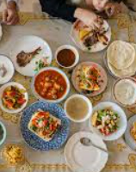
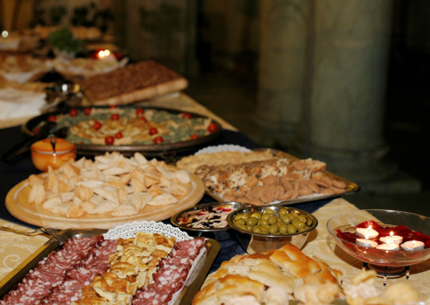
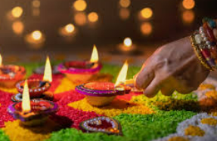
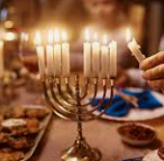
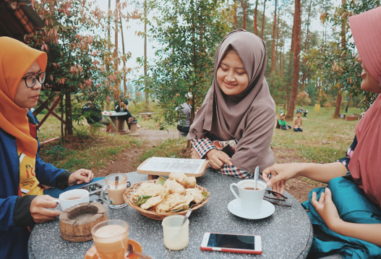
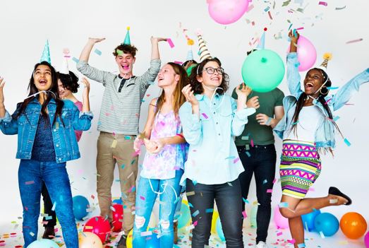
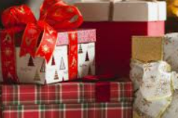
RE – Reception– Why do we have celebrations?
Special celebrations:
Birthdays: A birthday is when we celebrate the day someone was born. This happens once every year. People give presents, eat cake, and have fun with friends and family. | Weddings: A wedding is a special day when two people promise to love and take care of each other. They often have a party with friends and family.
Christian festivals
Christmas: Christmas is a time when we celebrate the birth of Jesus. People give gifts, decorate trees, and spend time with family. This is celebrated in Winter. | Easter: Easter is a time when we celebrate the story of Jesus coming back to life. People often have egg hunts and eat chocolate eggs to celebrate. This is celebrated in Spring. | Harvest: Harvest is when we say thank you for all the food that grows. People bring food to share with others. This is celebrated in Autumn.
Ways to celebrate:
cards | dancing | decorations
fireworks | flowers | food and drinks
gathering | party | presents / gifts
Festivals in our community
Chinese New Year: Chinese New Year is when people celebrate the new year with parades, dragon dances, and special meals. They wish each other good luck for the year ahead. | Diwali: Diwali is the Hindu “festival of lights” which celebrates the New Year. It is India’s most important holiday. Diwali is celebrated by Hindus in Britain and all over the world. People celebrate with lights, fireworks, and sweets. It is about the victory of good over bad. | Eid: Eid al-Fitr is a Muslim festival where people give thanks, share food with family, and help those in need after a month of fasting. | Hanukkah: Hanukkah or Chanukah is the Jewish festival of light. Hanukkah celebrates one of the greatest miracles in Jewish history. A menorah is a special type of candle. It is lit by Jewish people. One candle is lit for each day of the festival.

Slide 2
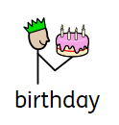
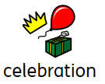
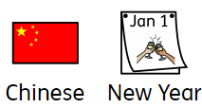
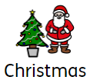
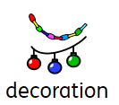



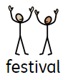



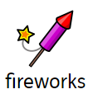



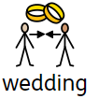
RE – Reception– Why do we have celebrations?
Key Vocabulary
noun: The day you were born, and each year we celebrate how old you are. | noun. A time when people come together to have fun and enjoy something special, like a birthday or a holiday | noun: A big celebration in China and other places to mark the start of a new year. | noun: A special day when Christians celebrate the birth of Jesus.
noun: Something we use to make places look pretty for special occasions, like tinsel or balloons. | noun: A festival of lights in India and other places that celebrates the victory of good over evil. | noun: A Christian holiday to celebrate when Jesus came back to life after dying. | noun: A special celebration for Muslims that marks the end of Ramadan, a time of fasting.
noun: A time of celebration with family and friends, often with music, food, and fun. | noun: Emotions like happy, sad, excited, or angry that we all have. |  | noun: Bright lights and loud sounds in the sky used to celebrate special occasions.
noun: Presents we give to people to show we care about them. | noun: A time when farmers collect the crops they have grown, and people give thanks for the food. | noun: A Jewish festival where people light candles to remember a miracle. | noun: A special ceremony where two people get married.

