Slide 1

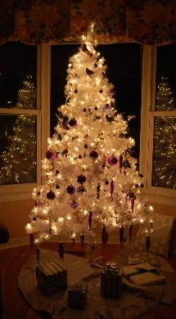
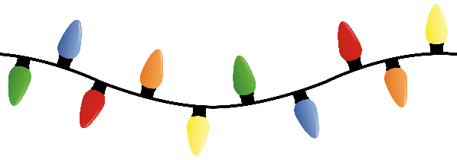
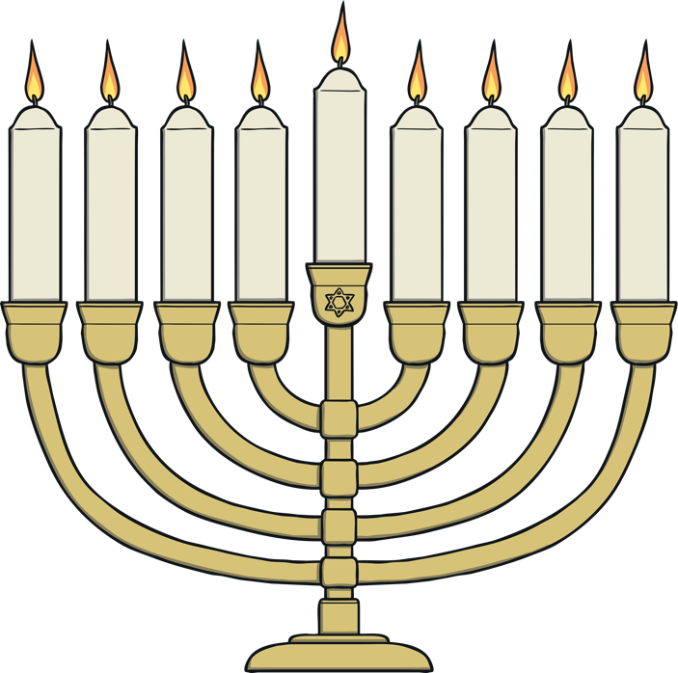
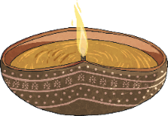
RE – Y6 – Christianity – Why is light important at Christmas?
Light in Christianity:
Light plays an important role in Christmas celebrations. Christmas lights, candles, and stars are all symbols of light. These lights represent hope, joy, and the coming of Jesus, who Christians believe brings light to a dark world.
During Christmas, light is used in many ways to celebrate. Advent candles are lit in the weeks leading up to Christmas to symbolize hope, peace, joy, and love. Christmas lights on trees and homes symbolize the joy and celebration of Jesus’ birth. The star that guided the Wise Men is also a symbol of light.
Key Vocabulary
Christingle service | noun. a Christingle service is a special Christmas tradition where an orange is decorated with a candle, ribbon, and sweets, each of which has a special meaning. During the service, all the lights are usually turned off when people light their Christingle candle. Christian people think about how the birth of Jesus brought light in the darkness of the world. It is an important time for Christian people to reflect and pray.
Festival of Light | phrase. Diwali comes from the Sanskrit word deepavali, meaning “row of lights.” It marks the triumph of light over darkness, of good over evil.
fulfilment | noun. the fulfilment of a promise, threat, request, hope, or duty is the event or act of it happening or being made to happen.
light of the world | phrase. "Light of the World is a phrase Jesus used to describe himself and his disciples in the New Testament.
nativity | noun. the occasion of a person's birth; the birth of Jesus Christ
prophecy | noun. a prediction of what will happen in the future.
sign | noun. a sign is something you see (or hear) which means something.
symbolism | noun. symbolism is the idea that things represent other things.
Light in other religions:
In Judaism, Hanukkah celebrates the victory of the Maccabees, a small group of Jewish rebels, over the much larger Greek-Syrian army in around 165 BCE. After reclaiming the temple in Jerusalem, the Jews purified and rededicated it. The miracle of the oil, where a small amount of sacred oil kept the temple's menorah burning for eight days, is the central focus of the holiday. Jewish families celebrate Hanukkah by lighting the menorah, eating traditional foods like latkes (potato pancakes), playing games like dreidel, and exchanging gifts. | In Hinduism, Diwali celebrates the triumph of good over evil. For some, Diwali commemorates the return of Lord Rama, his wife Sita, and his brother Lakshmana to their kingdom after 14 years of exile and the defeat of Ravana; for others, it honours Lakshmi, the goddess of wealth. People celebrate Diwali by lighting oil lamps (diyas), decorating their homes with rangoli (patterns made with coloured powders), setting off fireworks, and sharing sweets. It is a time for family gatherings, renewal, and the exchange of gifts.
Jesus and light in the Bible:
Jesus: “A light for all the people of the world” Isaiah 42, versus 5-6 Christians believe that Jesus’ birth fulfills a prophecy from the Old Testament that promised a light would come for all people. This prophecy, found in Isaiah, speaks about a special person who would bring hope and peace to the whole world. Christians see Jesus as that promised light. | Jesus: “I am the Light of the world” John 8, verse 12 In the Bible, Jesus says, “I am the light of the world.” Christians believe this means Jesus brings guidance, truth, and hope to people, just like light helps us see and find our way in the dark. His message of love and salvation is seen as a light that can lead people out of darkness.
So, why are lights so important at Christmas?
Light is important at Christmas because it symbolizes Jesus, who Christians believe is the light that brings hope to the world. It also represents the joy, love, and peace that his birth brings. By using light in decorations and celebrations, Christians remember the special meaning of Christmas.

Slide 2
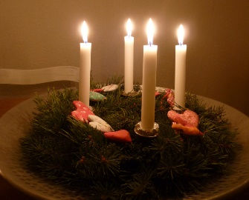





RE – Y6 – Christianity – Why is light important at Christmas?
Symbols of light in Christianity: Advent:
Advent is the start of the Christian year. It is a time for Christians to prepare for the celebration of the birth of Jesus. Advent is the four weeks before Christmas. It starts on the nearest Sunday to 30th November and ends on Christmas Eve. The Advent wreath is a circle of evergreen branches (which is a reminder that God does not change). There are 4 candles standing in the circle. In the centre there is a 5th candle. The candles remind Christians of the light of God. A new candle is lit each Sunday during Advent until all 4 candles are burning. Each candle has a different meaning (joy, hope, love, peace, Jesus). The final candle is lit on Christmas Day to celebrate the birth of Jesus.
Symbols of light in Christianity: Christingles
Christians believe that the coming of Jesus was like a light appearing in the darkness and the word Christingle actually means ‘Christ’s light’. Christingles are used by some Christian people in church to celebrate Jesus during the time of Advent. Christingles are made up of different parts, each one being there to remind us of something. The orange represents the world. The candle reminds Christians of Jesus who they believe to be the light of the world. The foil is only there to catch waxy drips from the candle. The red ribbon goes all round the 'world' and being the colour of blood, reminds Christians that Jesus died. The four cocktail sticks have either of two meanings; the four seasons or the four corners of the world. The sweets (or sometimes dried fruit) remind Christians of God's gifts to the world including kindness and love. What happens at a Christingle Service? Children make a Christingle before going to the service. Christingles are lit and the lights in the room are turned off. The candles shining in the darkness represent hope. The service reminds Christians that God sent Jesus to bring hope, comfort and joy to those who feel sad, lost or lonely. Christingle services often raise money for children’s charities.
Symbols of light in Christianity: Star of Bethleham
According to the Gospel of Matthew (Matthew 2:1-12), the star appeared in the sky to guide the Wise Men (Magi) from the east to the place where Jesus was born in Bethlehem. The star has many meanings: Christians believe that the appearance of the star fulfills Old Testament prophecies that spoke of a coming Messiah or King The star is also a symbol of Jesus as the “Light of the World.” Just as the star shone brightly in the night sky to guide the Wise Men, Christians believe that Jesus came to bring light, hope, and truth into a world of darkness The Star of Bethlehem symbolizes hope and spiritual guidance. Just as the Wise Men followed the star to Jesus, Christians are encouraged to follow the light of Christ in their own lives
Why do we need light and dark?
Literally, we need light and dark for balance in our daily lives and the natural world. Light is essential for life. It allows us to see, helps plants grow through photosynthesis, and regulates our bodies' internal clocks (circadian rhythms), which control when we sleep and wake. Light also provides warmth and energy, making it vital for survival. Darkness is equally important. It allows us to rest, sleep, and recover. Our bodies need darkness to produce melatonin, a hormone that helps us sleep. The cycle of light and dark helps maintain the balance of life on Earth, guiding animals’ behaviour and helping ecosystems thrive. | Light and dark are often used as metaphors, or symbols. Metaphorically, light and dark represent different emotional and mental states or ideas. Light often symbolizes positive things like hope, truth, goodness, and understanding. When someone "sees the light," it means they’ve gained clarity or wisdom. Light can also represent joy, happiness, or goodness in literature, art, and religion. It can also represent hope and understanding. Darkness can symbolize uncertainty, fear, or confusion. It often represents difficult emotions like sadness, isolation, or evil. "Being in the dark" can mean feeling lost or unaware of important information, while "coming out of the darkness" represents overcoming hardship or finding hope.
In both literal and metaphorical ways, light and dark are necessary contrasts. Without darkness, we wouldn’t fully appreciate light, and the balance of both gives meaning to our experiences.

