Slide 1

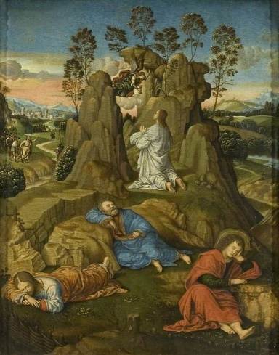

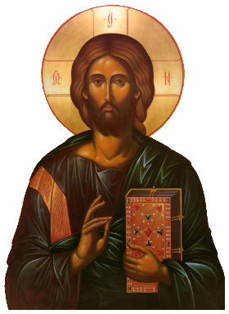
Christ in Gethsemane, Timoteo Viti (1469–1523)
RE – Year 5 – Christmas – What do Christians believe about the Messiah and why is it good news?
Prophecies
Many Christians think that long ago, before Jesus was born, people called prophets were given messages by God that told them about things that would happen in the future, including the birth, life, and even the death of Jesus. Jesus fulfilled many Old Testament prophecies as he did things that matched the predictions made in these old prophecies. Because of this, Christians believe he is the ‘Messiah,’ which means the special saviour God promised to send. For Christians, Jesus fulfilling the prophecies shows that he is the saviour that God promised. This is important because it means that Jesus came to help them and bring them closer to God. This is considered good news by Christians.
Key Vocabulary
fulfilment | noun. when something that was promised or predicted comes true, like when Jesus was born just as the Bible said.
Gospel – good news | noun. a story in the Bible that tells the good news about Jesus' life.
Incarnation | noun. the idea that Jesus is God who came to live on earth as a person.
Luke | noun. one of the writers of the Bible who tells the story of Jesus' birth.
Messiah | noun. a special person that God promised to send to help and save people. Christians believe Jesus is the Messiah.
prophecy | noun. a message from God about something that will happen in the future or giving them some guidance.
prophet | noun. a prophet is someone chosen by God to deliver messages or prophecies.
salvation | noun. being saved from something bad, like how Christians believe Jesus saves people.
Prophecies (shared in the Old Testament) | Fulfillment (as recorded in the New Testament)
A virgin will give birth, and he will be called Immanuel (God with us) Isaiah 7:14 Therefore the Lord himself will give you a sign: The virgin will conceive and give birth to a son, and will call him Immanuel | Luke 1:35 The angel answered, “The Holy Spirit will come on you, and the power of the Most High will overshadow you. So the holy one to be born will be called the Son of God.”
The Messiah will end up in Egypt Hosea 11:1 When Israel was a child, I loved him, and out of Egypt I called my son | Matthew 2:14–15 So he [Joseph] got up, took the child and his mother during the night and left for Egypt, where he stayed until the death of Herod. And so was fulfilled what the Lord had said through the prophet: ‘Out of Egypt I called my son’
The Christ will be born in Bethlehem Micah 5:2 But you, Bethlehem Ephrathah, though you are small among the clans of Judah, out of you will come for me one who will be ruler over Israel, whose origins are from of old, from ancient times | Matthew 2:4–6 When he had called together all the people’s chief priests and teachers of the law, he asked them where the Messiah was to be born. ‘In Bethlehem in Judea,’ they replied, ‘for this is what the prophet has written: “‘But you, Bethlehem, in the land of Judah, are by no means least among the rulers of Judah; for out of you will come a ruler who will shepherd my people Israel.”
Jesus: the centre of Christian worship:
Christians believe in one God. They also believe that Jesus is the Son of God and that God exists as the Holy Spirit. Christians believe that each part makes up the whole God they believe in. Christians call this the Holy Trinity. Jesus is at the heart of Christian worship because Christians believe he is God’s son and that he fulfilled the important promises made in the Bible - Jesus’s life matched what was said in the old prophecies. Jesus said many things about himself, like that he was the Son of God or that he would save people. When you look closely, you can see that some of the things he said were already mentioned in those old prophecies. To Christians, this shows that he really was sent by God to save people. Through Jesus, Christians are able to build their relations with God.

Slide 2
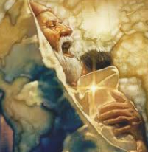
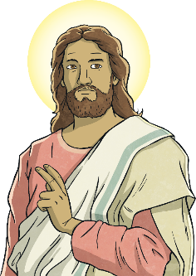
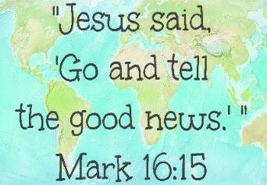
RE – Year 5 – Christmas – What do Christians believe about the Messiah and why is it good news?
The Prophecy of Simeon
Simeon was a Jewish man whose name means, “God has heard.” God had revealed to Simeon that he would see the promised Messiah before his death. Prior to Jesus’ birth, Christians believe that God had not spoken through a prophet for 400 years. For Christians, Simeon’s story is one of incredible faith, as he waited and watched with great hope for God to fulfill His promise made long ago to His people Israel, and to him personally. After years and years, Simeon’s faith was not deterred. Finally, one day, he was prompted to go the Temple. On that same day, a young, poor couple walked up the steps to fulfill the Jewish offering for their firstborn son. That day, faith became sight for Simeon as he took the Jesus in his arms, lifted Him up, and blessed the Lord for His faithfulness. The Messiah was here; a Saviour not only for the Jews but also for the whole world.
Luke 2:25 – 2:35 ²⁵ At that time there was a man in Jerusalem named Simeon. He was righteous and devout and was eagerly waiting for the Messiah to come and rescue Israel. The Holy Spirit was upon him ²⁶ and had revealed to him that he would not die until he had seen the Lord’s Messiah. ²⁷ That day the Spirit led him to the Temple. So when Mary and Joseph came to present the baby Jesus to the Lord as the law required, ²⁸ Simeon was there. He took the child in his arms and praised God, saying, ²⁹ “Sovereign Lord, now let your servant die in peace, as you have promised. ³⁰ I have seen your salvation, ³¹ which you have prepared for all people. ³² He is a light to reveal God to the nations, and he is the glory of your people Israel!” ³³ Jesus’ parents were amazed at what was being said about him. ³⁴ Then Simeon blessed them, and he said to Mary, the baby’s mother, “This child is destined to cause many in Israel to fall, and many others to rise. He has been sent as a sign from God, but many will oppose him. ³⁵ As a result, the deepest thoughts of many hearts will be revealed. And a sword will pierce your very soul.”
The four times Jesus predicted his death (and resurrection) in Matthew:
Jesus predicts his death Matthew 16:21 21 From that time on Jesus began to explain to his disciples that he must go to Jerusalem and suffer many things at the hands of the elders, the chief priests and the teachers of the law, and that he must be killed and on the third day be raised to life. | Jesus Predicts His Death a Second Time Matthew 17:22-23 22 When they came together in Galilee, he said to them, “The Son of Man is going to be delivered into the hands of men. 23 They will kill him, and on the third day he will be raised to life.” And the disciples were filled with grief.
Jesus Predicts His Death a Third Time Matthew 20:17-19 17 Now Jesus was going up to Jerusalem. On the way, he took the Twelve aside and said to them, 18 “We are going up to Jerusalem, and the Son of Man will be delivered over to the chief priests and the teachers of the law. They will condemn him to death 19 and will hand him over to the Gentiles to be mocked and flogged and crucified. On the third day he will be raised to life!” | Jesus Predicts Peter’s Denial Matthew 26:31-32 31 Then Jesus told them, “This very night you will all fall away on account of me, for it is written: “‘I will strike the shepherd, and the sheep of the flock will be scattered.’[a] 32 But after I have risen, I will go ahead of you into Galilee.”
The Good News
When Jesus told his followers that he would die and then come back to life (resurrection), this was a sign of his divinity. For Christians, this is a sign that Jesus Christ is who he said he was and that he could do what he said he could do. It is important for Christians to know that Jesus rose from the dead as without this, there would be no hope as can be seen in 1 Corinthians 15:12-14: ¹²But tell me this—since we preach that Christ rose from the dead, why are some of you saying there will be no resurrection of the dead? ¹³For if there is no resurrection of the dead, then Christ has not been raised either. ¹⁴And if Christ has not been raised, then all our preaching is useless, and your faith is useless. When he came back, this was further proof of Jesus’s role in Christianity as the Messiah and the person through whom, human’s relations with God can be developed. In Mark 16:15, we see that: Jesus said to the followers, “Go everywhere in the world . Tell the Good News to everyone. ¹⁶Anyone who believes and is baptised will be saved.

