Slide 1

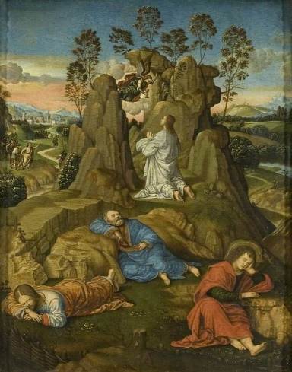

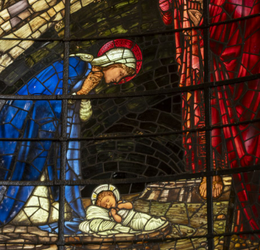
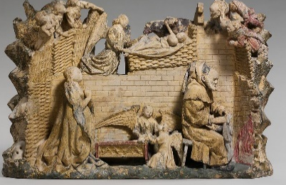
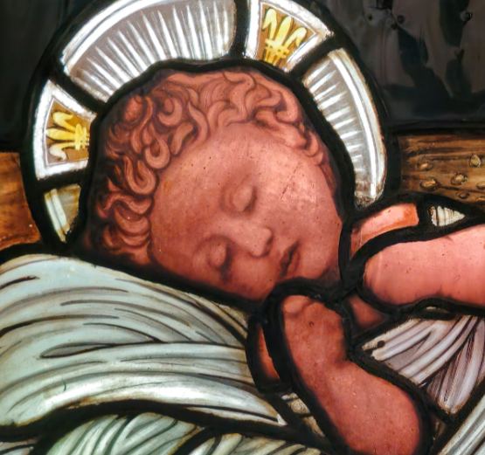
Christ in Gethsemane, Timoteo Viti (1469–1523)
RE – Year 4 – Christmas – How can artists help us to understand what Christians believe?
Depicting the Christmas story through art:
Many artists throughout history have tried to show the nativity because it is such an important event for Christians. By painting or sculpting the birth of Jesus, artists help people reflect on the significance of this moment and how it represents love, hope, and God’s presence in the world. | Artists often use symbols, like stars, angels, or gifts, to tell the story of the nativity and to show important Christian beliefs about Jesus. For example, a bright star might symbolize Jesus as a light to the world, or a lamb might represent peace and innocence. These symbols help people understand the deeper meaning of the story. | By looking at how different artists show the birth of Jesus, we can see the many ways people think about and understand Christmas. Some artists might focus on the joy and celebration, while others show the humble and peaceful nature of the scene. Reflecting on this helps us appreciate the deeper meanings of Christmas and how the story has inspired people throughout history.
Key Vocabulary
artists | noun. a person who creates paintings or drawings as a profession or hobby.
belief | noun. an acceptance that something exists or is true, especially one without proof.
icons | noun. a devotional painting of Christ or another holy figure used ceremonially in the Byzantine and other Eastern Churches.
incarnate | noun. (especially of a deity or spirit) embodied in human form.
Jesus | noun. the man who Christians believe is the son of God and whose life, death, and resurrection as reported in the New Testament of the Bible are the basis of the Christian religion
nativity | noun. the birth of Jesus Christ.
symbolism | noun. the use of symbols to represent ideas or qualities.
representation | noun. the depiction of someone or something in a work of art.
Why do people create art?
People create art for many reasons: to express feelings, to tell a story, or to share ideas. Art can sometimes convey emotions or ideas that words can’t easily capture. For example, a painting of the nativity might make us feel the joy or peace of Christmas in a way that reading about it might not. Art can use colours, shapes, and symbols to show something in a new and powerful way.
Stained glass artwork | Birmingham Cathedral
Stained-glass windows are made from small pieces of coloured glass held together by thin strips of metal, usually lead. These windows were very popular in Europe a long time ago, from about the years 1150 to 1550. You could often find them in churches, cathedrals, and even in fancy homes. What makes stained-glass windows special is that light can shine through them. In churches, for example, they often showed scenes from the Bible or the lives of saints. When sunlight passed through the colourful glass, it created beautiful patterns of light that made the space feel more sacred. The look of the windows would change slightly throughout the day and seasons, depending on how the light hit them. | Birmingham Cathedral is home to four stunning stained-glass windows. The windows were created by the famous Pre-Raphaelite artist Edward Burne-Jones and his lifelong friend William Morris. They depict four significant events from the life of Christ, and continue to inspire and guide worshippers to this day.
Sculpture:
Name: Nativity Artist: Circle of Antoine Le Moiturier French Date: 1450 Medium: Limestone with later paint and gilding The relief includes the unusual subject of Joseph warming the infant Jesus’ clothes at a fire.
Interactive link:
https://birminghamcathedral.com/windows/the-nativity/

Slide 2
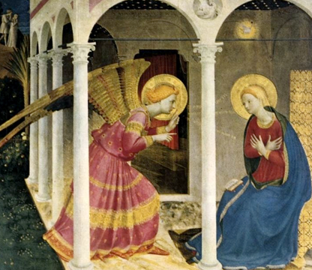
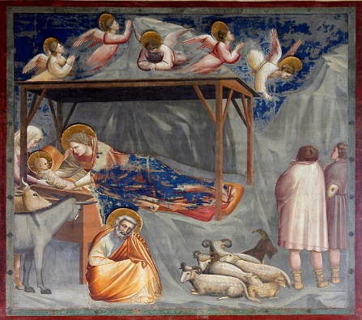
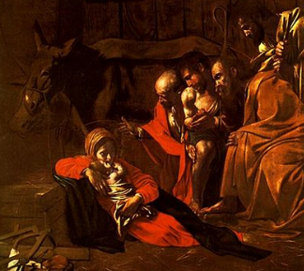
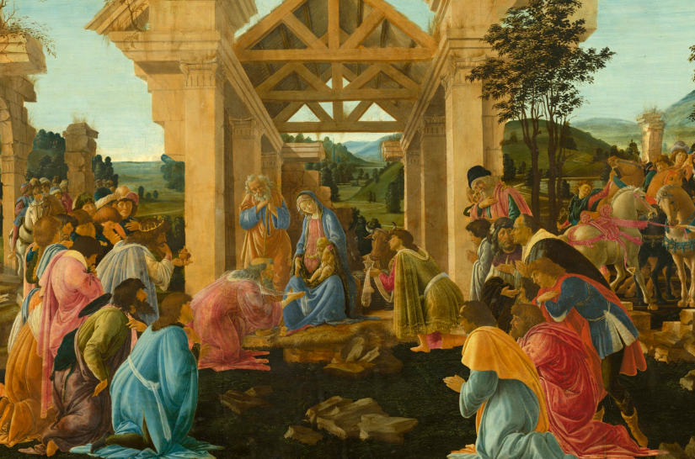
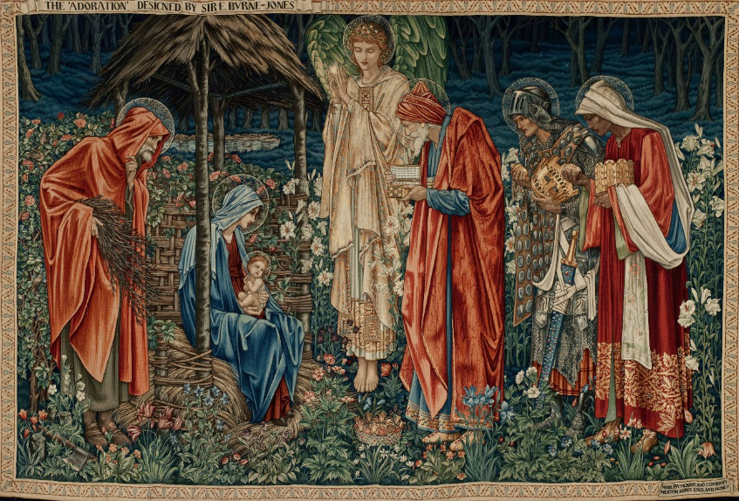
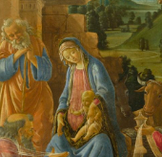
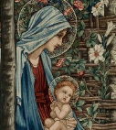
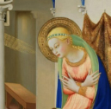
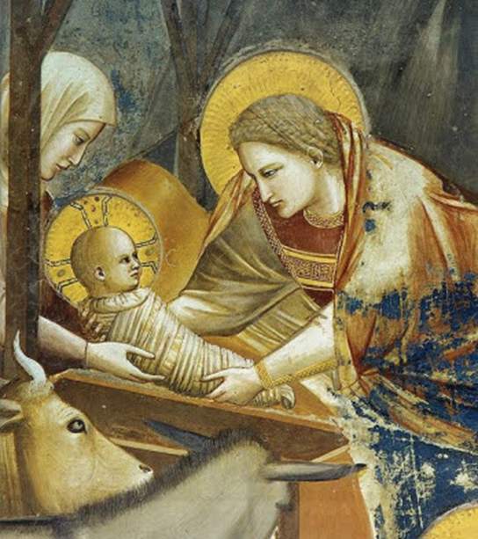
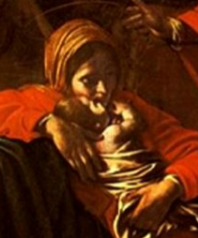
RE – Year 4 – Christmas – How can artists help us to understand what Christians believe?
The Nativity in paintings and tapestry:
Different artists have represented the nativity in various ways. Each piece of Christmas art has different meanings based on the symbols and details the artist includes. Investigating the details of these artworks helps us understand the messages they convey about the Christmas story.
Title: Annunciation Artist: Fra Angelico Medium: panel, tempera Date: 1433-1434 Links to Bible Passage: Luke 1.26-38 This painting focuses on the moment that Angel Gabriel shared the good news to Mary. | Title: The Nativity Artist: Giotto Medium: fresco and tempera Date:1304-1315 Links to Bible Passage: Luke 2:1–7 Giotto focuses on the emotion between Mary and baby Jesus. Giotto shows Mary looking at Jesus with a hint of sadness, as if she knows she will lose him one day. | Title: The Adoration of the Shephards Artist: Caravaggio Medium: Oil on canvas Date: 1609 Links to Bible Passage: Luke 2:8–20 Here, the shepherds kneel in adoration of the infant Jesus. Caravaggio uses stark contrasts between light and shadow to enhance the solemn and sacred atmosphere of the moment. | Title: Adoration of the Magi Artist: Sandro Botticelli Medium: Tempera on Panel Date: 1482 Links to Bible Passage: Matthew 2:1–12 This light and bright painting depicts the three Magi visiting the infant Jesus. They are shown presenting their gifts which reflect Jesus’ role as a king and saviour. The foreground shows figures kneeling in worship, while their vibrant garments cascade in rich folds, showcasing Botticelli’s mastery of colour and fabric. | Title: The Adoration of the Magi Artist: William Morris Medium: Tapestry Date: 1890 Links to Bible Passage: Matthew 2:1–12 Here, the Magi present their gifts to the infant Jesus. They are richly dressed, carrying their gifts and a haloed angel stands behind them which enhances the divine nature of the scene. There are intricate details and vibrant colours.
God incarnate
The word “incarnate” means God becoming human, which Christians believe happened through the birth of Jesus. Artists around the world represent Christmas in different ways, showing the importance of Jesus as God coming to Earth. Famous examples include The Nativity by Giotto, which shows Jesus with a glowing halo, and Adoration of the Magi by Botticelli, where the Wise Men honour Jesus as the king. These depictions help people see Jesus’ divine role.

