Slide 1

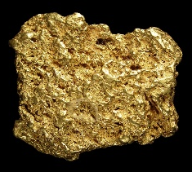

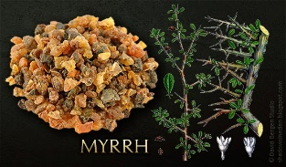


RE – Y3 – Christmas - Why are presents given at Christmas and what might Jesus think about it all?
Gifts given to Jesus
In the Nativity story, the three wise men brought gifts for baby Jesus. Each gift had a special meaning linking to the role of Jesus in Christianity:
Gold was a gift for a king, showing that Jesus is a ruler (kingship). | Frankincense was used in worship, showing that Jesus is holy and connected to God (in a priestly role). | Myrrh, used for burials, hinted that Jesus would one day die for others.
Key Vocabulary
commercialisation | noun. the process of managing or running something for financial gain.
frankincense | noun. an aromatic gum resin obtained from an African tree and burnt as incense.
gold | noun. a yellow precious metal, used especially in jewellery and decoration and to guarantee the value of currencies.
mission | noun. a specific task with which a person or a group is charged.
myrrh | noun. a fragrant gum resin obtained from certain trees and used, especially in the Near East, in perfumery, medicines, and incense.
priest | noun. an ordained minister of the Catholic, Orthodox, or Anglican Church, authorised to perform certain rites and administer certain sacraments.
salvation | noun. Deliverance from sin and its consequences, believed by Christians to be brought about by faith in Christ.
worth | noun. The level at which someone or something deserves to be valued or rated.
The gift God gave to the world
John 3:16 explains the special gift God gave to the world—Jesus. The verse says that God loved the world so much that he gave his only Son, Jesus, so that anyone who believes in him can have eternal life. This shows that Christians believe Jesus was sent to bring salvation and hope to everyone. Jesus’ birth is seen as a sign of how much God cares for people and wants to help them live with love and kindness.
When do we give gifts?
Presents and gifts are given to mark special occasions (birthdays, anniversaries, get well soon, graduations) and to celebrate new beginnings. When people bring gifts to a new baby, they often think about things that are helpful or meaningful for the baby and their family. Similarly, when Christians give gifts at Christmas, they may consider what would show love and care to the people they care about. | Christians give gifts at Christmas to remember the gifts that were given to Jesus and to celebrate the love and hope that Jesus brought to the world. Giving gifts is a way to show love and care to others, just as God gave the gift of Jesus to the world
Meaningful gifting:
The true meaning of gift-giving at Christmas is not about how expensive or fancy the presents are, but about showing love, kindness, and generosity. People can think of meaningful gifts that reflect this, such as homemade gifts, acts of kindness, giving to charity e.g. Oxfam sponsoring a child or animal donating to those in need These types of gifts capture the real spirit of Christmas (helping others and spreading love) and what it means to give.
The commercialisation of Christmas
The commercial aspect of Christmas refers to how the holiday has become focused on shopping, spending money, and buying lots of gifts, decorations, and other items. Many stores and businesses use Christmas as a time to sell more products, with advertisements and sales encouraging people to buy more than usual. While this can be fun and exciting, it can also take attention away from the original meaning of Christmas, which for Christians is about celebrating the birth of Jesus, showing love, and spending time with family. The focus on shopping and material things can sometimes overshadow the holiday's deeper purpose of giving, kindness, and reflection.

