Slide 1

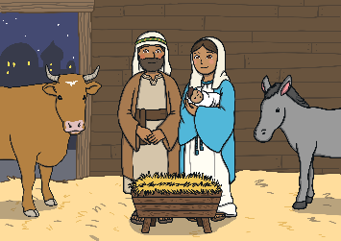
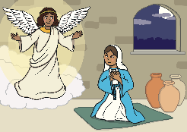
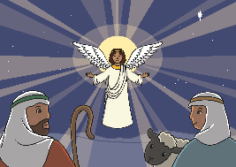
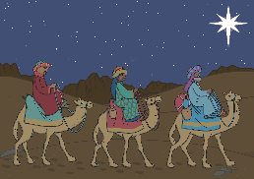
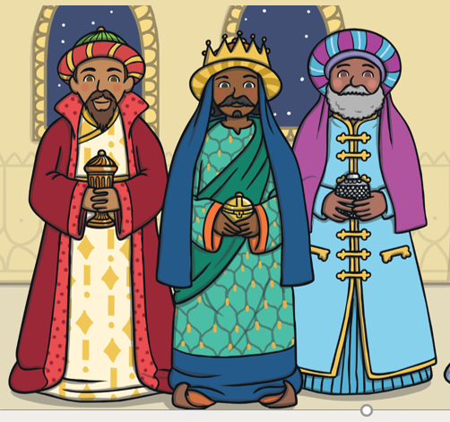
RE – Y2 – Christmas - What does the Christmas story tell Christians about Jesus?
What is Christmas?
Christmas is the time when Christians celebrate the birth of Jesus. It’s an important day because they believe Jesus is the Son of God, and his birth marks the beginning of his mission to teach people about God and his love.
Key Vocabulary
Angel Gabriel | noun. special type of angel (archangel) who brought God’s message to humans.
announced | verb. make known the arrival of (a guest) at a formal social occasion.
magi/ wise men | noun. in the Bible, the three men, thought to be kings or astrologers, who followed a star to visit baby Jesus.
Nativity | noun. The nativity is the story of the birth of Jesus, a central event in Christianity, and is told in the Gospels of Matthew and Luke.
sign | noun. A sign is a clue something happened, or a display that communicates a message, like a stop sign that tells you stop.
(unusual) star | phrase. an interesting star noun. stars are huge, glowing balls of gases.
symbol | noun. a thing that represents or stands for something else,
wise men | noun. men versed in magic, witchcraft, or astrology.
The Nativity (the Christmas story)
Mary, a young woman living in Nazareth, was visited by the angel Gabriel, who told her she would have a child through the Holy Spirit and that the child would be the Son of God. Mary was engaged to a man named Joseph, and though he was initially concerned about the pregnancy, an angel appeared to him in a dream, assuring him that the baby was from God. Joseph and Mary travelled to Bethlehem for a census ordered by the Roman emperor. When they arrived in Bethlehem, there was no room for them in the inns, so they found shelter in a stable. There, Mary gave birth to Jesus and laid him in a manger, a feeding trough for animals. That same night, shepherds in nearby fields were visited by an angel who announced the birth of the Saviour. The angel told them they would find the baby wrapped in cloths and lying in a manger. The shepherds went to Bethlehem, found Jesus, and spread the news of what they had seen. Meanwhile, Wise Men (or Magi) from the east saw a bright star (the Star of Bethletham) in the sky, which they followed, believing it would lead them to a new king. They traveled to Bethlehem, where they found Jesus and brought him gifts of gold, frankincense, and myrrh. The nativity story celebrates the humble and miraculous birth of Jesus, who Christians believe is the Son of God and the Saviour of the world. The Christmas story teaches Christians that Jesus is a gift from God, bringing love, peace, and hope. This is why Christmas is a special time for them—they remember and celebrate the birth of Jesus and the message of joy and peace that came with it.
What are the clues in the story?
Angel Gabriel visits Mary and lets her know that she is pregnant with a child who will be the Son of God. | The angels: Angels appeared to shepherds to tell them that Jesus was God’s Son. The angels are seen as messengers from God, announcing the good news of Jesus’ birth.
The star: The star that appeared in the sky was a sign of the birth of a new King, and it guided the Wise Men to where Jesus was born. | The presents: The Wise Men brought gifts to Jesus, showing they believed he was special. Christians see Jesus as a gift from God to the world, bringing hope and love.
Clues in the Christmas story tells Christians about Jesus:
Christians believe that the Christmas story has clues that show how important Jesus is. These clues help them understand that Jesus is not just an ordinary baby, but someone sent by God with a special purpose. By looking at these symbols, we can understand the deeper meaning of the story.
The Bible tells the Christmas story in a certain order, and as we read it, we find clues about who Jesus is. First, the angel tells Mary and Joseph that their baby is God’s Son. Then, when Jesus is born, he tells the shepherds. Then the star appears, leading the Wise Men. Finally, the gifts and the angels' message show how special Jesus is.

