Slide 1

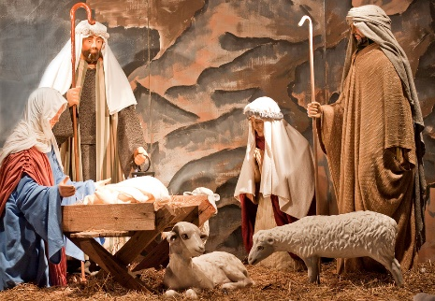

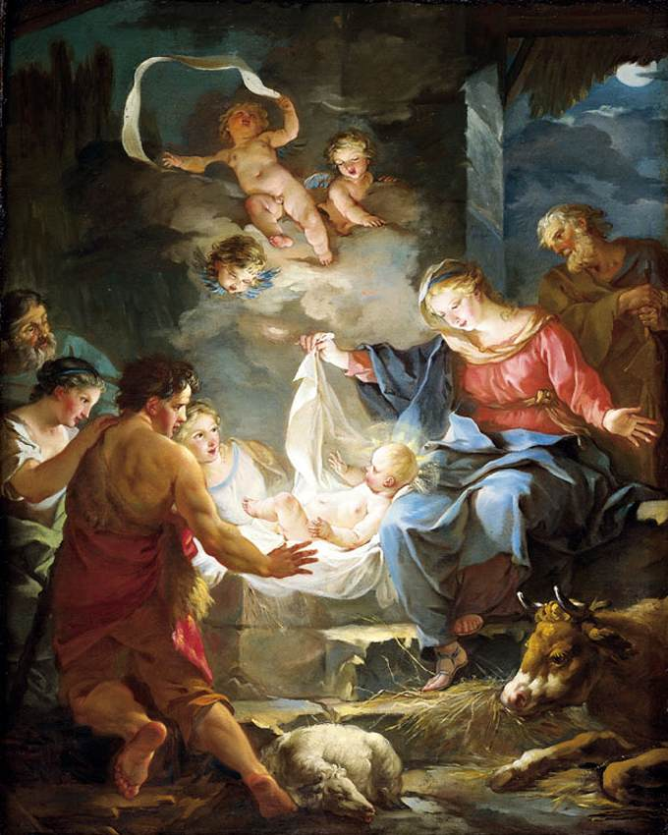
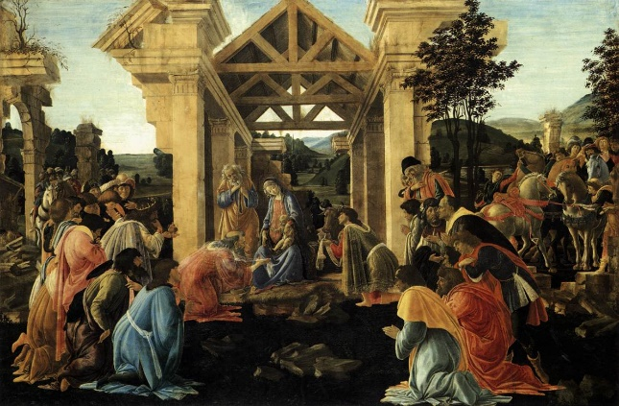
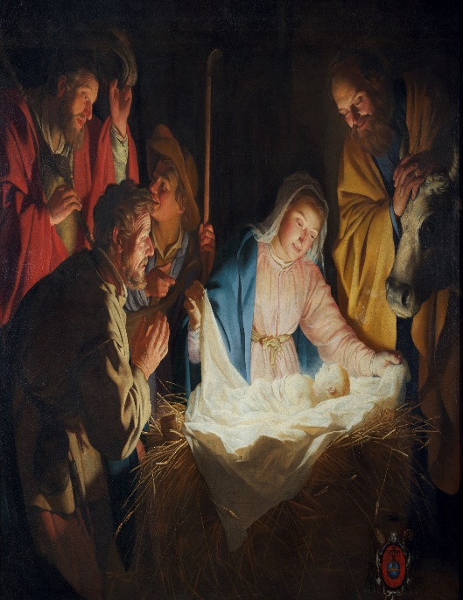

RE-Year 1 - What is the Nativity and why is it important to Christians?
What is Christmas?
Christmas is a time when Christians celebrate the birth of Jesus, who they believe is God's son. For example, many people set up nativity scenes to show the story of Jesus’ birth.
Why Christmas is an important celebration In Christianity.
Celebrations, like birthdays or holidays, are important because they bring people together and help them remember special events. Christmas is a special celebration where Christians celebrate by going to church, giving presents, and spending time with family. Why is Christmas important? Christmas is important to Christians because it celebrates the birth of Jesus Christ, who they believe is the Son of God. Christmas reminds Christians of God's love for the world. By sending Jesus, Christians believe that God showed how much He cares for people and wants to have a relationship with them. The story of Jesus' birth brings a message of hope, peace, and goodwill. It’s a time when Christians focus on these values, reflecting on how Jesus brought peace to the world. Christmas is also a time for celebrating with family, friends, and the community.
Key Vocabulary
Bethlehem | noun. the town where Jesus was born.
birth | noun. the moment when a baby is born into the world.
celebration | noun. a happy time when people come together to enjoy something special, like a birthday or a holiday.
census | noun. a time when everyone had to be counted by the government to know how many people there were.
inn | noun. a place where people could stay, like a small hotel.
innkeeper | noun. the person who looks after the inn and takes care of the guests.
Jesus | noun. a very special person in the Christian story, who Christians believe is the Son of God.
Mary | noun. the mother of Jesus.
Joseph | noun. the man who took care of Mary and baby Jesus and was engaged to Mary.
stable | noun. a building where animals, like cows and donkeys, are kept.
Wise men | noun. special visitors who followed a star to find baby Jesus and bring him gifts.
Famous art showing the nativity
"The Nativity" by Jean-Baptiste-Marie Pierre (1745) This artwork shows the nativity scene with an focus on the joy and brightness of the birth of Jesus. It uses soft light to highlight baby Jesus and the surrounding figures to show how important Jesus is. | "The Adoration of the Magi" by Sandro Botticelli (1475) This painting includes the Wise Men, which is often an exciting part of the nativity story. The bright colours and detailed clothing of the figures make the scene interesting to explore. | "Adoration of the Shepherds" by Gerard van Honthorst (1622) This painting is bright and full of light, showing the shepherds joyfully visiting baby Jesus.

Slide 2
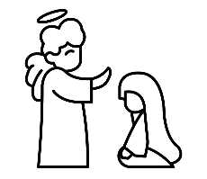
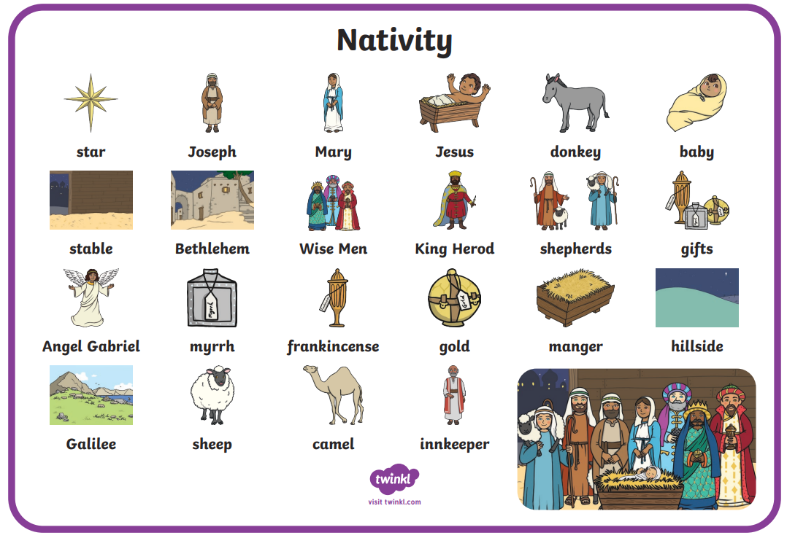




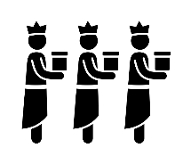
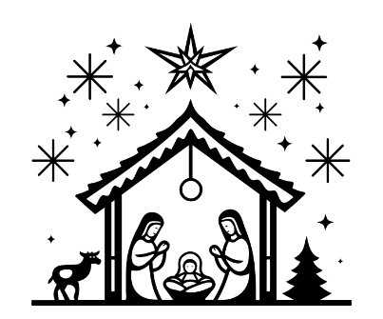
RE-Year 1 - What is the Nativity and why is it important to Christians?
The Nativity
The most important person for Christians is Jesus, the son of God. He was born over 2000 years ago and the story of his birth (called the Nativity) is why Christmas is celebrated every year. In a town called Nazareth, there was a young woman called Mary who was engaged to be married to a carpenter called Joseph. One day, God sent the Angel Gabriel down from heaven to visit Mary and tell her that she was going to have a baby boy. He would be called Jesus. The angel also told her that Jesus would be God’s son. The Angel Gabriel then appeared to Joseph in a dream and said, “Don’t be afraid.” Mary and Joseph were both very scared after the angel spoke to them. They had never see anything like that before but they trusted in God. The country that Joseph and Mary lived in was ruled by the Romans. The Roman Emperor was in charge and he wanted to have a list, also called a Census of everyone who lived in the country. He commanded everyone to go back to the town where they were born so he could make the list and count all of the people. Joseph’s family came from a small town called Bethlehem, which was a long way from where they were living so they had to walk for days to get there.
When they arrived in Bethlehem, Mary and Joseph tried to find a place to stay, but because everyone else was visiting so they could also get on the Roman list, there was no room at any of the inns. They thought they’d have to sleep outside in the cold. Then one kind innkeeper said Joseph and Mary could stay in the stable with his animals. Joseph and Mary stayed in the stable and made it as comfortable as they could. Just as the angel had said, Mary gave birth and Jesus was born. Mary laid baby Jesus in a manger which is where the animal’s food was usually kept. In the hills near Bethlehem, a group of shepherds were watching their sheep. In the night, an angel appeared and spoke to them. “This amazing baby is born, who will bring peace on Earth. He will show everyone God’s kindness.” The shepherds decided to travel to Bethlehem to see Jesus. They found Jesus in the manger, just like the angel had said. They told everyone the good news. ‘Could he be God’s son?’ they wondered. Far, far away, there were three wise men. They studied the stars and the Earth and had read in old books that a great king would be born when a new star appeared. A new star did appear in the sky. The three wise men felt sure that it meant that a new king had been born in the land of Israel, so they travelled to Bethlehem to meet him. The shining new star guided the wise men to the place where Jesus had been born. The three wise men entered the stable and bowed down to worship the baby Jesus. They each gave him a gift to welcome him into the world. The three gifts were gold, frankincense and myrrh. The visits from the shepherds and the wise men made everyone in the town start talking about the birth of Jesus. They wondered if he had been sent from God to bring us peace. Now every year, Christians celebrate Jesus’ birthday as one of their main holy days: Christmas Day. https://www.bbc.co.uk/teach/class-clips-video/articles/z7fp382

